Slide 1
Retail
Culture &
C O N N E C T
Recruiting & Interviewing
Goodwill

Slide 2
Introductions
Jennifer Brito,
Recruiting Manager
Natalie Rodriguez, Manager HRBP
Notes:
Intro to class- Jennifer/ Natalie (Time 3:00 minutes)
Key contributors (SME)- Jake Meyer and Becca Myers
Agenda and intro to resources
Form for questions- allow for name, store location, position and questions to address either same day or within 1 week
Include the data pull “why”, time constraints, etc.
Side note: this will help us develop future FAQ’s for future trainings

Slide 3
Icebreaker
Goodwill
Notes:
Jennifer (Time 5:00 minutes)
Intro- (5 min total) Tik Toks- Sit and Stand engagement

Slide 4
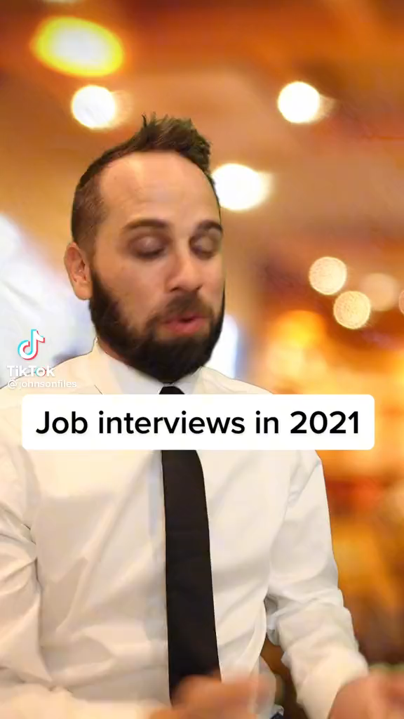

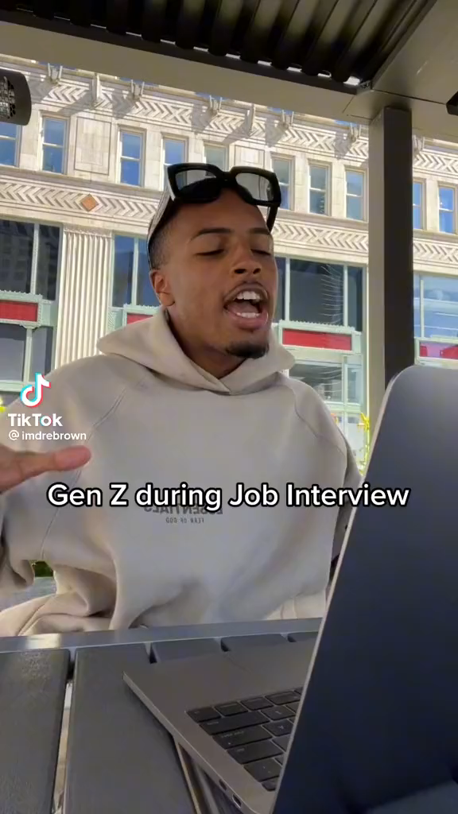
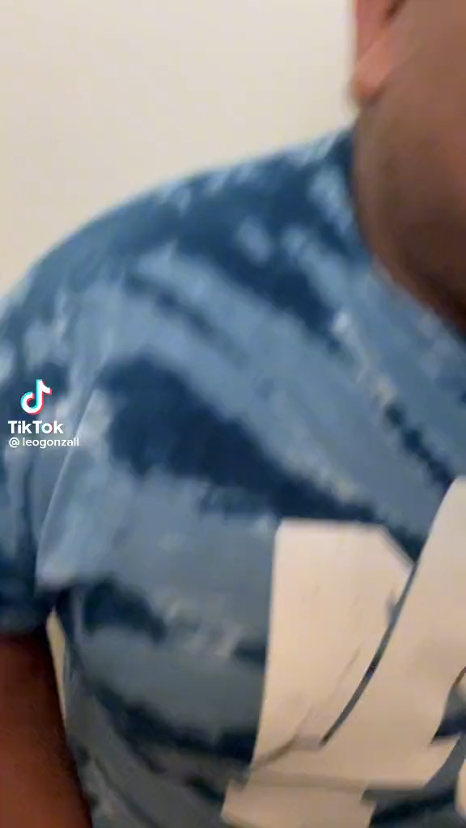
Interview Scramble
Sit Down or Stand-up

Slide 5
Objectives
Review functions in Workday to staff your store
Evaluate candidate engagement best practices
Examine interview guide completion
Goodwill
Notes:
Jennifer (Time 3:00 minutes)

Slide 6
Staffing your store
Getting Candidates
Sign into Workday
Click on the “Recruiting” icon
Create Job Requisition
Change Supervisory Organization
Enter Number of Openings & Reason
Change Target Hire Date
Enter Job Posting Title
Goodwill
Notes:
Jake to facilitate and Natalie to record (personal) (Time 15:00 minutes)
Getting Candidates (10 minutes total )
How to post a req (technical) Jake/ Christian
Get access to Sandbox to demo live; create req and add applicants
Load info Monday prior

Slide 7
Staffing your store
Getting Candidates
Chose the Suggested Job Profile
Enter Worker Sub-Type
Choose Part Time or Full Time
Adjust Scheduled Weekly Hours
Assign Roles – Primary Recruiter
Submit and post both internally and externally
Link to Evergreen Requisition
Goodwill
Notes:
Jake to facilitate and Natalie to record (personal) (Time 15:00 minutes)
Getting Candidates (10 minutes total )
How to post a req (technical) Jake/ Christian
Get access to Sandbox to demo live; create req and add applicants
Load info Monday prior

Slide 8
Staffing your store
Evergreen Requisitions
What is an evergreen requisition?
Examples:
Evergreen jobs are a position at your organization that are always open, either because they are high turnover positions or, more likely, because they are positions for which you have many employees in the same role.
DA
RSA
RMP
Goodwill
Notes:
Becca: (Time 2:00 minutes)
How it works, why doesn’t it auto post w/ Evergreen, how can including an Evergreen benefit you?
Now that you have learned how to open a job req- let’s review how to add Evergreen to your job req as a standard practice
Demo- Explain
How to move Evergreen candidates back into the pool that are not moving forward

Slide 9
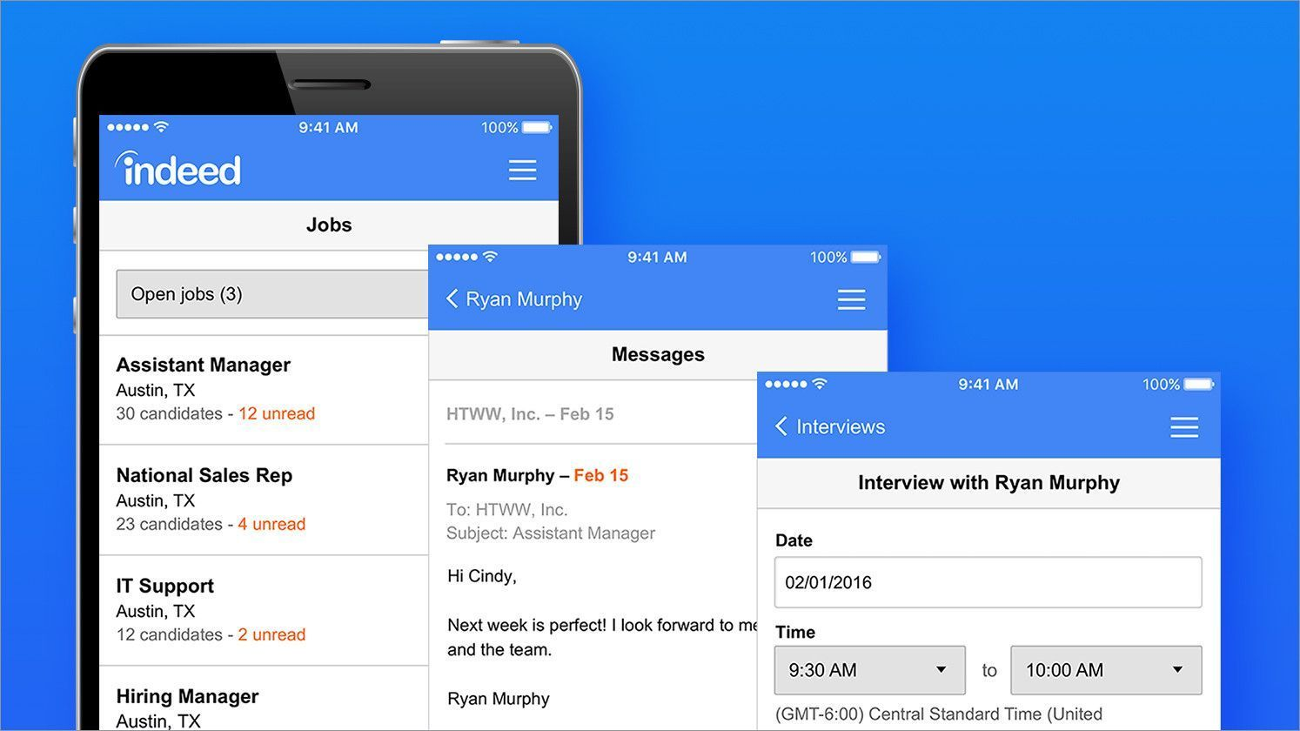


Interacting with Candidates
Sourcing Etiquette
Workday & Indeed Resumes
Don’t leave them hanging: work your Workday job requisitions
Indeed resumes: more traction leads to more organization
All candidates must apply on the Goodwill website
We aren’t looking for professional resume writers
Notes:
Lead: Becca (Time 10:00 minutes)
WD candidates should be contacted as soon as possible
The hard part is getting them to actually apply- so they are on a platter for you
Can be overwhelming: There is a way to create an Indeed folder in your Outlook inbox to organize your incoming resumes. * Can type Indeed in search bar to find all of your resumes if you need.
Find what works best for you to stay on top of the Indeed resumes coming to the store DL
When calling your candidates from the Indeed resumes coming in- be sure to ask them to apply online
Many leaders have them apply in the store where they can support on any questions
You may come across some very limited or even crazy resumes that make you wonder why they would even apply
Still take the time to scan it, call them and probe and then dive deeper in the in-person interview
You never know – you may find a gem who just didn’t know how to develop a professionally formatted resume
That’s why we have our My Career Matters

Slide 10
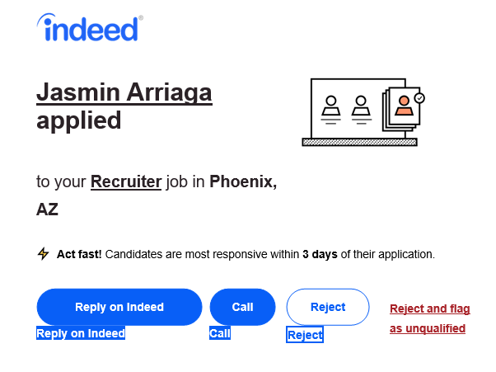
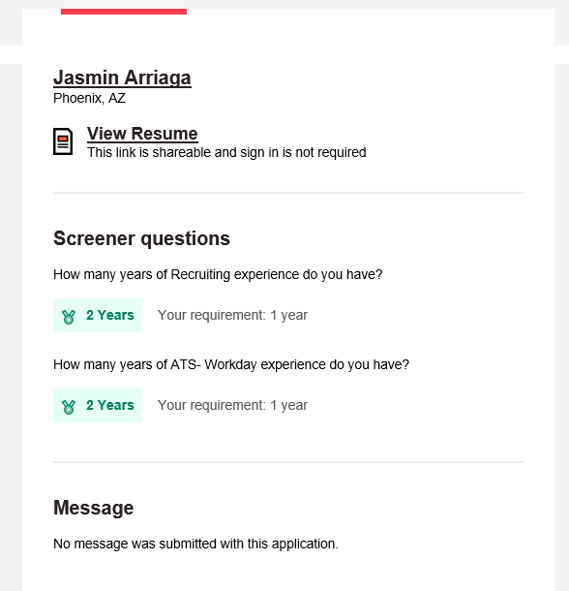
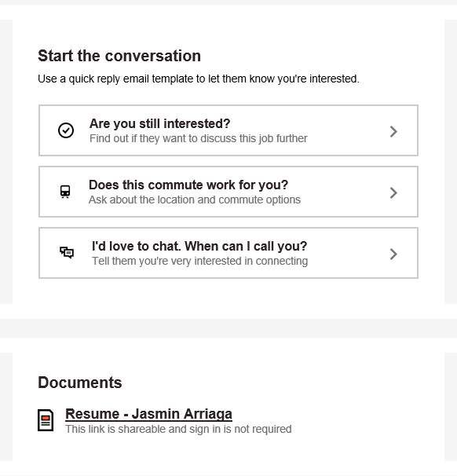
Interacting with Candidates
Email Notifications
Indeed Application Notification
Notes:
Becca: (2:00 minutes)
Review Indeed application notifications

Slide 11
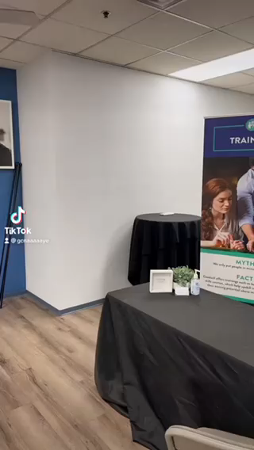
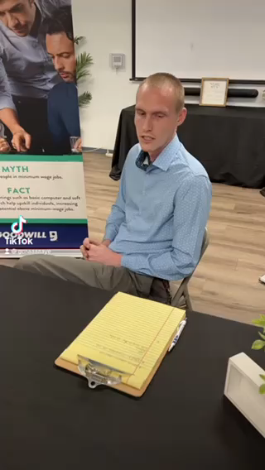
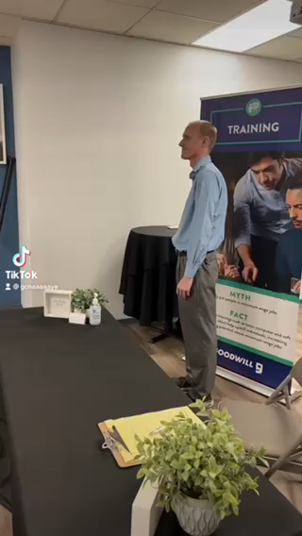
Interacting with Candidates
Best Practices
Challenging Candidate
Don’t
Do’s
Notes:
Lead: Natalie- (Time 5:00 minutes)
Alright, so lets take a look at some interviews that you can most likely relate to and discuss:
Challenging Candidate:
What did you notice that was challenging in this interview?
How did the interviewer react?
What behaviors did the interviewee display?
Don’t
What were some behaviors you observed that were unprofessional?
Do’s
What were some behaviors you observed that were professional/appropriate

Slide 12
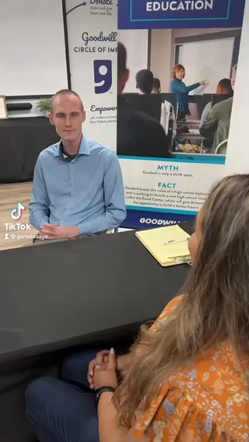
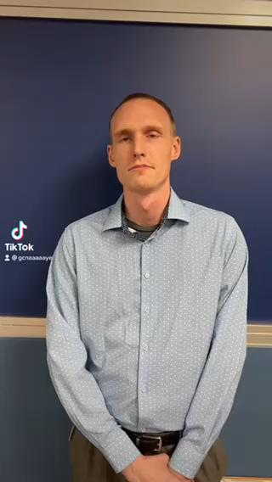
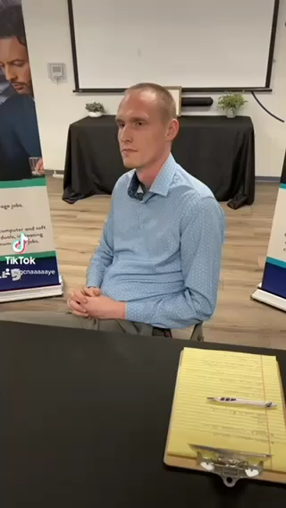
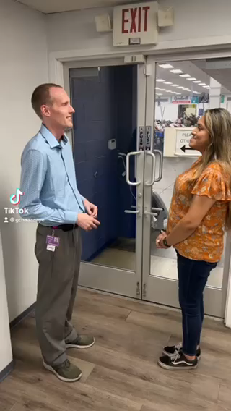
Interacting with Candidates
Best Practices
Set the Tone
Rapport & Trust
Eye Contact
Store Tour
Notes:
Lead: Jake (Time 5:00 minutes)
Great observations from those Tik Toks!
Let’s discuss more examples of Best practices (soft- skills)
Set the tone for the interview- set the tone for yourself before you go into the interview. Explain to the candidate that you may be called to the front and they will be part of the adventure.
Building rapport- Be friendly and warm- Ask about the persons interests and hobbies, answer their questions about you, be respectful and provide contact information
Make eye contact- Explain you will be taking notes throughout the interview so they understand why you break eye contact
Store tour- Always offer a store tour to your candidate so they can become familiar with roles, production and service to customers. Be sure to explain to your candidate the realistic expectations of each role in the store.
Ask for input from the group – Address IRL situations and ask for participation
It’s challenging when we get interrupted while interviewing and we get called up to the front. How do you navigate that situation without making the candidate uncomfortable?
I try to input interview questions while interviewing the candidate but it’s awkward because I have to use my office computer. What have you done to help that?
Natalie to send an updated question

Slide 13

Interviewing Guide
Completion Importance
Why is guide completion important?
Liability
Guided hiring decision
Scheduling
Reflects on Mission
Goodwill
Notes:
Lead: Natalie- (Time 5:00 minutes)
Why it's important to complete the interview guide
Liability- organization vs individual (time, $ spent on this)
Reflects on Mission- developing others
Being able to provide reasoning behind our hiring decisions
Info in interview guide is beneficial for scheduling, etc.
What was agreed upon in the interview and discussed upon hire?

Slide 14



Next Steps
Moving Forward
Communicate with Candidate
Disposition the Candidate
Impact of Onboarding
Goodwill
Notes:
Lead: Jake- (Time 5:00 minutes)
Next Steps
Communication and Follow up is HUGE:
Communication with Candidate (soft) Moving Forward or Not Moving Forward
Keep your req clean by updating candidate status info
Dispositioning the candidate/ confirm auto emails for manual dispositions and expired applications
How do these all play a part in the onboarding?
Impact of onboarding

Slide 15
?
QUESTIONS
Goodwill
Notes:
Lead: Jennifer/ Natalie
Questions on content FAQ- (5 minutes total) or Use as Closing Time and collect questions sheet

