Slide 1
Retail
Culture &
C O N N E C T
Retail Reports
Goodwill

Slide 2
Introductions
Mireya Orozco-Davila, Retail District Director
Al Cardenas, District Manager
Goodwill

Slide 3
Workshop Objectives
Evaluate retail reports
Discuss report information
Examine report data and importance
Goodwill

Slide 4
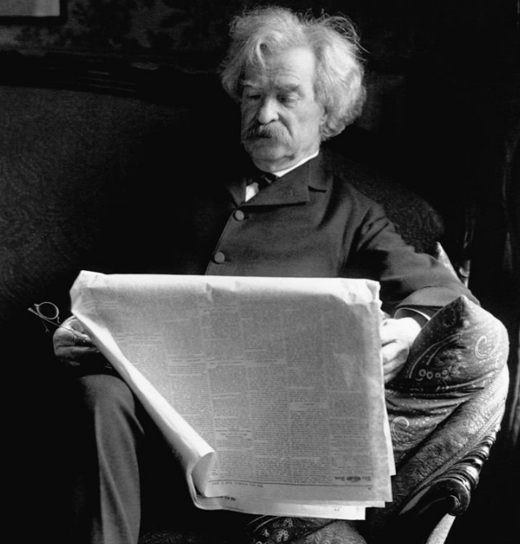
“A newspaper is not just for reporting news as it is, but to make people mad enough to do something about it.”
~ Mark Twain
Goodwill
Notes:
Quote:

Slide 5
Icebreaker
Goodwill
Notes:
Report Trivia Game- (Sit Down/Stand Up or Left/Right)
Trivia Questions
I will read the question and you must wait until I am done reading it before trying to answer it. The person who stands up first and gets the correct answer will receive 200 Kazoo points. If you stand up before I finish the question you will be disqualified.
Question: You use this report to view daily net sales, period to date sales, period budget, last year revenue, over/short dollar, customer count, dollar per customer, and donors.
Answer: 445
Bonus Question: For an extra 100 points why is it called the 445?
Answer: 4 weeks 4 weeks 5 weeks
Question: You use this report to view the budget by day and determine if you controlled payroll within standards.
Answer: 100p
Question: This report contains production information for one store on a specific date.
Answer: Production summary
Question: This report compares production goals with the number of items and dollar amounts produced for each department during selected time frame.
Answer: 8a Production Summary Actual vs Quota Graph
Question: This report provides a breakdown of each departments sales for the day.
Answer: Daily Financials

Slide 6
Basic Reports
What are retail basic reports?
445- Net Sales Comparison by Period
100p- Net Sales and Hourly Payroll vs Budget by Period
Production Summary
8a- Production Summary Actual vs Quota Graph
Daily Financials
Notes:
What are retails basic reports?
Answer:
The retail reports include:
Net sales by comparison
Net sales & hourly payroll
Production Summary & 8A
Daily Financials

Slide 7
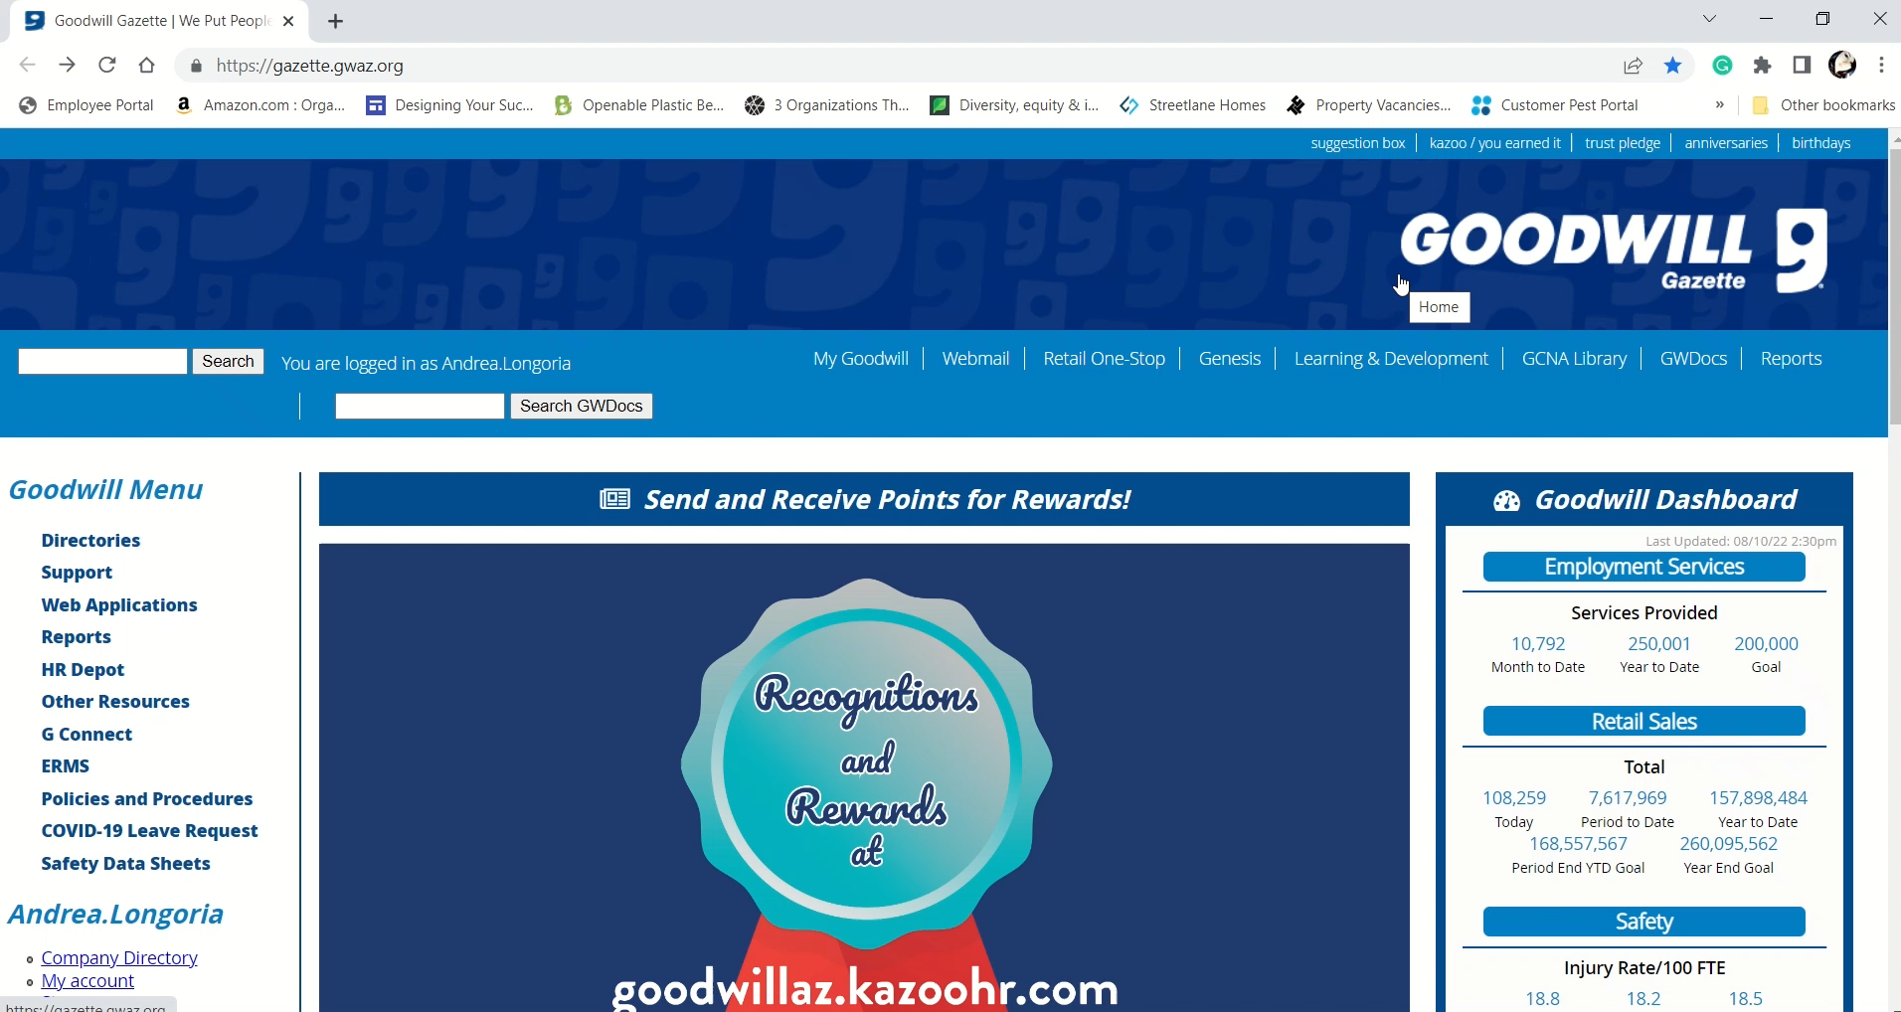
Basic Reports
How do we access these reports?

Slide 8
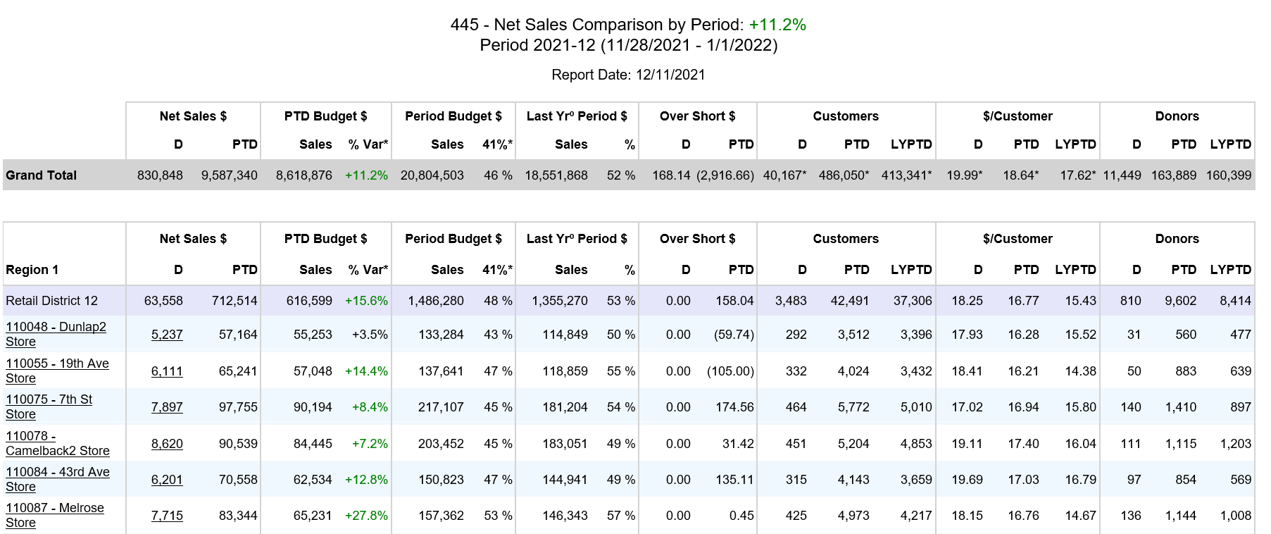
Basic Reports
Net Sales by Comparison
Goodwill

Slide 9
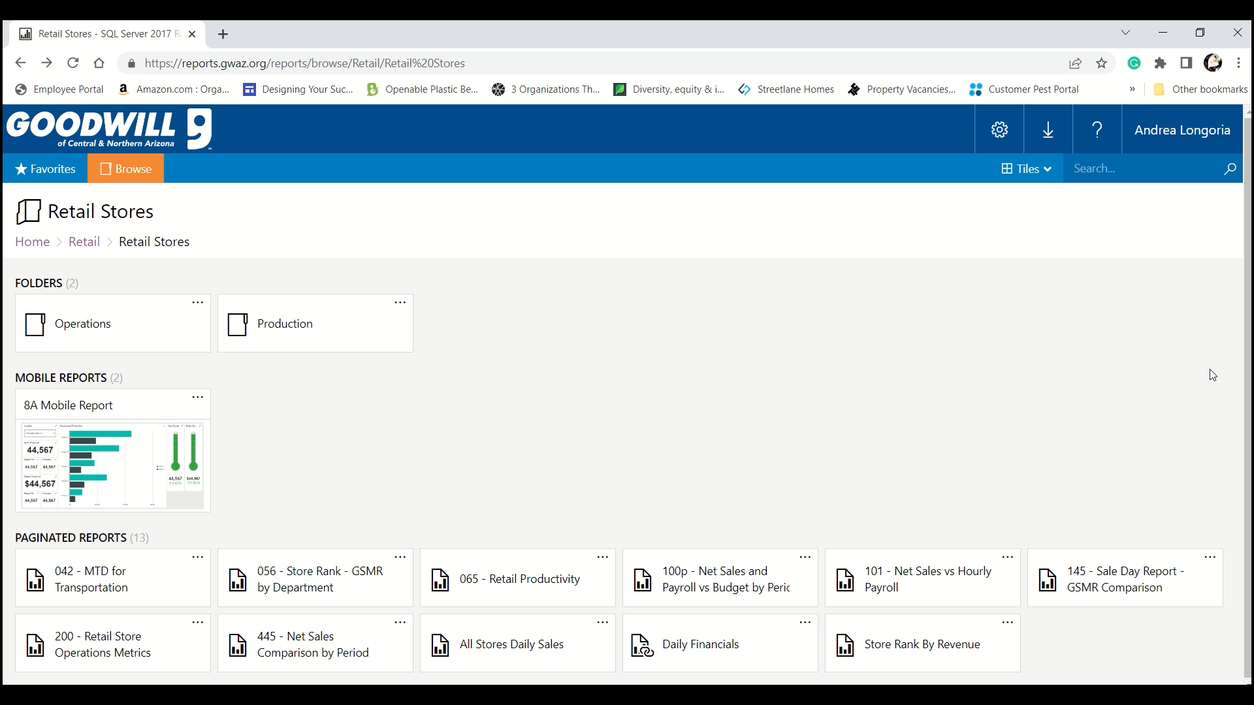
Basic Reports
How do we access these reports?

Slide 10
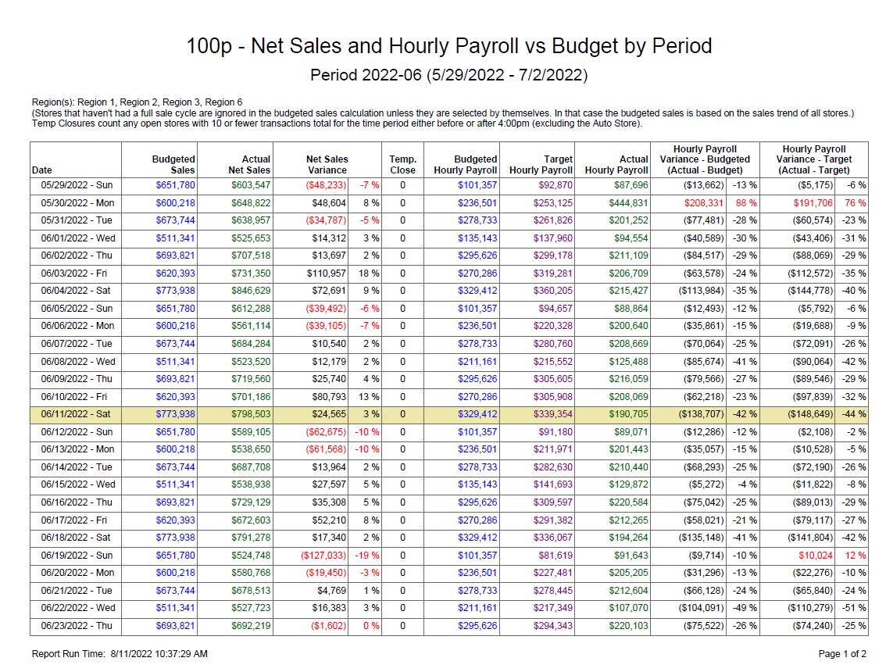
Basic Reports
100p Net Sales and Hourly Payroll vs Budget
Goodwill

Slide 11
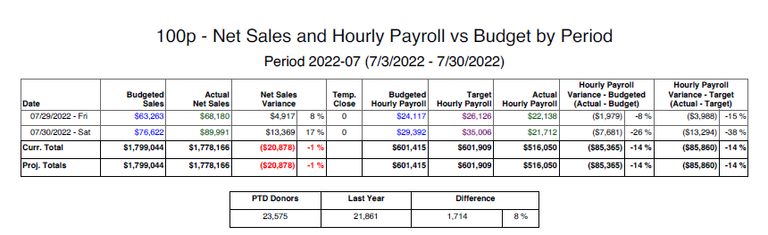
Basic Reports
100p Net Sales and Hourly Payroll vs Budget
Goodwill

Slide 12
Activity
Goodwill
Notes:
Payroll Activity-
Per Table- Handout a report to each table

Slide 13
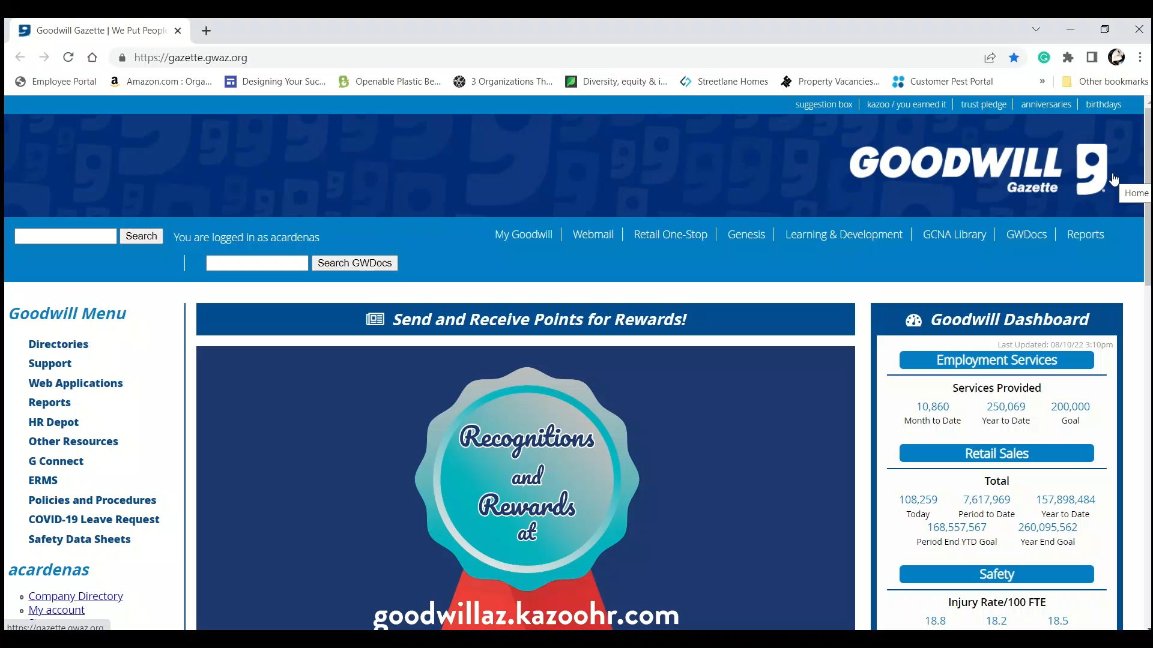
Basic Reports
How do we access these reports?

Slide 14
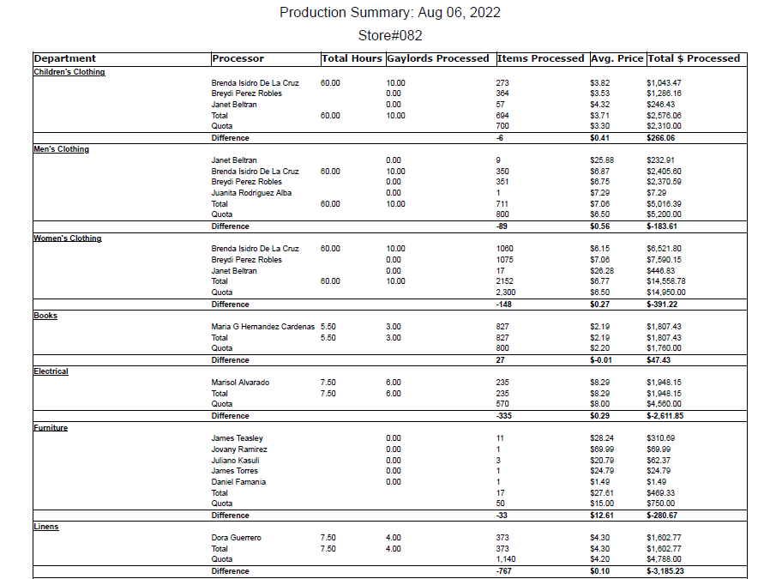
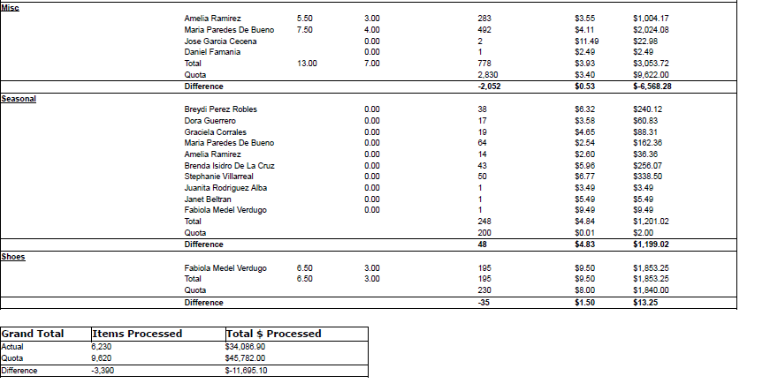
Basic Reports
Production Summary
Forrest Gump
Selena Quintanilla
Jenny Gump
Abie Quintanilla
Janet Jackson
Paula Abdul
Beyonce
Brandy
Monica
Prince
Madonna
Bono
Drake
Eminem
Mickey Mouse
Donald Duck
Minnie Mouse
Michael Jordan
Dolly Parton
Jenifer Lopez
Shakira
Warren G.

Slide 15
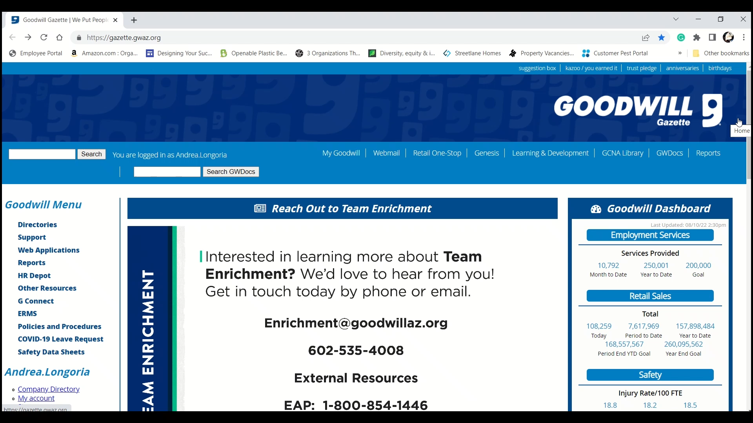
Basic Reports
How do we access these reports?

Slide 16
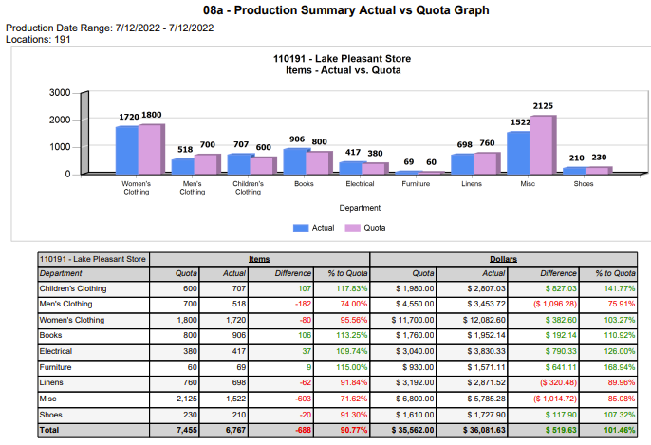
Basic Reports
8a Actual vs Quota

Slide 17
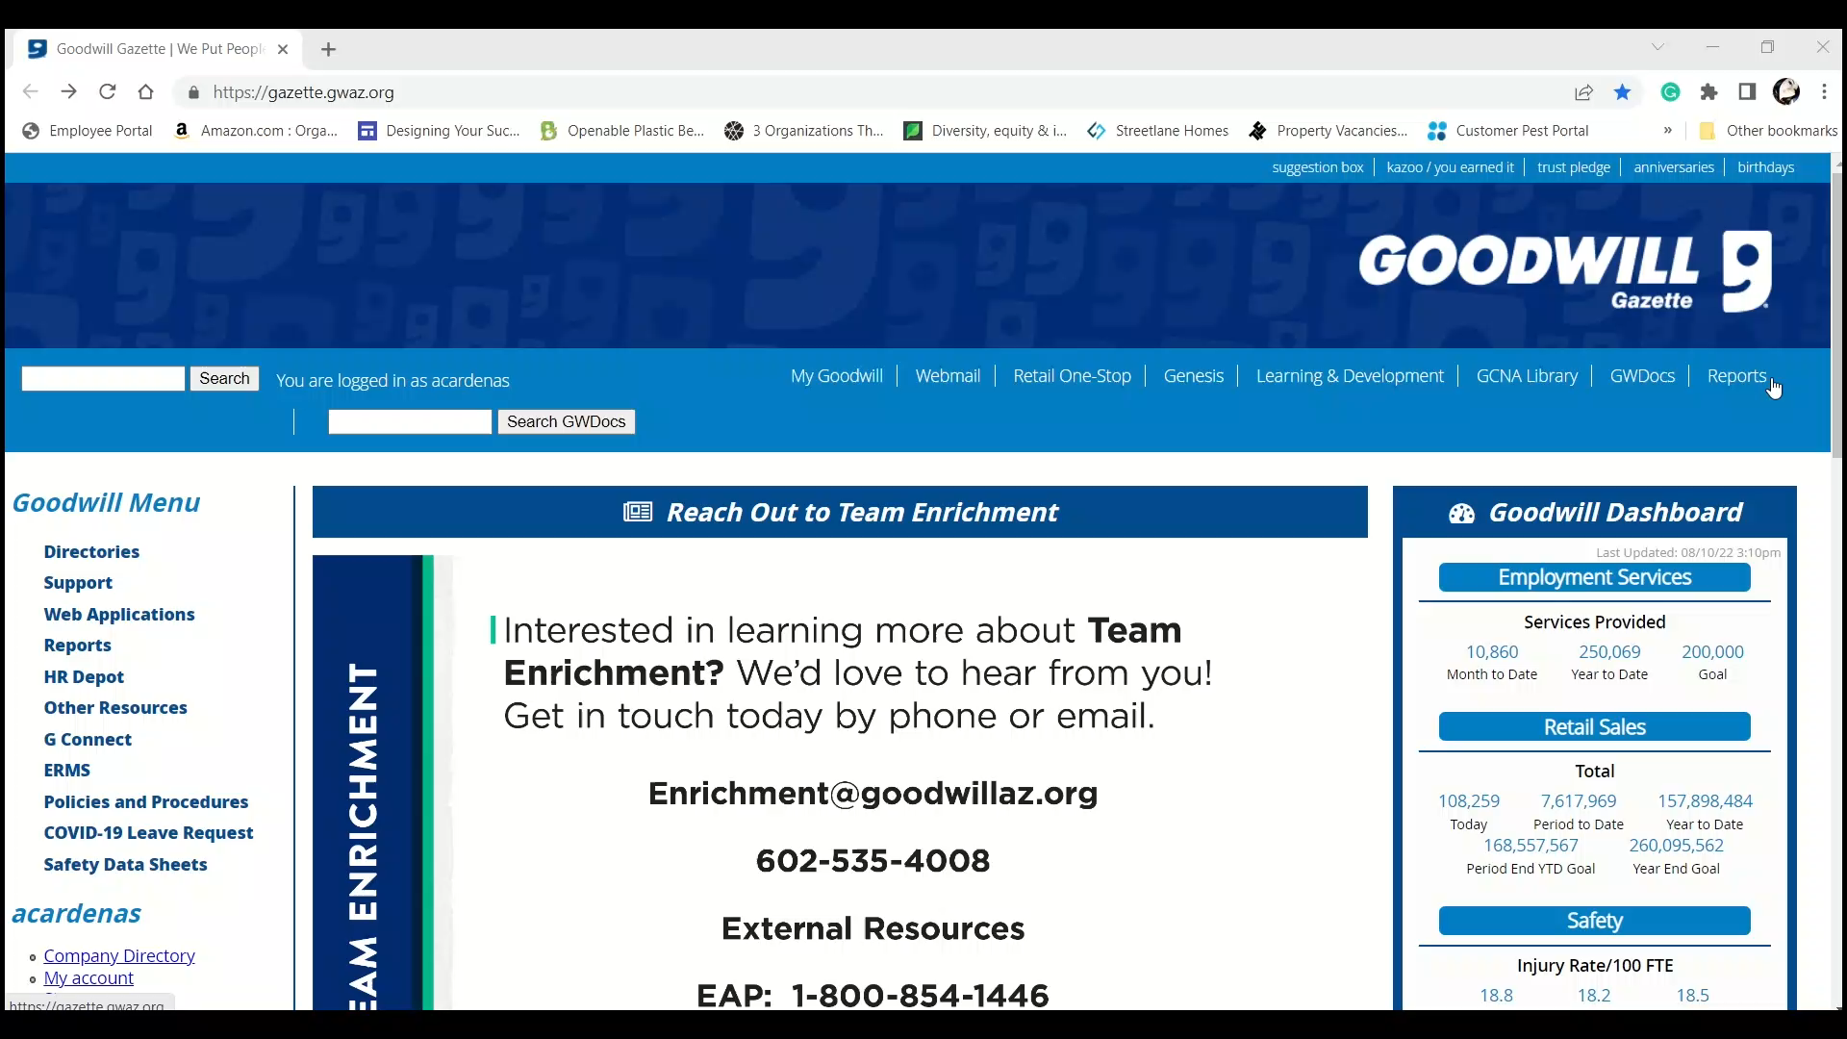
Basic Reports
How do we access these reports?

Slide 18
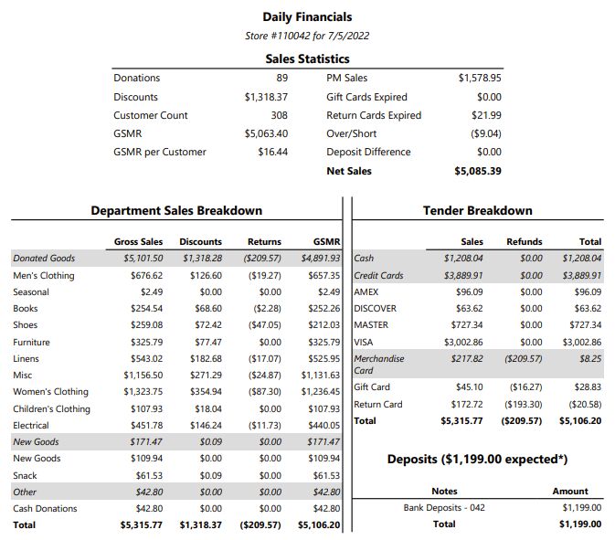
Basic Reports
Daily Financials

Slide 19
Activity
You wouldn’t drive blindfolded
Goodwill
Notes:
Activity- Would you drive blind?
“You Wouldn’t Drive Blindfolded”
At your tables find out how long each person has been with Goodwill and line yourselves up in order.
Once this is completed instruct the newest member of the team to go outside. Once outside hand them each a car and blindfold. Have them test the cars and put their blindfolds on. They will then join their group.
In the room please set up the rug as well as the blocks. This is done while the drivers are outside.
The goal of this activity is to get through the maze in the fastest time possible. The winning team will receive 100 Kazoo points each.
Once everyone reaches the finish line, drivers will take their blindfolds off and go through the maze once again without the blindfolds.
Talking Points
What does the blindfold, car, and maze represent in this activity?
Blindfold-The blindfold represents the lack of knowledge the manager has of the business whether that be reports or overall basic knowledge.
Car- manager
Maze-The maze represents the day to day operations and the obstacles that we are faced with every day.
How much support did everyone need to provide to the driver when they had their blindfolds on?
Once the driver removed the blindfold how much less support did they need from you and how much easier was it for our drivers to get through the maze? How can we translate this to ou

Slide 20
?
QUESTIONS
Goodwill
Notes:
Q&A Session

