Slide 1
Retail
Culture &
Seasonal Product Knowledge
C O N N E C T
Goodwill
Notes:
Blain opens up and introduces the topic

Slide 2
Introductions
Diana Byers,
Retail District Manager
Blaine Jimenez,
Retail Projects Manager
Goodwill
Notes:
Diana introduces herself – Pics can remain as they represent us in “costume”
Blaine Introduces himself

Slide 3
Objectives
Review seasonal product revenue
Identify seasonal product best practices
Develop a daily seasonal product mindset
Goodwill
Notes:
Blaine reviews objectives

Slide 4
Quiz Time
Goodwill
Notes:
Blaine will lead activity
Kazoo Points – Each table will guess Sales Revenue Last year for:
Halloween-
Christmas-
Total-
Flip Chart Sheet for each table with guesses and names

Slide 5
Ice Breaker
Goodwill
Notes:
Diana leads Ice Breaker
Ice Breaker: Stand/Sit Questions: reset, everyone sits after each question. (5 minutes)
Stand if you love Halloween?
Sit if you dress up for Halloween? (in the store)
Stand if you love Christmas?
Sit if you dress up for Christmas?
Stand if you only want the gaylords back that your team made?
Sit if you think seasonal gaylords are frustrating to create throughout the year?

Slide 6
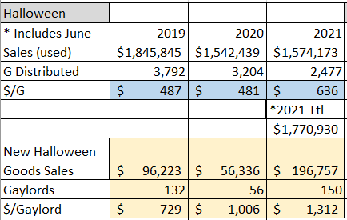
Seasonal Product Financials
Halloween
Notes:
Blaine to review (Break into 3 Slides)
Show Historical Sales
Historical Data
Show current Standings
Show $/G generates- Christmas vs Halloween
Opportunities
Previous years retail results
Revenue per gaylord
Gaylord Inventory
Forecast
Celebrate the wins (Christmas)
Call out the biggest opportunity – Halloween

Slide 7
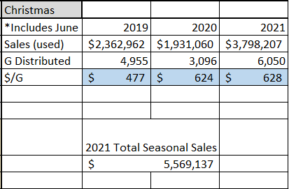
Seasonal Product Financials
Christmas
Notes:
Blaine to review (Break into 3 Slides)
Show Historical Sales
Historical Data
Show current Standings
Show $/G generates- Christmas vs Halloween
Opportunities
Previous years retail results
Revenue per gaylord
Gaylord Inventory
Forecast
Celebrate the wins (Christmas)
Call out the biggest opportunity – Halloween

Slide 8
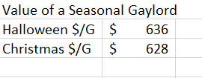
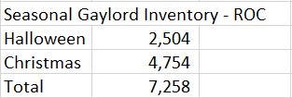
Seasonal Product Financials
Gaylord Values
Notes:
Blaine to review (Break into 3 Slides)
Show Historical Sales
Historical Data
Show current Standings
Show $/G generates- Christmas vs Halloween
Opportunities
Previous years retail results
Revenue per gaylord
Gaylord Inventory
Forecast
Celebrate the wins (Christmas)
Call out the biggest opportunity – Halloween

Slide 9
Seasonal Product Best Practices
Best Practices Discussion
Notes:
Diana will review
Best Practices Currently in Place:
PPM – Floorwork – Each RMP takes a box to the sales floor and fills with items selected from pulls.
Check pull gaylords for items that can be back stocked
RMPs pre-print seasonal tags in the morning
RMPs pricing seasonal daily & clearing stations daily and priced product placed into Cardboard Gaylords
Management checking the seasonal created by the RMPs
Carts checked for:
Accurate pricing of seasonal items
Items tagged as seasonal getting rolled to the floor vs back stocked
Items tagged to a department when it should be seasonal
ASIS – Checked for items that should be back stocked into seasonal
Verify Seasonal Gaylords have correct product (Halloween and Christmas is not mixed). HW in HW.
Costume hunt activity during morning floor work.
Always be on the look out for the unique items that can be selected in all departments, such as accessories & hats.
Cart hunt – Manager goes into departments and gathers all the product that was rolled instead of back stocked and review with the team.
Follow Christmas Tree PPM – How to palettize trees for storage in stores.

Slide 10
Seasonal Product Best Practices
Table Activity
Goodwill
Notes:
Diana will review
Flip Chart Paper- Table Activity- (20 minutes) 5- 5- 10
Goal of the Activity – To gather information and feedback from the participants around best practices already in play and what could be added.
ACTIVITY: TABLE
Need 2 large sheets for each table
We can make # groups by counting depending on the size of the group 4-6 (6 for large attendance)
On one sheet they write all the best practices they currently have in place at stores around seasonal
On the other sheet – ideas – what can we add or do differently to best practices
Debrief –
Each table will be responsible to say only what was not already said by the previous table due to time restraints
Review Best Practices the Organization has in place –highlight what was not already covered – Stress PPM
Create a guide to handout that has key best practices
Take pics and collect sheets from each table.

Slide 11
Activity:
Floor or Backstock
Goodwill
Notes:
Blaine leads activity
To the Floor or Not to the Floor – that is the Question
Each Table will go over the items on the handout and decipher if they are to be processed and rolled to the floor or are they to be processed and placed directly in the Seasonal Gaylord.
Each table will state 1 of each and we will debrief. Goal is to get them to start thinking of items that are more valuable to be processed as seasonal and backstocked rather than processed into a regular department.

Slide 12
Create a daily seasonal product mindset
What are the opportunities in each department to create seasonal backstock?
Cloth
Miscellaneous
Shoes
Books
Electrical
Linens
Goodwill
Notes:
Blaine to review
Each table will be assigned a department. As a table they will list items that can be processed from production or selected from pulls in that department.
Debrief a few items from each table.
Balance – Product comes from production and the sales floor
Dialogue: Items that should never been found in asis/pulls.
Resources to validate seasonal is being captured in production:
Daily – Production Summary
Report by Person – who is and who is not pricing seasonal – Stress who is not pricing any
Track increase of gaylords being created

Slide 13
Key Takeaway Discussion
Goodwill
Notes:
Diana to review
CONCLUSION - Key Takeaways – Q&A
Review objectives – Why does all this matter? Behavior drives the creation which drives the revenue. The goal of this session is for all of us to have a renewed commitment to capture seasonal daily – It matters every day. Generate Tomorrow’s $$.
Chose 4-5 People – Ask what their major takeaways from today’s session?

Slide 14
?
Q&A
Goodwill
Notes:
Blaine and Diana to lead

