Slide 1
Retail
Culture &
C O N N E C T
Electrical
Goodwill

Slide 2
Introductions
Dylan Chamberlain:
Retail District Manager
Goodwill

Slide 3
Objectives
Discuss the value of knowing your electrical
Questions?
Demonstrate ability to properly price electronics
Apply hands-on knowledge with an activity
Explore indicators: Brands, Features, Age, and Quality
Goodwill
Notes:
Examine the value of electronic products (covered thru facilitation)
Explore product value indicators
Review eBay product/value information
Demonstrate

Slide 4
Icebreaker
Goodwill
Notes:
Before we get started, let’s start with an icebreaker. Talk amongst your tables: what is the most hard to identify electronic you’ve seen in your time with Goodwill? Compare stories and choose one to share with the room. What was the electronic? What made it hard to identify? What tools did you land on to identify it? What did it sell for?

Slide 5
Mystery Machine
What is this?
How would you begin to find out?
What tools are available to you?
Notes:
Dylan: Open up the session with the questions/prompts above for the attendees. Let them talk through the answers. Then tell your story about receiving this item, how you were able to identify it, and the price it commanded. Rope this story back to the idea that there is a lot of value to be realized in electronic items. You’re going to share how to get better at it.

Slide 6
Indicators
Brands, Features, Age, Quality
Goodwill

Slide 7
Indicators: Brands
AV/Stereo
Gaming
PC/Computer
Kitchen Appliances
Tools
Notes:
Gaming: Steel Series, ASUS ROG, Turtle Beach, Astro Gaming, Logitech G, Razer
Computer: Asus, Logitechm Lenovo, Netgear, Linksys, Belkin, Blue Yeti Microphone, EVGA
Kitchen Applicances – Kitchen Aid, Cuisinart, Breville, Oster, Hamilton Beach, Presto, Nespresso
Tools: Chicago Electric, Makita, Dewalt, Stanley, Ryobi, Hart, Hilti, Rigid

Slide 8
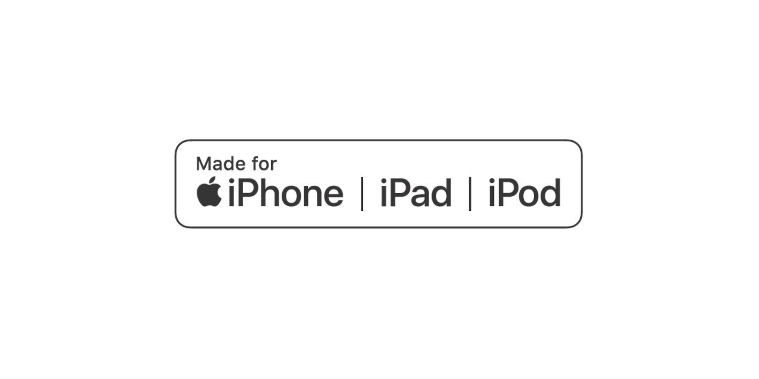
Indicators: Features
Notes:
Dylan: review what external compatibility markers to look for that might indicate value.

Slide 9
Activity
Indicators: Age
Goodwill
Notes:
Is this hands-on or a digital activity? I’ll need an explanation to help.
Bearing in mind that this will need to be adapted to GIMV, digital is best. ☺

Slide 10
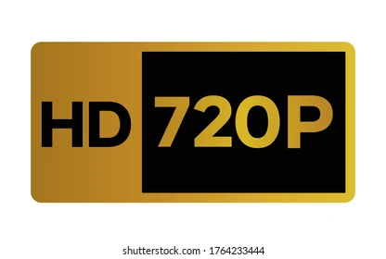
Indicators: Age
Notes:
Turn this into a table activity: either laminated matching game or digital Kahoot participation.
Correct order: 480<720<1080i<1080P<4K<4K HDR<8K

Slide 11
Build Quality
Construction, Weight, Input
Goodwill

Slide 12
Indicators: Construction
Buttons & Knobs
Mechanical buttons
Removable knobs
Hollow/plastic accessories
Notes:
Turn this into a table activity: either laminated matching game or digital Kahoot participation.

Slide 13
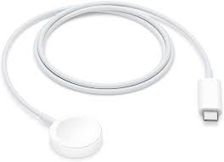
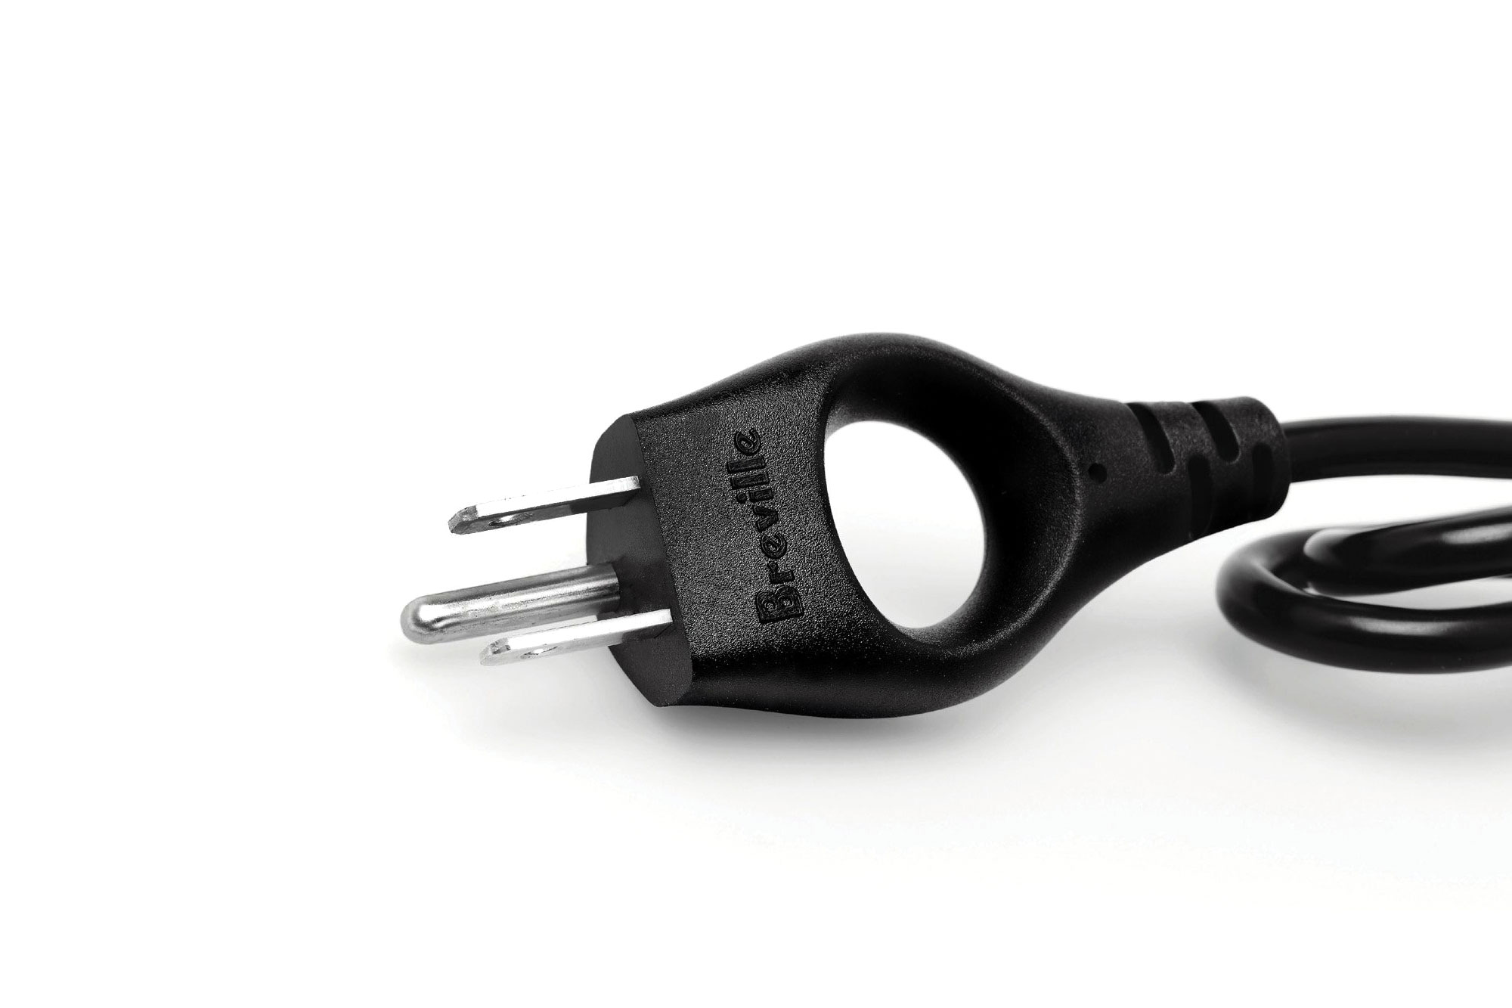
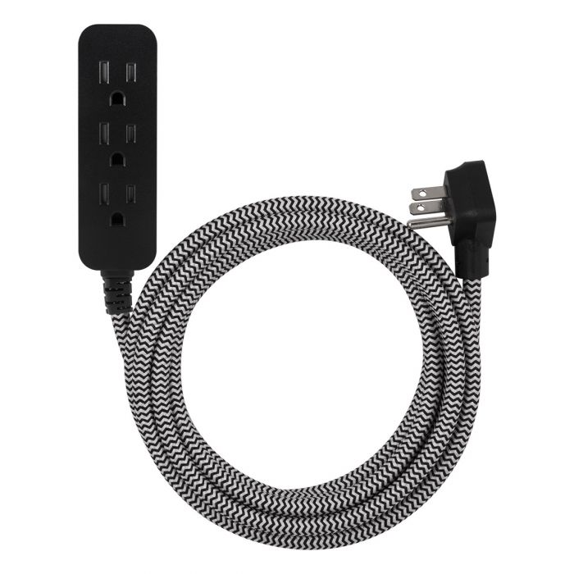
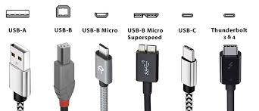
Indicators: Construction
Cords
Gauge/thickness
Magnetic connector
Branded cords
Notes:
Turn this into a table activity: either laminated matching game or digital Kahoot participation.

Slide 14
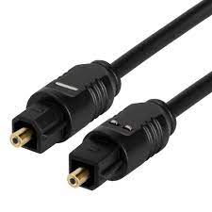
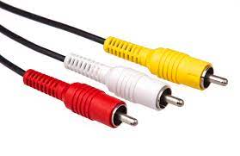
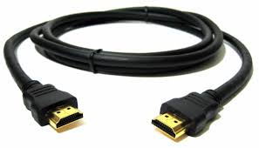
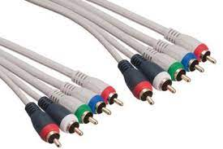
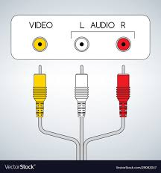
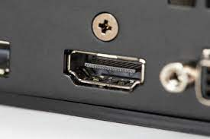
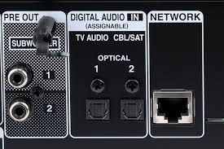
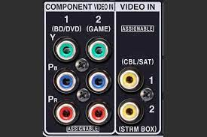
Indicators: Quality
AV Input
NEEDS CONTENT
Notes:
Make this into a matching exercise?

Slide 15
Activity
Blind Box
Goodwill

Slide 16
Ebay
Recent Sale Value
Goodwill

Slide 17
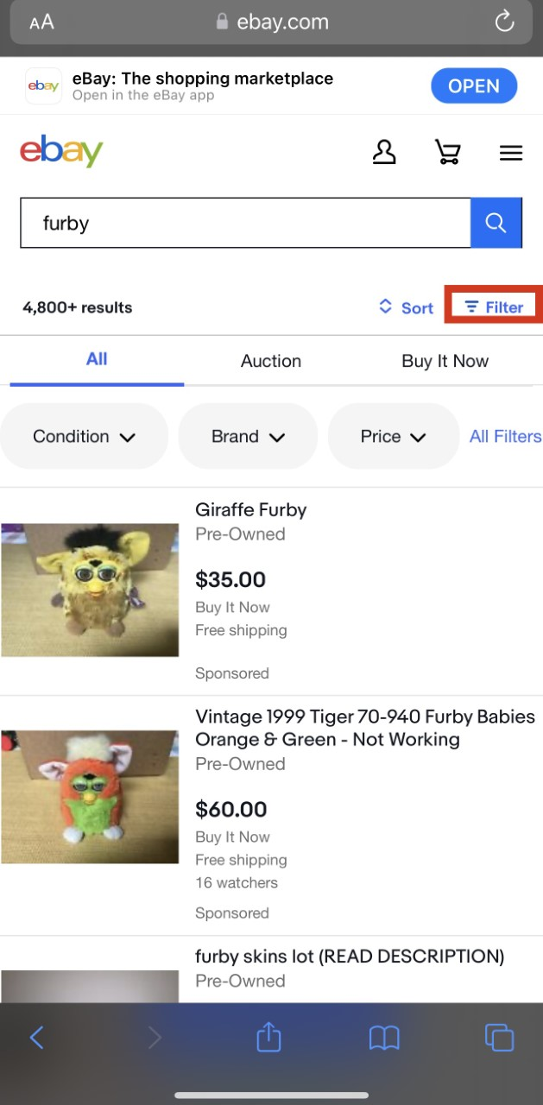
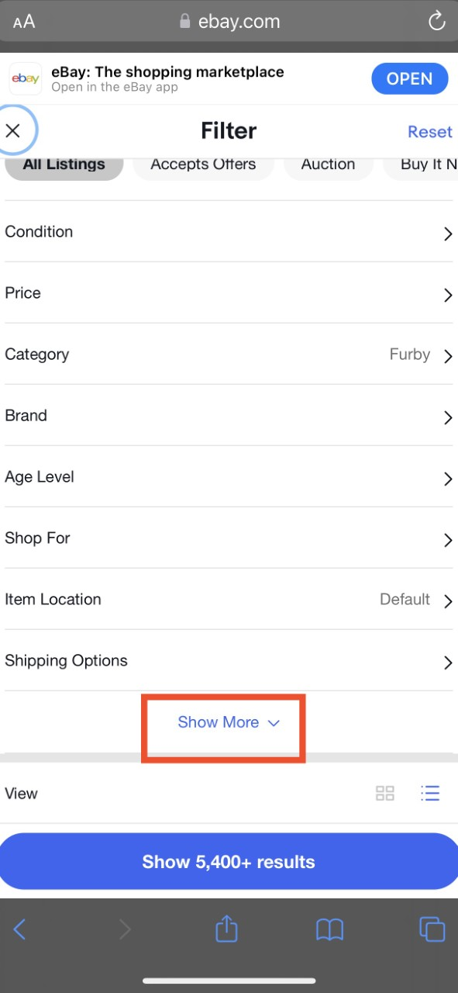
Ebay
Recent Sale Value
STEP 1
STEP 2
Enter the name of the item in the search bar
Click the Filter button
Clicking the filter button will open up a menu
Press Show More to uncover additional filter options.
Notes:
Turn this into a table activity: either laminated matching game or digital Kahoot participation.

Slide 18
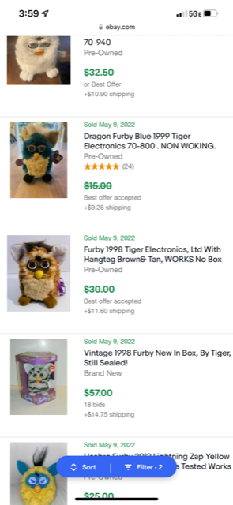
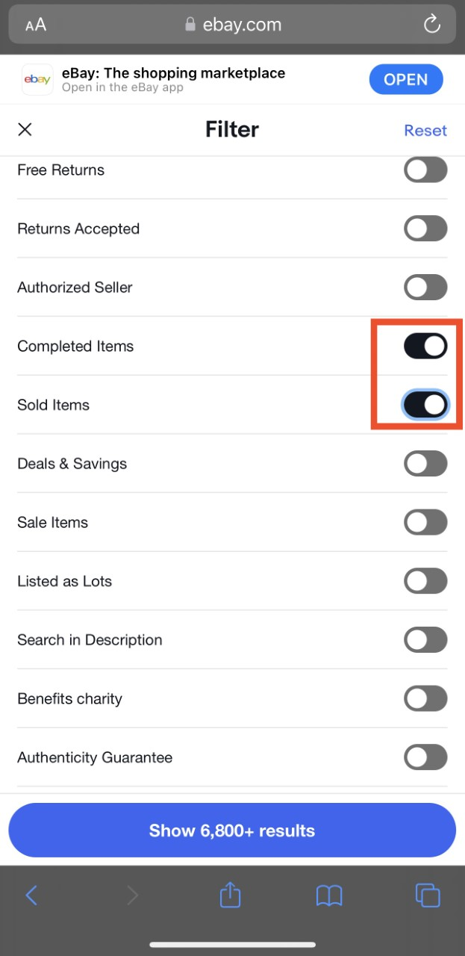
Ebay
Recent Sale Value
STEP 3
STEP 4
Toggle on Sold Items button
This will automatically toggle the Completed Items button as well
You will see completed auctions and what the items actually sold for
Beware of Buy It Now prices
Trust live auctions with more bids

Slide 19
Questions?
Contact:
Dylan.Chamberlain@goodwillaz.org
Goodwill

Slide 20
…Through the power of EBAY!
At this point you will see completed auctions and what the items actually sold for. Beware of buy it now prices, and always trust the auctions with more bids
Once in the expanded filter meu, toggle on sold items button, doing this will automatically toggle the completed auctions button as well.

Slide 21
Finding what people are willing to pay…
When Searching for an item, first search the name of the item you would like to find, Then Click the Filter button
Once the you click the filter button it will open up a menu, Press show more to uncover additional filter options.

Slide 22
Electronics:
Sales Routes
Goodwill

Slide 23
Sales Routes
In store
e-Commerce
Dell Connect
Notes:
Review the different options/outlets for moving electronic inventory and the value proposition associated with each. Also what the criteria is for acceptance on Dell Connect.

Slide 24
Electronics:
Dell Connect or e-Comm?
Goodwill

Slide 25
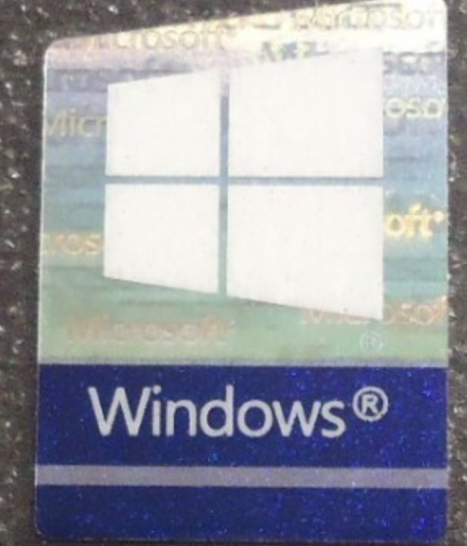
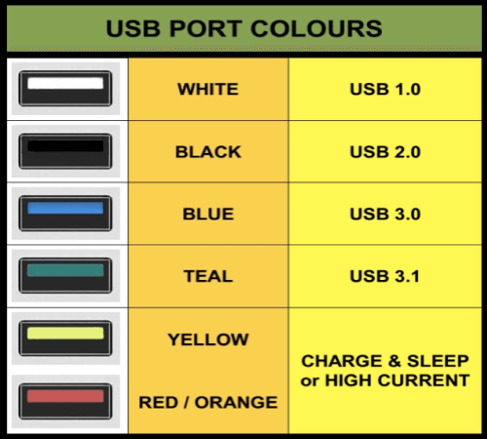
Dell Connect or e-Commerce?
Windows
Processor Marks
Newer Ports
All Apple
BLUE
TEAL
YELLOW
RED/ORANGE
Notes:
Split this out into two slides: one for criteria for Dell Connect and one for e-commerce?
Also, is it ‘Dell Connect’ or ‘Dell Re-Connect’?

Slide 26
Dell Connect or e-Commerce?
Windows
Processor Marks
Newer Ports
All Apple
BLUE
TEAL
YELLOW
RED/ORANGE
Notes:
Place holder for slide 12 break into two

Slide 27
Dell Connect or e-Commerce?
By sending direct to E-Commerce, your store gets direct credit for items sold individually.
E-Commerce has sold $150k+ in computers, cell phones, tablets and computer parts in the last 6 months.
Many items in Dell Reconnect end up getting broken; therefore we do not process them.
An estimated 80% of the above sales came from Dell Connect. If you are not sure – send to E-Comm.

Slide 28
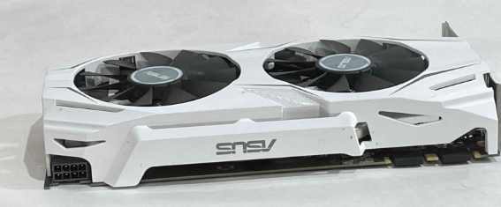
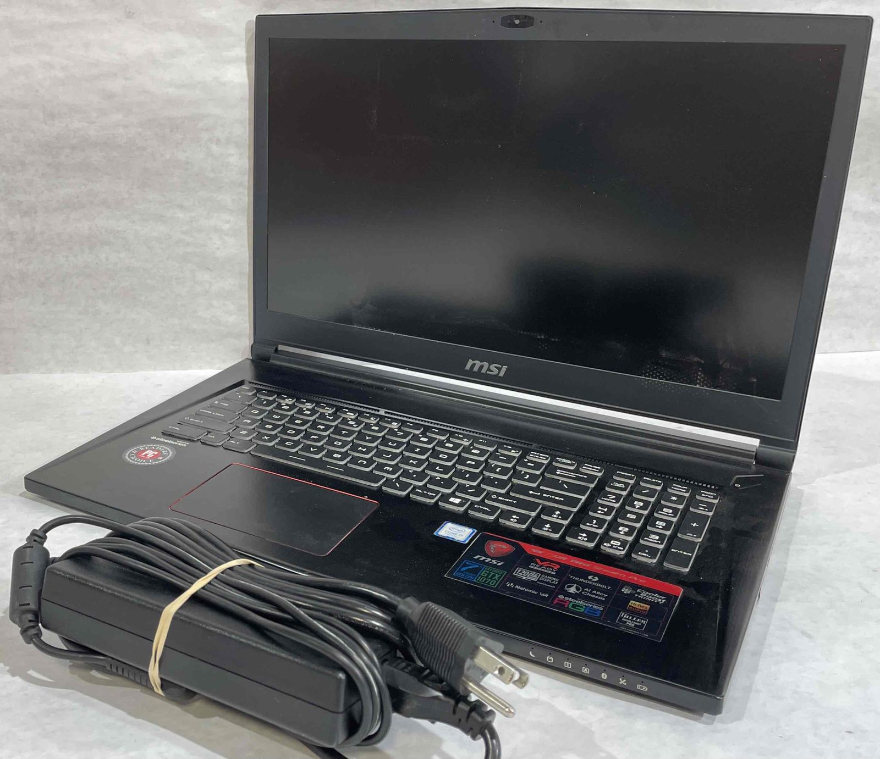
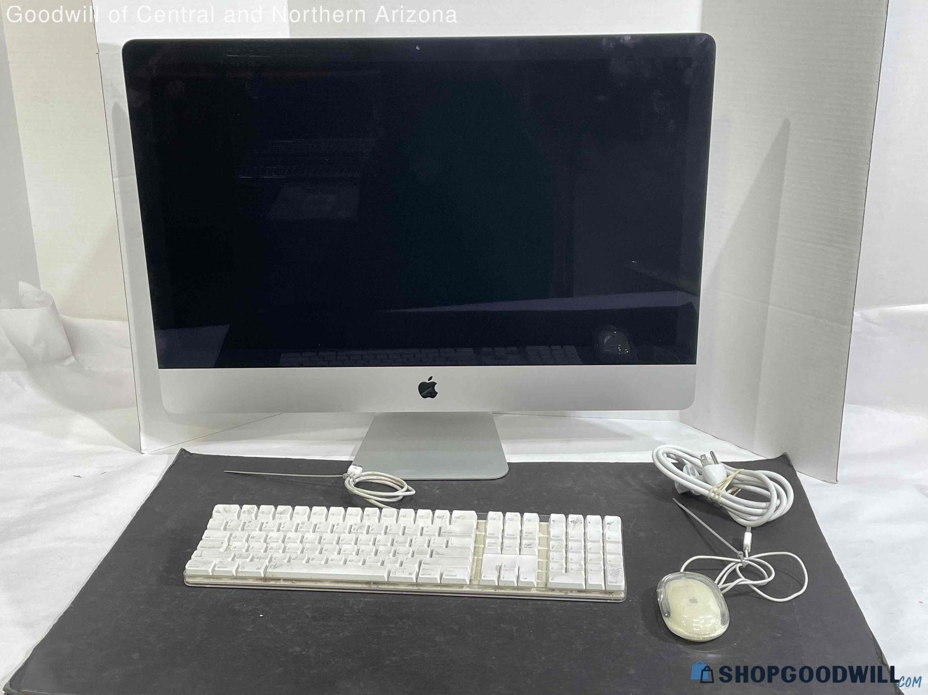
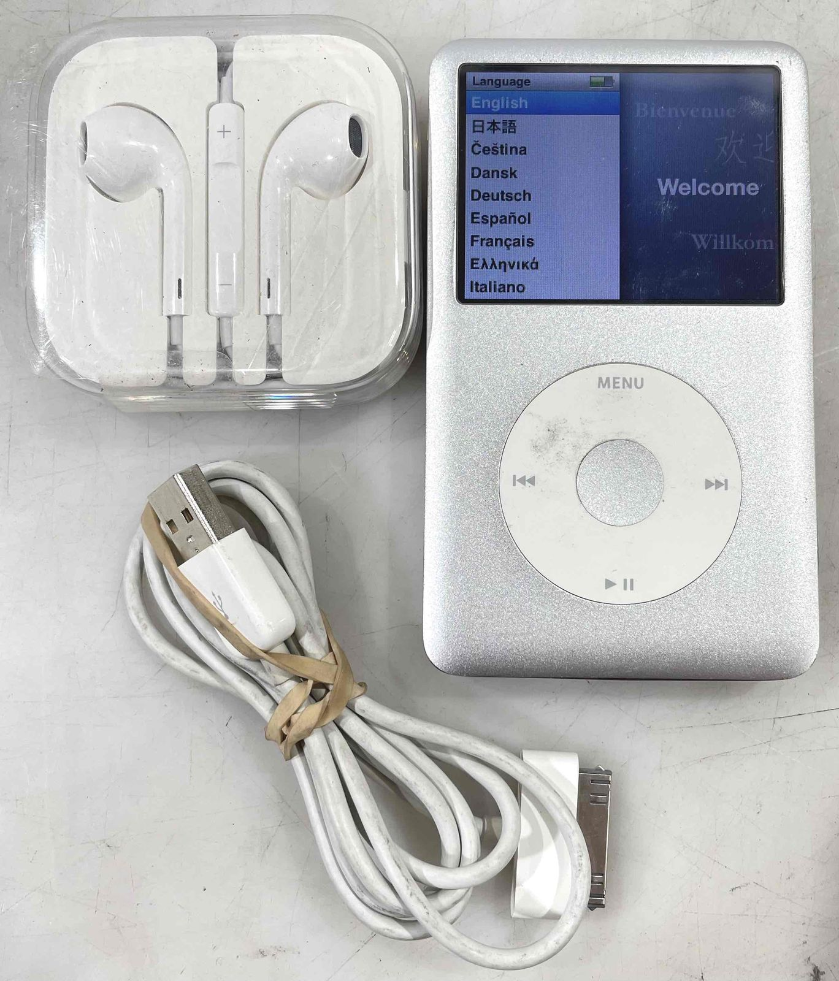
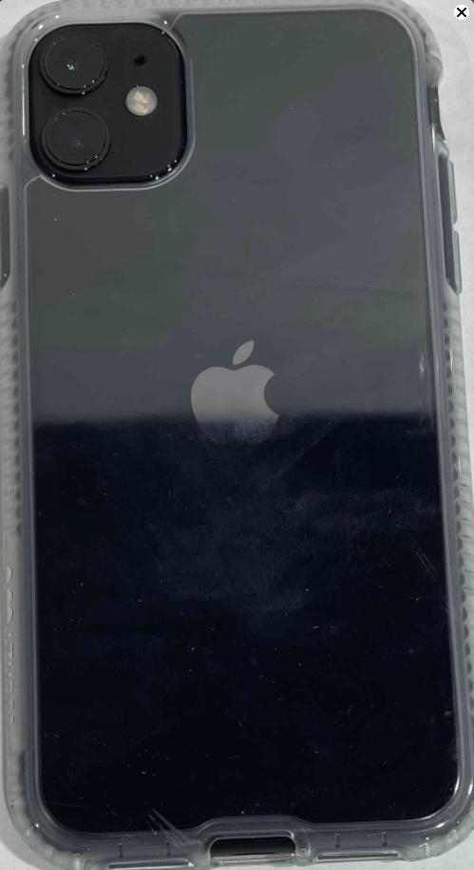
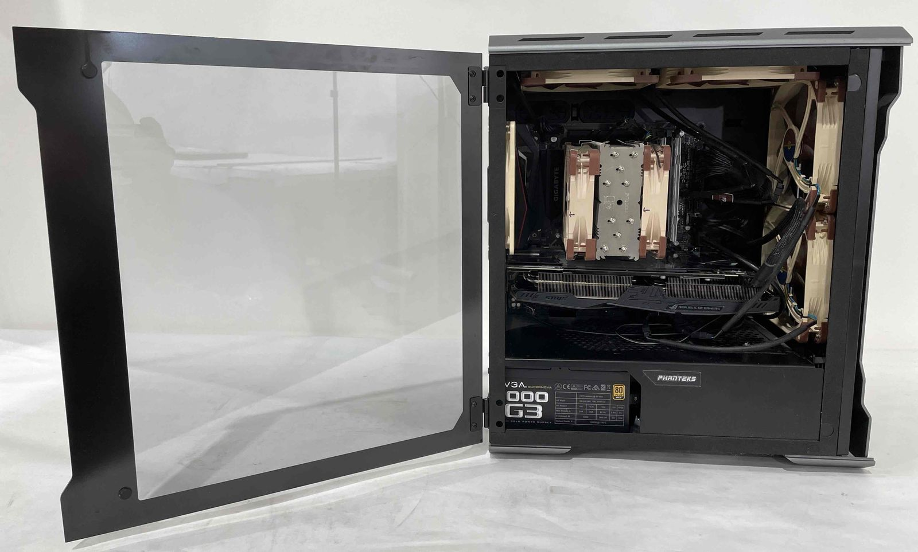
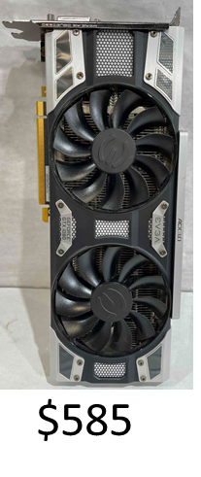
Dell Connect or e-Commerce?
High-value items pulled back from Dell Connect
Graphics Cards - $336
$466
iMac $556
Old iPods $125
Phones $336
Gaming Desktops - $1,501

Slide 29
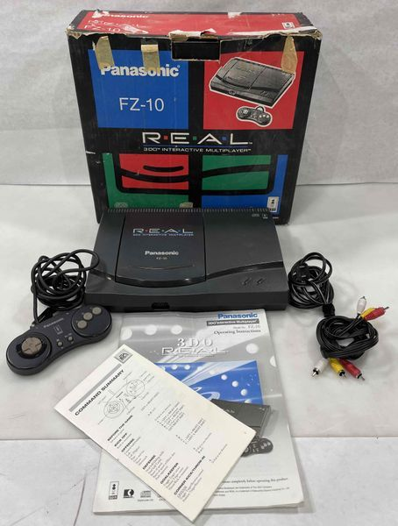
Dell Connect or e-Commerce?
Gaming Consoles
These consoles do not contain user data so they can be sold in store; however they can achieve higher selling cost through e-Commerce.
Panasonic Q Gamecube Console - $946
NES Deluxe Set Console - $731
Visteon Gameboy Advance Console - $475
Sega Genesis CDx Console – $415-$1k
Sega Dreamcast – Orange Color - $2,500
TurboGrafx-16 Console - $680-$1250
Dark Blue Limited Edition PS1 – Approx. $7,500
Game Boy Advance SP – Gold Zelda Version - $20,000
$366
Notes:
***I only noted consoles here that retail COULD sell in-store as they do not have user data; however, they are of higher value that they may be able to get in-store.

Slide 30
Dell Connect or e-Commerce?
Gaming Consoles
Price Charting Example – How to Use (Not sure if we are keeping this? Dylan?
Determining Value – Special Editions, Colored Versions (not always, but mostly), Clear Consoles (any color)
$366
***I only noted consoles here that retail COULD sell in-store as they do not have user data; however, they are of higher value that they may be able to get in-store.

Slide 31
Activity
Dell or e-Comm?
Goodwill
Notes:
Is this hands-on or a digital activity? I’ll need an explanation to help.
Bearing in mind that this will need to be adapted to GIMV, digital is best. ☺

Slide 32
Spotlight:
e-Comm Electronics
Goodwill
Notes:
Is this hands-on or a digital activity?
Bearing in mind that this will need to be adapted to GIMV, digital is best. ☺

Slide 33
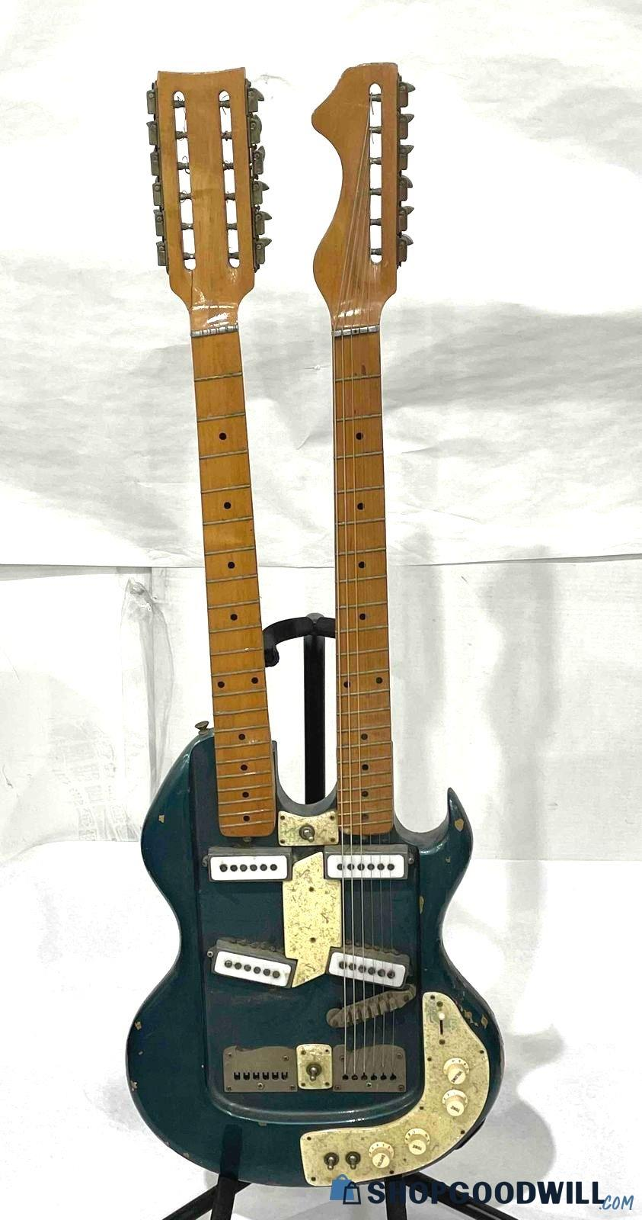
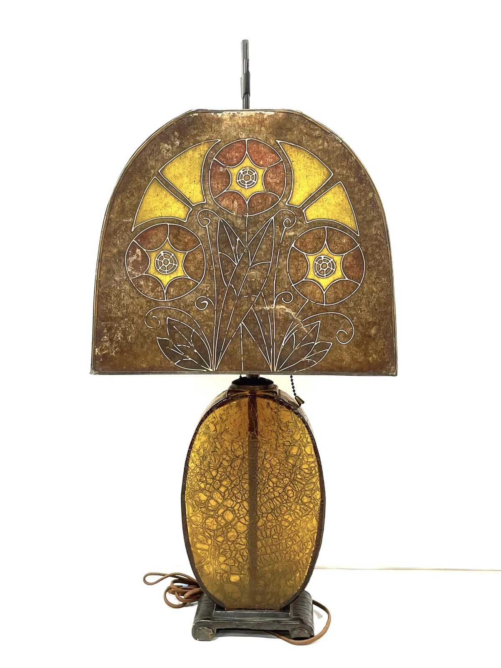
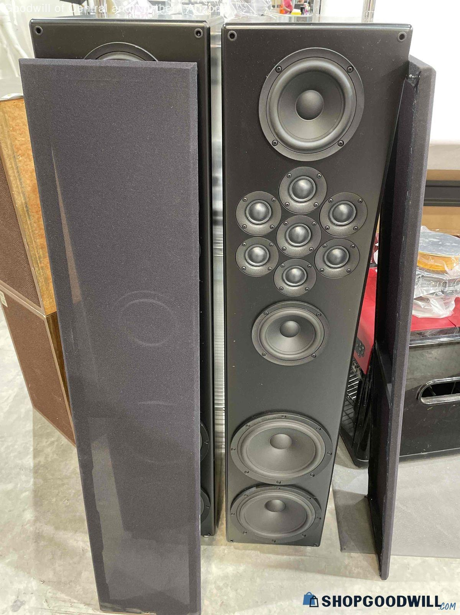
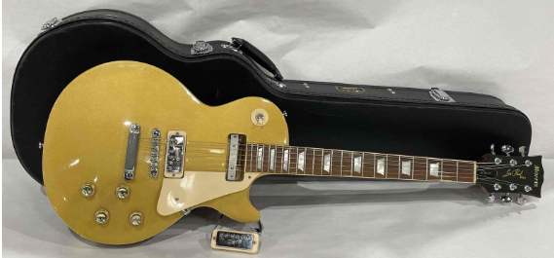
Misc Electronics
$4,800
This Lamp Made it to Clearance – EComm Sold for $1,090
$1,161
$1,351

Slide 34
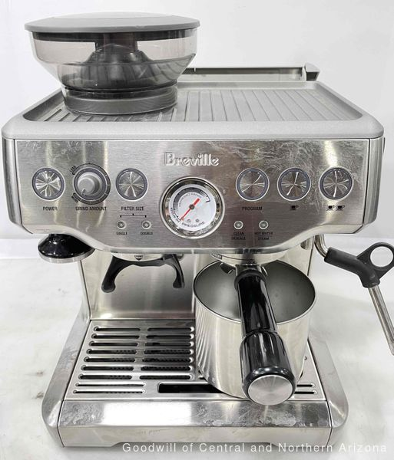
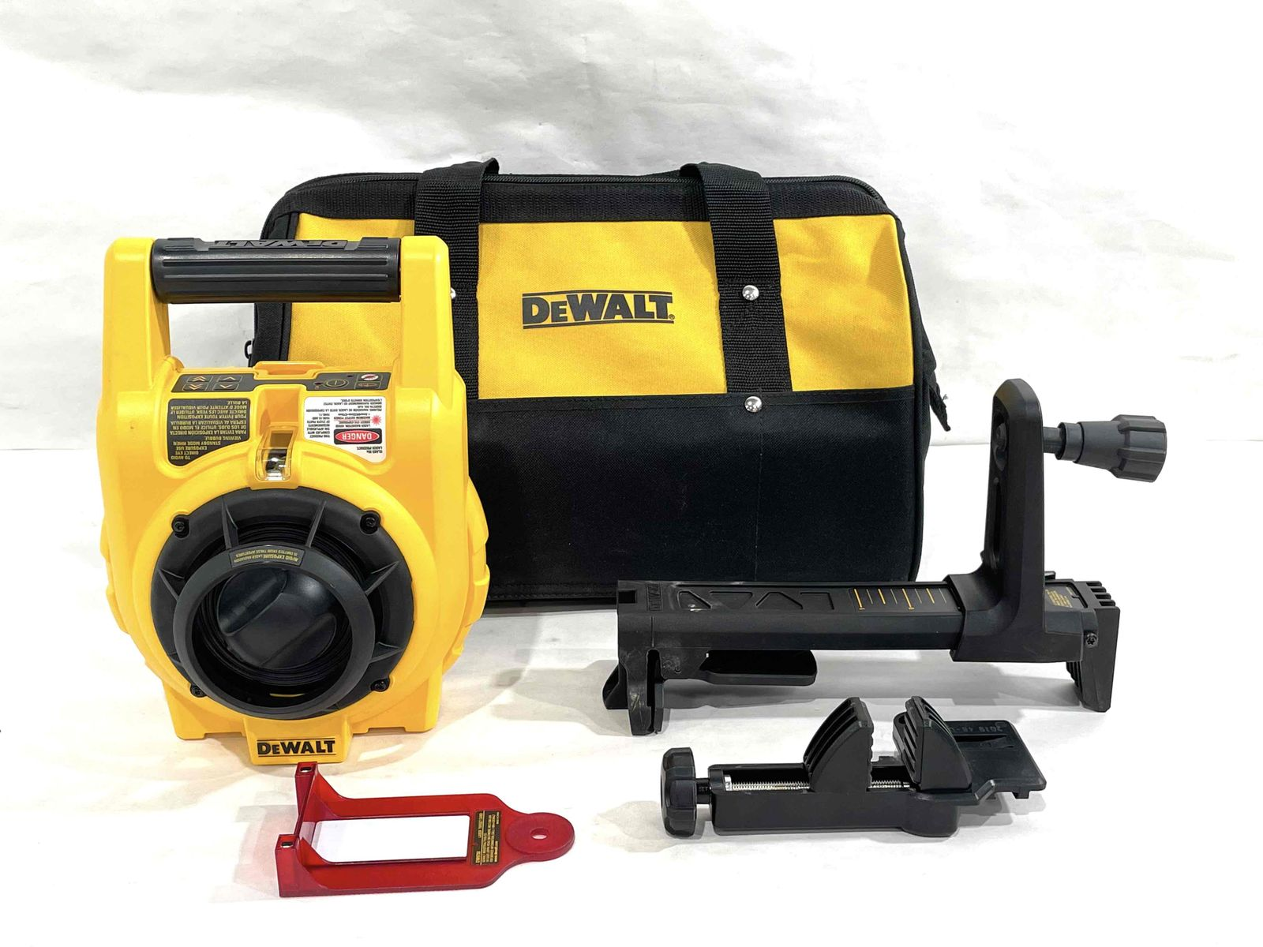
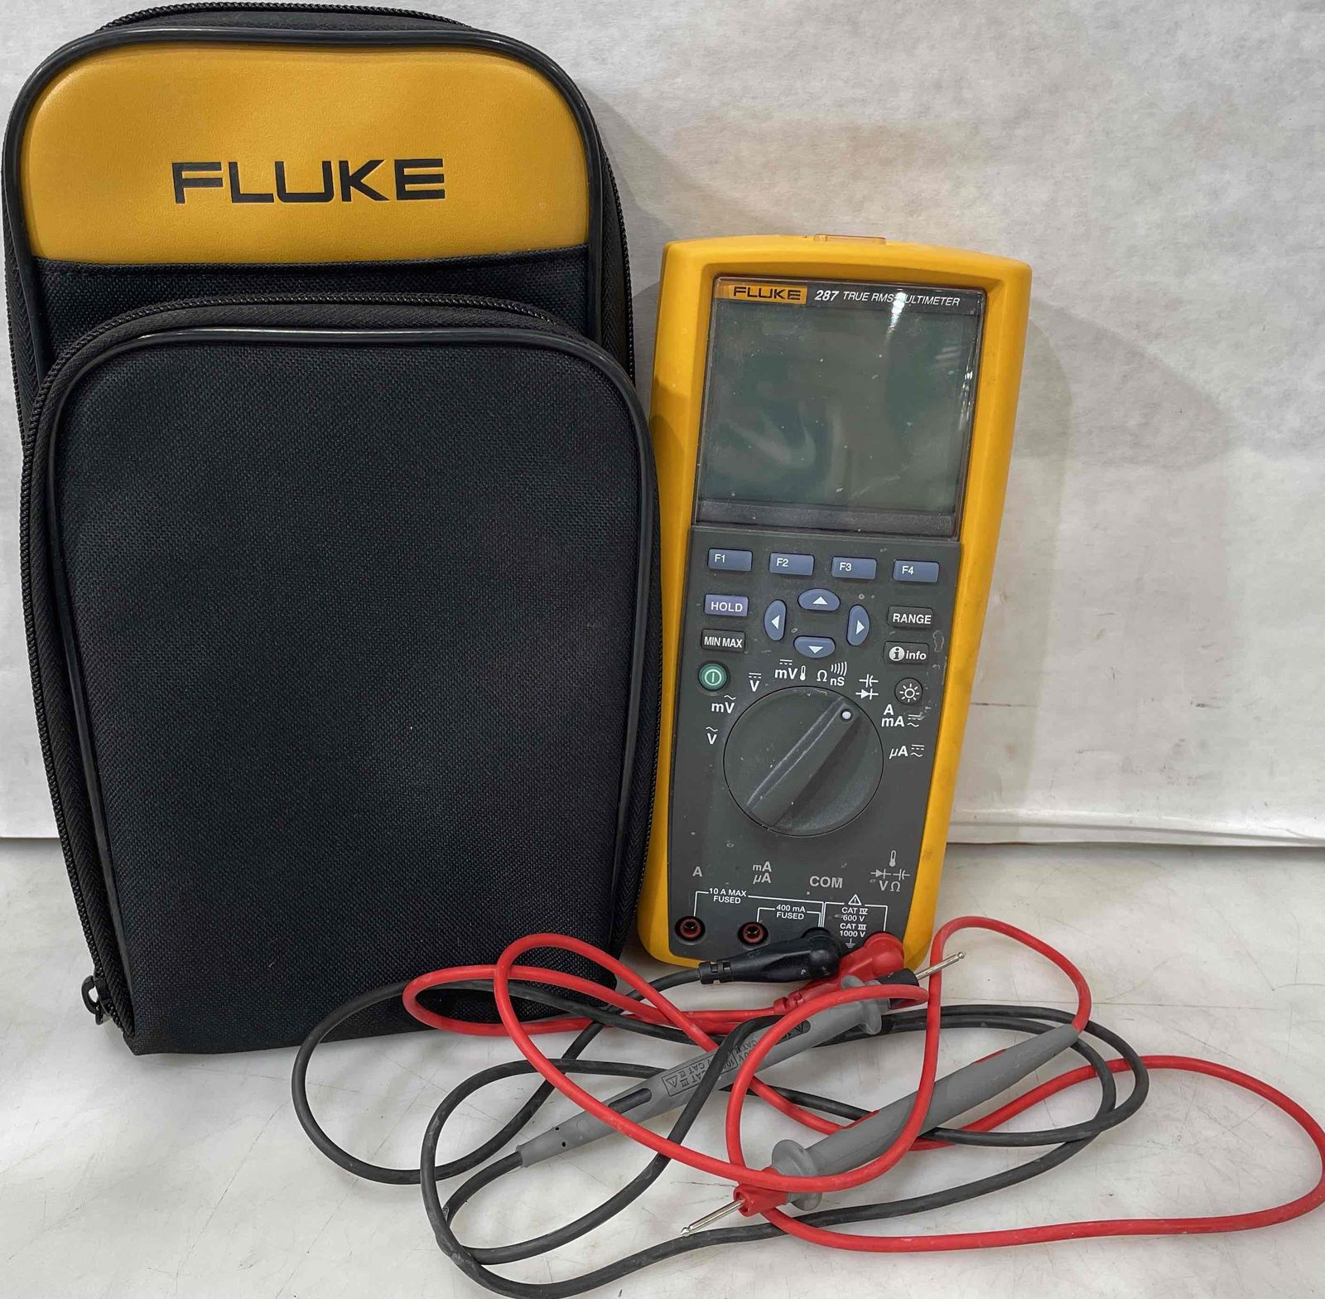
Home Electronics &Tools
$161
$342
$201

Slide 35
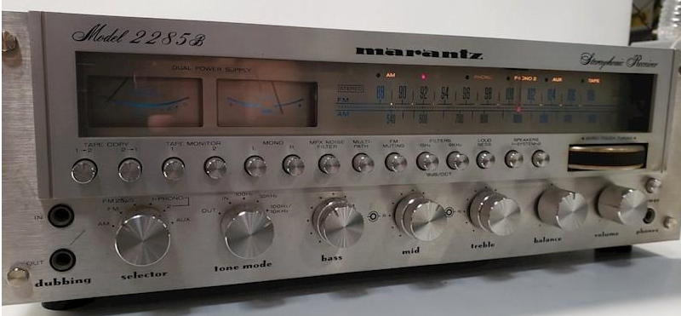
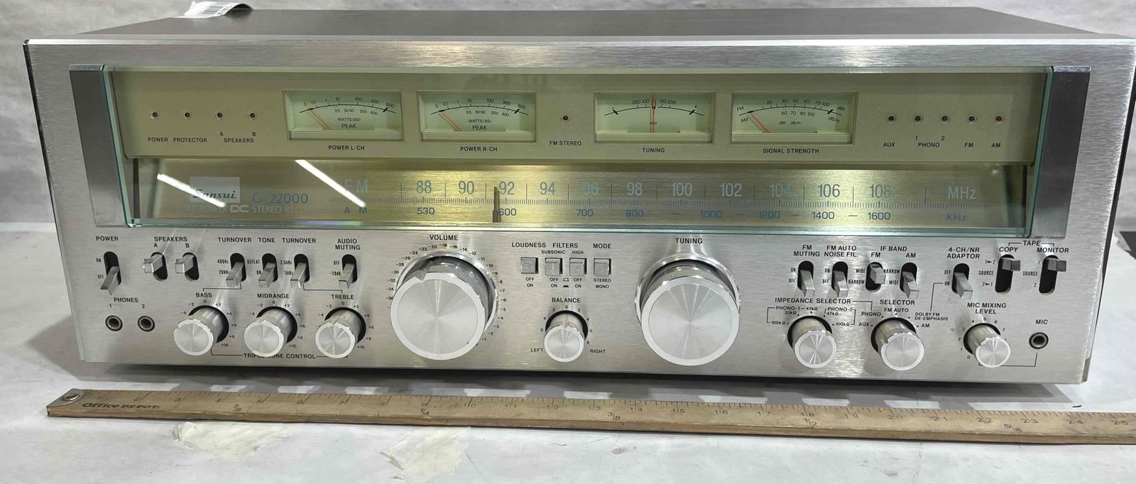
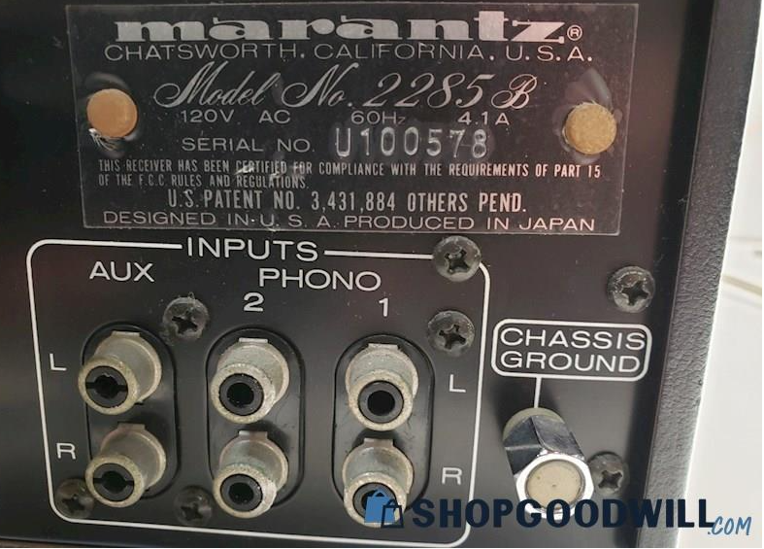
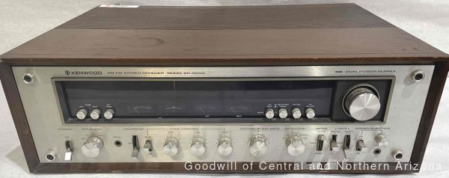
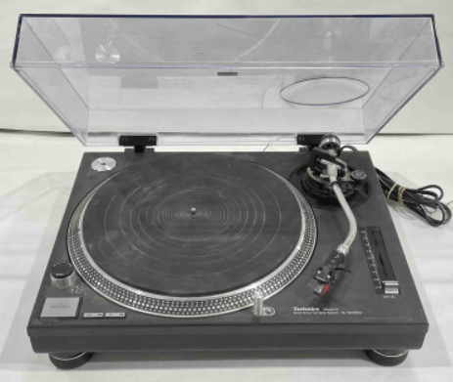
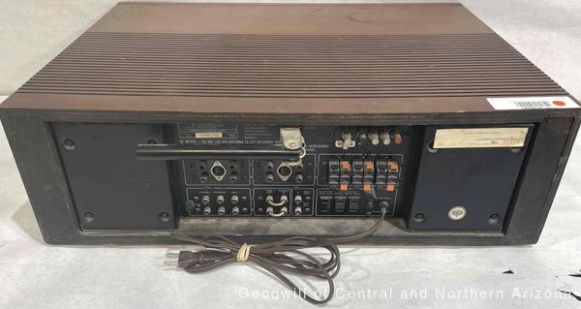
Receivers / Turntables
$3,056
$759.47
Marantz 2285B
Receiver/Amplifier
Vintage Sansui G-22000
$7,201
$659
Technics Quartz
These receivers did not have any
Of the newer inputs, but sold for
Price shown.
Vintage Kenwood KR-9600
Notes:
(Introduce shopgoodwill website: collection of Goodwills selling online. Review what categories of merchandise we sell through e-Comm.)

Slide 36
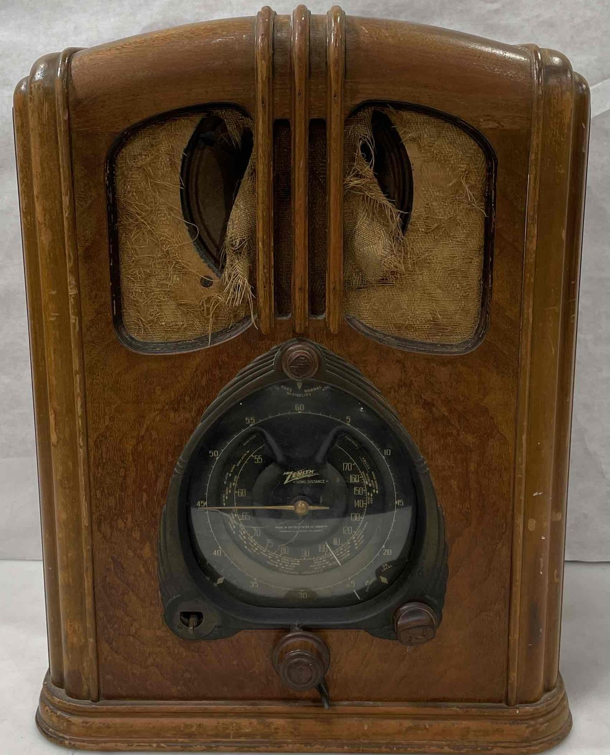
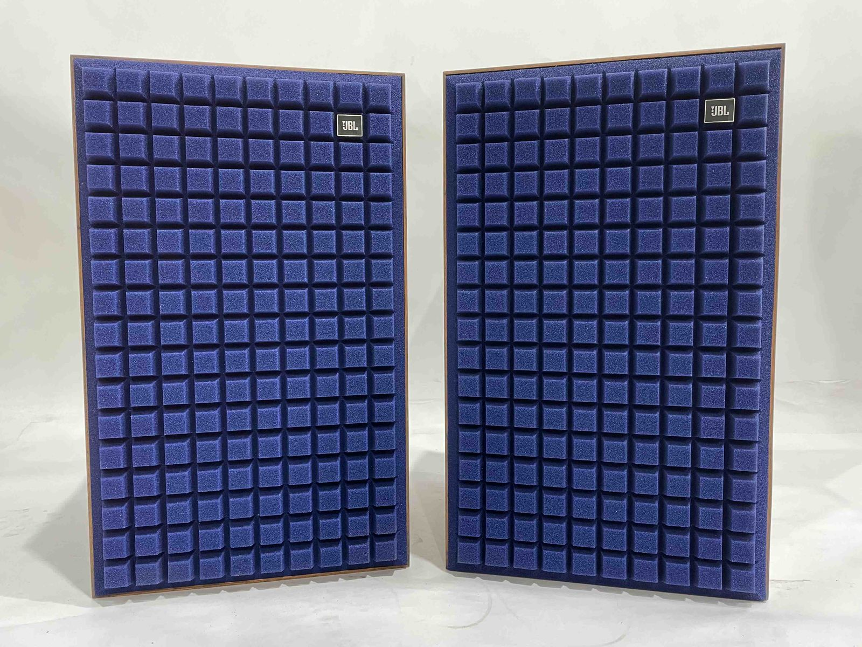
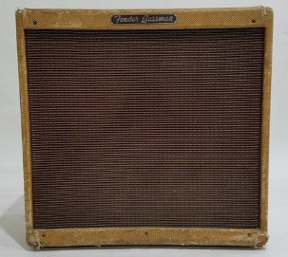
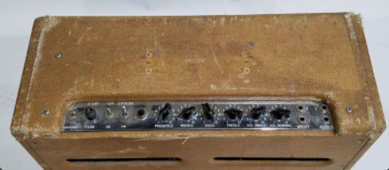
Amplifiers & Other Music
$1,376 – Vintage Zenith Long Distance Radio
$1,977 – Vintage JBL Speakers – Blue Foam
These amps also did not have any of the newer inputs, and some
were sold for parts/repair, but sold for Price shown.
$5,501 – Fender Baseman Amp
Notes:
(Introduce shopgoodwill website: collection of Goodwills selling online. Review what categories of merchandise we sell through e-Comm.)

Slide 37
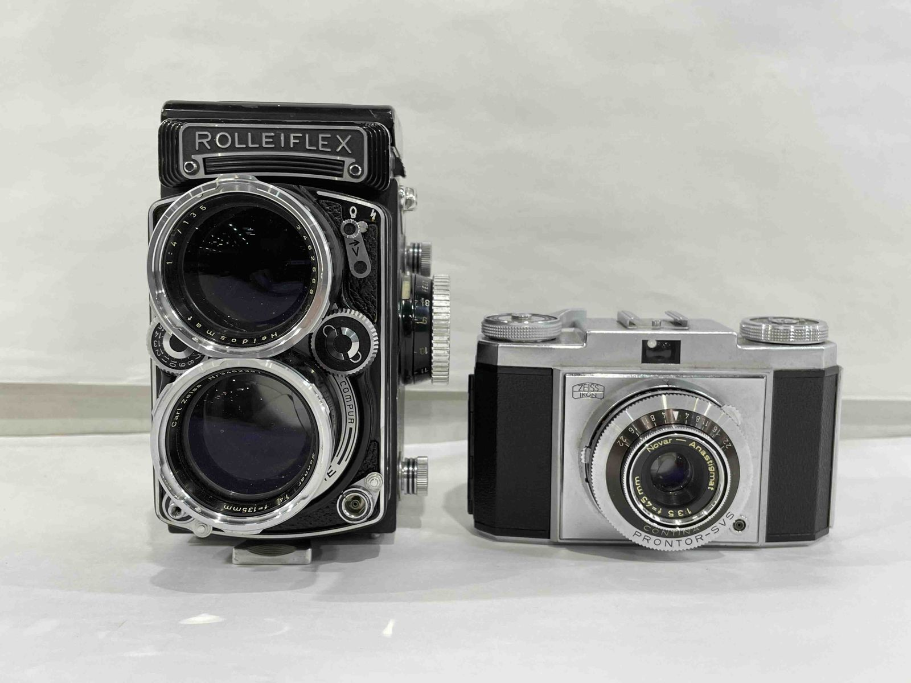
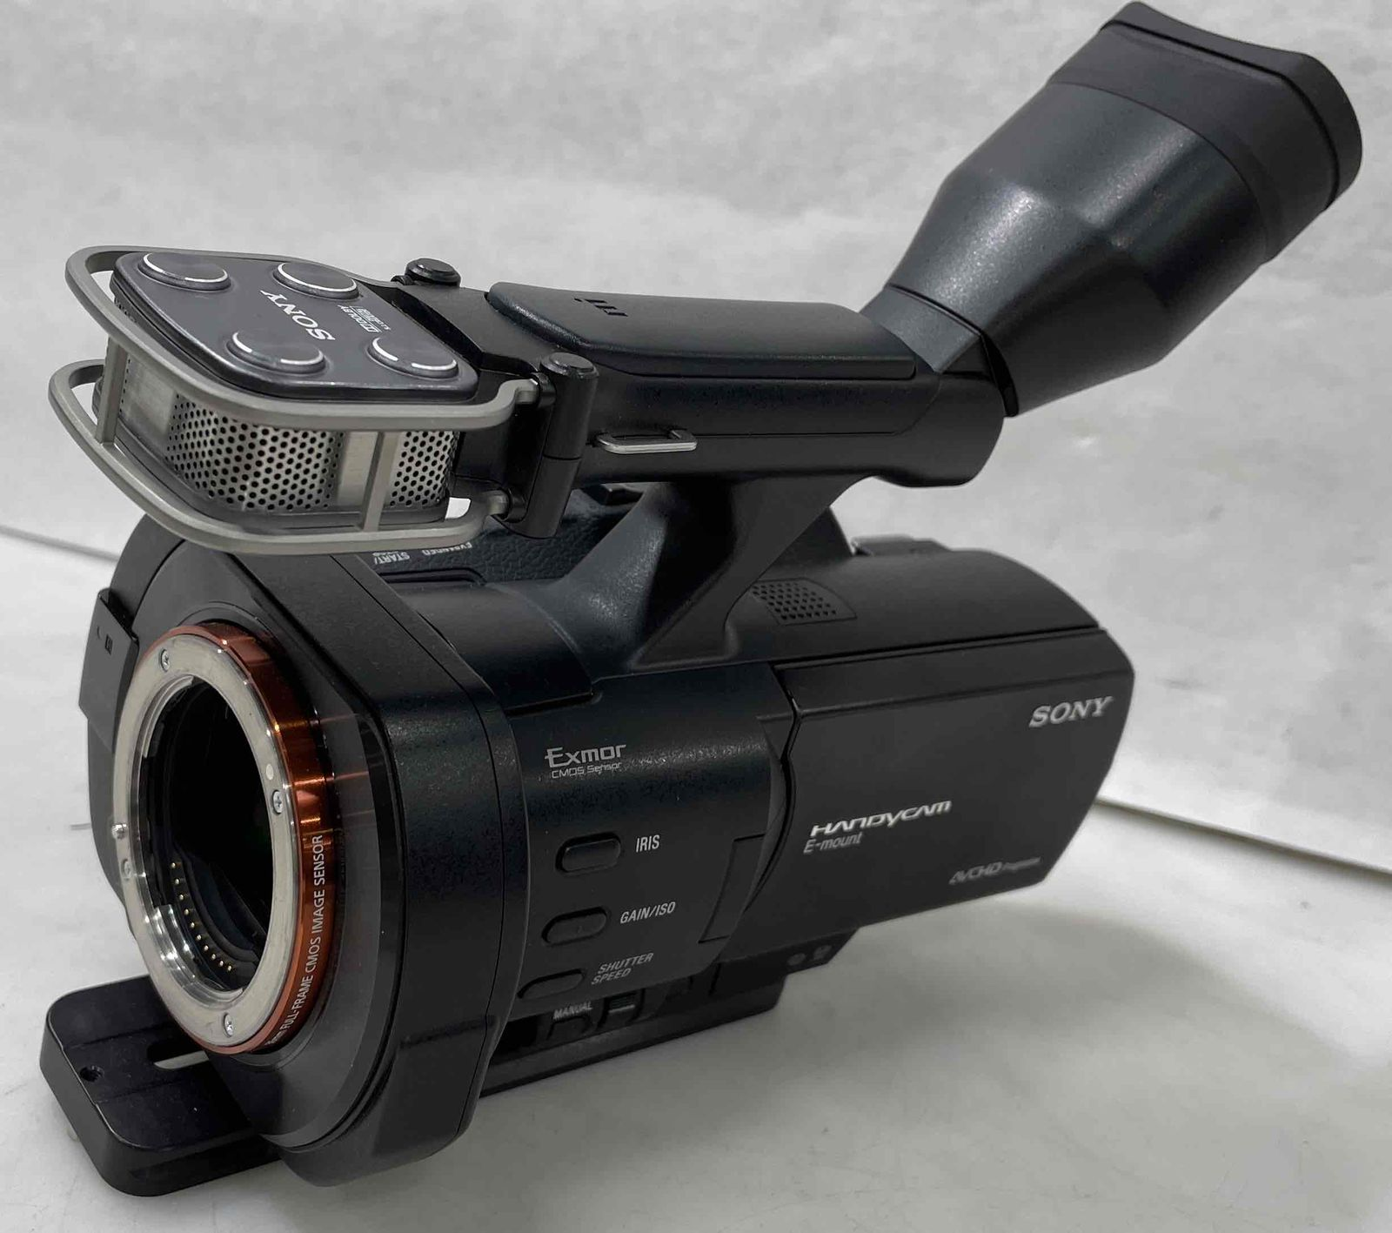
Photography & Video Equipment
$1,208.89
$888.00
Notes:
Need a description of what these items are: models, date, etc.
**Not sure if cameras made the cut for training so remove if not.

Slide 38
Electronics With User Data
Which Ones Have User Data?
Goodwill of Central & Northern Arizona

Slide 39
Electronics with User Data
Xbox 360, Xbox ONE, Xbox Series X
PlayStation 3, 4, 5
PSP
PS Vita
Nintendo Switch, Wii, Wii U
Nintendo DS, 3DS, Dsi, DS Lite
Computers
Cell Phones
Smart Watches
Some Smart Health Devices (FitBit, etc.)
Newer Smart Home Devices are often locked to a user account and may have personal data stored that would allow a Goodwill buyer to purchase items from the original owner’s account (Netflix, Amazon, etc.). Examples: Smart TVs, Roku Devices, FireSticks, Chromecasts, Apple TV Devices.
Many Sonos/Hue devices are locked to user accounts that may prevent a buyer from using. E-Commerce Tests these devices prior to sale.
***Many Sonos speakers are in ‘Recycle Mode’ which prevents the speaker from being used indefinitely. No buyer or original owner can reactivate or use.
Notes:
Let’s gamify this: we can put turn it into a table activity where folks can vote user data/no user data.

Slide 40
Activity
The Price is Right!
Goodwill

Slide 41
Other Electronics sold by E-Comm & Prices
***Electronics-related…could be good for a wow factor & is related, good for education? Maybe tie in to PriceCharting if we end up doing that demo.

