Slide 1
Retail
Culture &
C O N N E C T
Design Your Success: Odyssey Adventure
Goodwill

Slide 2
Introductions
Anton Ray
Sr. Director Culture & Engagement
Jason Kimmell
Sr. Director Virtual Services
Goodwill

Slide 3
Objectives
Define an Odyssey
Discuss the importance of your Odyssey Adventure
Design your personalized Odyssey Adventure
Goodwill
Notes:
Objectives

Slide 4
Ice Breaker
Goodwill
Notes:
Alternative Self-
“What do you want to be when you grow up?”

Slide 5
“
“But you, brave and adept from this day on . . . there’s hope that you will reach your goal . . . the journey that stirs you now is not far off.”
Goodwill
Notes:
Quote: What does this mean to you?

Slide 6
What is an Odyssey?
Goodwill
Notes:
Merriam-Webster Dictionary definition: an Odyssey is “a long wandering or voyage usually marked by many changes of fortune.”
Lets talk a little more about Odysseys. Can anyone give me an example of a famous Odyssey?

Slide 7
Famous Movie Odysseys
Finding Nemo
Wizard of Oz
Goodwill
Notes:
Famous Movie Odysseys: Can you tell me other familiar odysseys?

Slide 8
Famous Music Odysseys
Juicy- Notorious B.I.G.
Lose Yourself- Eminem
Goodwill
Notes:
Famous musical Odysseys: Can you name another famous musical odyssey?

Slide 9
Your Odyssey Adventure
Goodwill
Notes:
Title Slide- Introduce the activities they are about to participate in.

Slide 10
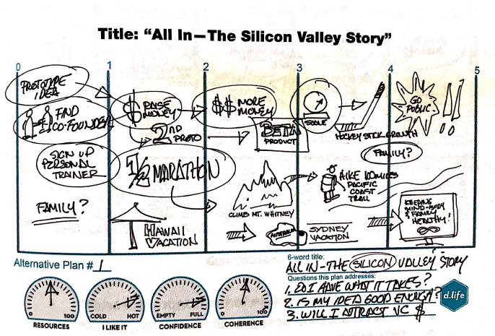
Example of an Odyssey
Notes:
Title Slide- Introduce the activities they are about to participate in.

Slide 11
Odyssey Adventures
Odyssey Adventure 1
Odyssey Adventure 2
Odyssey Adventure 3
That thing you would do if nothing were to change on your current trajectory.
That thing you’d do if thing 1 were suddenly gone.
The thing you’d do if there were no barriers.
Notes:
Odyssey Adventures:
Adventure 1:
Pass out the FIRST Odyssey Adventure worksheet to each person.
Explain that they have 5 minutes to write or draw their 5-year plan to the prompt: “That thing you’d do if nothing were to change on your current trajectory.”
Set a timer and let everyone know when the 5 minutes is up.
*Reassure the participants they do not need to create the perfect plan. The time limit is there to think quickly and to not overthink it. If someone is stalling, nudge them to draw or write the first thing that comes to mind.
Adventure 2:
1. Pass out the SECOND Odyssey Adventure worksheet to each person.
2. Explain that they have 5 minutes to write or draw their 5-year plan to the prompt: “That thing you’d do if Thing One were suddenly gone.”
3. Again, set a timer and let everyone know when the 5 minutes is up.
*Ask questions around differences they made to their adventure based on the updated prompt.
Adventure 3:
1. Pass out the THIRD Odyssey Adventure worksheet to each person.
2. Explain that they have 5 minutes to write or draw their 5-year plan to the prompt: “The thing you’d do if there were no barriers (money, image, geography, etc.).”
3. One last time, set a timer and let everyone know when the 5 minutes is up.
* Tie the 3 prompts to the changes they have made in their adventures. Prepare to switch slides for the share portion of this activity.

Slide 12
Share Your Odyssey Adventure
Goodwill
Notes:
Share Your Adventure: Ask your participants to partner up with someone they do not typically work with on a daily basis.
Ask participants to share their Odysseys. Instruct participants that each person should get approximately 5 minutes to share before they switch. When each person is done, their partner should provide some feedback/reflections. Here are some prompts to guide the feedback:
● Which Odyssey Adventure did your partner sound most excited about? Why might that be?
● When did your partner seem nervous, anxious, or intimidated? When did his/her voice go flat, lacking enthusiasm? Why might that be?
● Make note of any qualifiers (If I could… then…) or hints of sarcasm as your partner shares. Why did those qualifiers/sarcasm come out in some instances?
● I like… I wonder… I wish... (write the feedback framework on flip chart paper for them to reference during their share experience)

Slide 13
Debrief
Goodwill
Notes:
Explain & Debrief: ( each table group will choose their favorite odyssey per table and the chosen person will win a gift card) (8 tables- 1 winner x 8 workshops= 64 gift cards for 2 sessions)
Have participants sit with all three Odyssey Adventures in front of them. Instruct them to follow these steps:
1. Circle the parts in your Odysseys that you know the least about (i.e. you’ve never done that thing before, you’ve never lived there before, you don’t know if making that thing is possible, etc.).
2. Square the parts in your Odysseys that you’d like to test out or ask someone about to get more information.
In large group discussion format, ask participants to look at their THIRD “wild card” Odyssey Adventure. Have them respond to the following questions:
● While it may not be completely practical to do, what did you learn about yourself in this odyssey?
● Are there real ways to add the best parts about this plan into your present or future lifestyle?
*Take a moment to scan over your three odysseys. Choose one odyssey to focus on; one that really excites or scares you, perhaps the one that involves the most risk. Look for parts of that adventure where you would be taking a big risk, or where you are about to go through a big change or do something you’ve never done before. What motivates you to take that risk or take on that big change? What becomes of it long-term?

Slide 14
Wrap-up
Goodwill
Notes:
I used to think… Now I think… (Offer Kazoo points for participants who volunteer to share)

Slide 15
Q&A
Goodwill
Notes:
Questions Session

