Slide 1
Retail
Culture &
C O N N E C T
Let’s Talk Linens
Goodwill

Slide 2
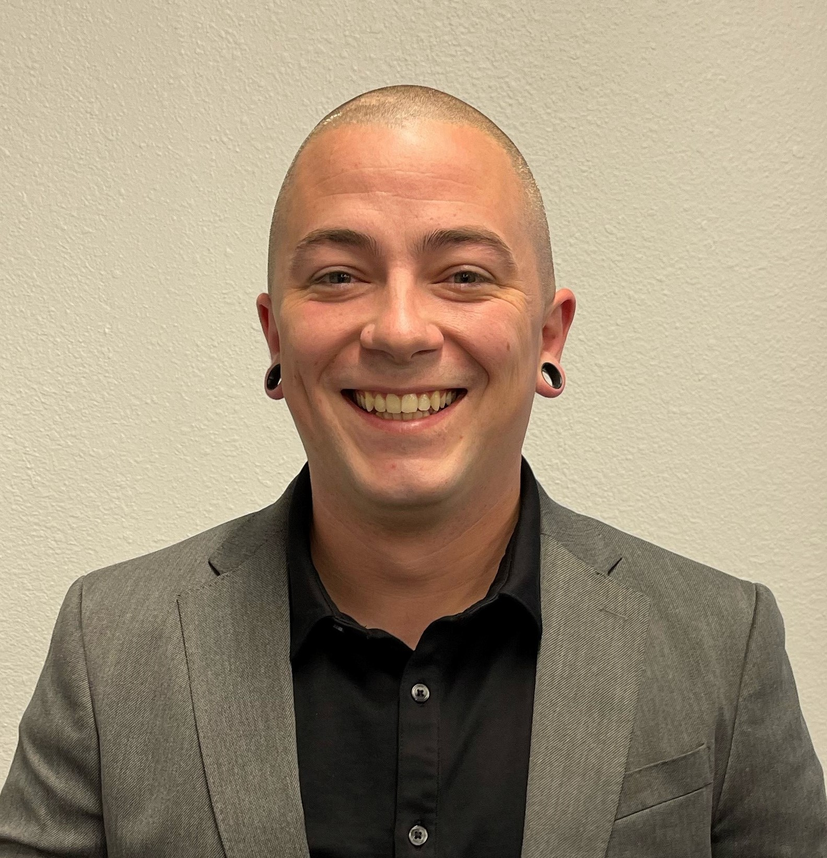
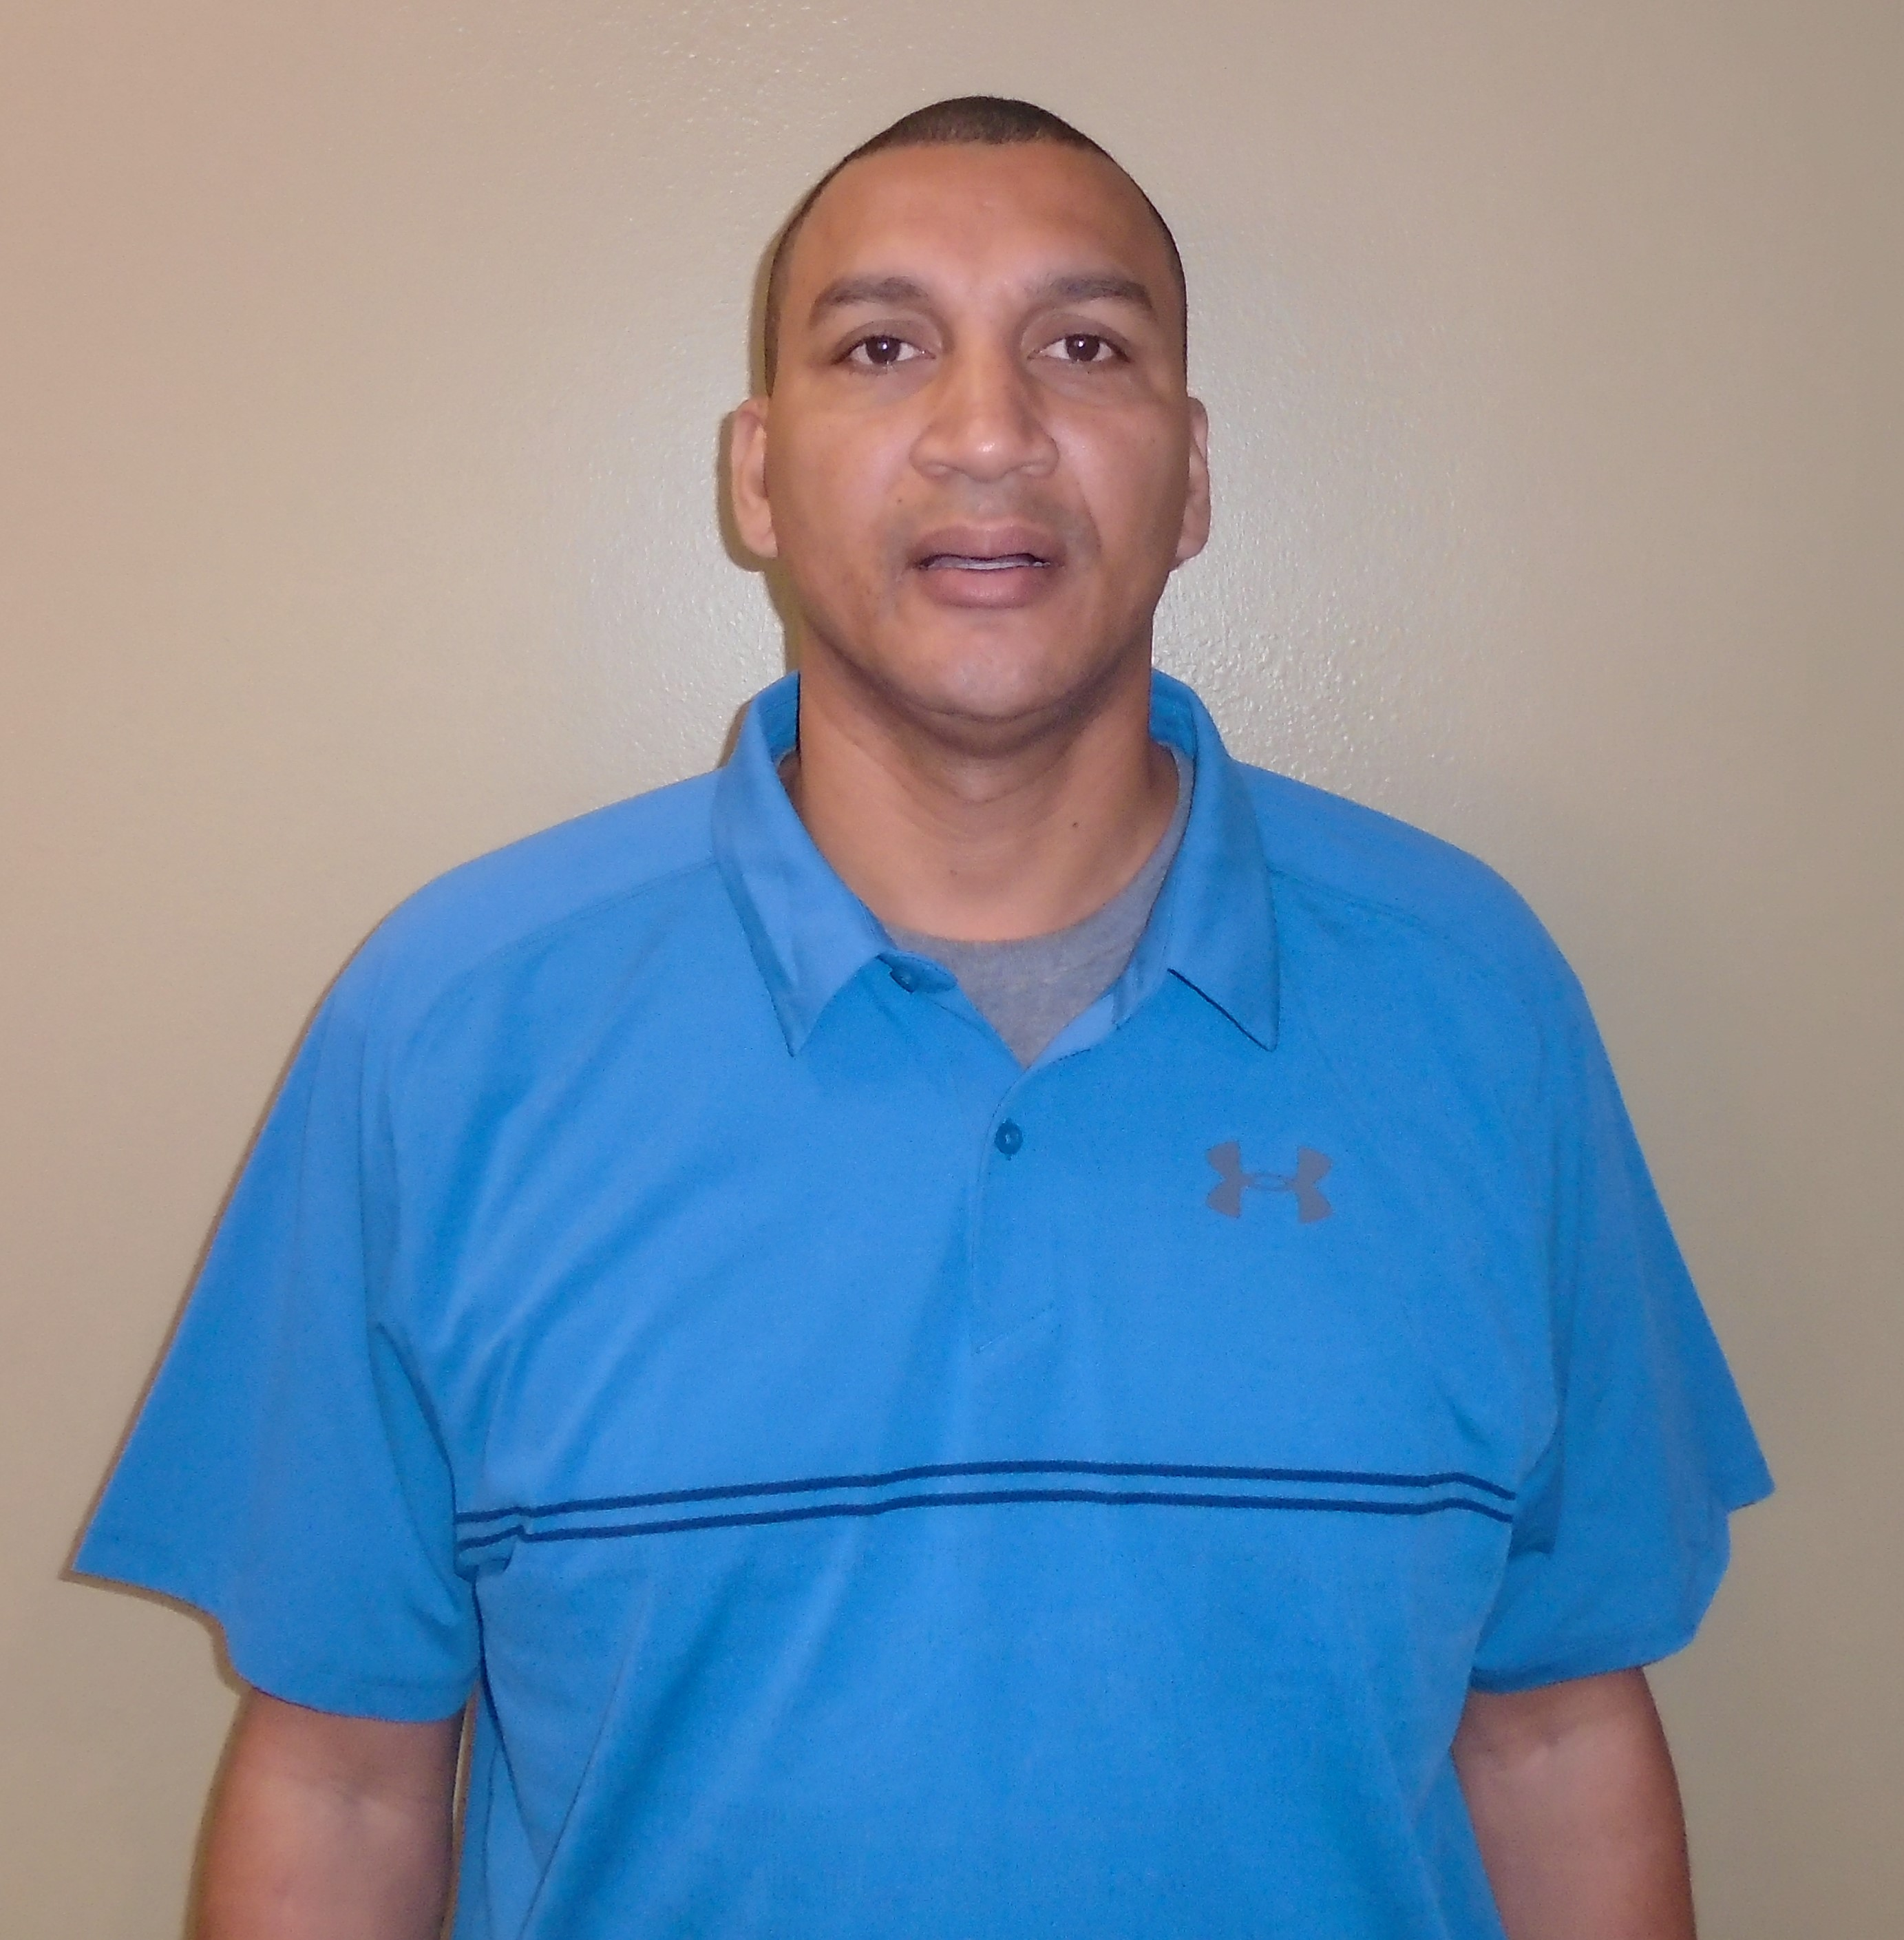
Facilitators
Patrick Mancuso,
District Manager
Rey Zelaya,
District Manager
Goodwill
Notes:
Natalie will be main presenter
Justin to co present.

Slide 3
Objectives
Discuss ways to capture value in your linens department
Identify quality factors of linen products
Employ linen best practices to maximize department productivity
Goodwill
Notes:
Introduce the objectives and explain the purpose of the workshop

Slide 4
Fitted Sheet Folding
Icebreaker
Goodwill
Notes:
Have participants race to see who can fold a fitted sheet the fastest. Award a prize to the winning team.

Slide 5
Identifying Value
How do we identify the value of linen products, and what factors can we use to help assign a value?
Goodwill
Notes:
Explain how to assign a value to linen products based on the quality factors discussed in Topic 1

Slide 6
Identifying Value
Activity
Goodwill

Slide 7
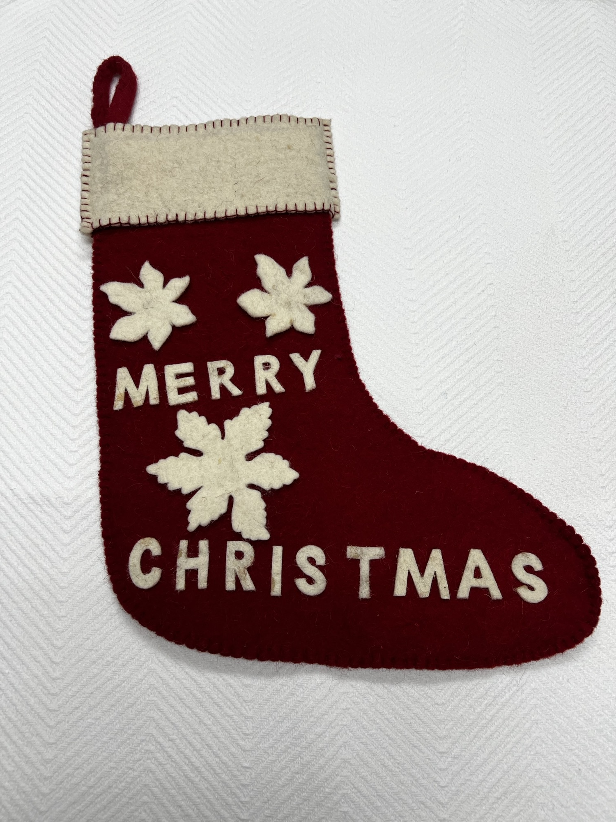
Table 1
Felt stocking made in India (Wool)
Price - $50
Goodwill
Notes:
Discuss the various quality factors
Show examples of high-quality and low-quality linen products.
Ask the participants to identify the differences

Slide 8
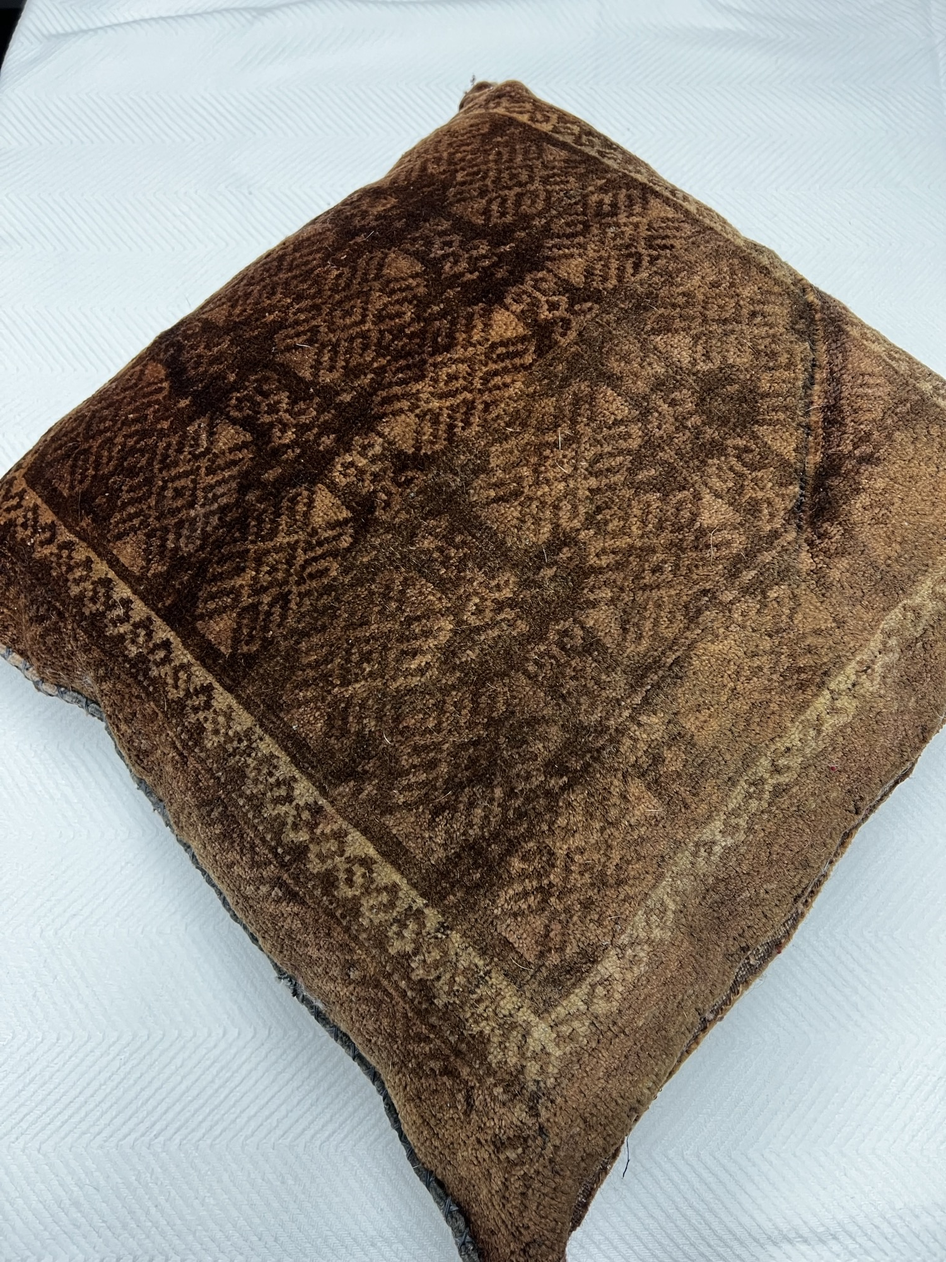
Table 2
Vintage Turkish pillow
Price - $200
Goodwill
Notes:
Discuss the various quality factors
Show examples of high-quality and low-quality linen products.
Ask the participants to identify the differences

Slide 9
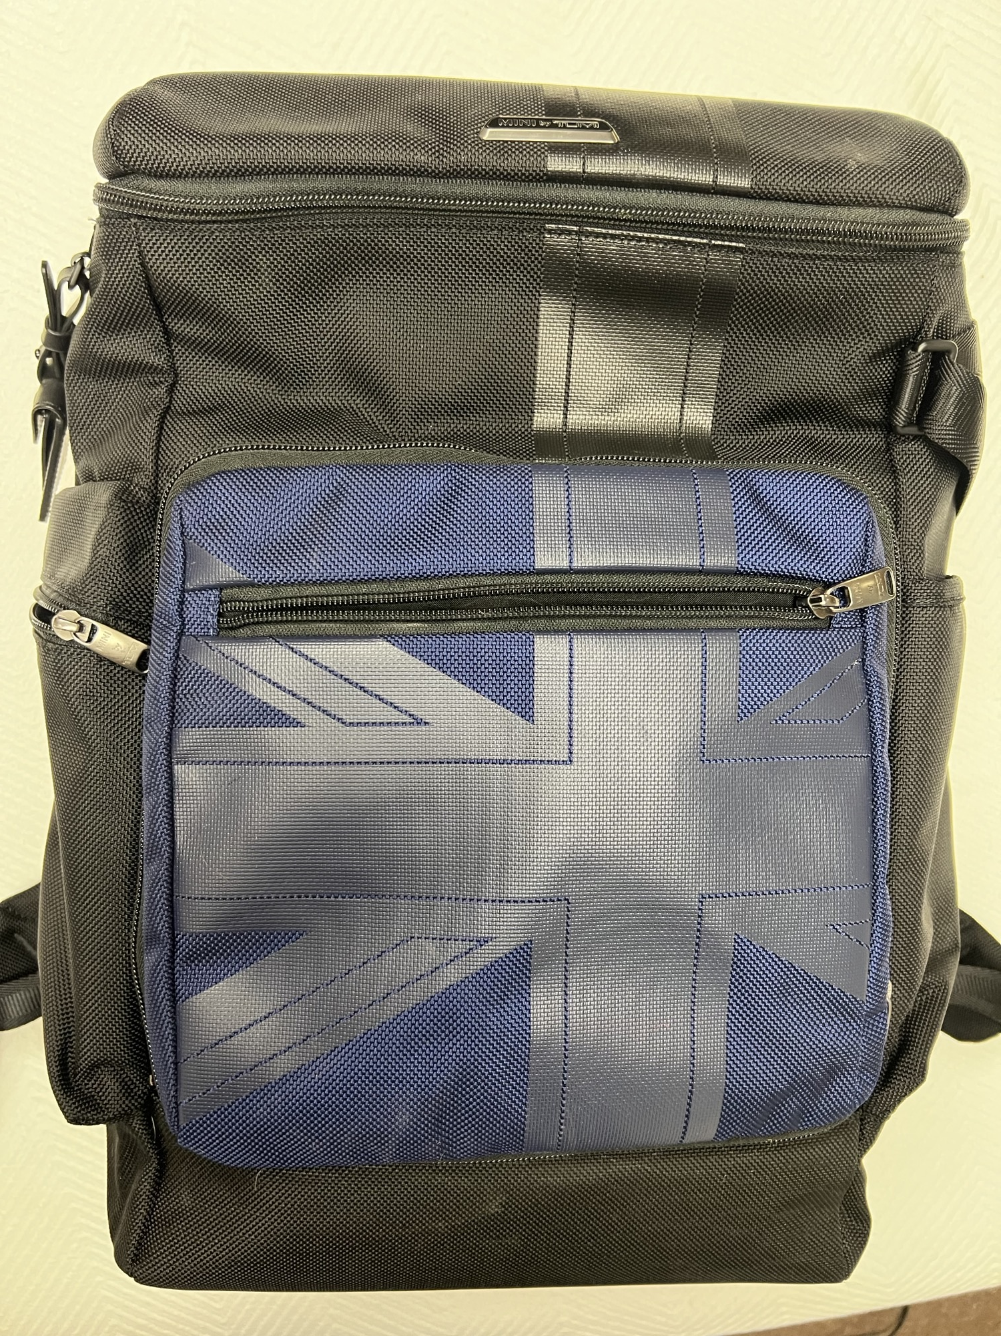
Table 3
Tumi Backpack
Price - $600
Goodwill
Notes:
Discuss the various quality factors
Show examples of high-quality and low-quality linen products.
Ask the participants to identify the differences

Slide 10
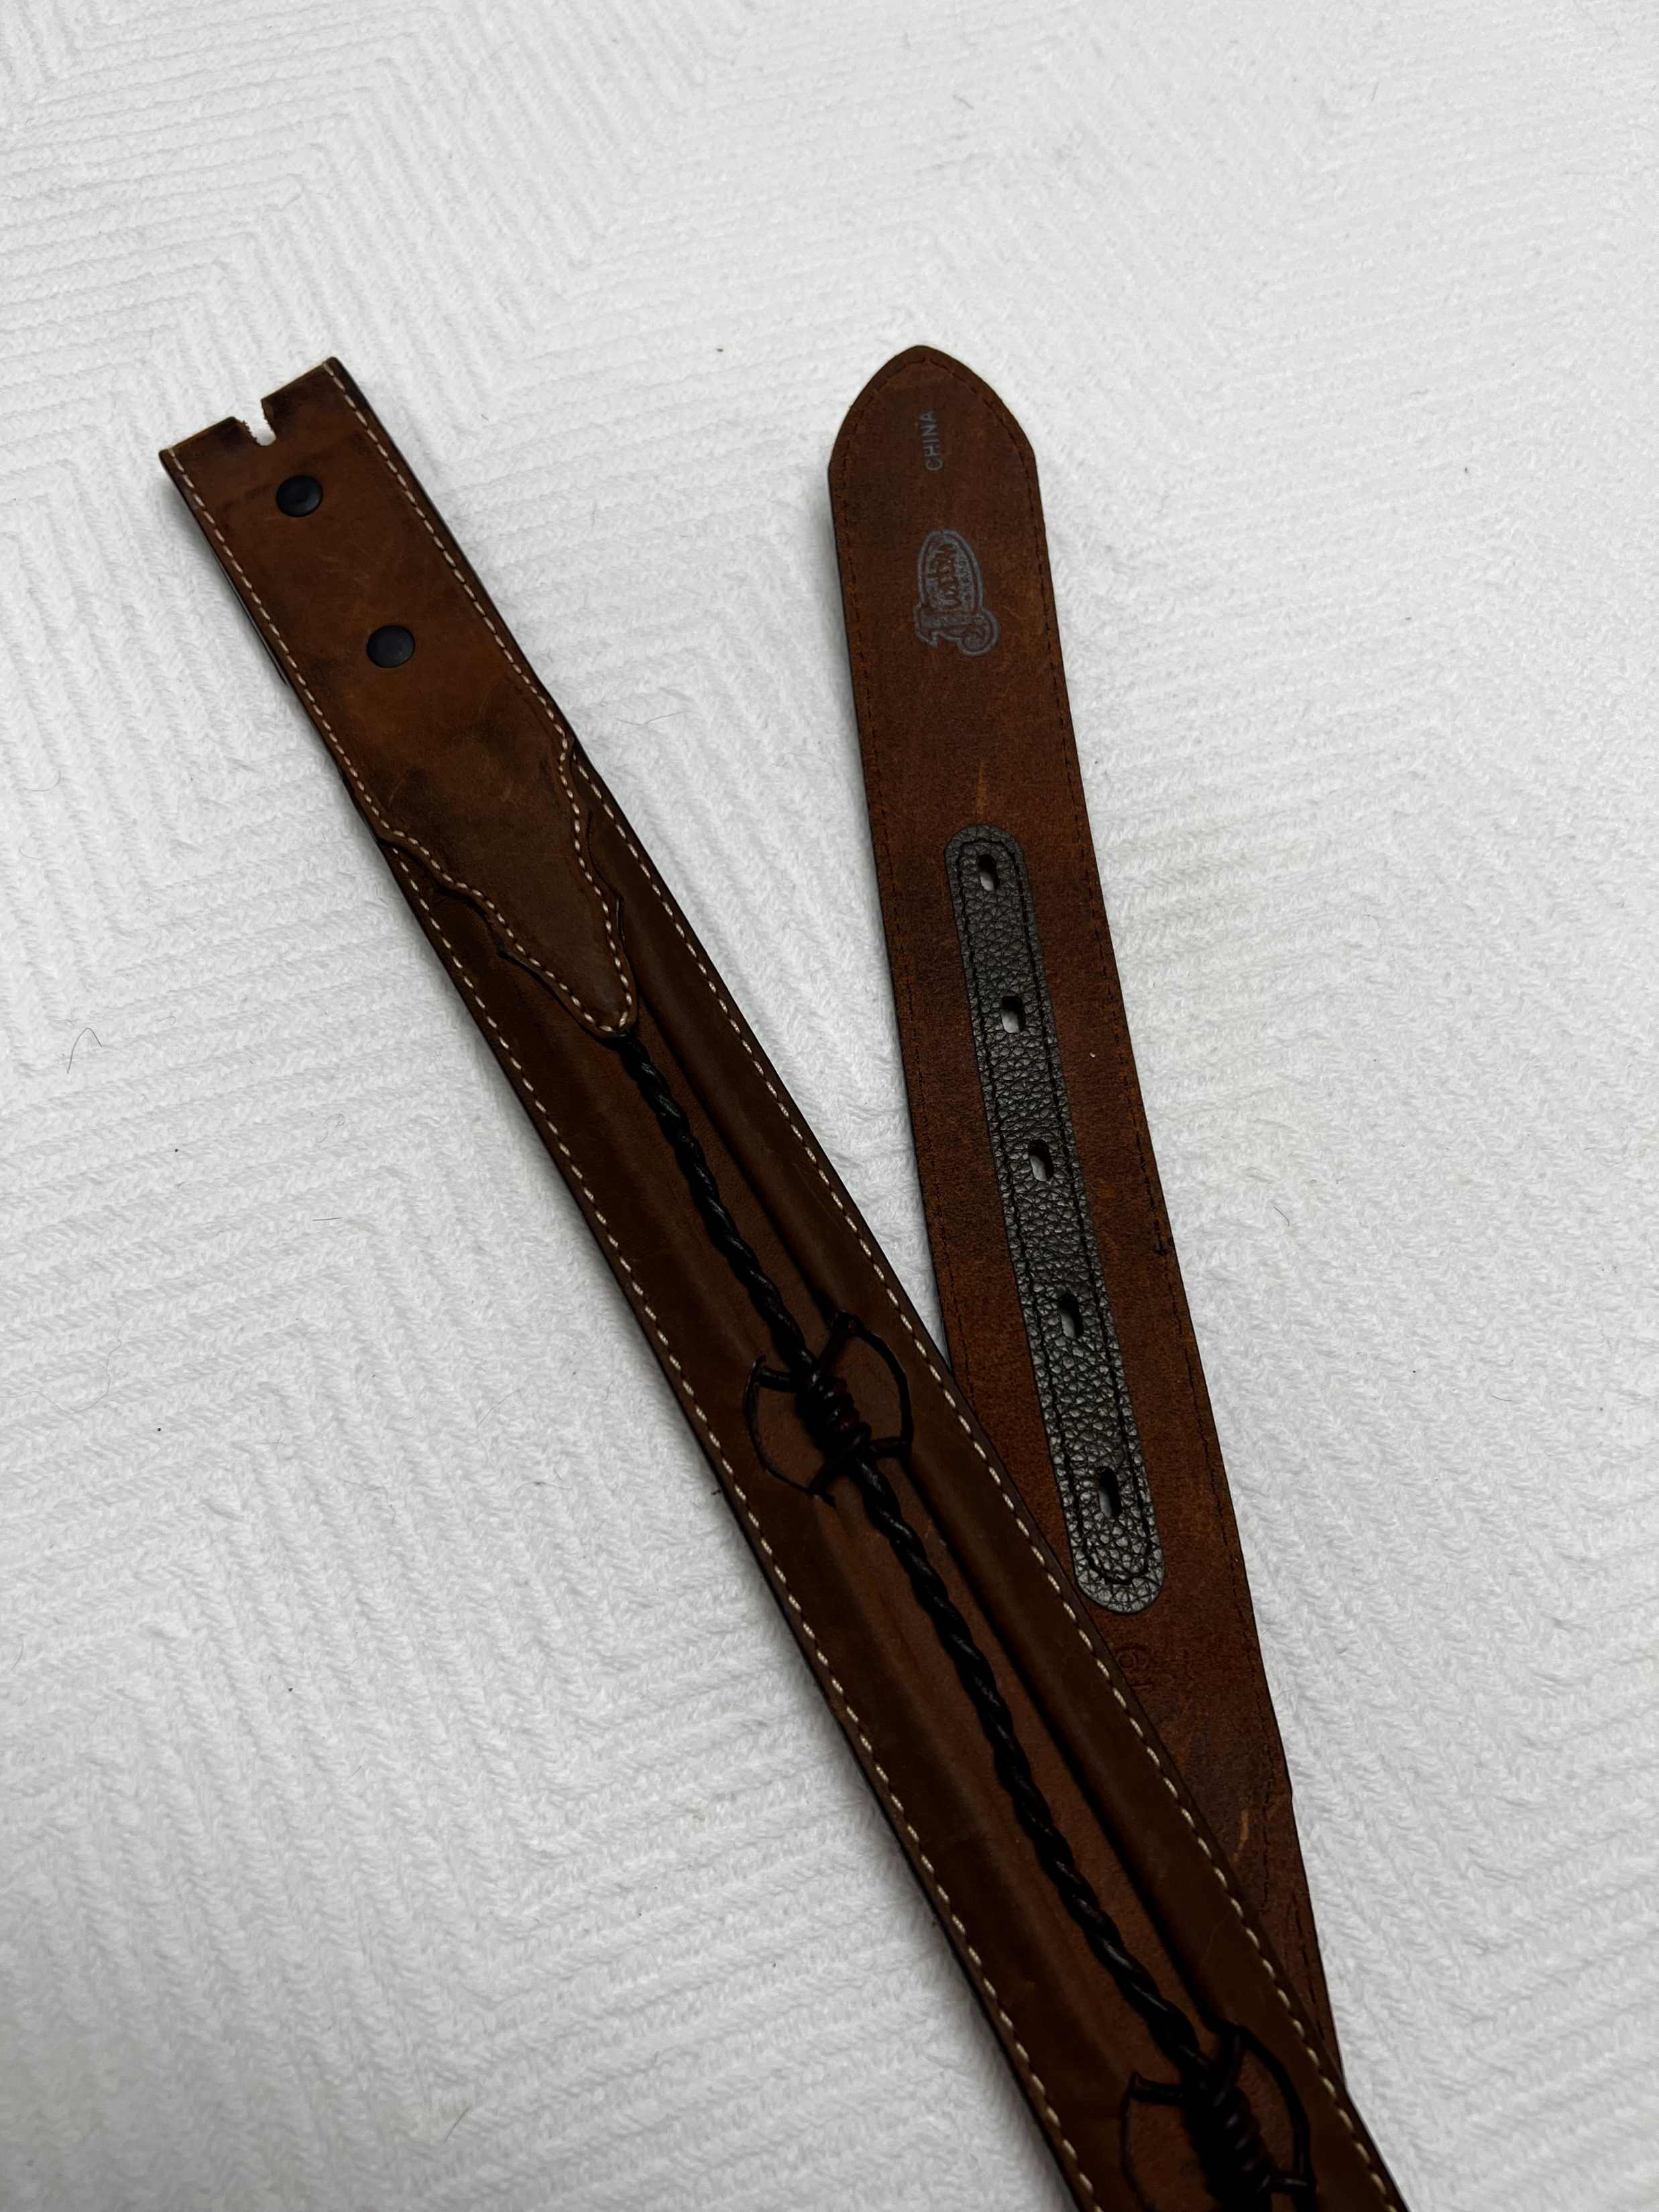
Table 4
Justin belt
Price - $85
Goodwill
Notes:
Discuss the various quality factors
Show examples of high-quality and low-quality linen products.
Ask the participants to identify the differences

Slide 11
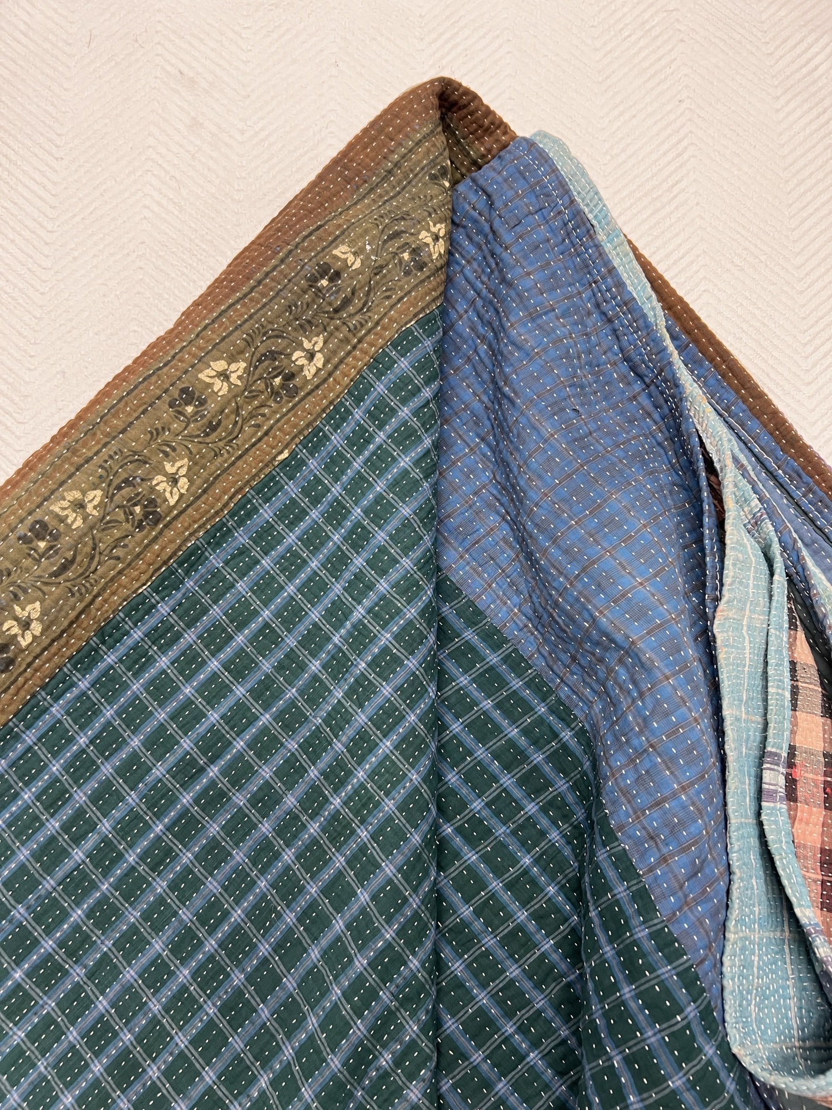
Table 5
Kantha Blanket
Price - $200
Goodwill
Notes:
Discuss the various quality factors
Show examples of high-quality and low-quality linen products.
Ask the participants to identify the differences

Slide 12
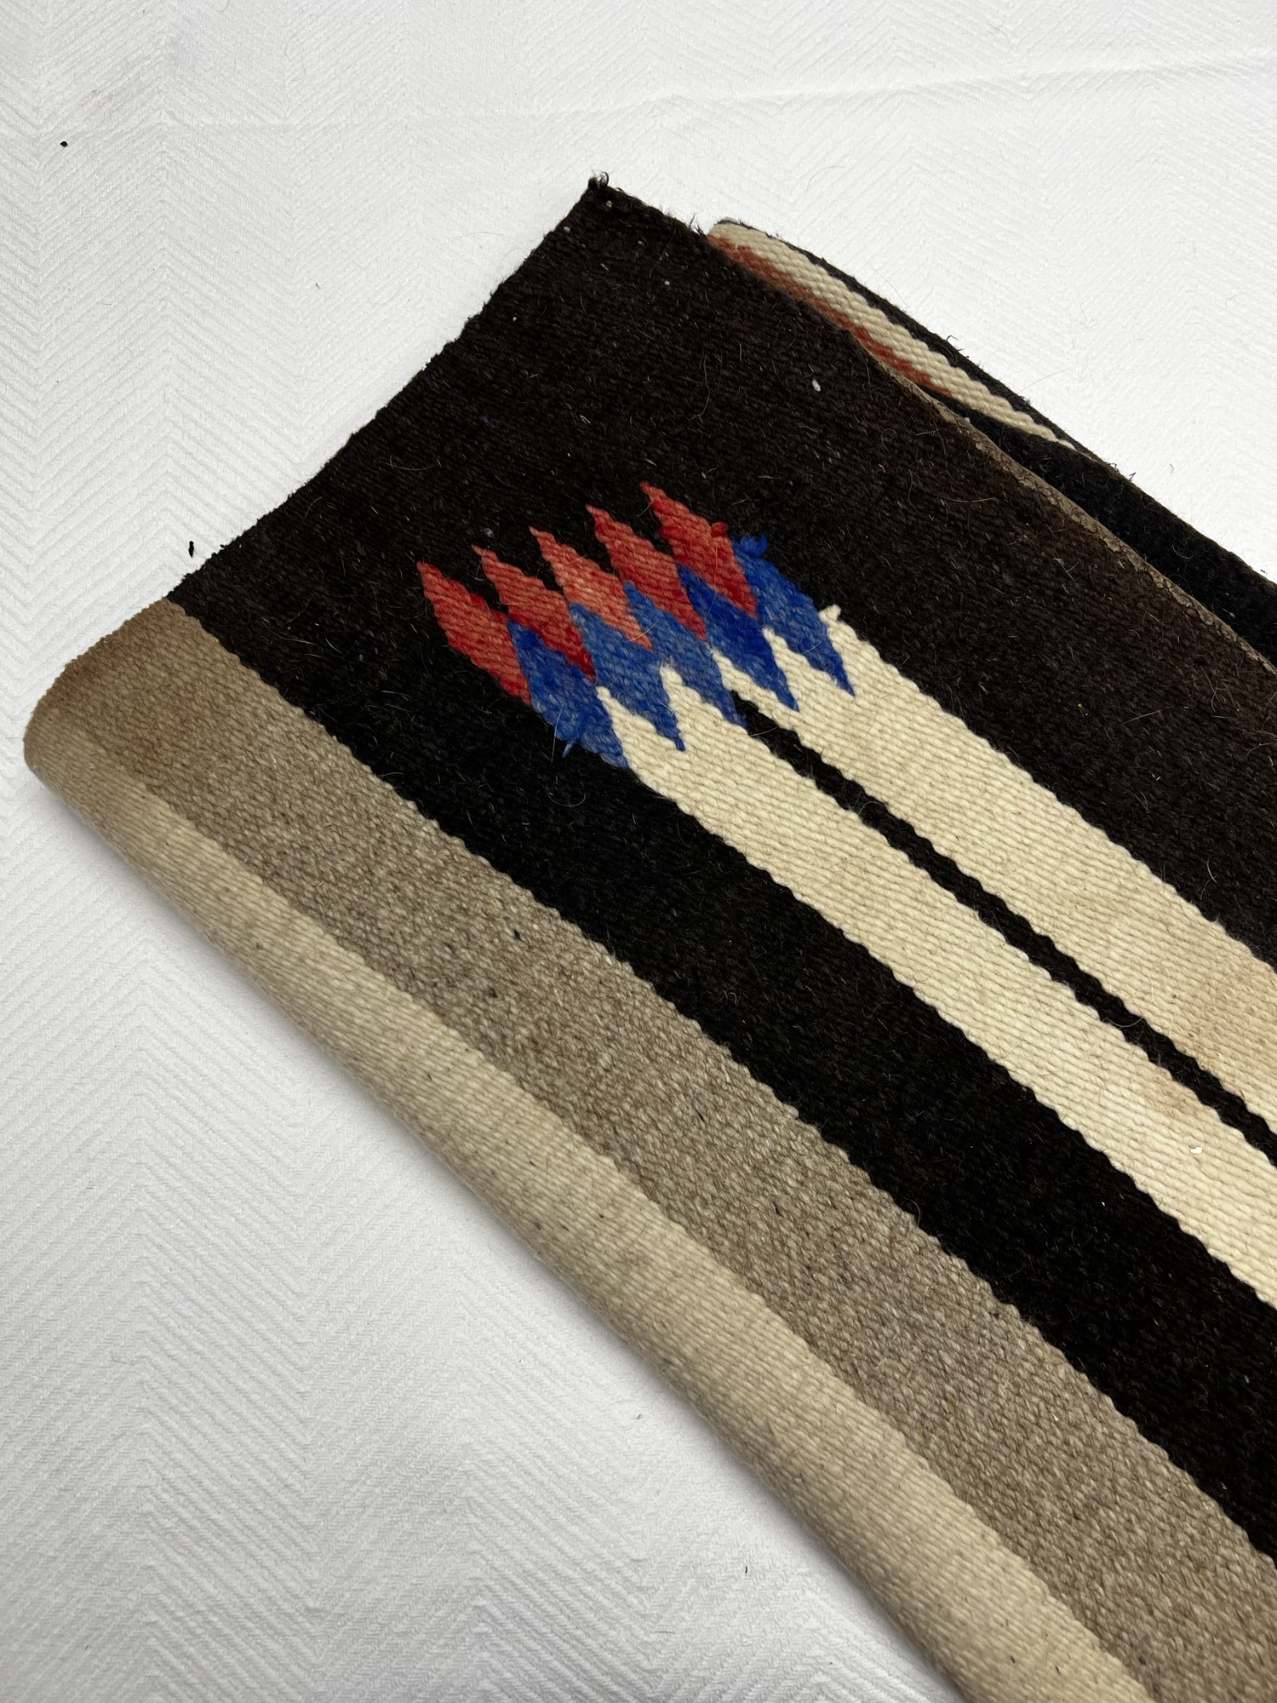
Table 6
Wool horse blanket
Price - $250
Goodwill
Notes:
Discuss the various quality factors
Show examples of high-quality and low-quality linen products.
Ask the participants to identify the differences

Slide 13
Factors of Quality in Linen
Age
Build Quality
Condition
Stitching
Trends /
Brands
Material
Goodwill

Slide 14
Effective Linen Management
Regularly check racks and as-is.
Spend time in the department.
Communicate effectively with your team.
Goodwill

Slide 15
Objectives
Discuss ways to capture value in your linens department
Identify quality factors of linen products
Employ linen best practices to maximize department productivity
Goodwill
Notes:
Introduce the objectives and explain the purpose of the workshop

Slide 16
“
Questions?
”
Goodwill
Notes:
What are some key takeaways from the session?

