Slide 1
Retail
Culture &
C O N N E C T
Grading 2.0
Goodwill
Notes:
Emilio

Slide 2
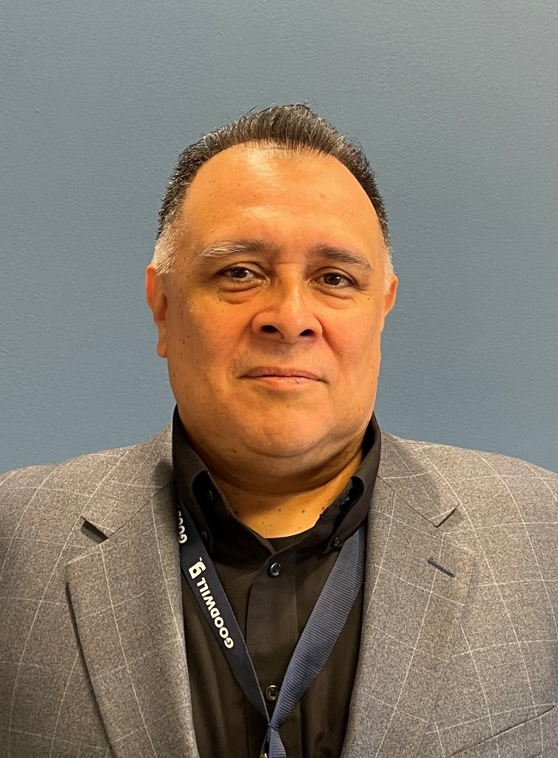
Facilitators
Robert Enger,
District Manager
Al Cardenas,
District Manager
Emilio Perez,
District Manager
Goodwill
Notes:
Emilio

Slide 3
Objectives
Identify grading factors using the fundamental four
Define our “A”
Help you be able to work with your teams to increase grading accuracy and evaluate and iterate on the effectiveness of grading
Goodwill
Notes:
Emilio

Slide 4
Bucket Bouncer
Icebreaker
Goodwill
Notes:
Bob- Ball game

Slide 5
Fundamental Four
Condition
Quality
Stock Level
Style
Goodwill
Notes:
Al- For anyone that has never seen this, this is the fundamental four. We use this a training tool for our cloth grading. We will be going through the four categories today. This can also be found our learning portal.

Slide 6
Condition
CONDITION – The present condition of an item.
Main points are:
Clean and no smell
Worn or damaged
Torn or holes
Able to be fixed
Ask the following questions:
How worn is it? Does it affect the item’s wear?
Is it in need of repair? If so can it be fixed?
Is the fabric in good condition?
It is stained, balled, or does it smell bad?
Holes, rips, or tears
Stains or strong odors
Snags, pilling, and balling
Elastic waistbands (for wear)
Fraying
Missing or broken pieces
Goodwill
Notes:
Al- Ask the learners to list off characteristics of condition and discuss- What are a few things we look for.
Here are the categories for condition:
1 –Like New: Little to no wear/items may still have tags
2 –Normal: Gentle signs of normal wear such as slight pilling or little signs of stretching; fabric color is still bright
3 –Acceptable: Shows obvious signs of wear, but still has life in it; the item can have one or more of the following characteristics: obvious pilling/balling, faded color, and/or stretching in the neck, body, or arms

Slide 7
Stock Level
STOCK LEVEL –on sales floor.
Main points are:
Supply (check if full or low)
Items are of good quality
All price points are represented
In season, trend, or current style
Sales floor meets quality standards
Pulls are current
Ask the following questions:
Is each department well stocked?
Are items selling and are all price points represented?
Are items of good quality?
Seasonality
Pull with purpose
Goodwill
Notes:
Bob
- Pricing according to the season, space allocation according to season
-Understand why its not selling, when auditing pulls ensure that we are looking into the WHY
-Supply and demand- are we
-Redefining our A
-Kohls clothes are a B, but think Kohls cash
Using seasonality to asses stock levels, pushing out extra while in season
Being more selective in kids

Slide 8
Quality
QUALITY – The original value of an item.
Main points are:
Original price
Constructed well
Popular brand
Ask the following questions:
Was it expensive when brand new?
Is it well known, a classic, or high-quality brand?
Is it a classic that stands the test of time?
Is it well made or made of expensive materials?
Does it have a lot of detailing?
Fabrics
Stitching
Finish
Structure
Embellishments
Goodwill
Notes:
Al
Quality Factors
-Fabric
100% cashmere can go as high at $2400, with blend as low as $40 interesting fact- cashmere comes from Mongolia, part of the reason its so expensive is that the goats only produce 200-300 grams per year. I sweater will take 3-4 goats to make.
Polyester- low as 2.99 a yard
Other fabrics
▪Bamboo ▪Canvas ▪Cashmere ▪Corduroy ▪Cotton ▪Denim ▪Leather ▪Linen ▪Nylon ▪Polyester ▪Rayon ▪Spandex ▪Silk ▪Twill ▪Wool
-Stitching
A sign of high quality is more stitches per inch. If you pull the seams and can see through, it is a sign the garment was made quickly and is lower quality.
Check stitching for stray threads –high quality will not have stray threads
For a prize- What fabric is an expectation to the tight stitching?
-Finish
Check seams and hems–seams should be finished and pressed so they lie flat
Check for lining in dresses, pants, and jackets –lining should not be tight and should hang with a bit of give so it does not rip or tear
Hems/Lining: Higher quality have crisp, uniformed hems; budget quality tends to look unfinished and frayed
Pattern Matching: Look where the sleeve meets the body of the garment; higher quality items have a smooth transition from sleeve to the body and no break in pattern; budget garments typically don’t match up
Logo and Brand: Where a brand or logo is placed is a sign of quality; higher quality has logo or brand sewn in and lower quality has logos or brand names silk screened in garment- sewn in vs screen printed on
Zippers: Higher quality are covered; lower quality are exposed or are larger
-Structure
Dart stitching- mainly found in women's clothing- Darts are created by stitching a long, thin pinch to a point, which is then pressed down to one side.
Darts control the shape of the fabric and allows the fabric to conform to your body.
Zippers- Higher Quality are covered; lower quality are exposed or are larger. Zipper should move up and down freely without hesitation.
Buttons- is made of, hard plastic, seashell, metals, and wood? Does it have a logo or name brand?
-Embellishments
Examples include buttons, beads, decorative stitching, lace, etc. A higher quality garment may have more buttons and may be made of wood, shell, or metal. Lower quality garments have fewer buttons and are often made of plastic

Slide 9
Style
STYLE – Checking the current style.
Main points are:
Current style
Fad/trend
Classic/rare
Vintage/retro
Ask the following questions:
Is style current?
Is it something everyone wants?
Is it a classic or standard style?
Is it one of a kind or hard to find?
How often do similar items come through store
Fad/Trends
Operate from a place outside of “your style”
Understanding style by category
Goodwill
Notes:
Emilio
Talk about trends but we do not make style choices for our customer, not taste makers,
understand value of the of the current market, Comp shops
Just because you don’t like it or wear it, doesn’t assign its value
Assign quick value, 12 sec per item
Summer looks are typically dominated by vibrant colors, Tory Burch and Velentino
Right now its oversized everything
Corsets, sheer
Y2K revival , sharp decrease of high rise jean and increase of low rise

Slide 10
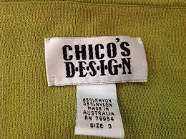
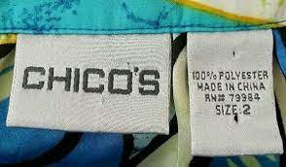
Era of tags
Goodwill
Notes:
Tags can be used as an indicator of when the item came out. Chico for instance, the tag on the left was used by Chicos FAS until the mid 2000s

Slide 11
Men’s Dress Shirts
Dillard's
Psycho Bunny
Pronto Uomo
Nick’s Menswear
Nick Graham
Tiglio
Men’s Wearhouse
Calvin Klein
Egara
Ben Sherman
Joseph Abboud
Calvin Klein
Hugo Boss
Pronto Uomo
Goodwill
Notes:
-Here are places you can shop
Psycho bunny- $89
Pronto Uomo- $70
Ben Sherman- 50-90

Slide 12
T-Shirts/Vintage
TikTok
Goodwill
Notes:
Vintage- single stitch, looks worn, tag is the biggest indicator

Slide 13
“Bro” Brands
Salty Crew
RVCA
Quicksilver
Metal Mulisha
Famous Stars and Stripes
Hurley
Tilly’s
Santa Cruz
Vans
Goodwill
Notes:
Popular among men, found at the mall, Not X but bump to A
Found in Buckle

Slide 14
Trending Jeans
Hudson
Joe
Wrangler
Retro
Madewell
Cody James
Carhartt
Miss Me
KUT
Good American
True Religion
Goodwill
Notes:
Retailer put higher sellers as displays, 501 and 511 vs 505 and 550 in the back
Tiered levi
Hudson and Joe about $100 jeans
Madewell- 150
Boyish 168
Agolde 98
NYDJ- 71-119
Ellaine Fischer
Carhartt 150
Lee Jeans
Levi
European sizing can be an indication of higher quality, like in chicos and torrid. There are a few exceptions such as H&M and Zara

Slide 15
Athletic
Goodwill
Notes:
We all know Lululemon, here are some similar brands that you may not know.
Spanx are not just shapewear or leggings but Athletic wear as well, even jeans

Slide 16
Supermarket Sweep
Activity
Goodwill
Notes:
Emilio
Have a rack of Clothing, make 3 team, Each team will send one person at a time to grab the best quality item they can identify. After 5 garments have been selected we will calculate the value of each teams items. Team with the highest value wins.

Slide 17
Objectives
Identify grading factors using the fundamental four
Define our “A”
Help you be able to work with your teams to increase grading accuracy and evaluate and iterate on the effectiveness of grading
Goodwill
Notes:
Emilio

Slide 18
Questions?
Goodwill

