Slide 1
Retail
Culture &
C O N N E C T
e-Commerce
Goodwill

Slide 2
Introductions
Richelle Erdman-Normand:
Senior Director, ROC Operations
Kristy Shaver:
Senior Manager, e-Commerce
Goodwill

Slide 3
Objectives
Meet e-Comm: Positions, Products, Timeline
Why e-Comm?
Top Sellers – e-Comm Fashion
Glass & Pottery – Product Spotlight
Activity: The Price is Right!
Questions?
Goodwill

Slide 4
Meet e-Comm:
Positions, Products, Timeline
Goodwill
Goodwill of Central & Northern Arizona

Slide 5
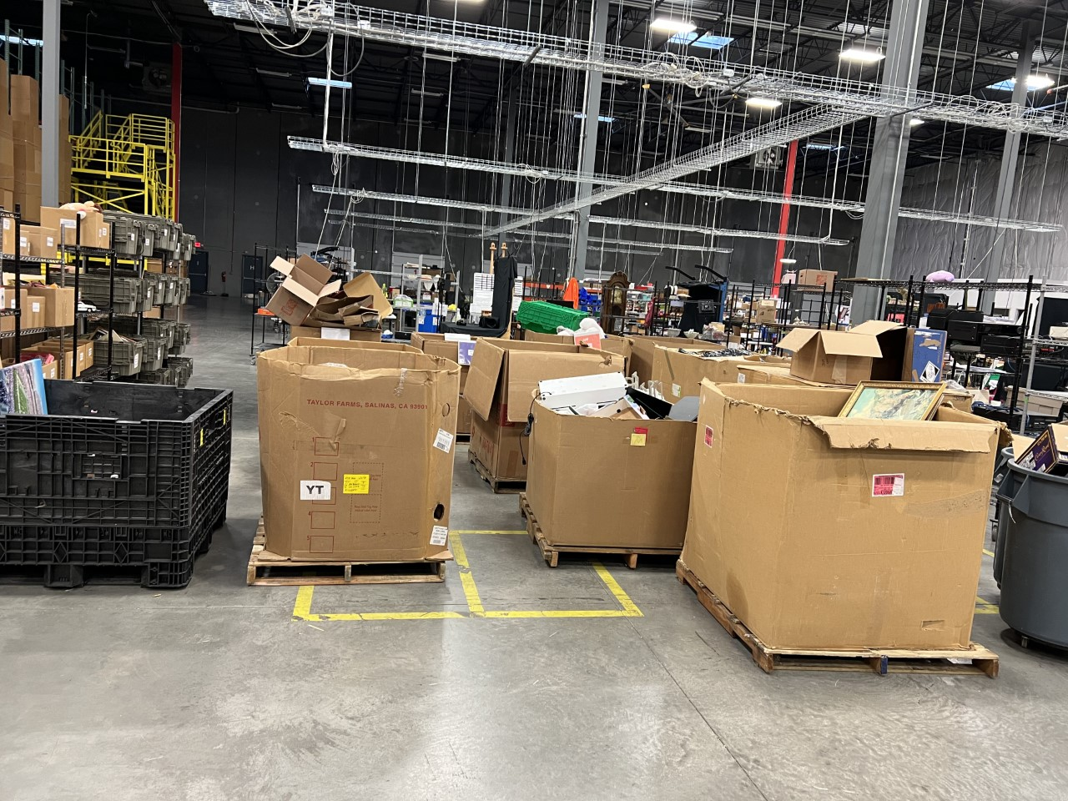
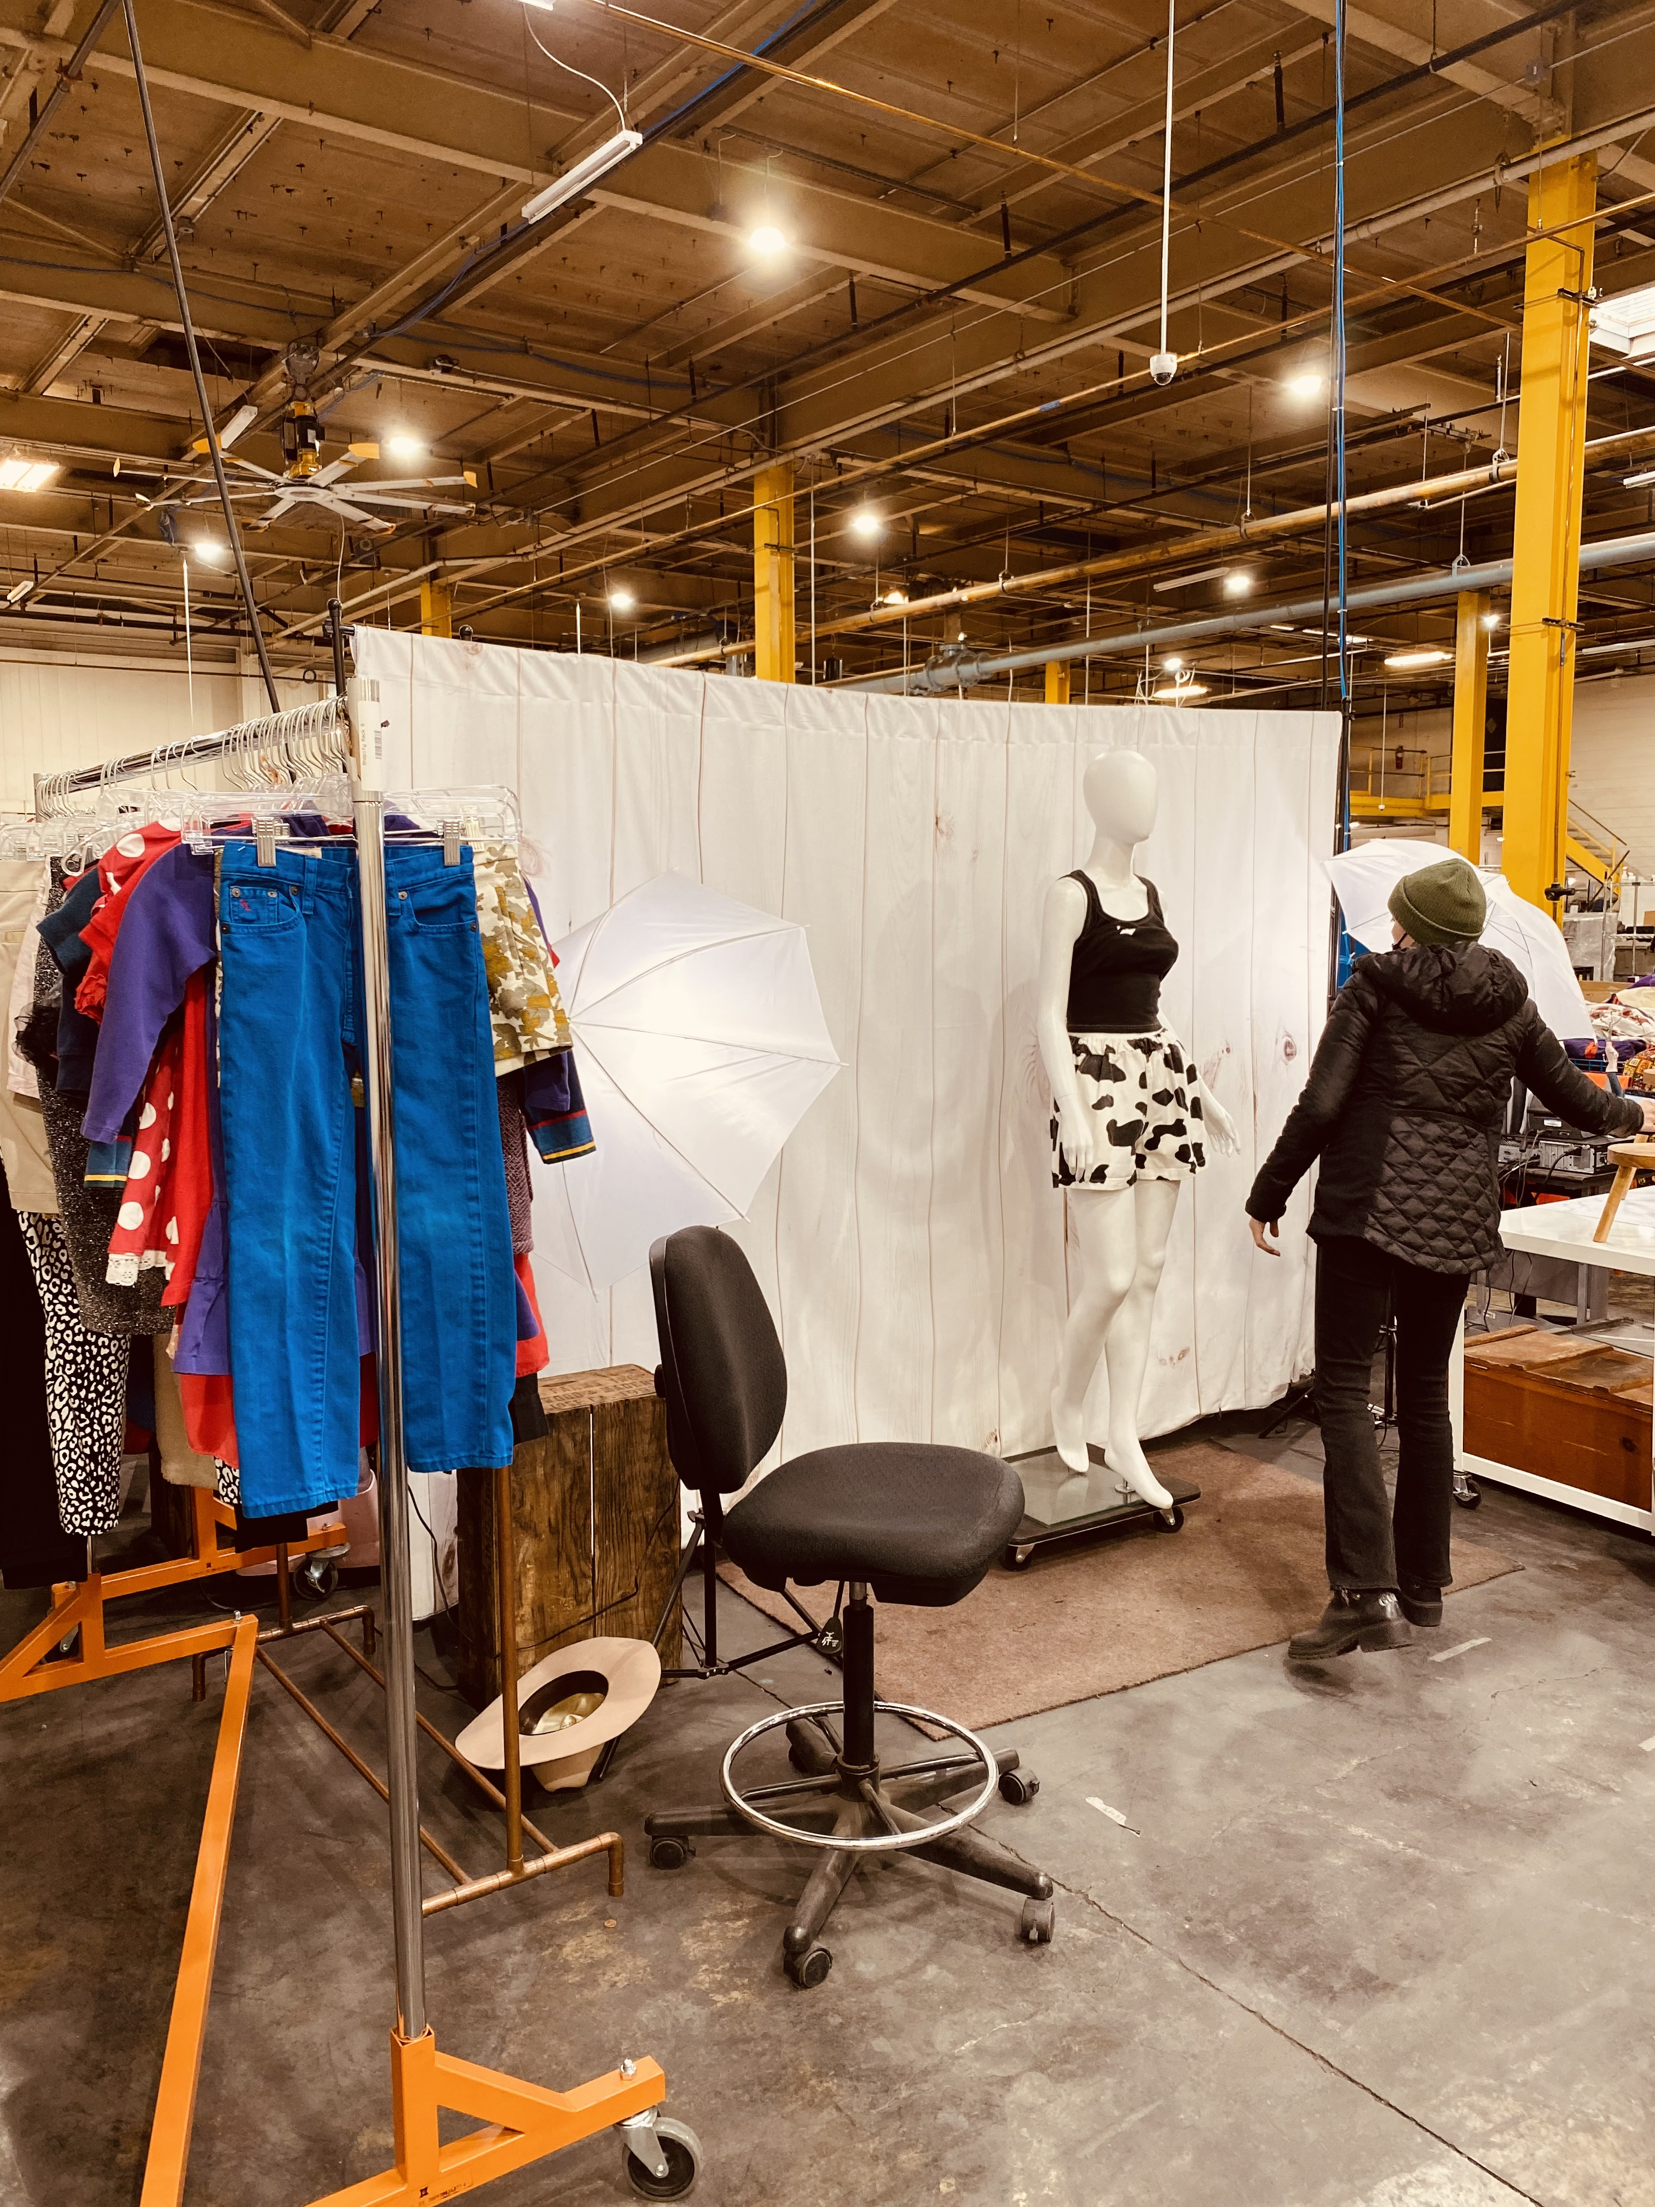
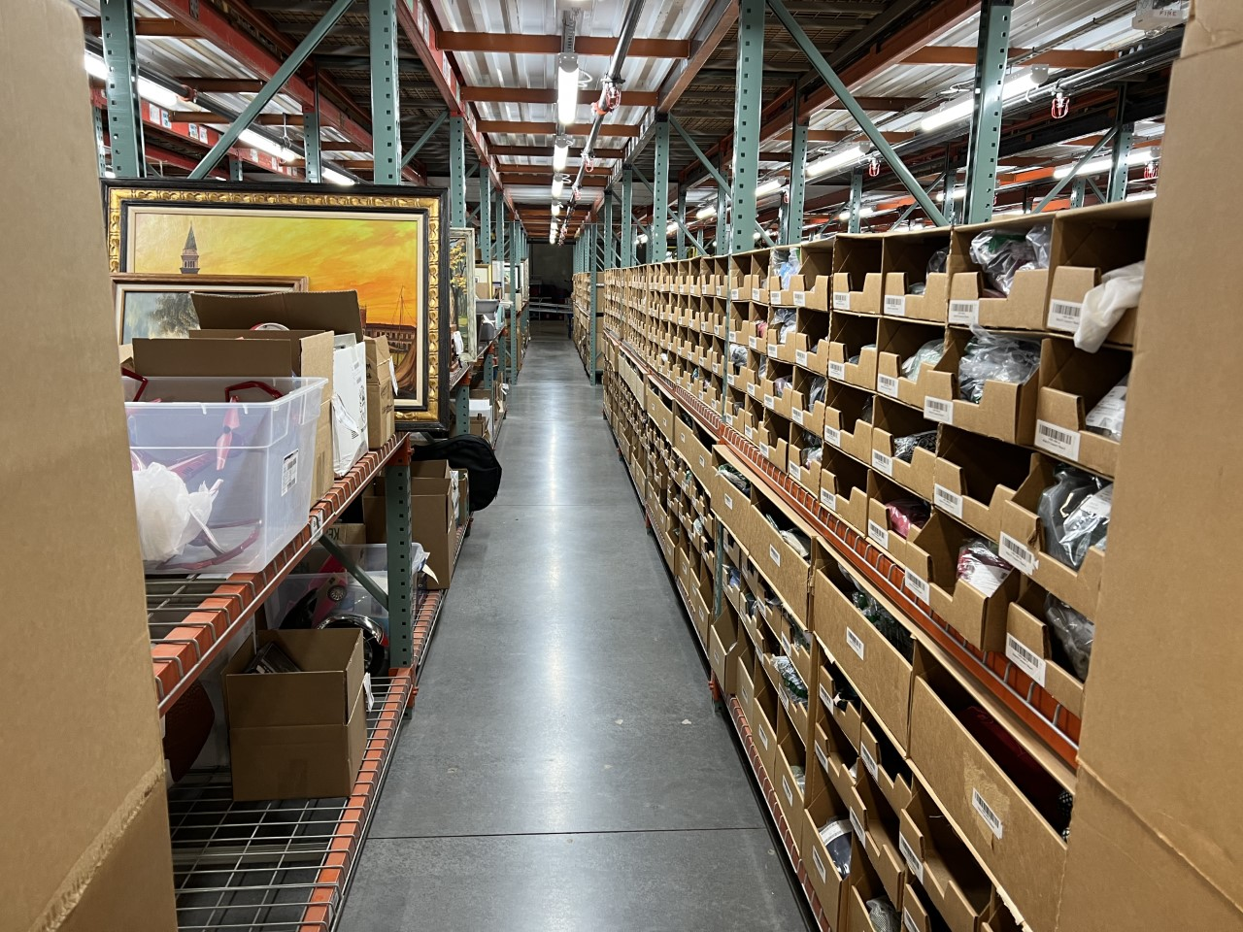
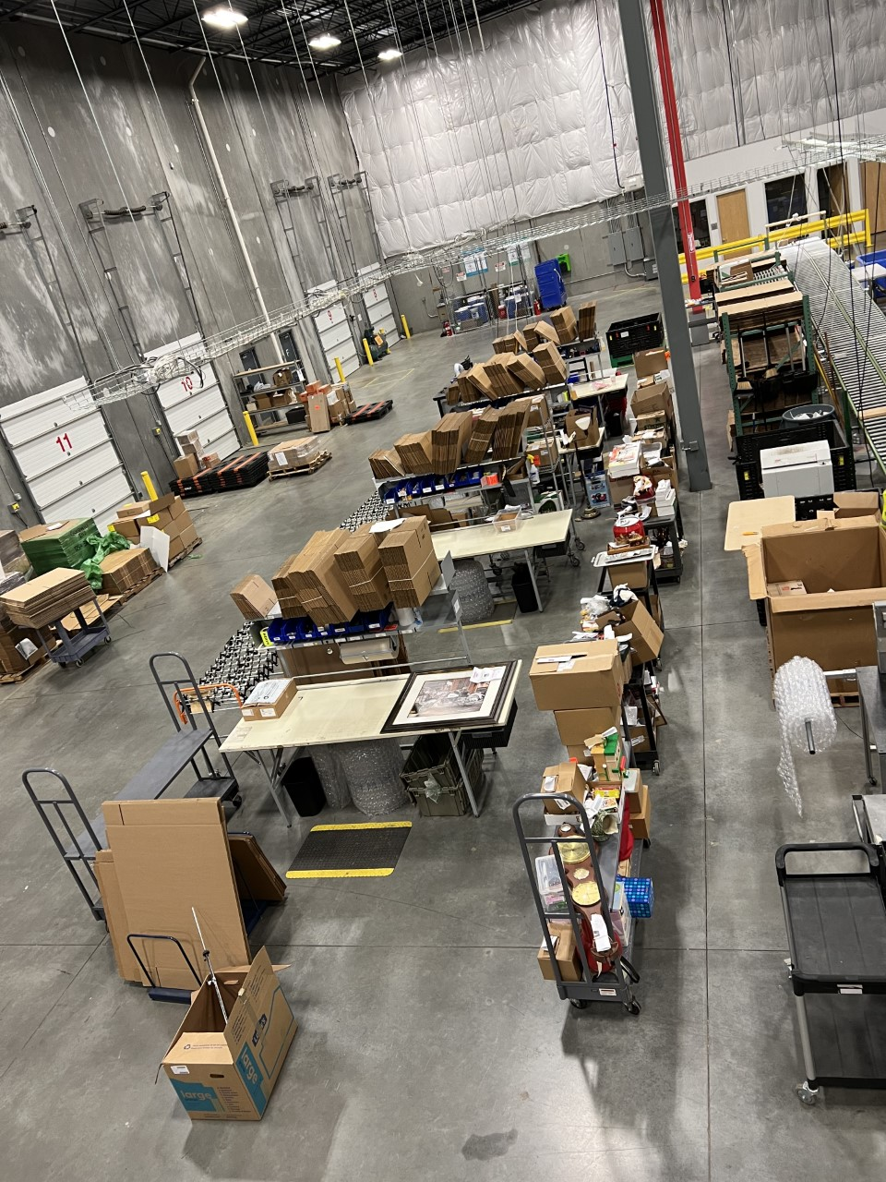
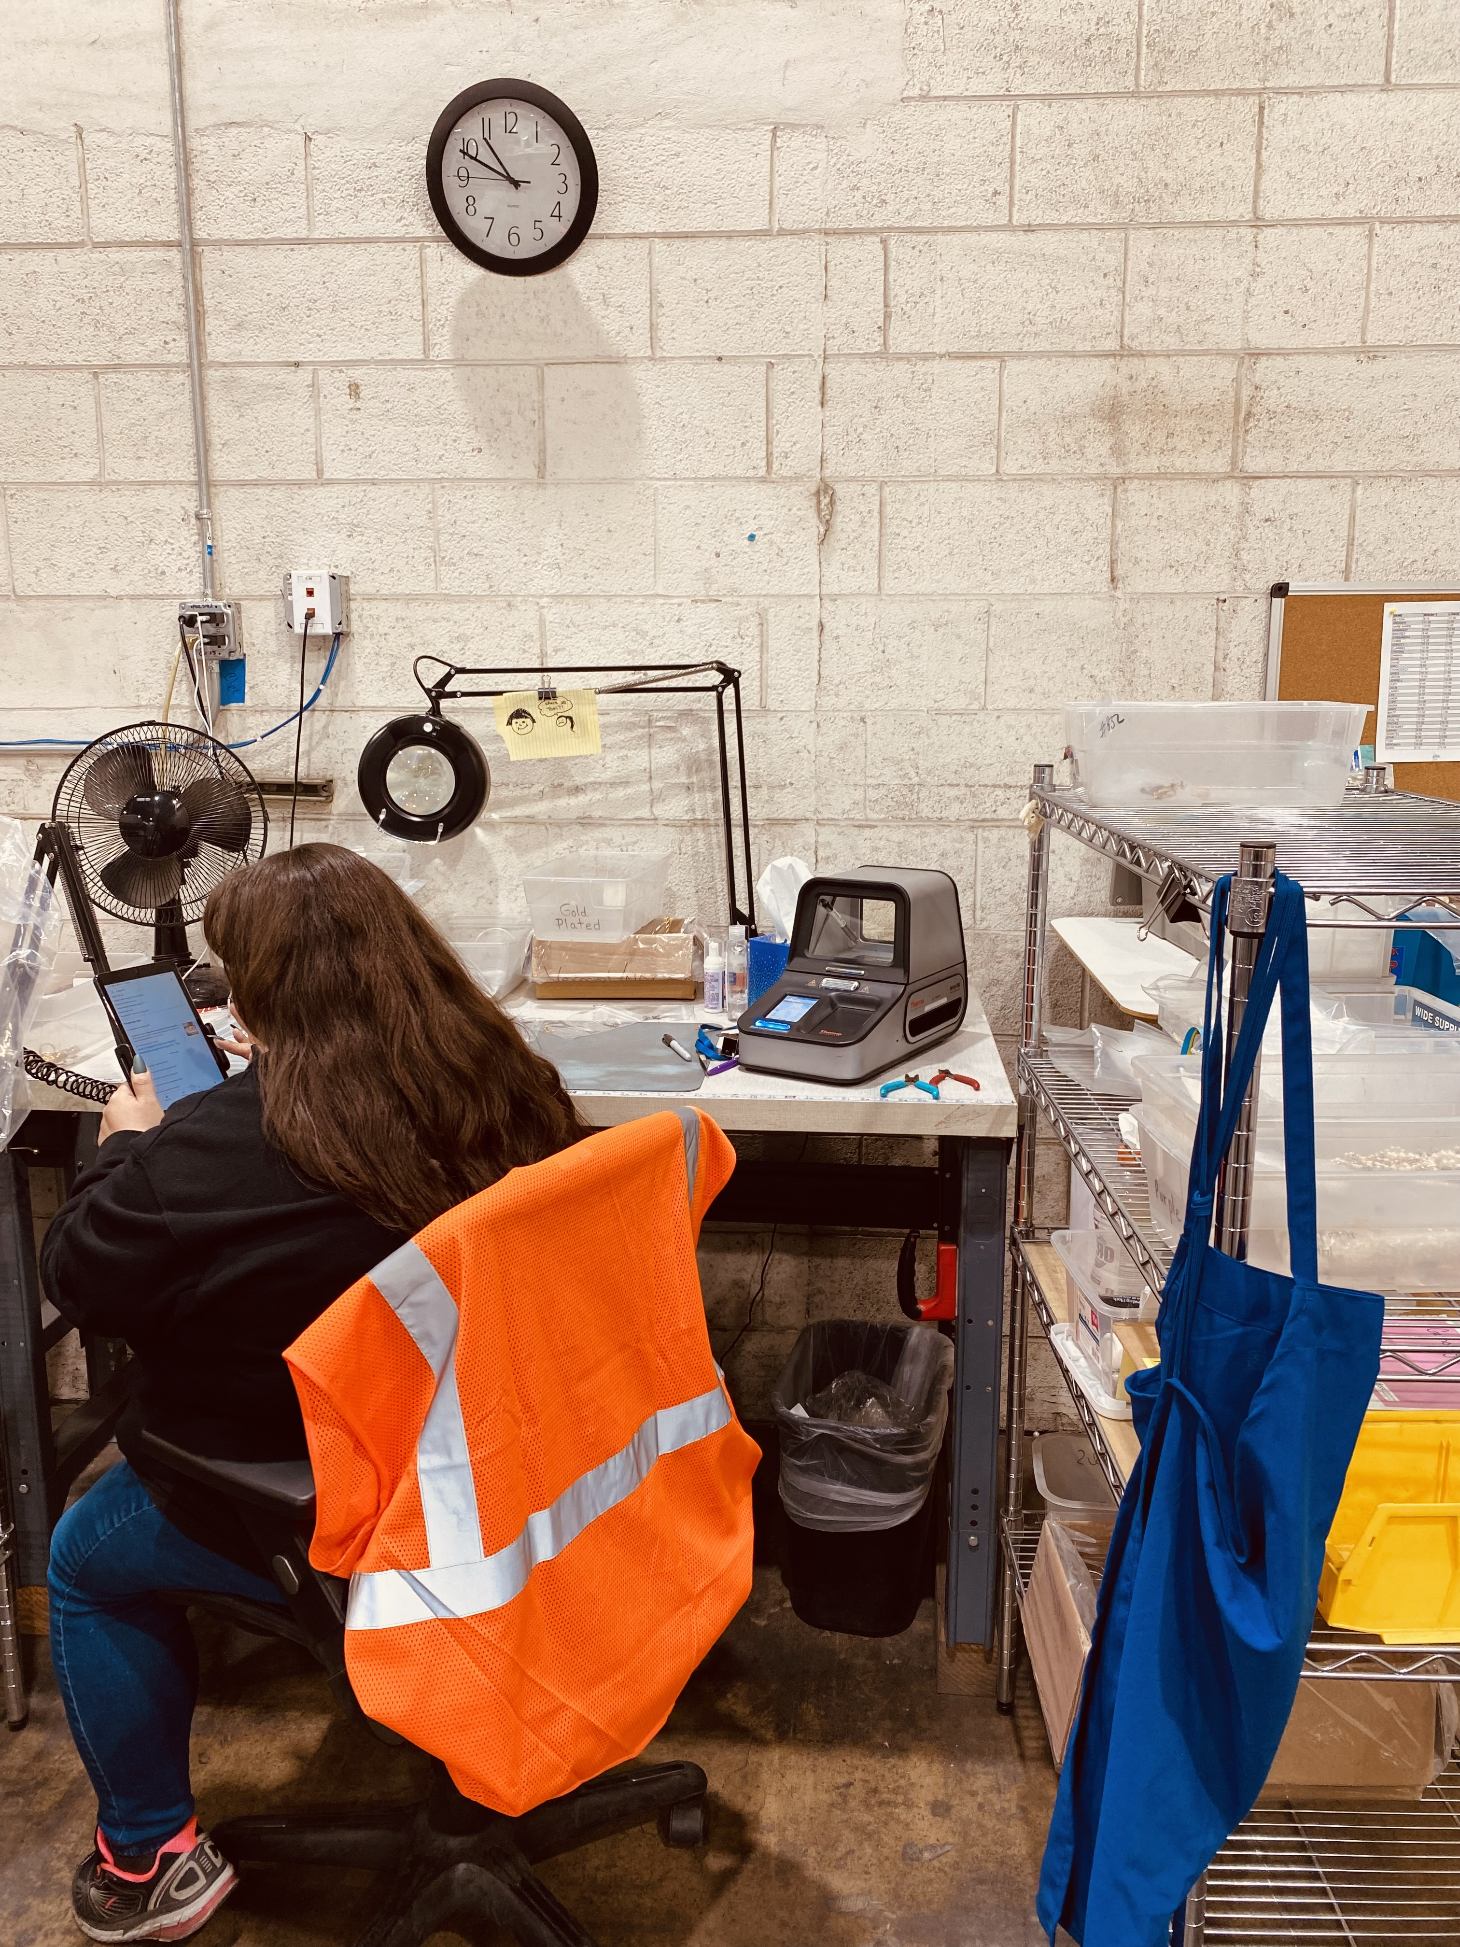
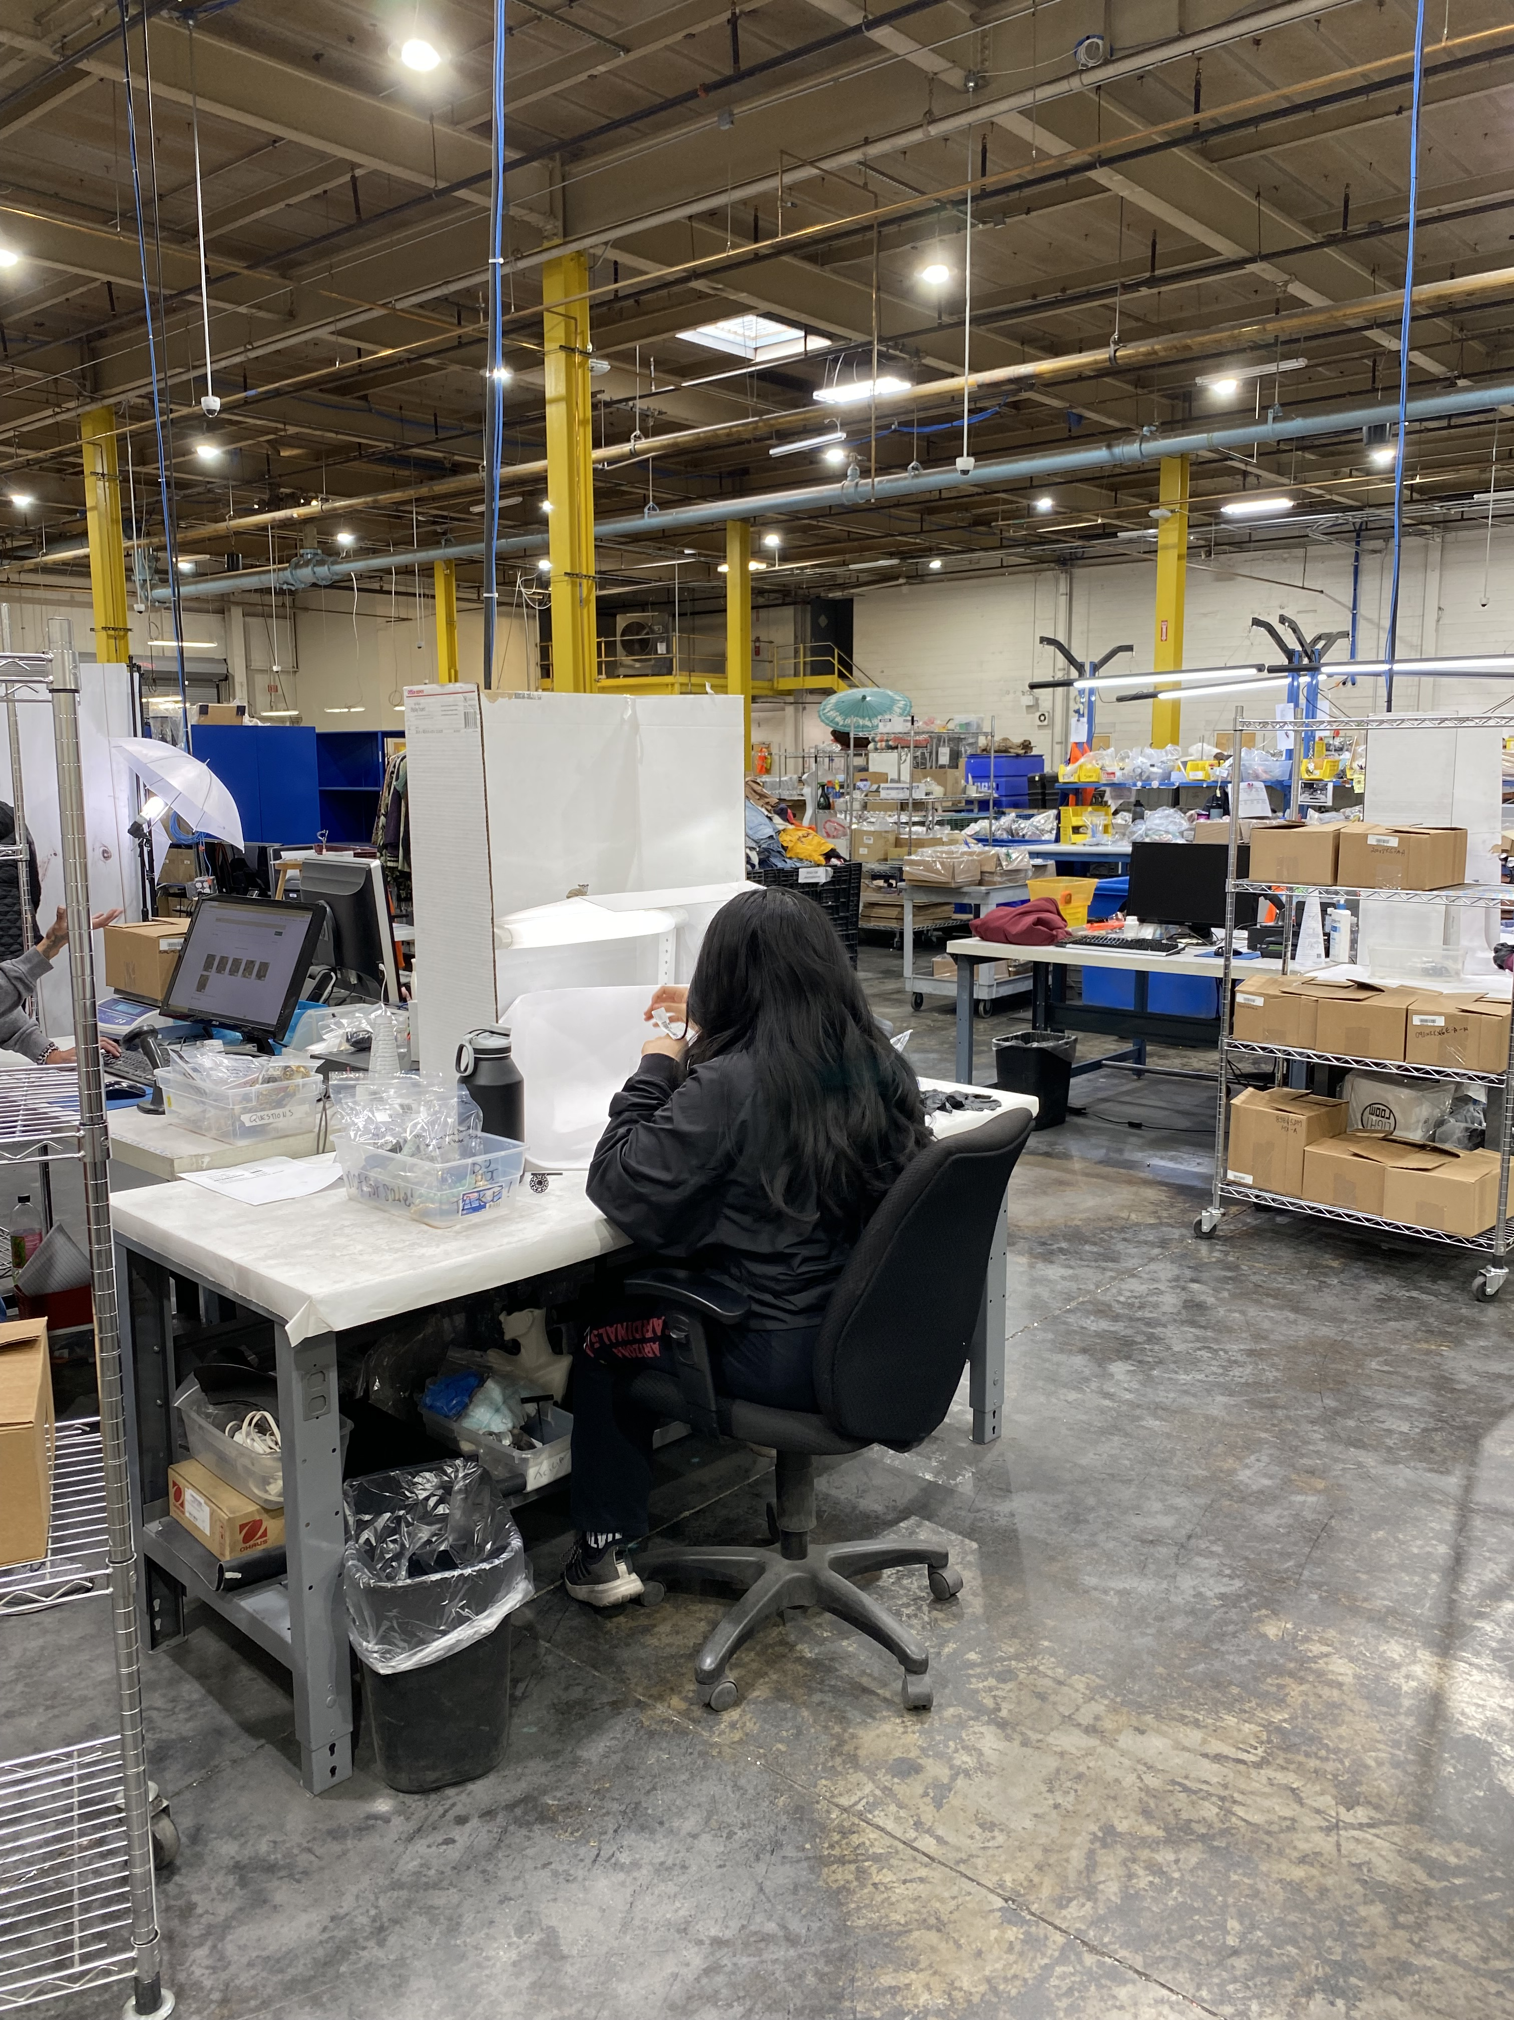
Meet e-Comm: Positions
Processors
Listers
Photographers
Inventory Control
Shippers
Customer Service
Goodwill
Notes:
(Talk through the photos we see and how product makes it’s way through e-Comm)

Slide 6
Meet e-Comm: Products
Jewelry
Collectibles
Designer
Instruments
Electronics
Sports
Games
Books
Art
Goodwill
Notes:
(Talk through the photos we see and how product makes it’s way through e-Comm)

Slide 7
Meet e-Comm: Timeline
< 24 hours
< 7 days
> 7 days
Product received
Checked in
Placed in the correct department
Product sorted
Product labelled
Photographed
Listed for a 7 day auction
Sale? 10 days to pay
No pay? Re-list
No sale? Re-list
3 auction cycles
Goodwill

Slide 8
Why e-Comm?
Sales, Site, Strategy
Goodwill
Goodwill of Central & Northern Arizona

Slide 9
Why e-Comm? Sales
Wider audience than a single retail store
Higher selling price
Retail stores get credit for the selling price of e-Comm items
Goodwill

Slide 10
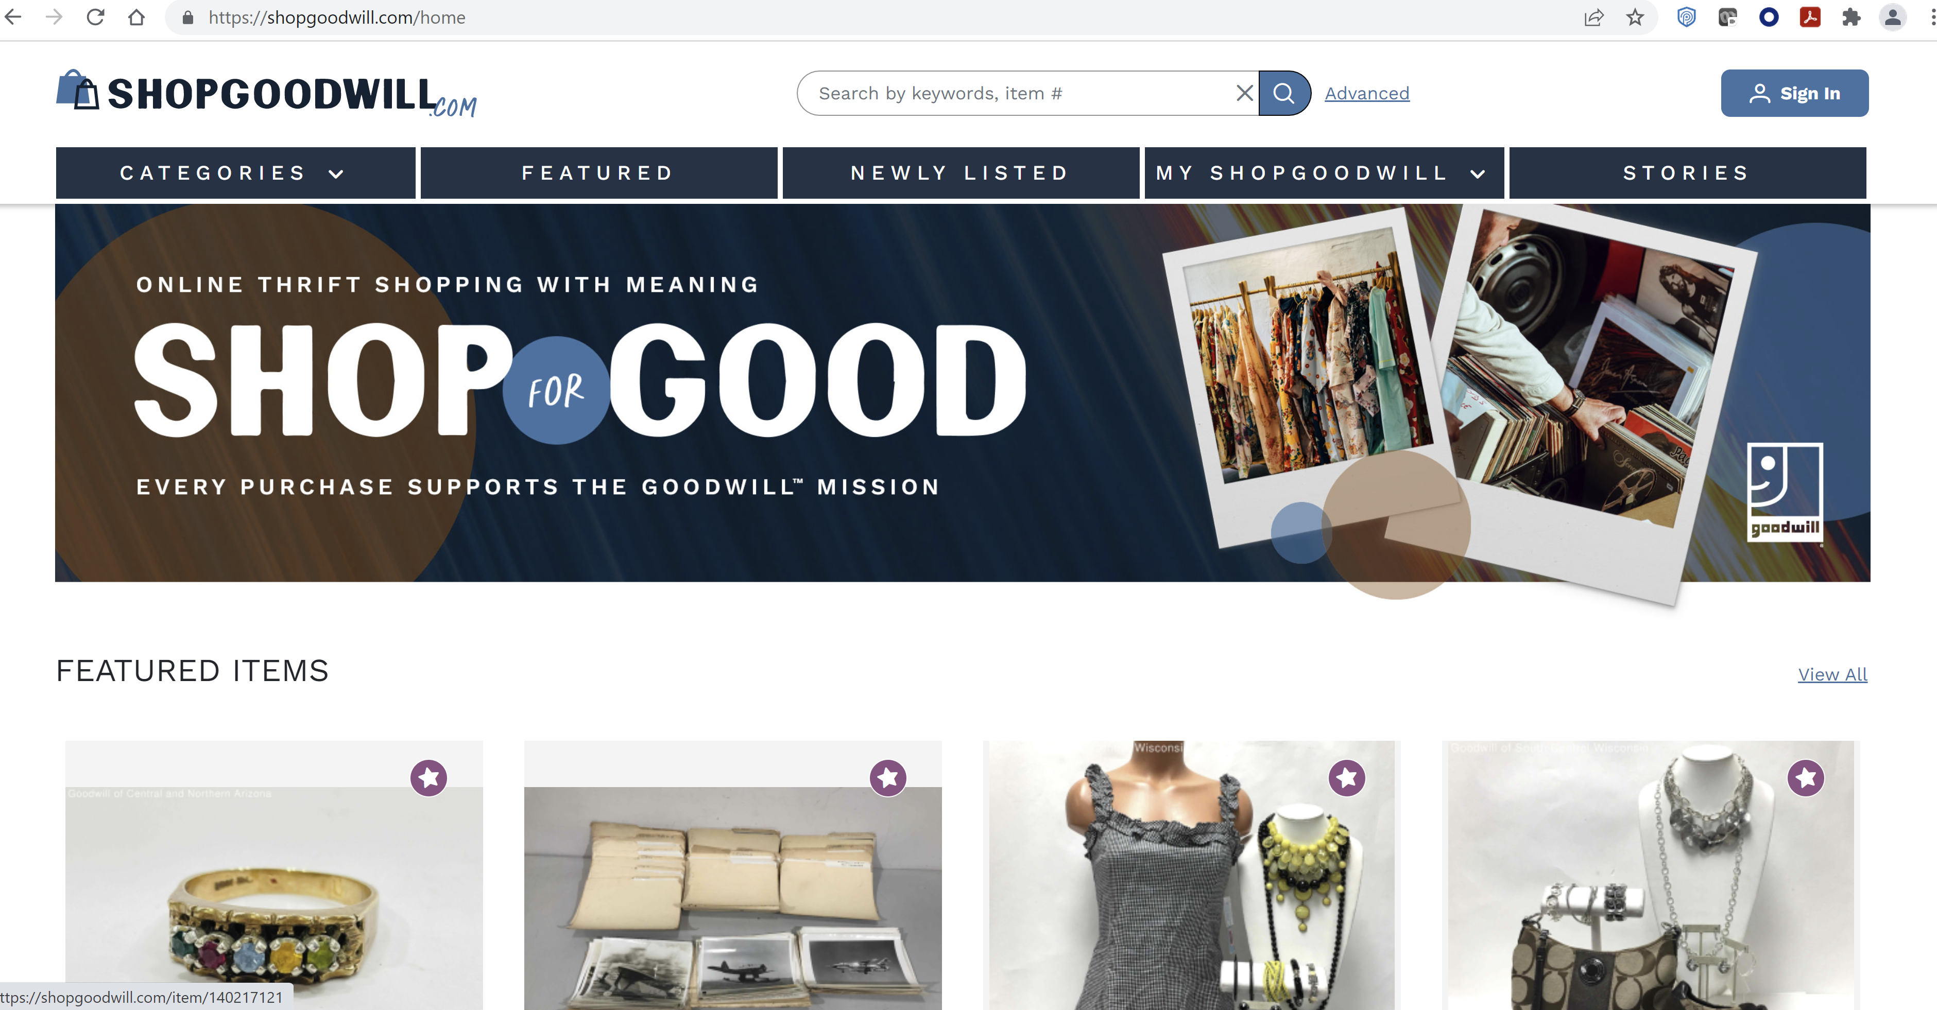
Why e-Comm? Site
Shopgoodwill.com
Online sale hub for over 138 Goodwill organizations across the U.S. and Canada
Offers E-bay style listing search including filters by category, keyword, brand, auction end and price.
Goodwill
Notes:
(Introduce shopgoodwill website: collection of Goodwills selling online. Review what categories of merchandise we sell through e-Comm.)

Slide 11
Why e-Comm? Strategy
Not everything of elevated value needs to go to e-Comm
If you can get higher value within your store, sell it there!
e-Comm team as deep product knowledge experts
Leverage their knowledge to be successful at pricing, selling, and what items are best for e-commerce sales
e-Comm sales are a good way to continue to learn and identify high-value product in the items you see every day
Goodwill
Notes:
(Introduce shopgoodwill website: collection of Goodwills selling online. Review what categories of merchandise we sell through e-Comm.)

Slide 12
ReclaimedFashion.com
Top Sellers!
Goodwill
Goodwill of Central & Northern Arizona

Slide 13
Top Brands: Keyword
Ranking | Search Term
#1
#2
#3
#4
#5
Ranking | Search Term
#6
#7
#8
#9
#10
Notes:
Ask team members to guess brands, starting with number #10 and reveal as you go!
Hints:
‘Jonathan, past-tense’
A sought-after brand that rhymes with ‘roach’
A region in Argentina, divided by the Andes mountains
This brand should be the official sponsor of Coachella vibes
‘The Devil Wears this’
Athletic brand named after the Greek goddess of speed, strength, and victory
Their French fashion house’s brand is two interlocking ‘C’s”
This monogram-oriented brand made their fame by creating luxury suitcases and steamer trunks
This Italian fashion house’s brand is two interlocking “G’s”
This activewear brand has been rather fruitful in recent years

Slide 14
Top Items: Keyword Search
Ranking | Search Term
#1 | Shoes
#2 | Vintage
#3 | Plus Size
#4 | Jersey
#5 | Jewelry
Ranking | Search Term
#6 | Jeans
#7 | Purses
#8 | Silk
#9 | Gold
#10 | Leather
Goodwill
Notes:
Make this into a Family Feud style game? Tables get to submit keywords and if they make the board, they get points.

Slide 15
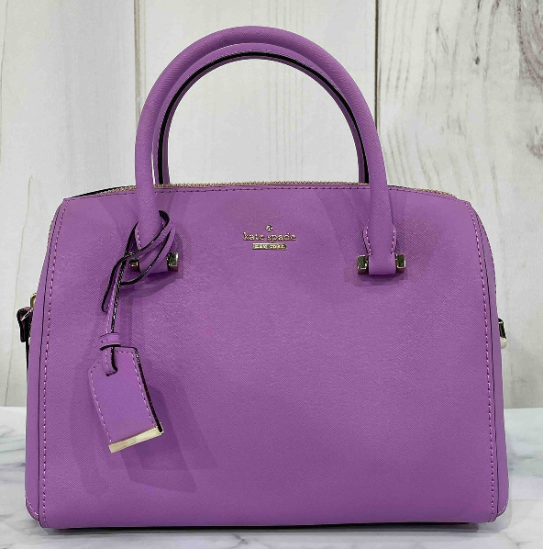
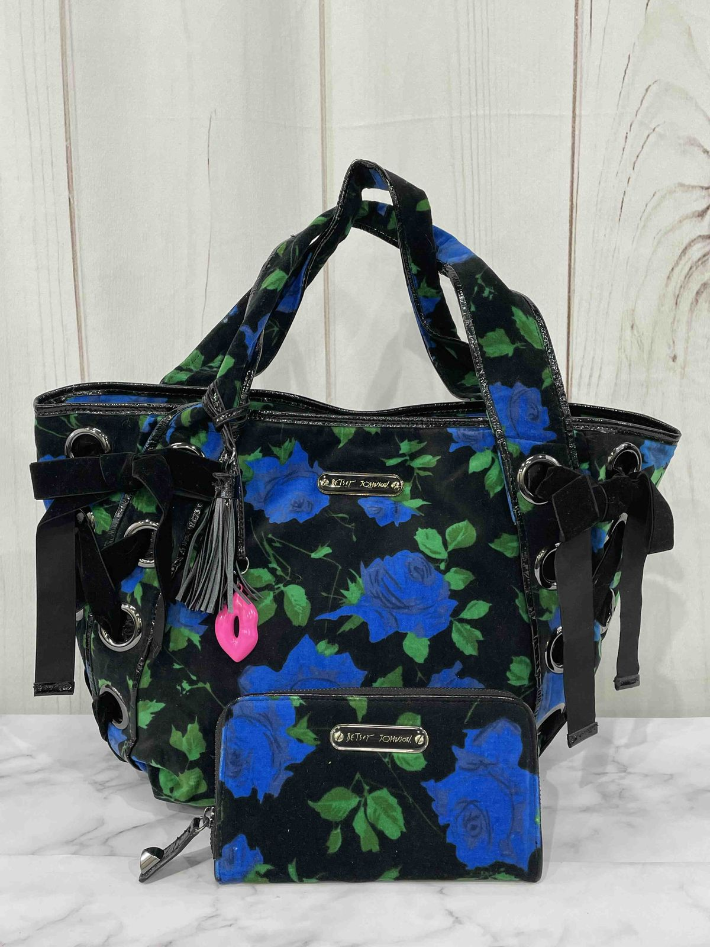
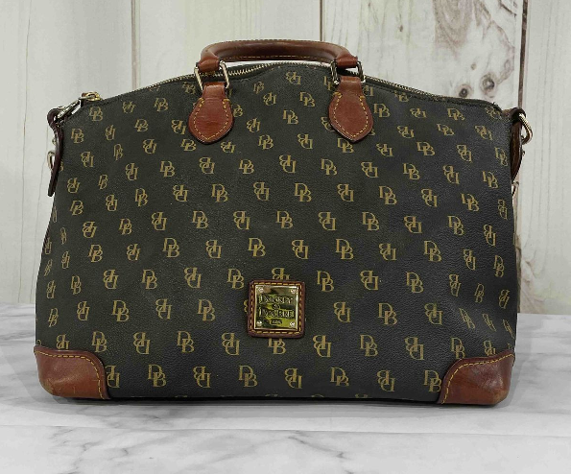
Handbag Sales
Dooney & Bourke
NWT Kate Spade
Betsey Johnson
$59.95
$85.00
$45.95
Goodwill

Slide 16
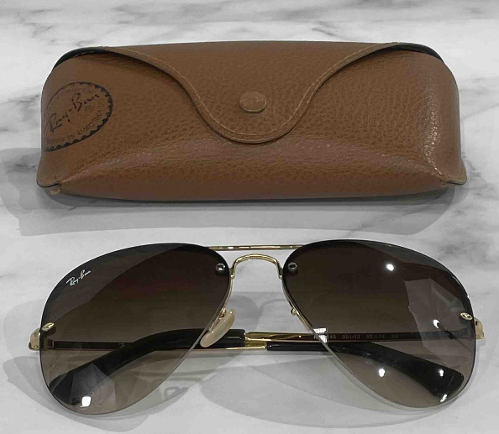
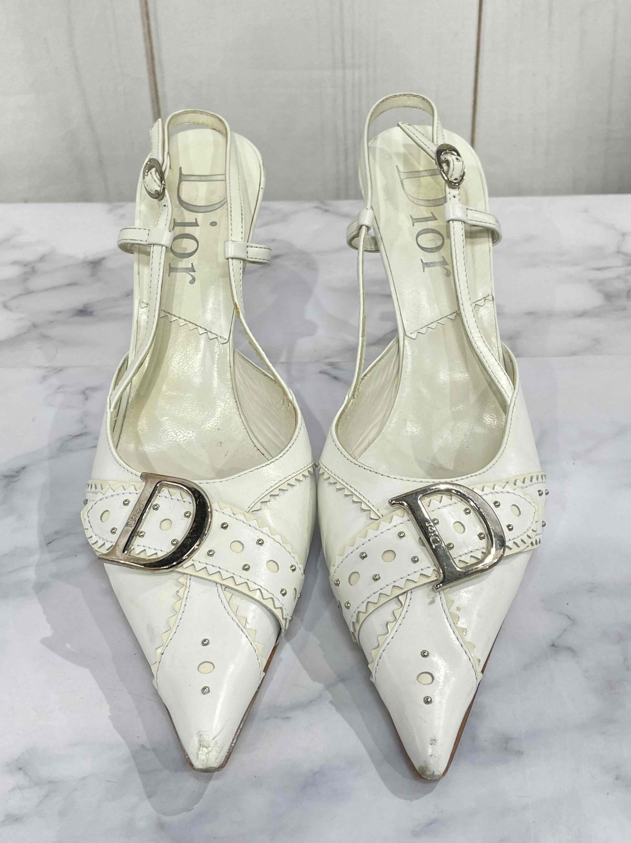
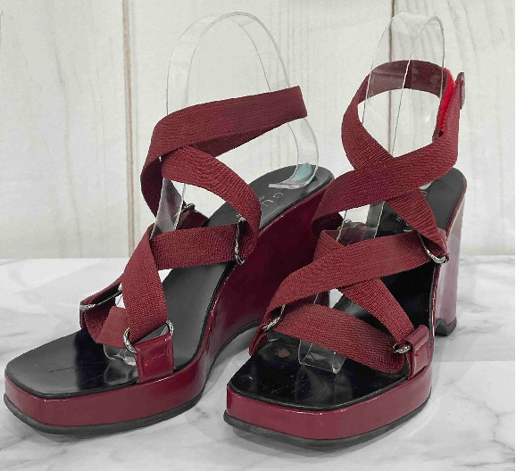
Accessory/Shoe Sales
Ray-Ban
Gucci
$54.95
$69.95
Christian Dior
$69.95
Goodwill

Slide 17
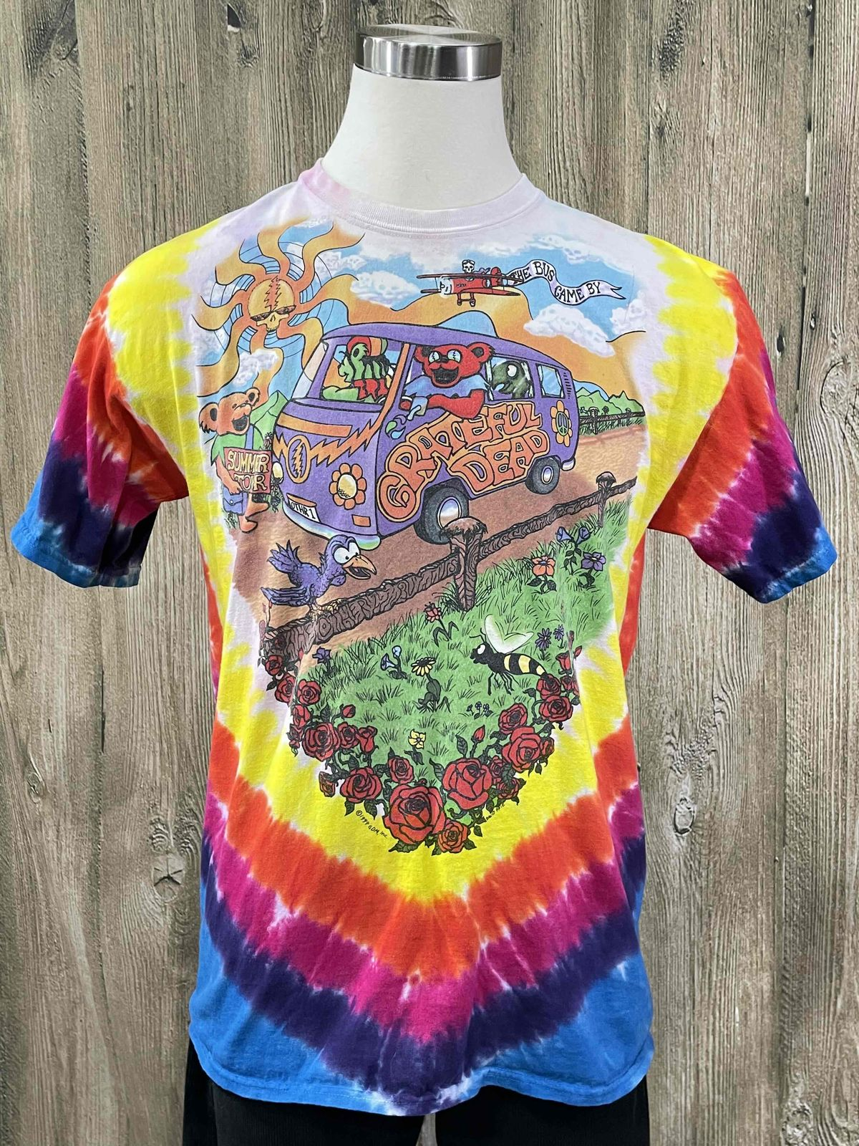
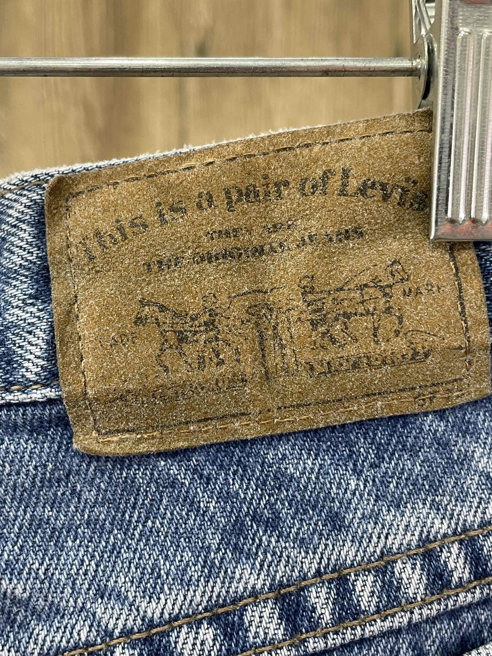
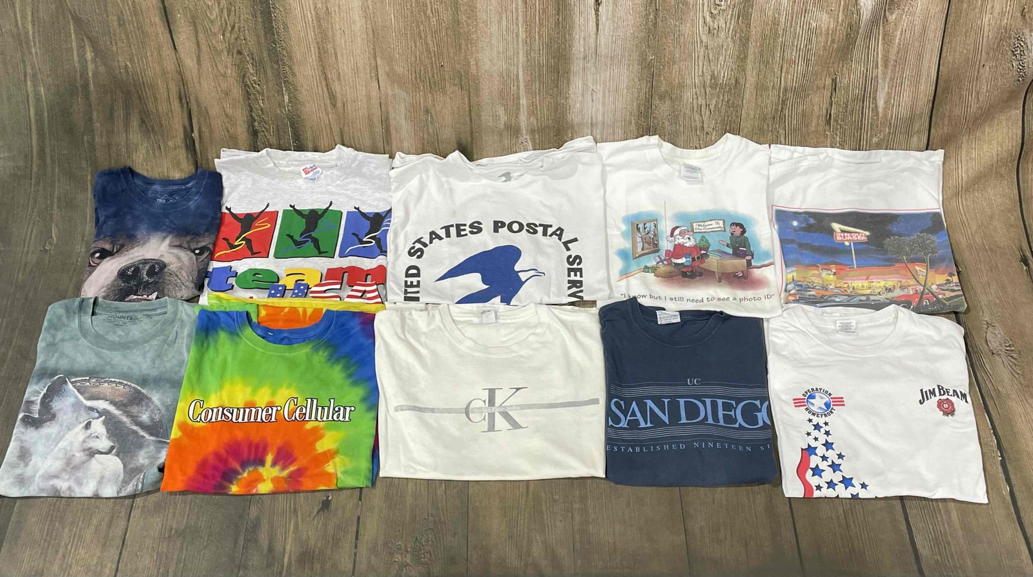
Vintage Clothing Sales
Bundle of 10 T-Shirts
$49.95
Silver Tab
Levi’s
Grateful Dead Tour T-Shirt
$54.95
$44.95
Goodwill

Slide 18
e-Commerce: Glass & Pottery
Product Spotlight
Goodwill
Goodwill of Central & Northern Arizona

Slide 19
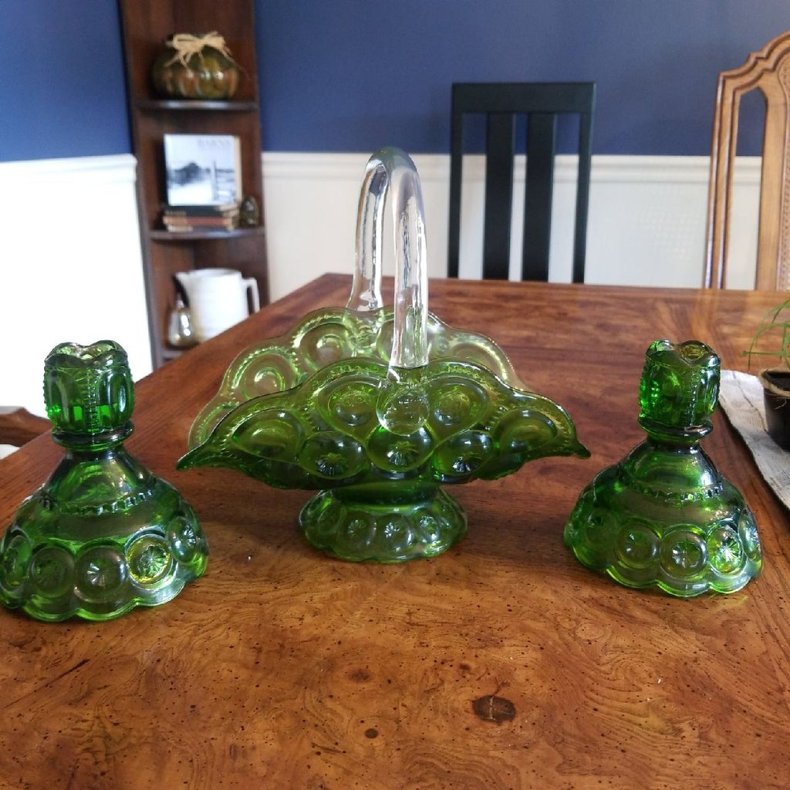
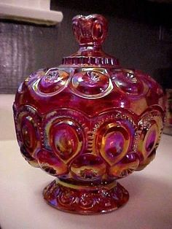
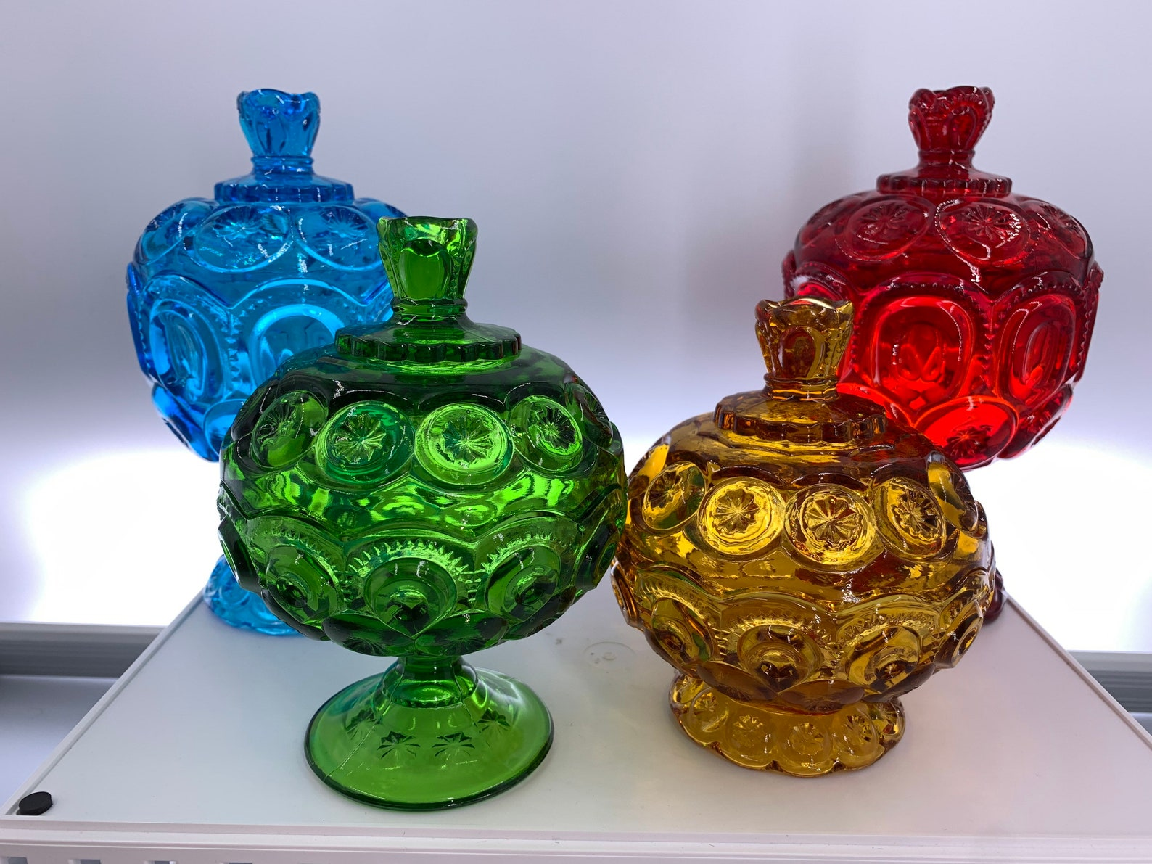
Moon And Stars Smith Glass
Originally known as “The Palace”
Produced from 1894-1905; styles still reproduced
Retail value: $15-$50
Goodwill

Slide 20
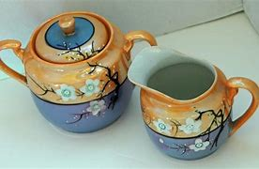
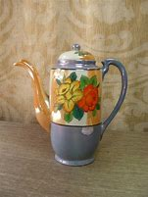
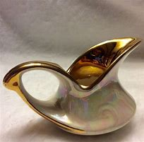
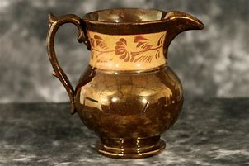
Lusterware
Pottery/porcelain with metallic glaze
Retail value: $5-$75
Goodwill

Slide 21
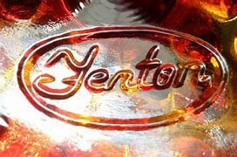
The Many Looks of Fenton
After 1973, Fenton is marked with an oval shaped raised Fenton logo.
Pre-1973, there will be a sticker.
Retail value: $10-$200,000
Terminology to describe: Hobnail, Opalescent, Ruffled, Crimped, Splatter, and Satin.
Goodwill

Slide 22
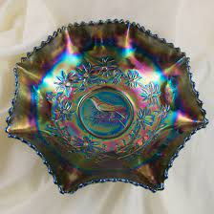
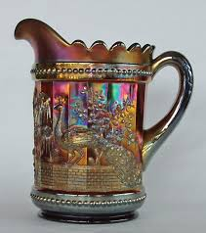
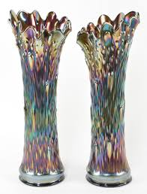
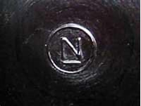
Carnival Glass
Branded Fenton, Northwood, Millersburg
Molded or pressed glass with iridescent shimmer
‘Poor man’s Tiffany’
Retail value: $10-$200,000
Goodwill

Slide 23
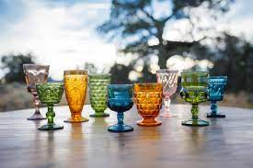
Vintage Pressed-Glass Goblets
Jewel tone colors
Heavy and smooth
Seams
Sets can range from $25-$50
Goodwill

Slide 24
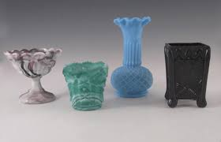
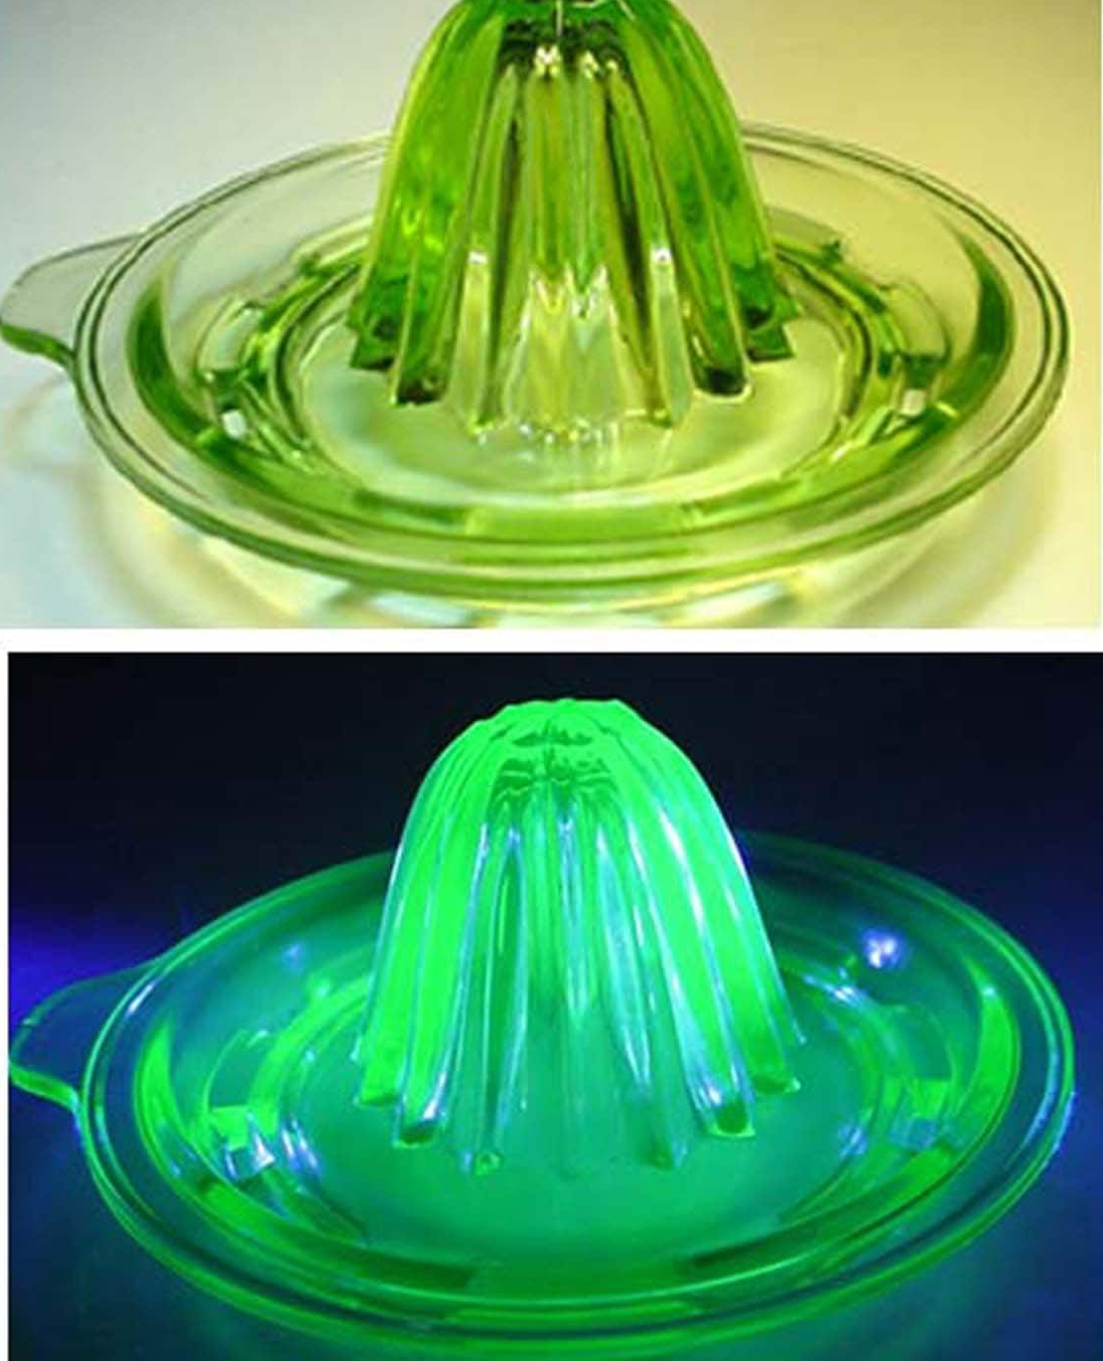
Slag, Vaseline, and Goofus Glass
Slag looks like marble 19th Century.
Uranium/Vaseline, has uranium in the mixture (glows under blacklight)
Goofus Glass is pressed & decorated with unfired enamel
Pricing varies depending
on piece ($10-$65)
Goodwill

Slide 25
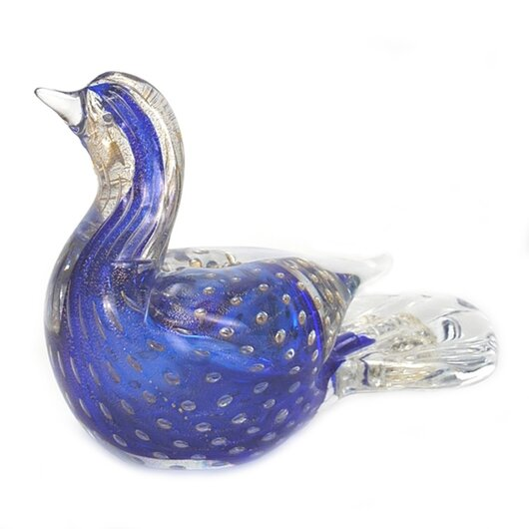
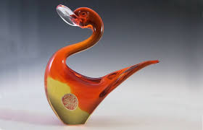
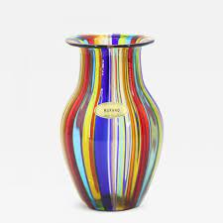
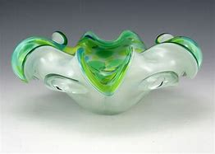
Murano Glass
Hand-blown
Some pieces can be marked by the artist or a mark call “pontil mark”
This is made by the rod that holds the glass
Retail value: Varies from $25-$500
Goodwill

Slide 26
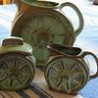
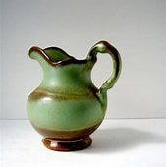
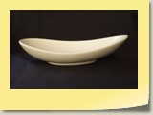
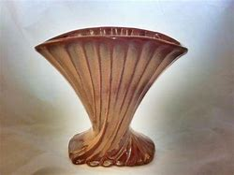
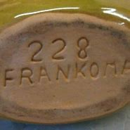
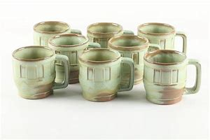
Frankoma/USA Pottery
Around WWI, US-made pottery pieces was prevalent
Slowed after WWII due to the rise of imports
Frankoma/USA range in pricing $7-$300 or more
Goodwill

Slide 27
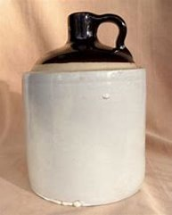
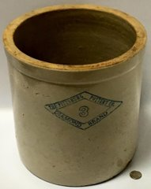
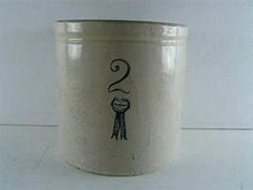
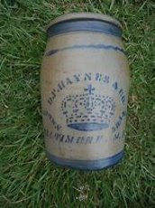
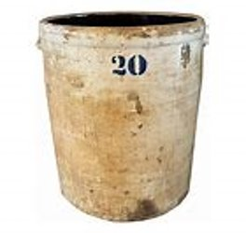
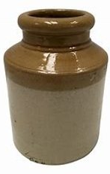
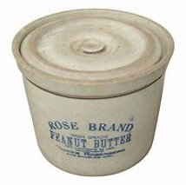
Stoneware/Earthen Ware
Stoneware & Earthenware Brands
The Pittsburg Pottery Co.
Rose Brand
The Ohio Company
Baltimore Brand
Blue Ribbon Brand
C&B
Buckeye
Pricing $15-$1200
Goodwill

Slide 28
Crazy Lamp Lady , Reseller, U-Tube
Glass/Pottery - Resources
Crazy Lamp Lady (YouTube) is a great resource for glass and pottery
Films in antique stores and GIMV retail stores
Goodwill

Slide 29
Activity
The Price is Right!
Goodwill

Slide 30
Questions?
Contact the team: Ecommerce@goodwillaz.org
Goodwill

