Slide 1
Retail
Culture &
C O N N E C T
Corrective Action Basics
Goodwill

Slide 2
Instructors
Natalie Rodriguez, Manager HR Business Partner
Jake Meyer,
HR Business Partner
Goodwill
Notes:
Natalie Rodriguez will be main present GCNA
Jake to help facilitate GCNA
Kimberly Stouffer will be main presenter GIMV

Slide 3
Instructors
Tammy Gallagher,
HR Business Partner
Goodwill
Notes:
Natalie Rodriguez will be main present GCNA
Jake to help facilitate GCNA
Tammy Gallagher will be main presenter GIMV

Slide 4
Objectives
Determine the Progressive Path
Identify CA/PIP Differences
Demonstrate CA/PIP Writing Process
Goodwill
Notes:
*Based on notes. Need to wordsmith

Slide 5
Icebreaker
Goodwill
Notes:
Skill or Will?
Video Scenarios (4)
Scenarios will be presented and participants will step to one side of the room or the other depending on their belief if the scenario is skill or will based. See next slide.

Slide 6
Will or Skill?
Will
It may be a behavior/attitude issue if:
The employee has an ability to perform the task and chooses not to (will)
The employee demonstrates a lack of commitment
The employee demonstrates a bad (negative) attitude
The employee demonstrates a disruptive presence in the workplace
Skill
It may be a performance issue if:
The employee lacks mastery of skills or tasks (skill)
The employee has not been fully trained
The employee is new in their position
Goodwill
Notes:
Explain the difference between Will (Behavior/Attitude) and Skill (Performance).

Slide 7
Will or Skill?
WILL
SKILL
Goodwill
Notes:
Short Video.
Subject is the sloth.

Slide 8
Will or Skill?
WILL
SKILL
Goodwill
Notes:
Short video.
Subject is the chefs.

Slide 9
Will or Skill?
WILL
SKILL
Goodwill
Notes:
Short video.
Subject is the cashier.

Slide 10
Will or Skill?
WILL
SKILL
Goodwill
Notes:
Short video.
Answer is will because its Will Farrell.

Slide 11
Progressive Action Tree
Issue Identified
Gather Information
Behavior or Attitude?
Performance Gap?
Behavior
Coaching
Performance Coaching
Disciplinary
Action
Performance Improvement Plan (PIP)
Goodwill
Notes:
So lets figure out what direction we are going…
1st Click: Identify the Issue – What happened?
2nd Click: Gather Information – Who was involved? When was the incident? Where did it take place?
3rd Click: Behavior or Attitude? VS Performance Gap? Think will vs skill…
4th Click: Is a coaching necessary or have we coached on the issue before?
5th Click: Corrective Action or Performance Improvement Plan

Slide 12
Which one do I choose?
Corrective Action
Performance Improvement Plan
What is Corrective Action?
What is it for?
When do I use it?
What is a PIP?
What is it for?
When do I use it?
Goodwill
Notes:
What is “Corrective Action”?
What is it for?
When do I use it?
What is a PIP?
What is it for?
When do I use it? When reasonable time has passed and we’ve trained/coached the team member and are not getting the results. We can give structure and feedback to build the skill deficits.
Manager partners with team member.

Slide 13
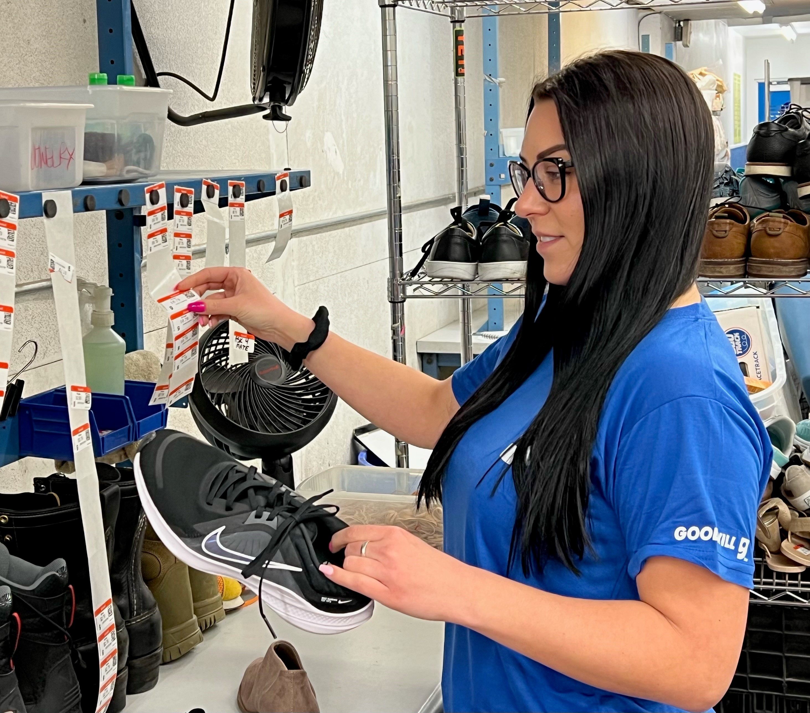
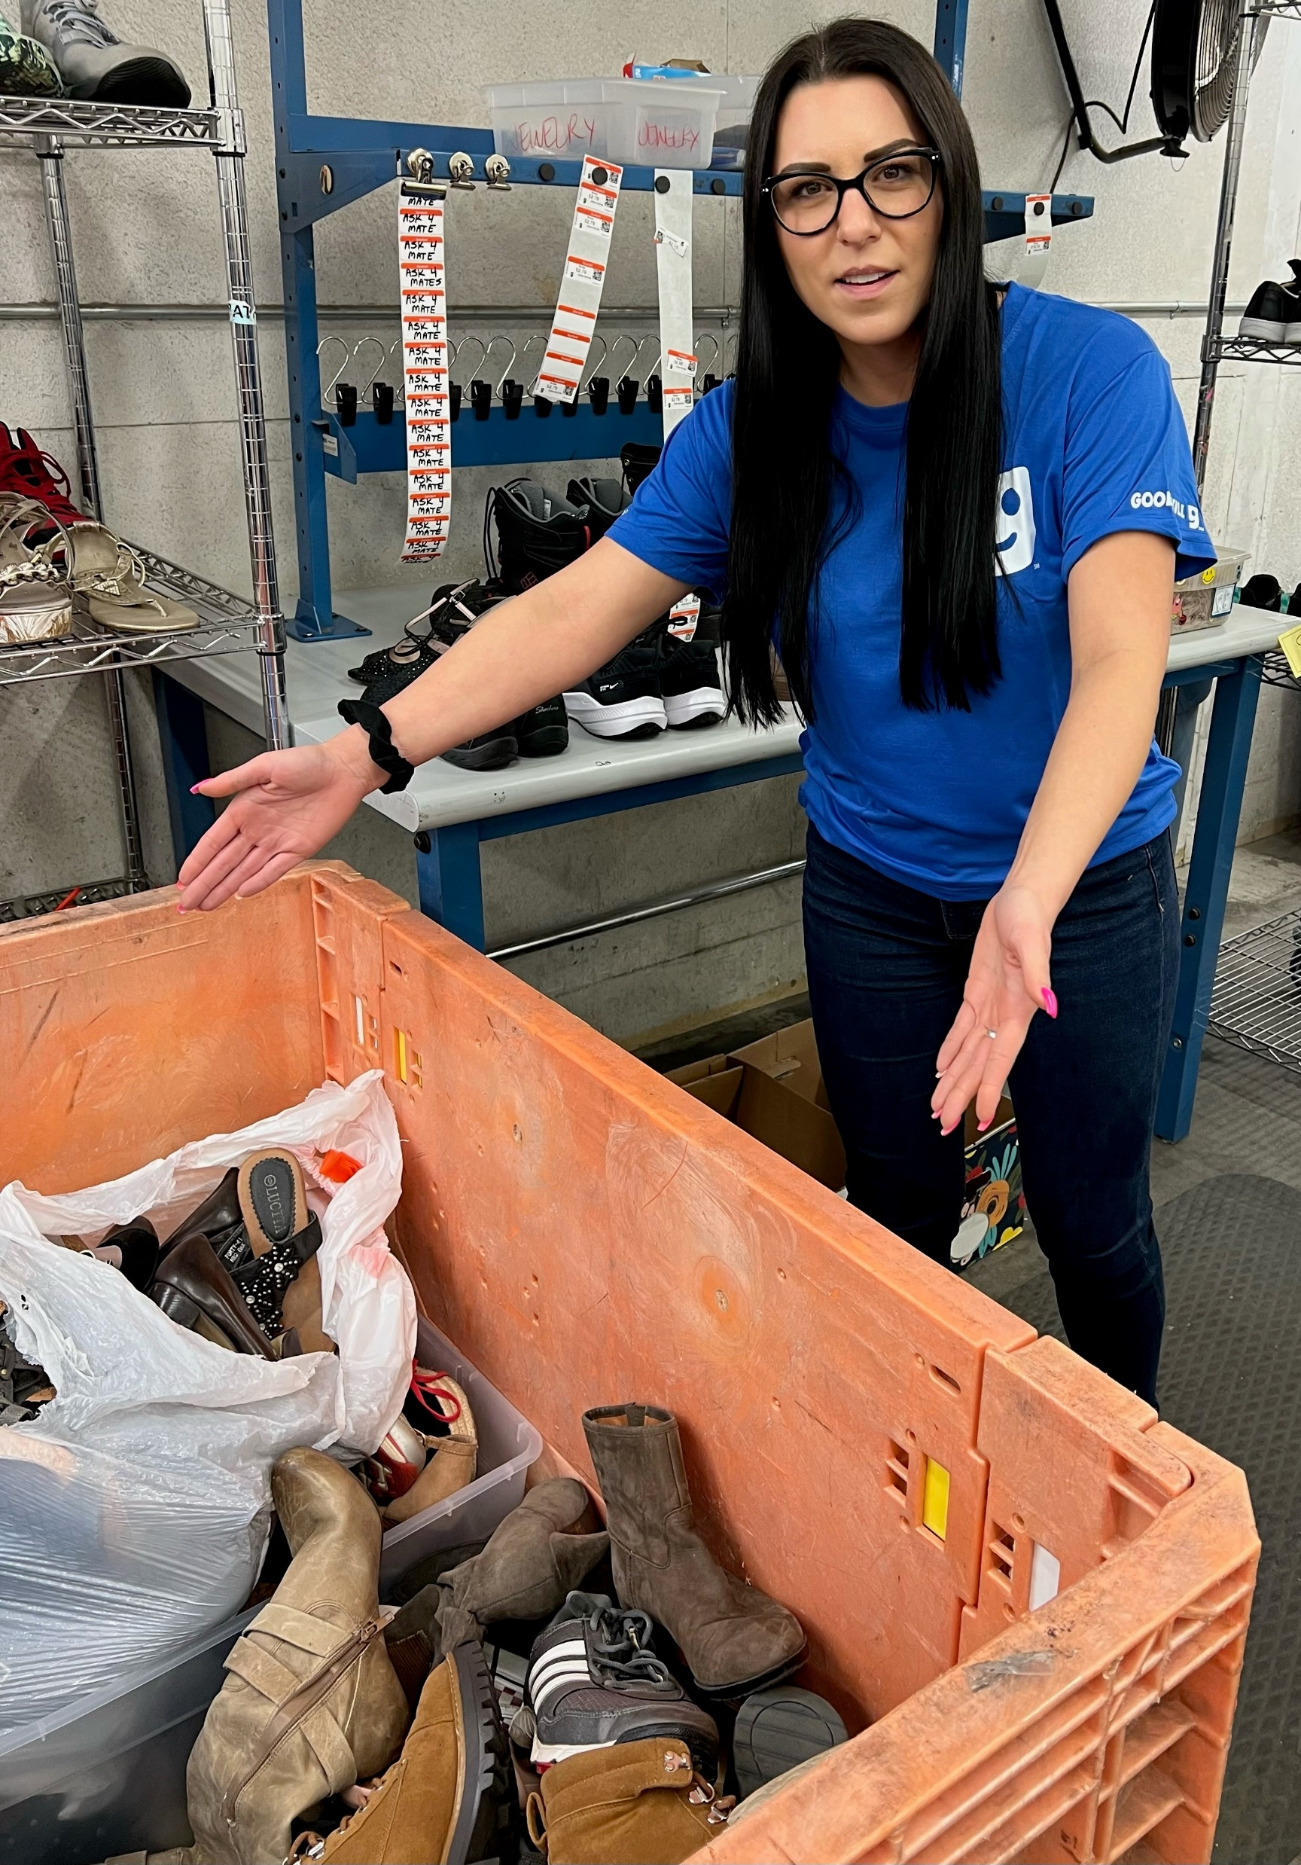
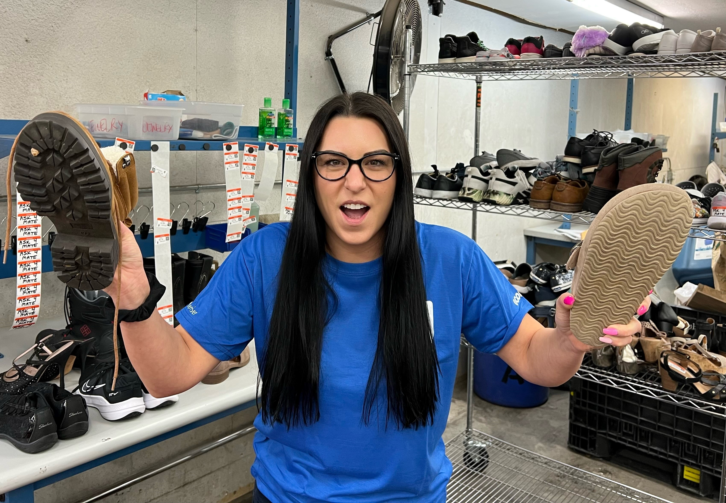
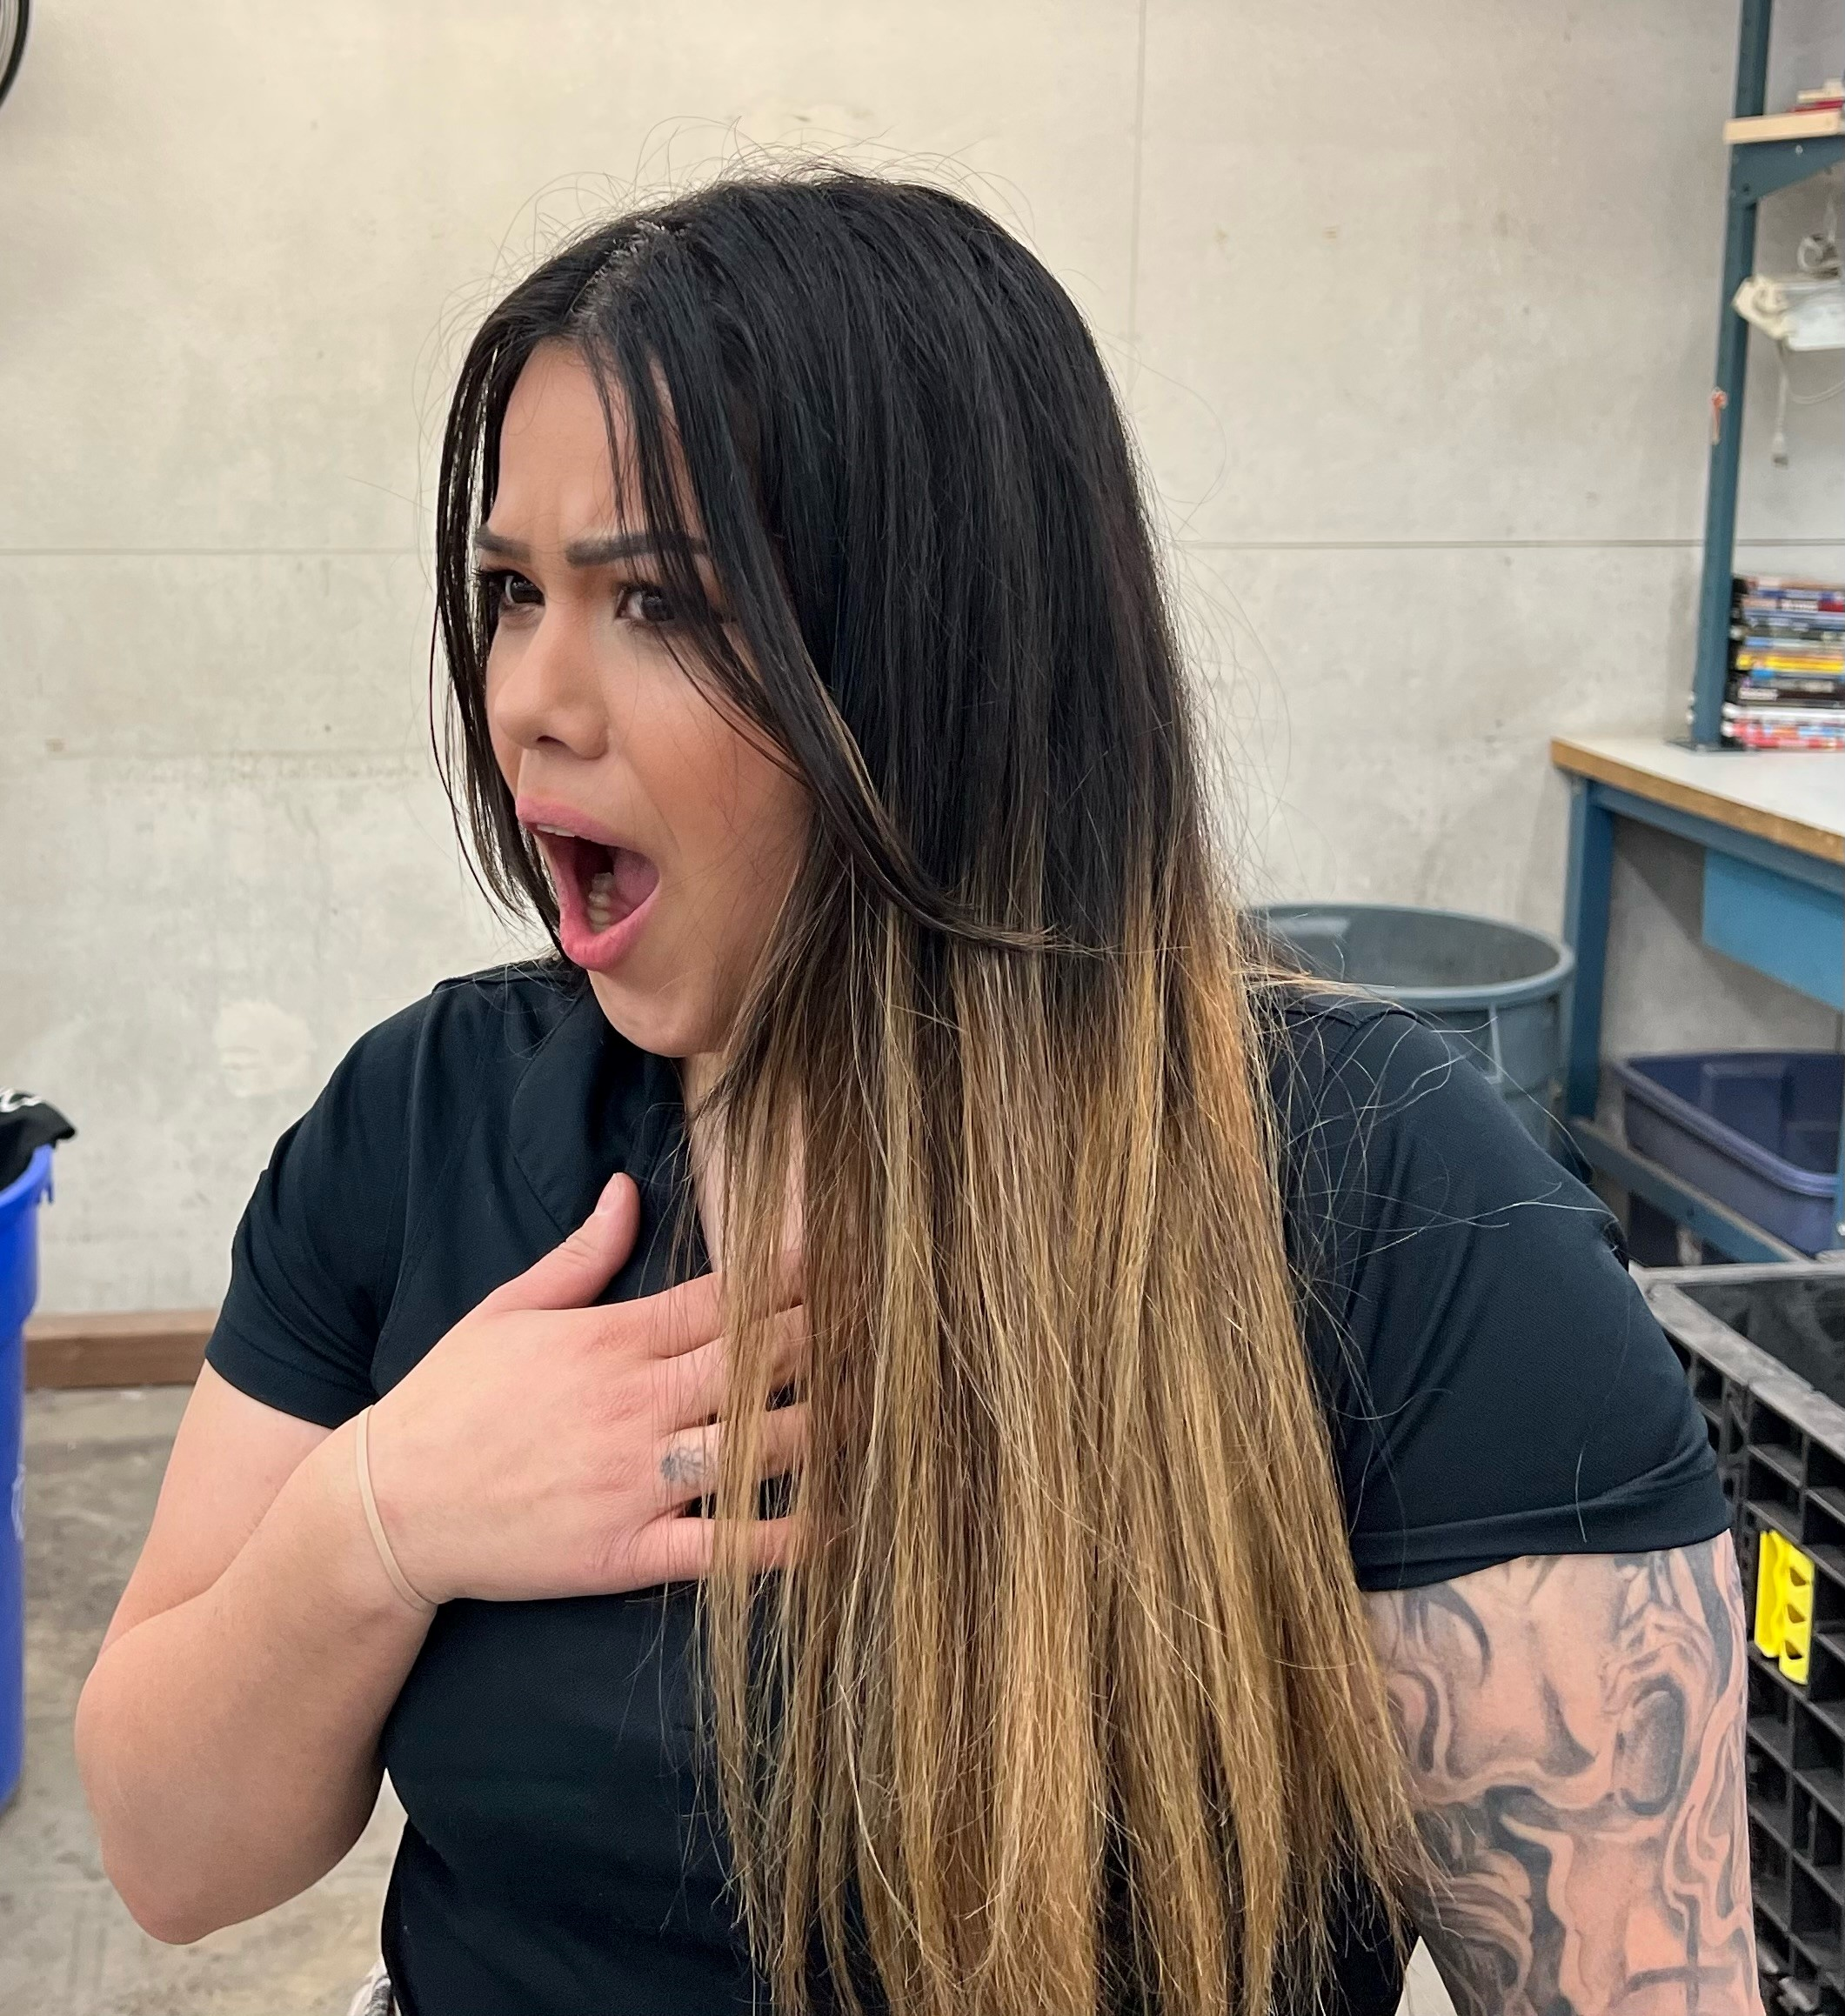
Scenario
&%$#
@#$% &$%@!*
&#@!
%@(*$%#
Goodwill
Notes:
Scenario
Click 1: It’s Monday morning and RMP who we are going to call….”Shalimar” is working at the shoe station today and is not happy…
Click 2: As she’s checking on as-is gaylords, “Shalimar” stops her manager Gabby to show her why she’s unhappy…(The condition of her donation’s)
Click 3: “Shalimar” then starts to show her anger…
Click 4: …and starts using unprofessional language…..
Click 5:…and Gabby is appalled.

Slide 14
Progressive Action Tree
Issue Identified
Gather Information
Behavior or Attitude?
Performance Gap?
Behavior
Coaching
Performance Coaching
Disciplinary
Action
Performance Improvement Plan (PIP)
Goodwill
Notes:
Let’s review the Progressive Action Tree
Click 1: Identify the issue. So what's the issue in this scenario?
Click 2: Gather Information. What's some information we need to know?
Click 3: Is it Behavior or Attitude? Or is it a Performance Issue?
Click 4: Its not performance…
Click 5: Should we coach or have we coached before?
Click 6: So now its corrective action right?

Slide 15
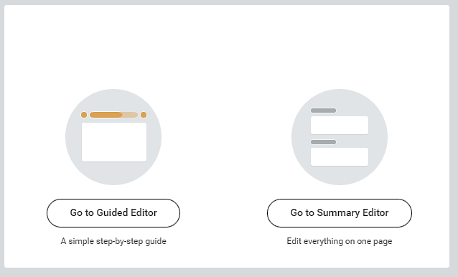
Corrective Action
Goodwill
Notes:
What's the difference between these two options? NOTHING. :P
They both are the same except that guided editor is one section at a time vs summary editor shows you the entire corrective action.

Slide 16
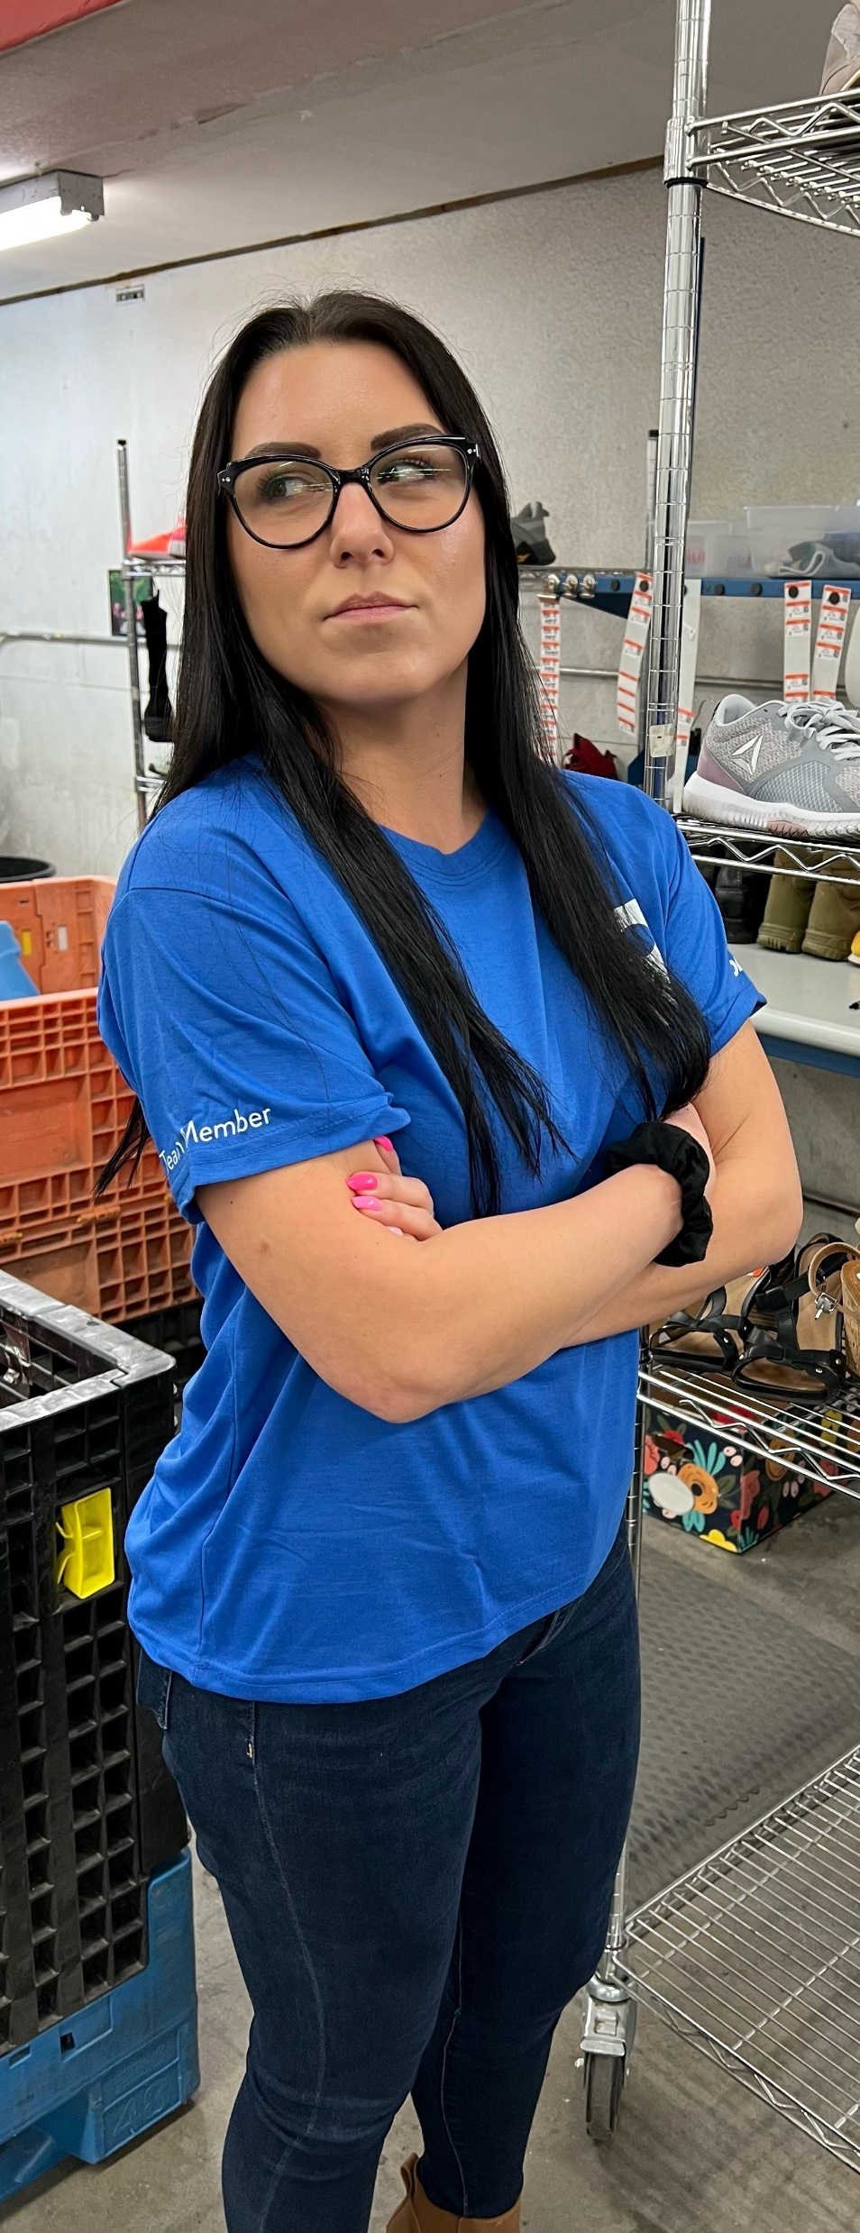
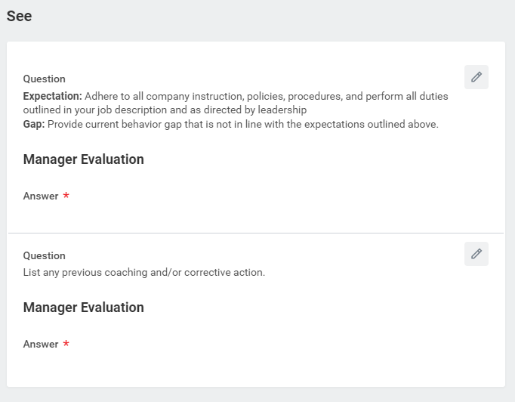
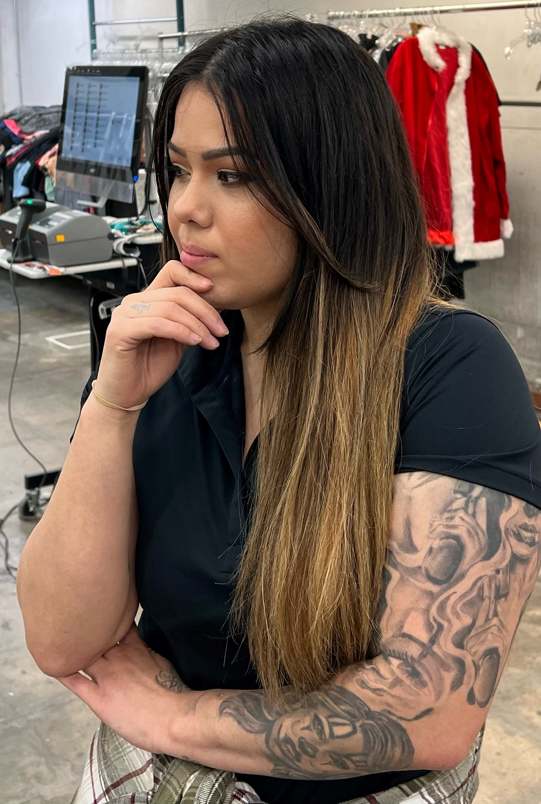
Corrective Action
%$&
Goodwill
Notes:
“SEE” Category
The first question is around expectation and the gap. What information should we be entering here?
When?
Who?
What?
Where?
*WHY or HOW?
*Specific incident
Second question is around documented coaching and/or corrective action. What information goes here?
What if the coaching that’s in workday has nothing to do with the issue that we are addressing?

Slide 17
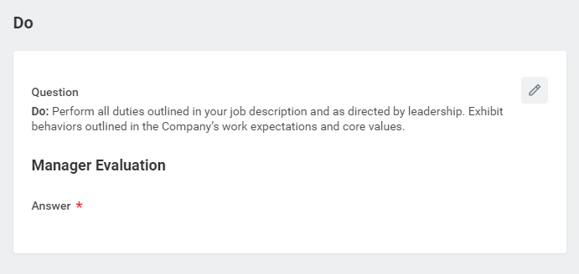
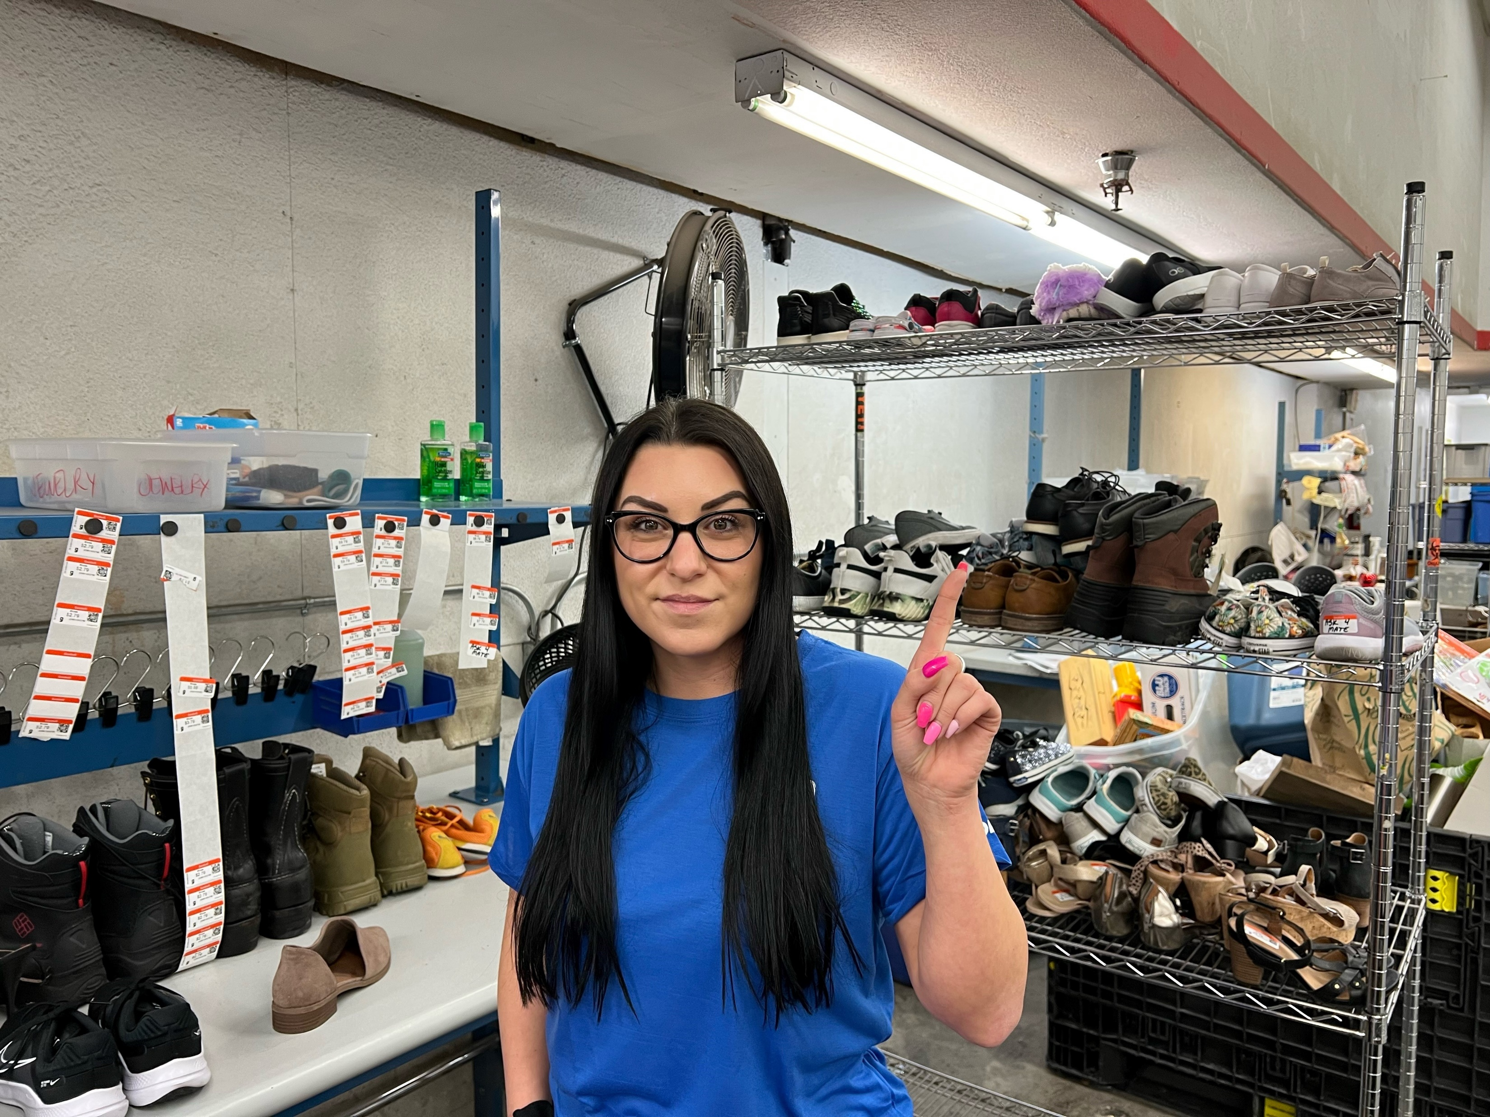
Corrective Action
%$#&@%
Goodwill
Notes:
What does the team member need to do?
What are our expectations around what the team member needs to do going forward?

Slide 18
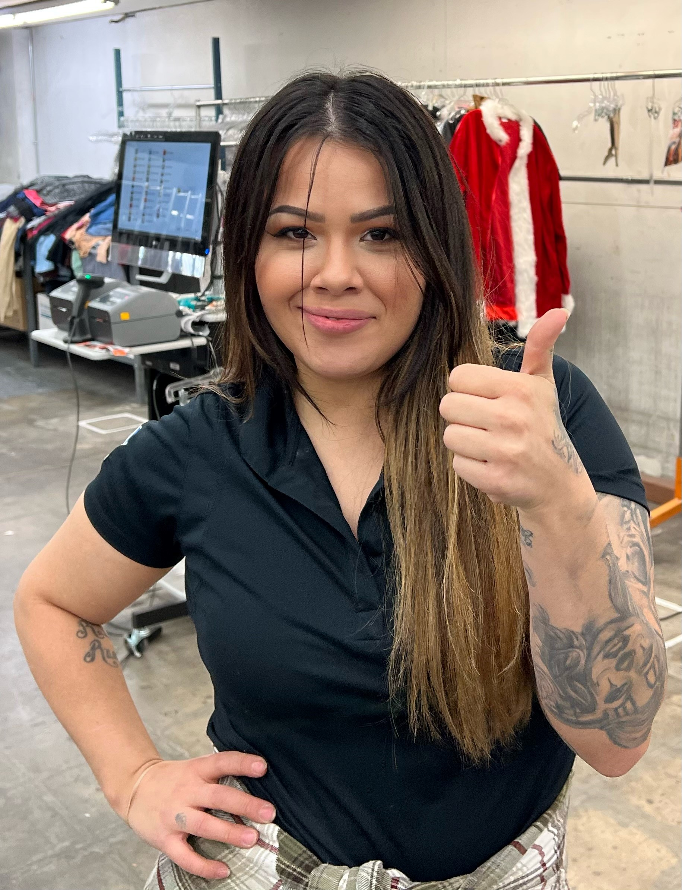
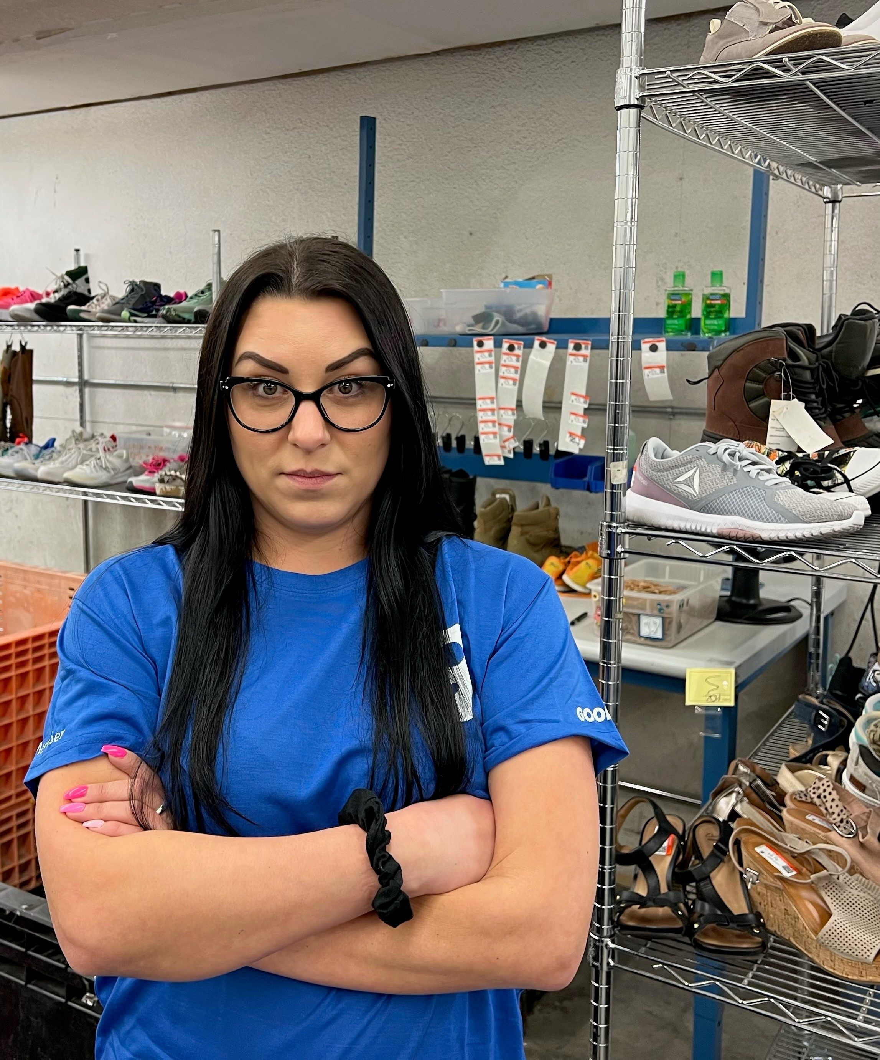
Corrective Action
…
Goodwill
Notes:
Review section is auto generated.
Supporting Documents – What kind of documents can/should be attached?
What comment do you write in the enter your comment section?
Button options. “Save for later” and “close” are the same thing. They live in your inbox until you submit.
Can not cancel. Must partner HRBP.
*revisit to take out “approved by HRBP out of training materials”

Slide 19
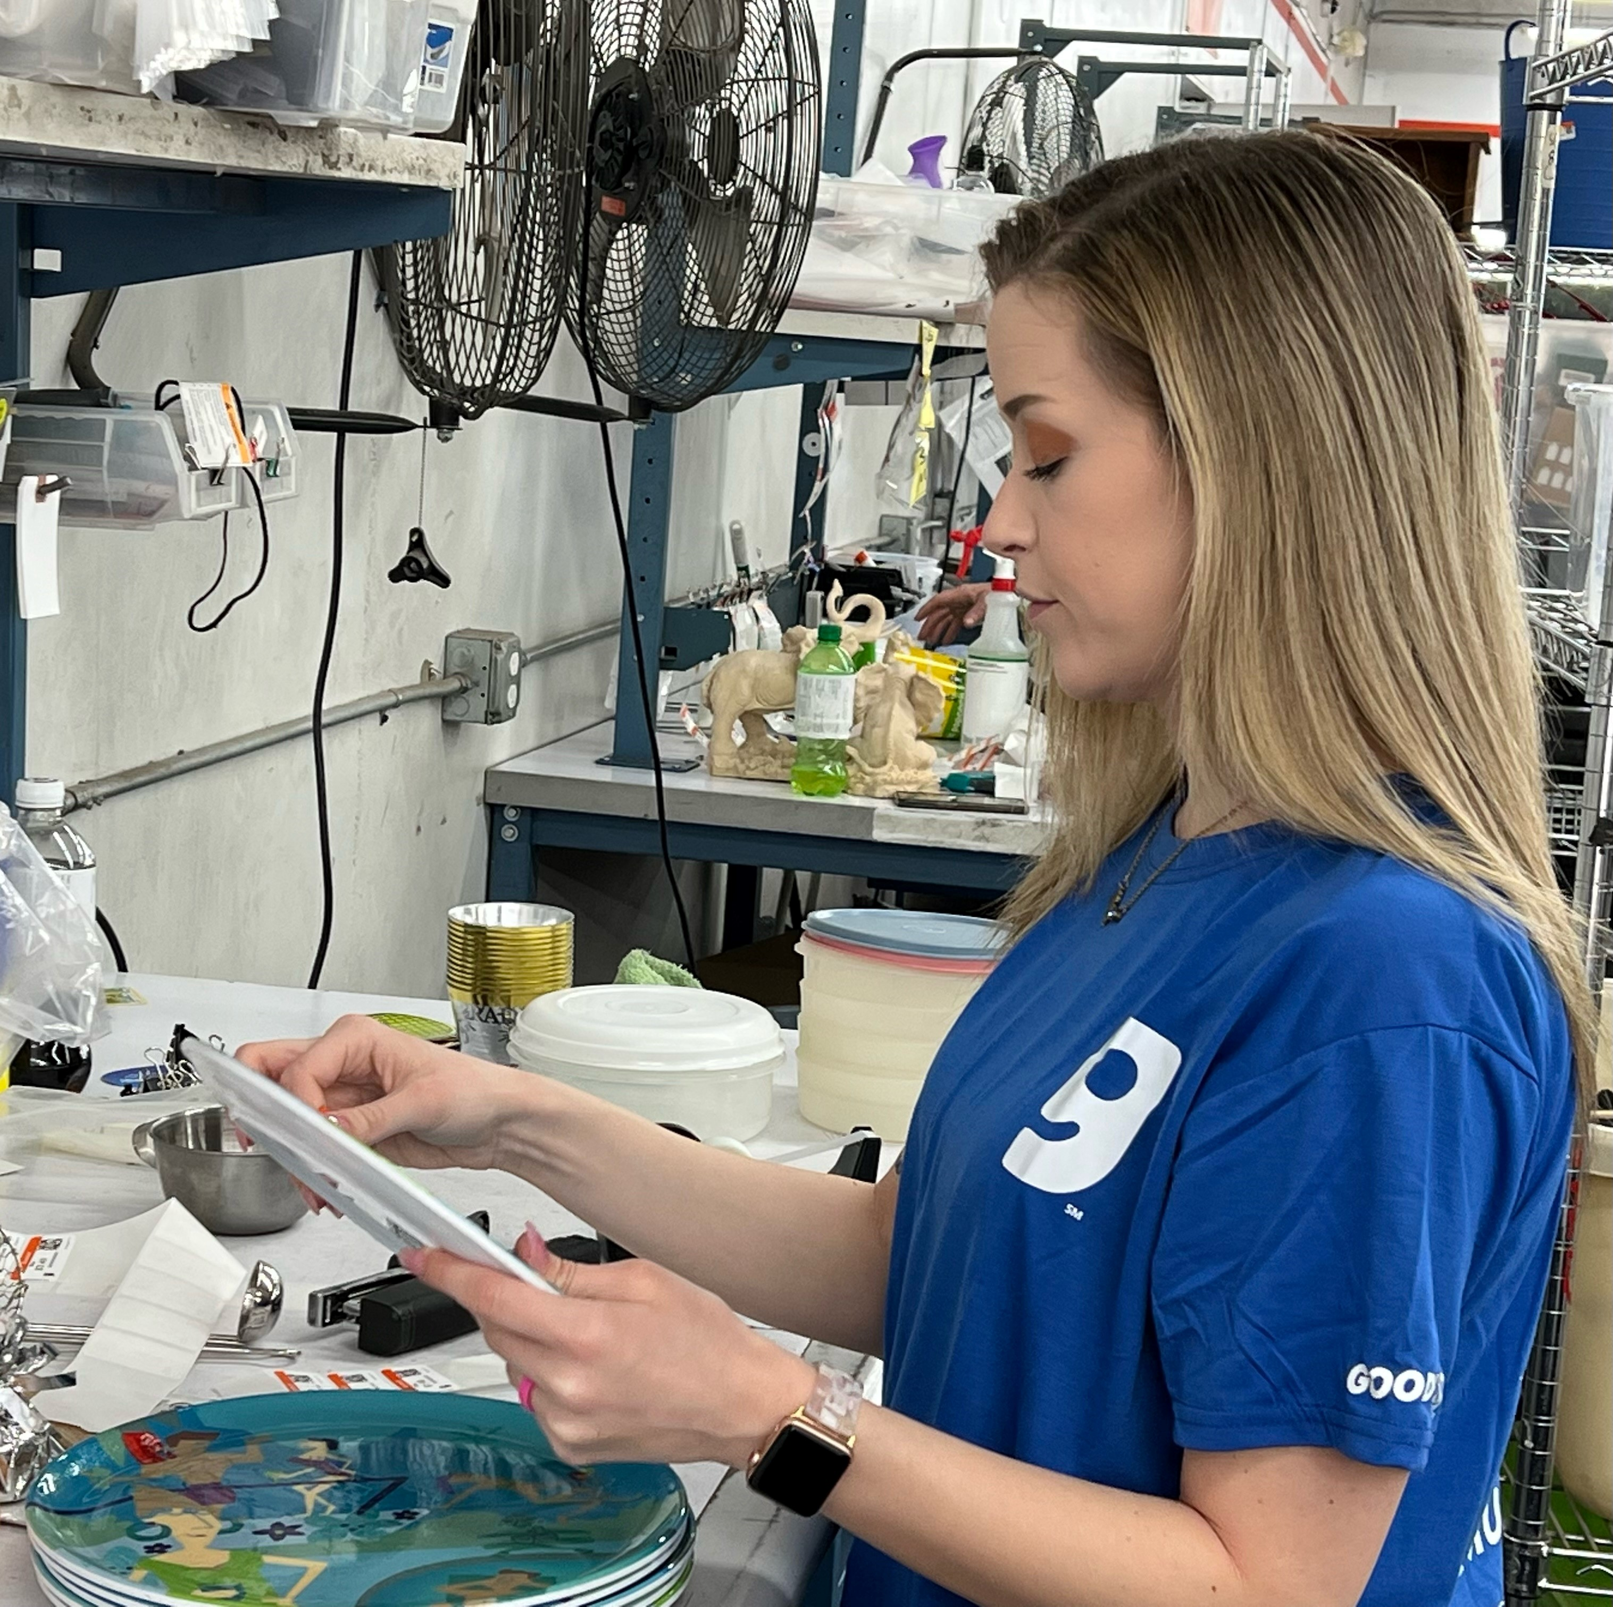
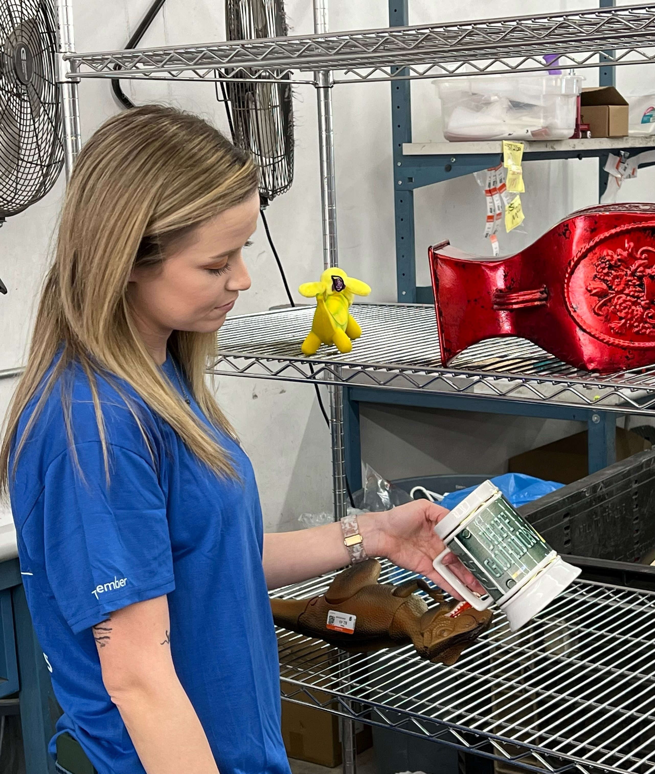
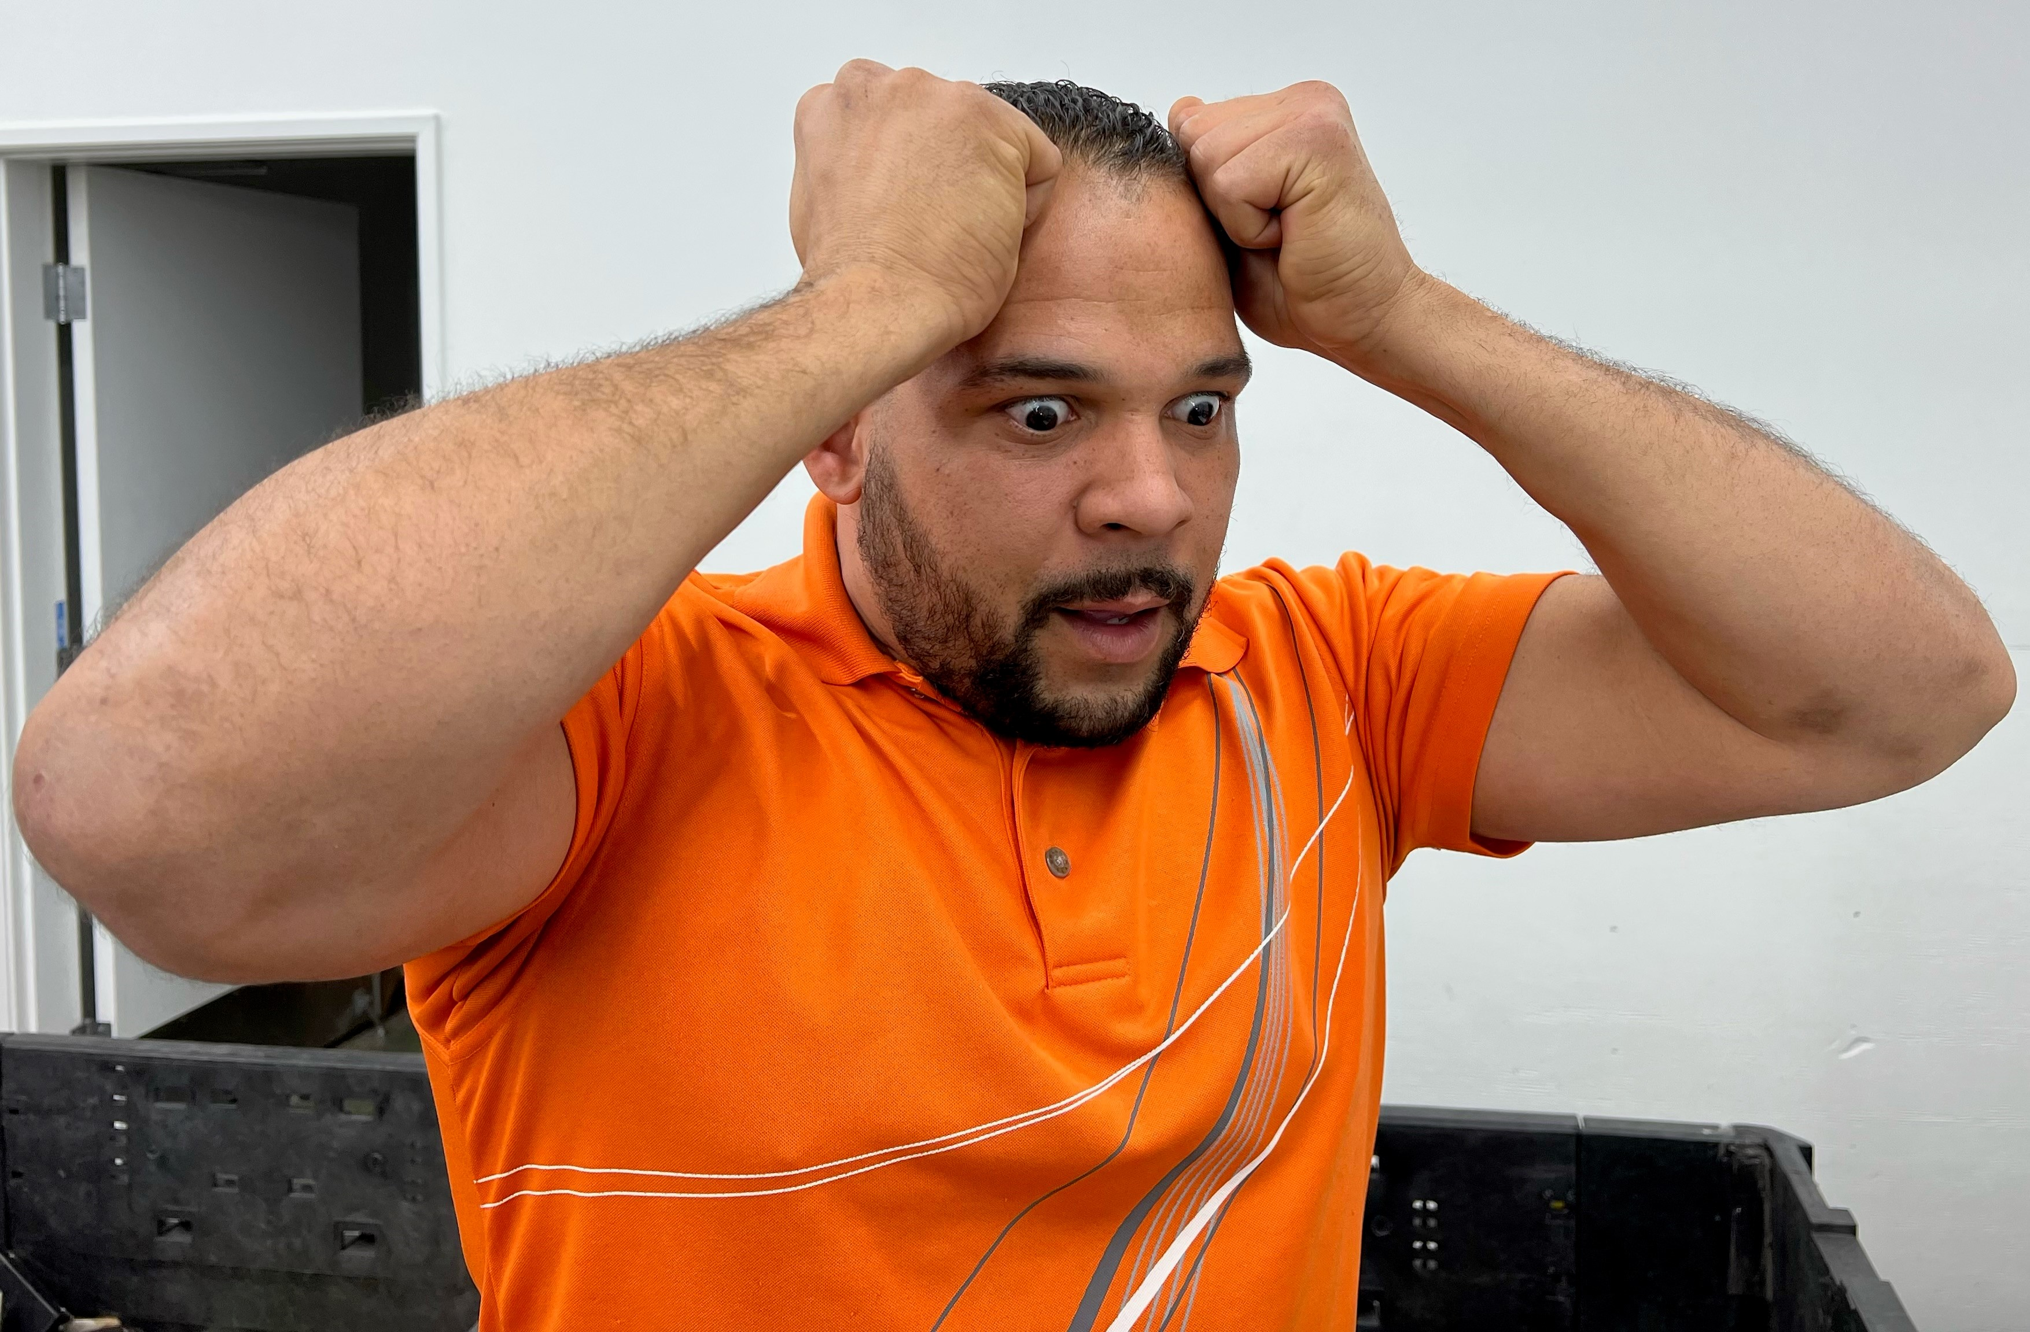
Scenario
Goodwill
Notes:
Scenario 2
Click 1: This is one of our processors….we are going to call her “Bri”.
Click 2: She’s got a great attuited, loves working for Goodwill, and wants to move up within the company!
Click 3: ***

Slide 20
Progressive Action Tree
Issue Identified
Gather Information
Behavior or Attitude?
Performance Gap?
Behavior
Coaching
Performance Coaching
Disciplinary
Action
Performance Improvement Plan (PIP)
Goodwill
Notes:
Let’s review the Progressive Action Tree
Click 1: Identify the issue. So what's the issue in this scenario?
Click 2: Gather Information. What's some information we need to know?
Click 3: Is it Behavior or Attitude? Or is it a Performance Issue?
Click 4: Its not behavior or attitude…
Click 5: Should we coach or have we coached before?
Click 6: So now it’s a PIP right?

Slide 21
Performance Improvement Plan
Goodwill
Notes:
Whats the difference between these two options? NOTHING. :P

Slide 22
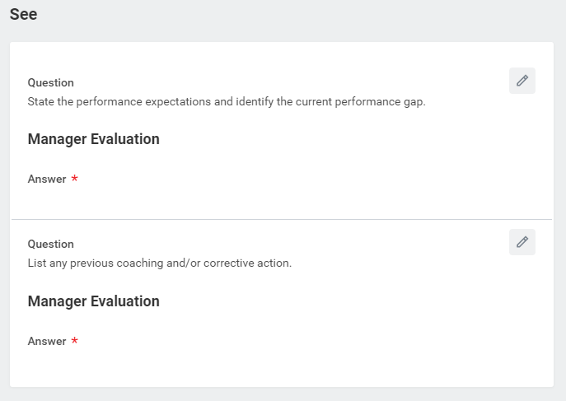
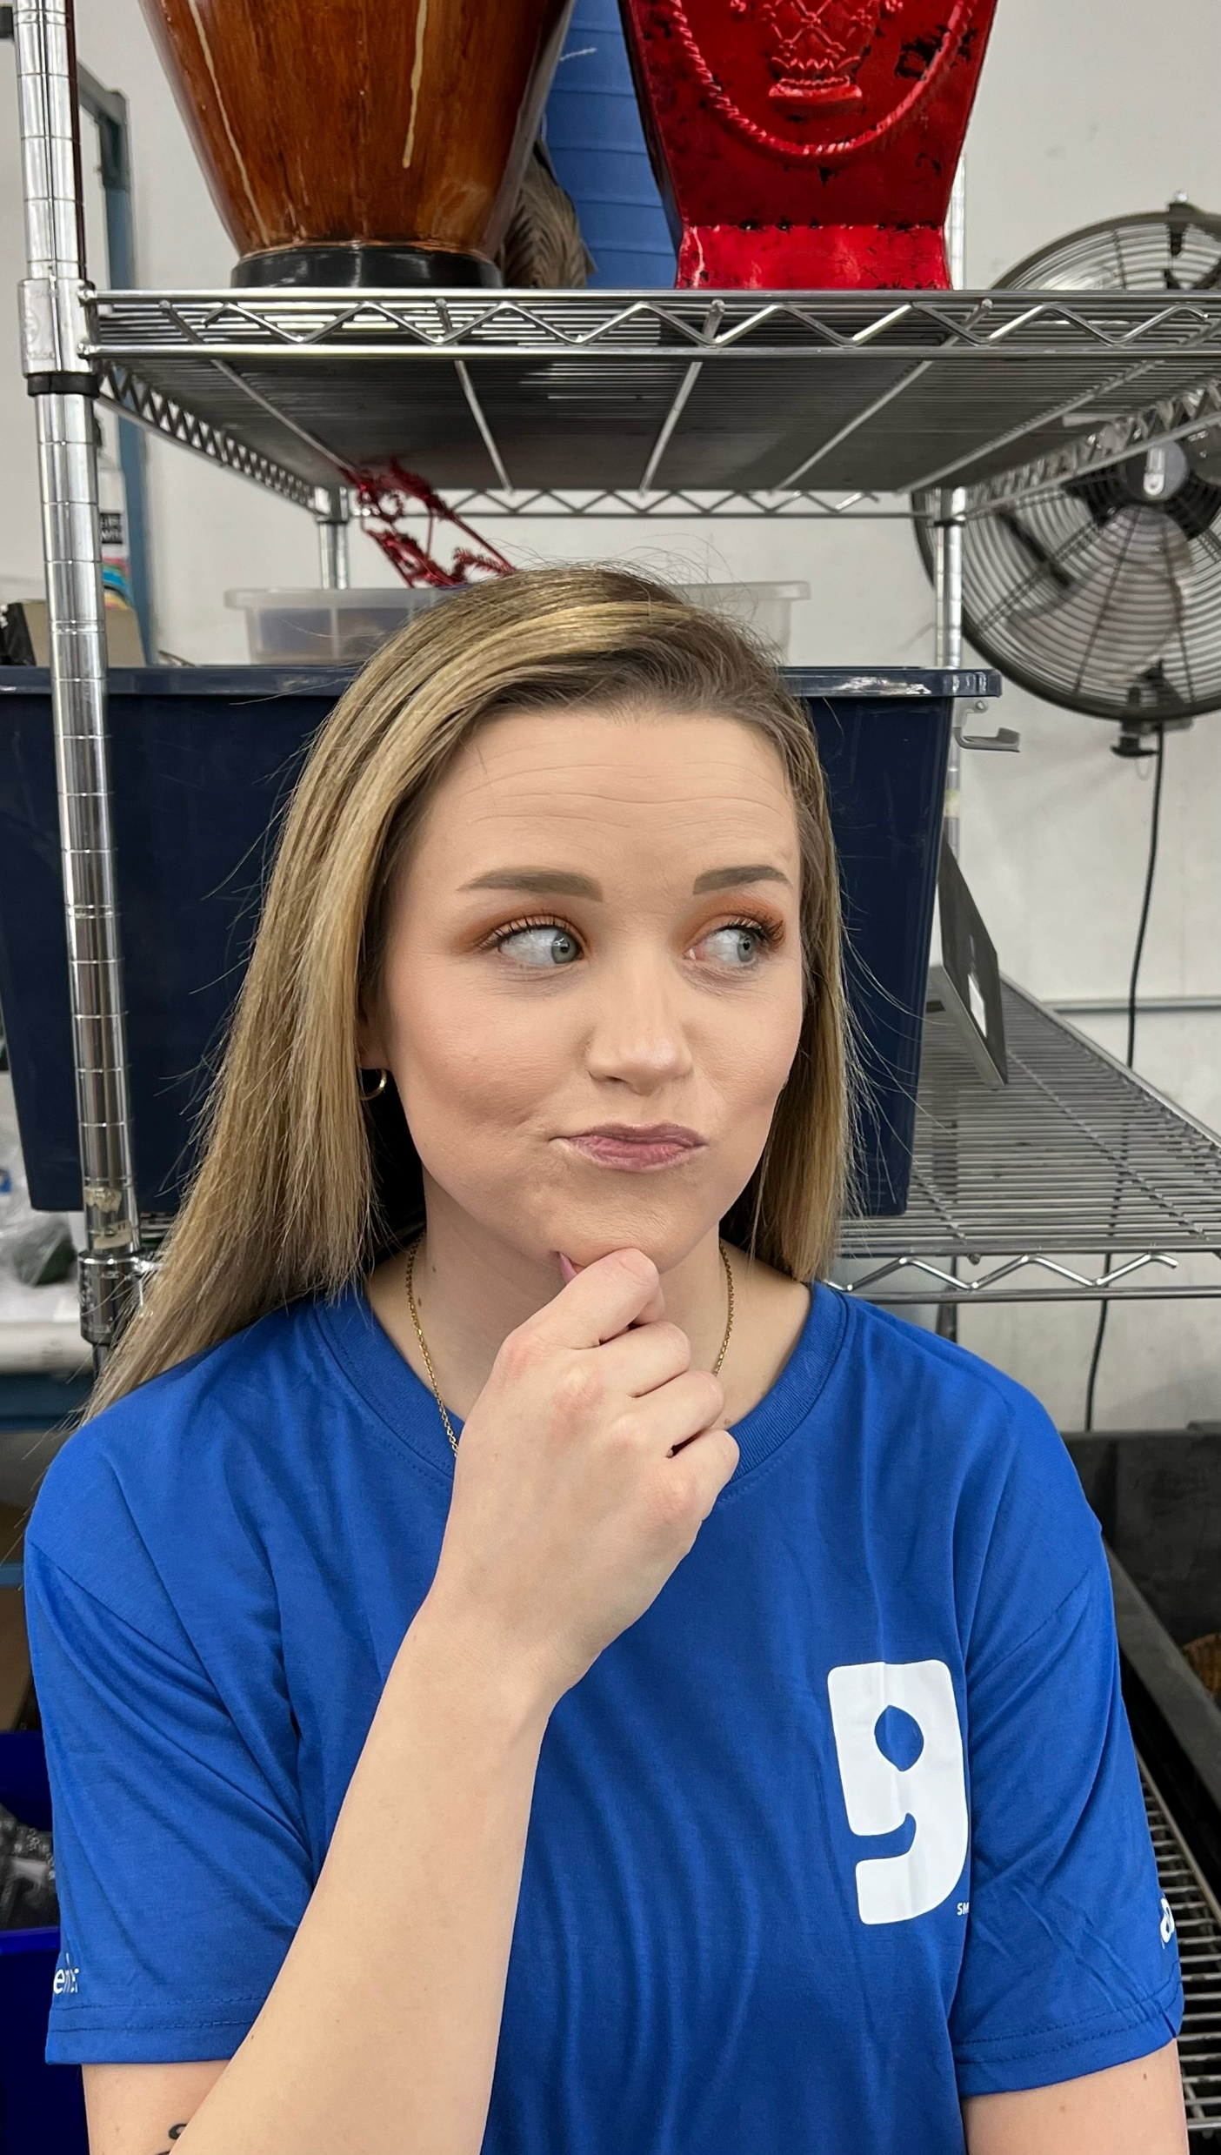
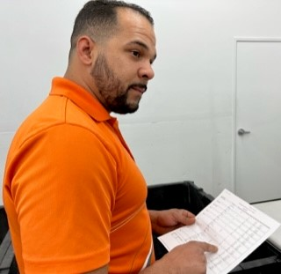
Performance Improvement Plan
Goodwill
Notes:
Whats the difference between these two options? NOTHING. :P

Slide 23
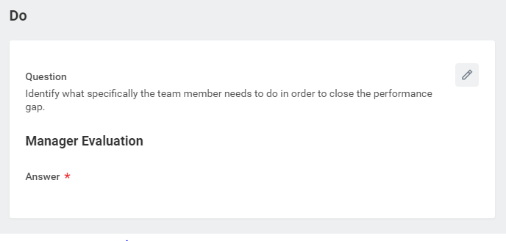
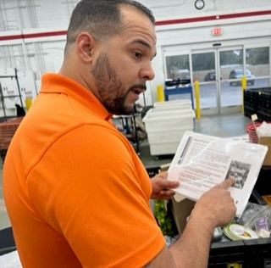
Performance Improvement Plan
Goodwill
Notes:
PIP “DO” CATEGORY
Longest section (typically)
Talk about what the team member needs to do specifically.
Last slide we identified that she puts out too much “filler” so here we will talk about the next steps.
Train with leadership side by side
Identify barriers and address with leadership
Identify higher price product by asking leadership when unsure
Eliminate distractions during processing time
Roll carts after breaks to monitor rolling times
Use blanket pricing guides
Work on creating value through bagging items
etc

Slide 24
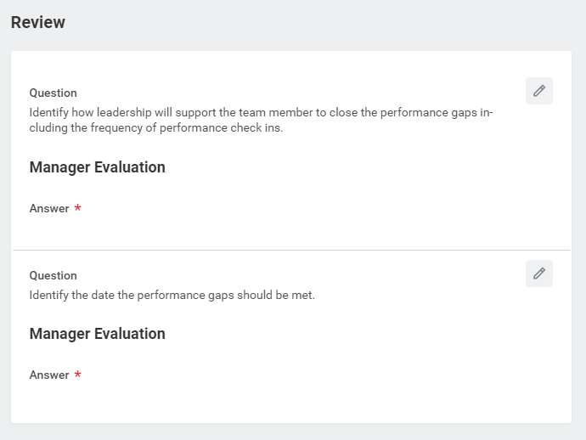
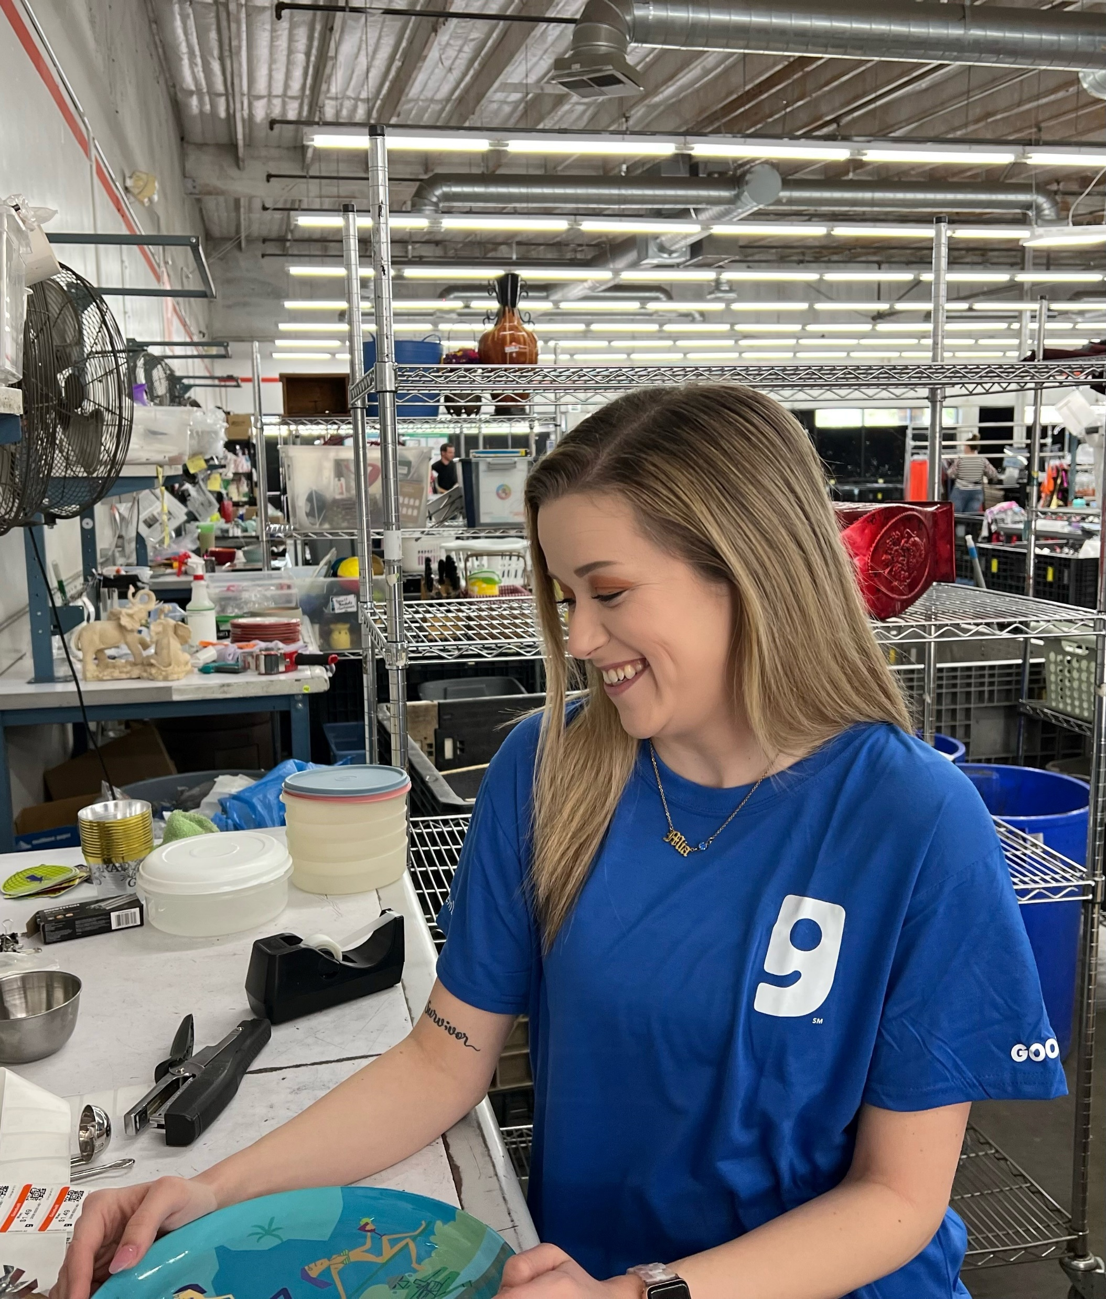
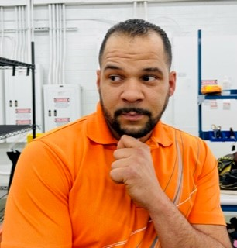
Performance Improvement Plan
Goodwill
Notes:
PIP “Review” CATEGORY
Not auto generated
Progressive dates with benchmarks for each date
Example: 3.3.23 Bri is expected to have a daily avg of 400 pieces processed, a $3.20 price average, an IPG of 115 and roll time within 25 mins.
Build 2^{nn} benchmark with class
Build 3rd benchmark with class
Completion date
Date Bri should be performaning

Slide 25
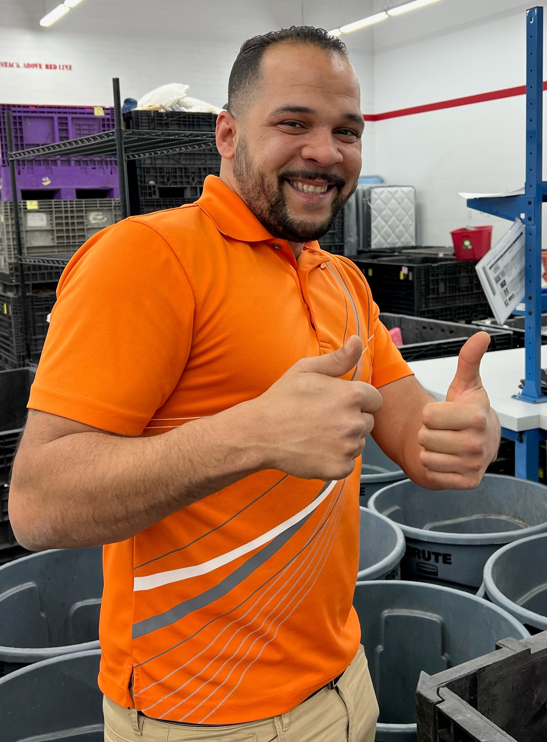
Performance Improvement Plan
Goodwill
Notes:
PIP Supporting Documents – Production Summaries? Supporting production reports?
PIP Enter your comment – Store #
Button Options – same as corrective action

Slide 26
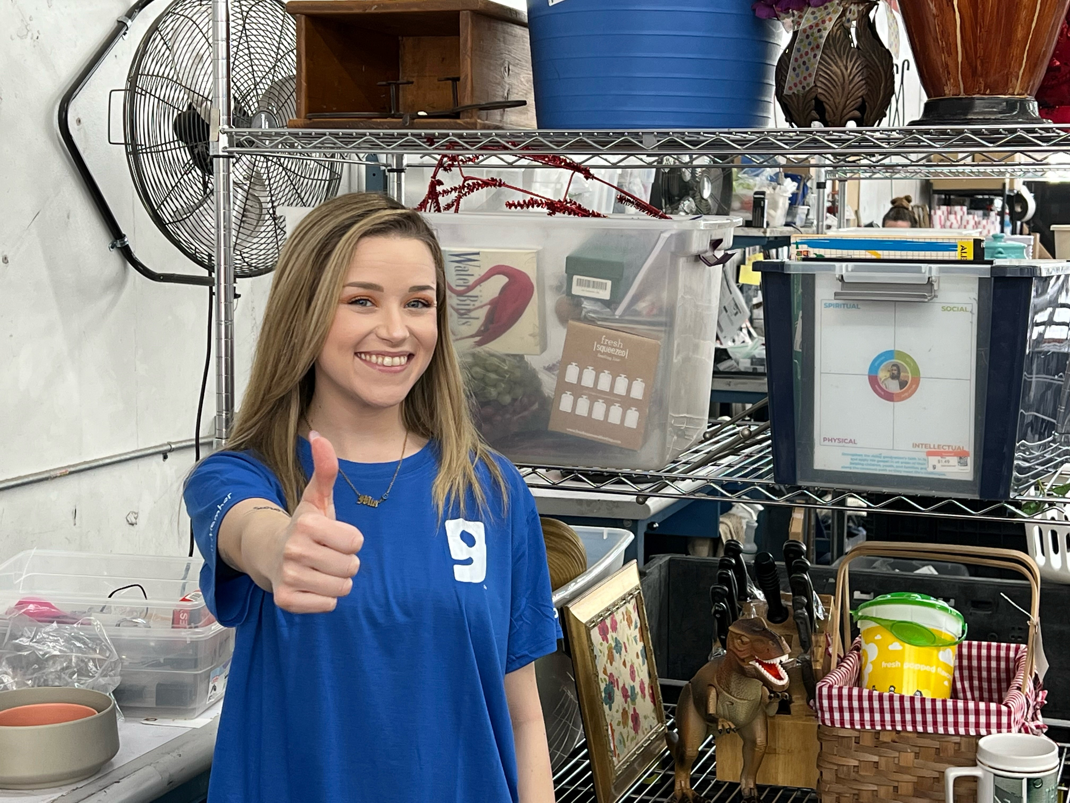
Performance Improvement Plan
Goodwill
Notes:
PIP Supporting Documents
PIP Enter your comment
Button Options

Slide 27
Objectives
Determine the Progressive Path
Identify CA/PIP Differences
Demonstrate CA/PIP Writing Process
Goodwill
Notes:
Review objectives with class to get agreement that objectives were met.

Slide 28
“
Questions?
”
Goodwill
Notes:
What are some key takeaways from the session?

