Slide 1
Retail
Culture &
C O N N E C T
Above the Grade
Goodwill

Slide 2
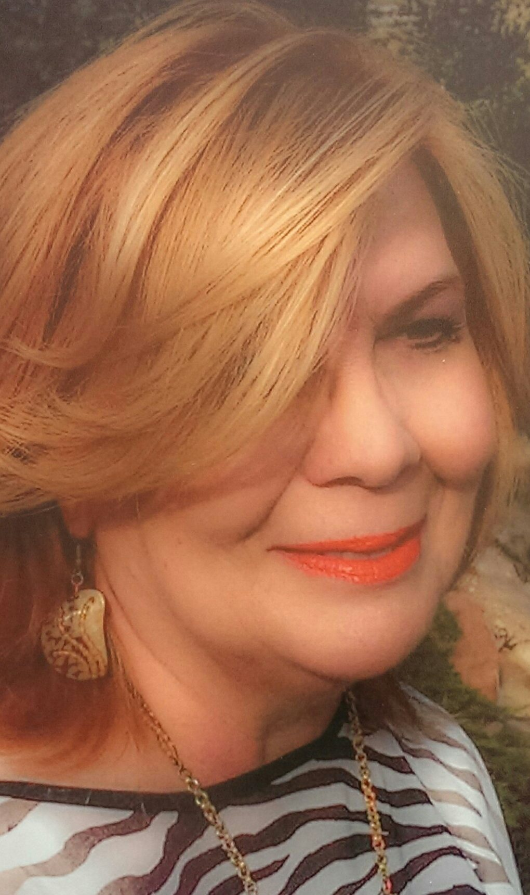
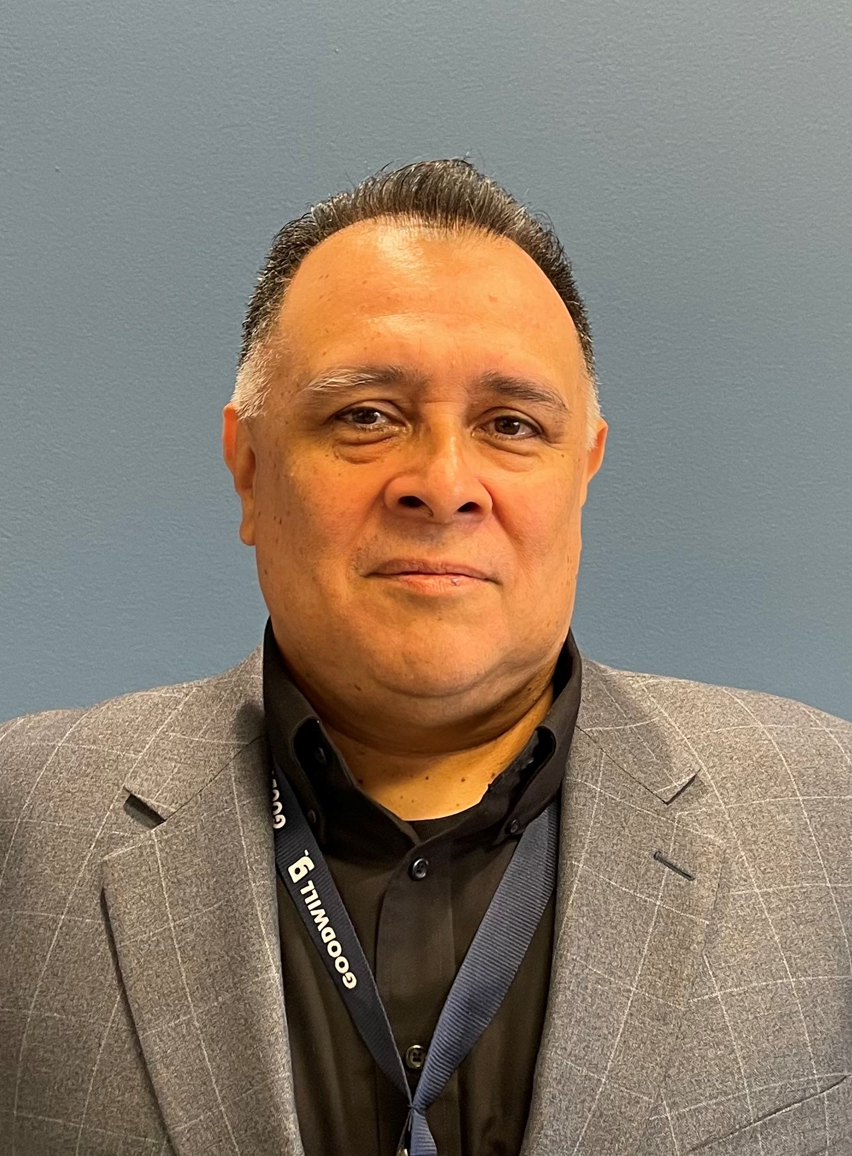
Facilitators
Linda Windsor,
Special Projects Coordinator
Robert Enger,
District Manager
Al Cardenas,
District Manager
Goodwill
Notes:
Natalie will be main presenter
Justin to co present.

Slide 3
Facilitator
Breanna James,
Retail District Manager
Goodwill
Notes:
Natalie will be main presenter
Justin to co present.

Slide 4
Objectives
Discuss and clarify the key elements of Condition and Quality
Identify potential elements of a “BQ” garment
Discuss opportunities to go “Above the Grade”
Goodwill

Slide 5
Condition vs Quality
Icebreaker
Goodwill
Notes:
Condition & Quality Activity
Have participants work in table groups to identify what sorts of things they look for in each category
Example: Condition → Holes, rips, tears, pilling, balling, stretching, etc.
Quality → pattern matching, hidden zippers, embellishments, etc.

Slide 6
It’s All About Condition
Activity
Goodwill

Slide 7
Condition and Quality
CONDITION
Highlights the present state of the item
QUALITY
Focuses on the original value and construction
Goodwill

Slide 8
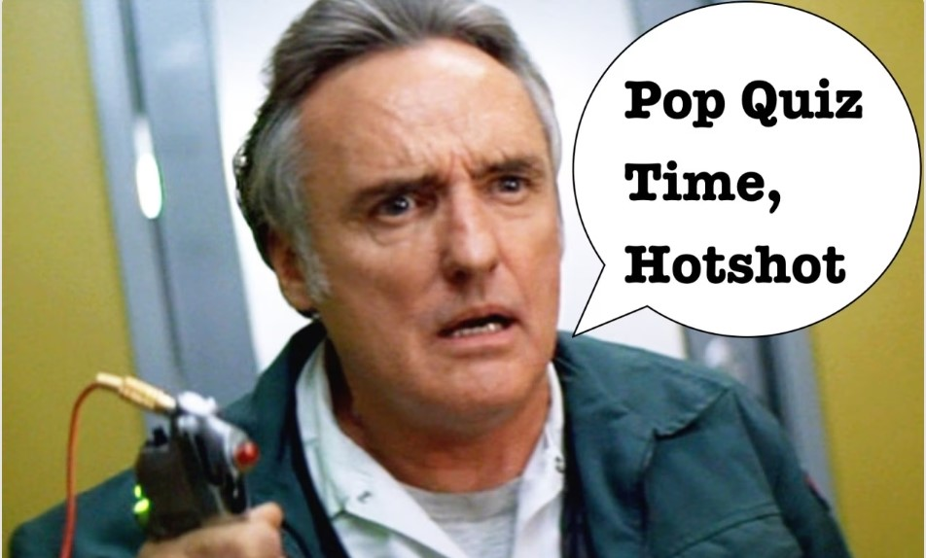
Goodwill
Notes:
POP QUIZ

Slide 9
Above the Grade
What are some of the features that would put a garment above the 1-A grade?
Goodwill

Slide 10
Above the Grade
What are some of the features that would put a garment above the 1-A grade?
BRAND
FABRIC
NEW W/TAGS
STRUCTURE
VINTAGE/RETRO
EMBELLISHMENT
Goodwill

Slide 11
Grading Opportunities
Activity
Goodwill

Slide 12
“
Questions?
”
Goodwill
Notes:
What are some key takeaways from the session?

