Slide 1
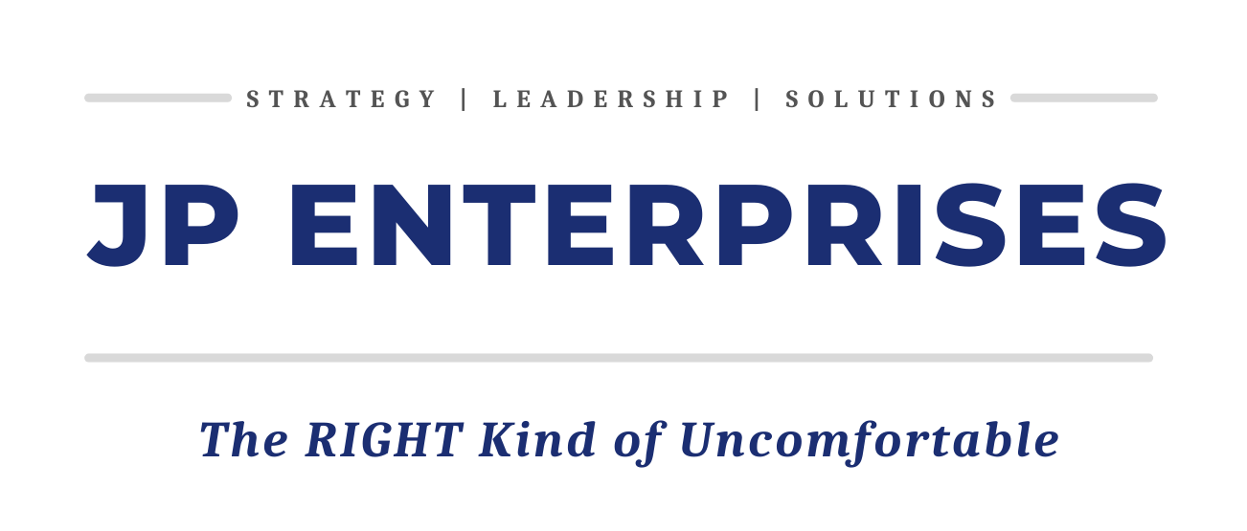
Goodwill: A No Nonsense Experience
JP Enterprises Copyright 2022

Slide 2
Good Faith
With Openness and Honesty.
With Vulnerability and Transparency
With Empathy…(Cognitive vs Emotional)
Without knowing what the result will be
JP Enterprises Copyright 2022
Notes:
Table Leaders:
You have been actively engaged with this work for a bit longer. The expectations for you are different.
You are expected to actively demonstrate ‘Good Faith’ throughout this session.
Additionally, you are expected to assist your colleagues in on ramping their own thoughts using ‘Good Faith’ as a platform.

Slide 3
General Outcomes
Increase willingness to learn more
1
Understand that Leaders and Teams are required for Success
2
Recognize expertise is not required to Lead
3
JP Enterprises Copyright 2022

Slide 4
Let’s start with shared language

Slide 5
The DIBs Model™
Meaningful Interactions w/ People, Places & Systems
Challenge/Reinforce Beliefs and Values
Impacts Behavior & Decision-Making
Change Results/Improve Outcomes/Shift Culture
JP Enterprises Copyright 2022

Slide 6
An Overview of Diversity and Inclusivity
Diversity: The full range of human differences and similarities.
Inclusivity: The level of belonging in an environment. Driven by its leadership, KPIs, policies, practices and procedures.
6

Slide 7
Bias: A pre-judgement in favor/against a person, or group
Conscious…
Happens automatically
Unconscious…
We are unaware it is present
It is out of our control
Triggered by the brain’s quick judgments of people and situations
Influenced by our background
7

Slide 9
Goodwill’s Inclusive Leadership Assessment
JP Enterprises Copyright 2022

Slide 10
JP Enterprises Copyright 2022

Slide 11
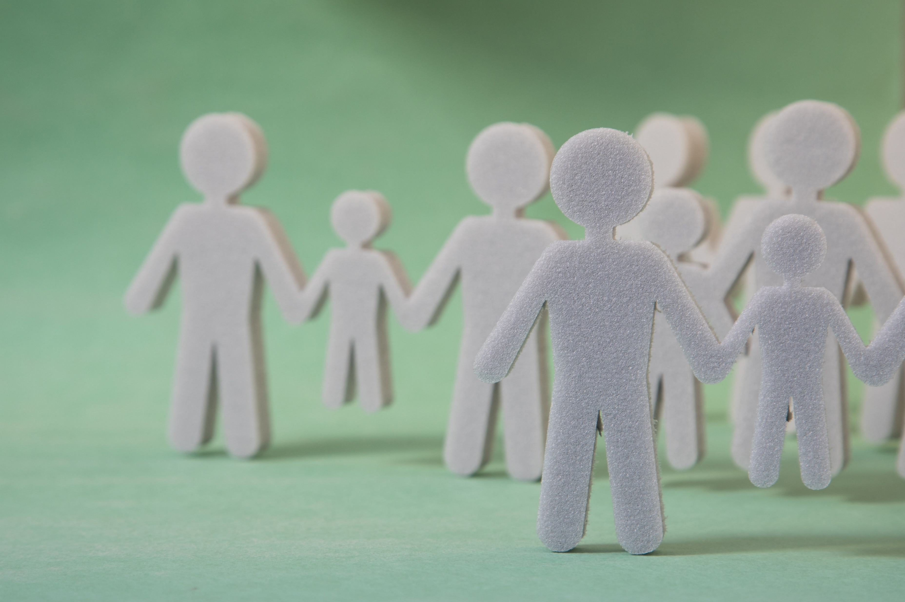
Inclusive Leadership Assessment
Hesitant
I’d prefer to work and interact with people who are like me.
Non-business conversations about difference don’t belong in the office space.
I don’t have issues with people who are different from me, we just don’t have a lot in common.
I am deeply fearful/scared that people are out to get me or ppl like me, they are waiting for me to make a mistake.
I cannot provide a clear definition for Diversity, Inclusion nor Bias
JP Enterprises Copyright 2022
Notes:
What does this look like at Goodwill?

Slide 12
Inclusive Leadership Assessment
Discomfort
I work and interact with people from different backgrounds as a function of my role, it’s a challenge.
Non-business conversation about difference sometimes happen, its uncomfortable. I’m not convinced of a direct business connection.
There’s anxiety around ‘speaking my truth’. I may be admonished or ridiculed. This is not a safe place/time to say the ‘wrong’ thing.
I’m not confident in my definitions for Diversity, Inclusion nor Bias
JP Enterprises Copyright 2022
Notes:
What does this look like at Goodwill?

Slide 13
Inclusive Leadership Assessment
Investigating
I work with different ppl all the time; it can be thought provoking.
Non-business conversations about difference happen, they’re interesting but I rarely see a business connection.
I want to initiate conversations to learn more, but I don’t. I can’t bring myself to ask the questions or share my experience. I’m pretty sure it will be ok, but I can’t/haven’t.
I believe I can define Diversity, Inclusion and Bias but I’m not clear on the differences nor overlap.
JP Enterprises Copyright 2022
Notes:
What does this look like at Goodwill?

Slide 14
Inclusive Leadership Assessment
Experimenting
At work, I push myself to have deeper interactions with people who are not like me.
Non-business conversations about difference happen. I think they make us better.
I encourage myself to ask questions so I can understand other perspectives. I grit my teeth and ask or say what is on my mind, its risky, stressful and necessary.
I believe I can define Diversity, Inclusion and Bias. I’m getting clarity on the differences nor overlap.
JP Enterprises Copyright 2022
Notes:
What does this look like at Goodwill?

Slide 15
Inclusive Leadership Assessment
Engaging
I prefer to work with people who are not like me. It increases innovation and creativity.
Non-business conversation are normal and deepen our connection to each other. Deeper connections make better teams.
I can say what I need to say. I feel ‘safer’ and supported. If a mistake is made, I handle it with grace, respect and if necessary, forgiveness and patience.
I can define Diversity, Inclusion and Bias. I am clear on the differences and overlap.
JP Enterprises Copyright 2022
Notes:
What does this look like at Goodwill?

Slide 16
The Business Case: Diverse Teams are More Productive, Creative, Innovative
Going Deeper…
The Right thing to do: Morals
The ‘Right’ thing to do: Ethics
Risk Mitigation
JP Enterprises Copyright 2022

Slide 17
DEI ‘Conflict’: Things to Remember
We avoid passionate debates that are necessary and essential
Conflict vs Fighting
Similarities: Passion. Emotion. Frustration.
Purpose of Conflict
To the best solution in the shortest period of time
Teams that avoid these conflicts
Do so to avoid hurting one another’s feelings…
But it encourages tension and back-channel attacks

Slide 18
Tools for Working Through Conflict
Acknowledge that conflict is productive
Be a ‘Miner’
Extracts the disagreement
Commitment to staying with the conflict till it is resolved
Real Time permission
Team members help each other engage
Remind each other conflict is necessary
At the end…letting team members know that the conflict was healthy and good for the team

Slide 19
Directions for Table Work
Choose a Table Leader
Responsible for managing the conversation
Choose a Timekeeper
Choose a Note Taker

Slide 20
Table Work Part 1: Calling Out and Calling In.
A complaint has been made by some Team Members that you have not been inclusive towards a particular group.
Team Members have asked to meet with you.
Leaders
What are the next steps you take to help your managers and other team members?
Team Members
What are the questions you need to ask your Store Manager?
What is the information you would want to gather FOR your Store Manager?
Outcome: Identify the Problem. Best possible solution. Every Team Member is heard and engaged.

Slide 21
Table Work Part 2: Cliques can be okay.
Your team has cliques, it is unavoidable.
We want to highlight diversity and not hide it.
Identify example Cliques.
Assume they are valuable
How can we use that value to bring the team together
Outcome: 2 examples of what can be done to create more Inclusion and the feeling of Belonging

Slide 22
Next Steps
Team Members
Store Managers
Insert Inclusion Conversations into regular meetings
Consider an Inclusion Moment
Remember the Open Door swings both ways
Encourage a ‘Speak Up’ Culture…even when it is difficult to do
‘Speak Up’…in a Graceful, Necessary way
Bring Inclusion challenges to your Manager’s Attention
Bring Inclusion Solutions too

Slide 23
What’s Next? Continue the Conversations
Homework: Internal/External
Start/Continue talk re Metrics
Connected to Recruitment, Retention, Promotion, Compensation

Slide 24
E. info@jamespogue.com
L: @drjamespogue
JP Enterprises Copyright 2022

Slide 25
E. info@jamespogue.com
L: @drjamespogue
JP Enterprises Copyright 2022

