Slide 1
Retail Culture & Connect Present:
Notes:
This is a short-term board response to the current market and environmental needs
FAQs:
How many can attend? 10 people maximum recommendation. Please contact Gary or a Board Member if your client would like to train more than 10.
Workbooks will be in hand? Yes.
All those attending will be given access.
How long before we get them rescheduled for training? Ideally 60 days or sooner but will depend on the virus situation.
Payments are due as normal.
We, as your board, will be monitoring the situation daily and be back in touch with updates and changes as needed.

Slide 2
Culture Index Information
Notes:
This is a short-term board response to the current market and environmental needs
FAQs:
How many can attend? 10 people maximum recommendation. Please contact Gary or a Board Member if your client would like to train more than 10.
Workbooks will be in hand? Yes.
All those attending will be given access.
How long before we get them rescheduled for training? Ideally 60 days or sooner but will depend on the virus situation.
Payments are due as normal.
We, as your board, will be monitoring the situation daily and be back in touch with updates and changes as needed.

Slide 3
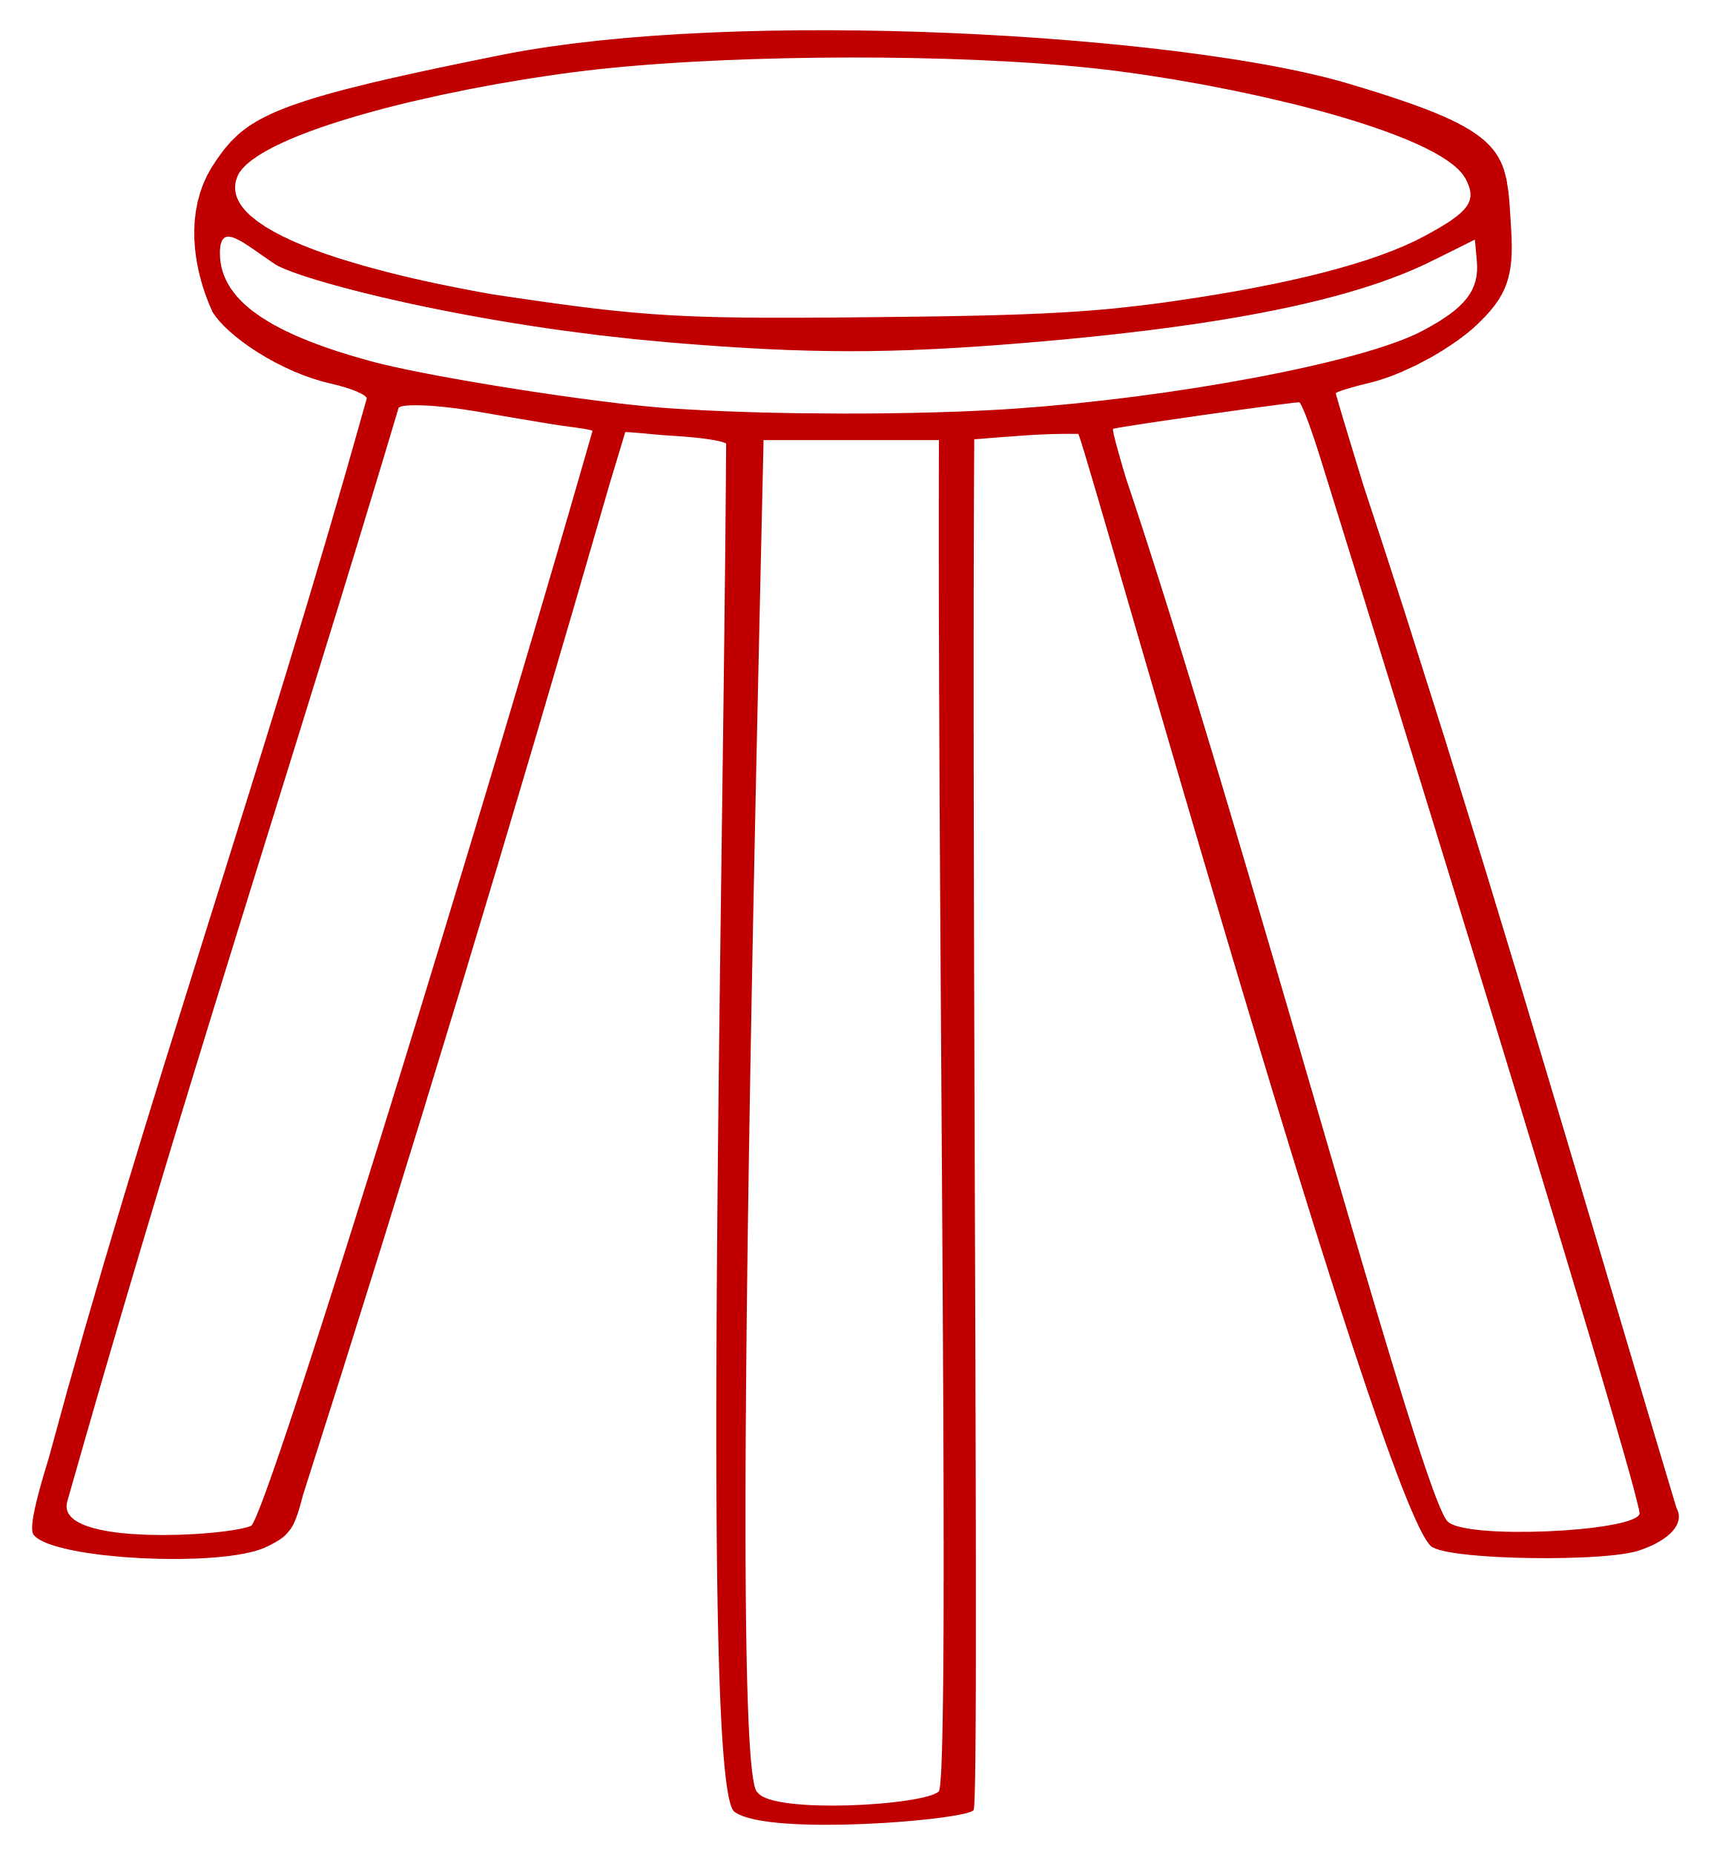
Primary Benefits and Uses of CI
3-Legged Stool
Strategic Hiring (Right People)
Organizational Development (Right Seats)
Scale and Maximization (People Development)
CAN-DO
For every person you add, we want to stack the deck in your favor!
WANT-TO-DO
Brake
Gas
HARD-WIRING (data)
Glue
10%
90%
90%
Notes:
The Primary uses (benefits) of CI is a 3 legged stool
10% of it is for hiring and talent acquisition, the other 90% is problems solving, people growth, communication, talent maximization

Slide 4
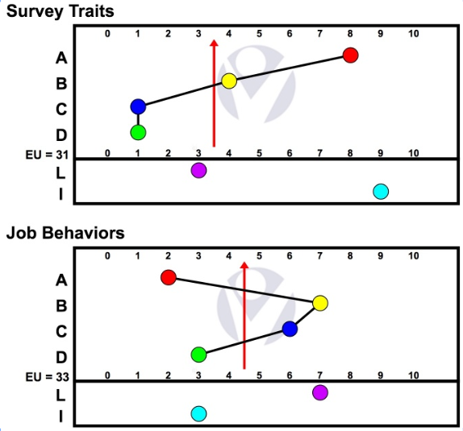
Traits And Behaviors
Seven Work Related Traits
A - Autonomy
B – Social Ability
C – Pace (Patience)
D – Conformity
EU – Mental Stamina
L – Logic
I – Ingenuity
Notes:
Your Introduction
What we do inside of the Culture Index Program is Study, Interpret and Mobilize 7 work related traits in order to drive 3 outcomes: more revenue, more earning and sustainable scale-ability. The purpose of this initial 2-hour overview is a temporary bridge to get the program off the ground until the actual 2 day workshop on MAY XX – XX, 2020 in FILL IN CITY, STATE. This is not intended to replace the 2-day training in person. This will, however, give you temporary full access to the system until you are trained as a true Culture Index Analyst in the 2 day workshop.
Today we are going to focus on interpretation, some basic knowledge transfer, and the C-job best practice. As your Culture Index Executive Advisor, I spend the majority of my energy and time mobilizing or applying all of this data to the top and bottom line growth of your organization. So, please keep in mind this is not a Personality Test. This is a Program you are embarking on to learn and use objective data on all people decisions.
10% of the Culture Index Program is how to find talent. 90% - the large majority of this program – is how do you keep A players on the team and engage them at the highest possible level: how do you get more work done with less labor.
This is going to change the way you look at talent for the rest of your life.
Are there any questions before we jump in?
10 Minutes – Traits Introduction and 3 Graphs
7 Work Related Traits – cannot measure anything clinical nor abnormal
3 Graphs – Traits, Job Behaviors and C-job (Required Behaviors)
Please notice on my screen here the Top Graph is Survey Traits and the Bottom Graph is Job Behaviors.
What is the difference between a Trait and a Behavior? (Call someone by name to answer to maximize time)

Slide 5
Survey Traits – Top Graph
Intrinsic
Environmental and hereditary (Nature vs Nurture)
Traits stay constant
Hard wired by 12
Think of the top graph as your personality Thumb Print
Notes:
Traits don’t change. Set by 12 years old. HIRE to the Top Graph and MANAGE to the Bottom Graph.

Slide 6
Job Behaviors – Bottom Graph
Behaviors are learned and can be modified
Follows observations and perceptions
Fluid and changing at will
A response to external demands and inputs
Notes:
Traits don’t change. Set by 12 years old. HIRE to the Top Graph and MANAGE to the Bottom Graph.
Touch on the concept of the C-job (Required Behaviors Graph)

Slide 7
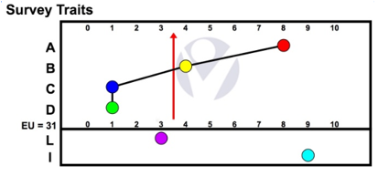
The Bell Curve
DOTs on the right side of the arrow are Higher than average
DOTs on the left side of the arrow are Lower than average
DOTs exactly cut in ½ by the arrow are Normative
-2.5
+4.5
+0.5
-2.5
Notes:
10 Minutes – Bell Curve
The first 4 traits are only measured comparatively on a standard 6 sigma sliding bell curve. The last 3 traits are specific placement.
High, Low and Normative.
Somewhat, Very & Extremely.
Place a person attending the training actual survey on the screen after the explanation and ask people by name about each trait (high, low, normative and how obvious, apparent or predictable each trait is relative to the red arrow).

Slide 8
Autonomy
(Control of Destiny)
Notes:
The Gas Pedal of the Profile
[P22-25]
Sort all profiles into 2 piles (High and Low)
Autonomy = Inner Directed Ego System
Inner: Thinking of Future from Within
Directed: Forward
Ego: From and For Self
System: Systematically planning and prioritizing to solve problems necessary to reach goals
{write on wall pages as discuss}
Page 21: HIGH A (autonoME) — Hostile (proactive)
Looking at your stack of high As, let’s fill out page 21
Traits
Motivating Needs
Pluses
Minuses
Page 22: LOW A (autonomoUS / accommodating) — Friendly (reactive)
Looking at your stack of low As, let’s fill out page 22
Traits
Motivating Needs
Pluses
Minuses

Slide 9
A – Autonomy
Low A
Selfless
Present
Consensus
Team Player
Amiable
Agreeable
Peaceful
Timid
Humble
Unobtrusive
High A
Independent
Proactive
Macro
Enough = More
Confident
Self-Starter
Assertive
Resourceful
Individualistic
Competitive

Slide 10
Social-Ability
Need Want & Desire to Seek Social Acceptance
Notes:
The Glue of the Profile
[P26-29]
Sort all profiles into 2 piles (High and Low)
Simplistically: Introversion vs. Extroversion
{write on wall pages as discuss}
Page 25: HIGH — Friendly (proactive)
Looking at your stack of high Bs, let’s fill out page 25
Traits
Motivating Needs
Pluses
Minuses
Page 26: LOW — Hostile (reactive)
Looking at your stack of low Bs, let’s fill out page 26
Traits
Motivating Needs
Pluses
Minuses

Slide 11
B – Social-Ability
Low B
Reserved
Factual
Cold/distant
Technical
Skeptical
Facts
Data
Introspective
Reflective
Quiet
High B
Relational
Small talk
Optimistic
Empathetic
Enthusiastic
Persuasive
Sociable
Friendly
Socially Poised
Warm/Approachable

Slide 12
Patience
(Pace)
Notes:
The Lighter Fluid or Water of the Profile
[P30-33]
Sort all profiles into 2 piles (High and Low)
Two concepts within this construct:
Pace/Patience: sense of urgency vs laid-back
Focus: multi-task vs single-task
{write on wall pages as discuss}
Page 29: HIGH (stable, patient, singular focus) — Friendly (reactive)
Looking at your stack of high Cs, let’s fill out page 29
Traits
Motivating Needs
Pluses
Minuses
Page 30: LOW (urgent, impatient, multi-focus) — Hostile (proactive)
Looking at your stack of low Cs, let’s fill out page 30
Traits
Motivating Needs
Pluses
Minuses

Slide 13
C – Patience (Pace)
Low C
Tense
Impatient
Quick
Fast
High-Strung
Intense
Disruptive
Multitask
Restless
High Sense of Urgency
High C
Patient
Methodical
Routine
Steady
Single Focus
Relaxed
Stable
Calm
Check List Oriented
Deliberate

Slide 14
Conformity
(Knowledge, Rules)
Notes:
The Brake of the Profile
[P34-37]
Sort all profiles into 2 piles (High and Low)
Think details, need to conform, perfectionism
{write on wall pages as discuss}
Page 33: HIGH (conforming) — Hostile (reactive)
Looking at your stack of high Ds, let’s fill out page 33
Traits
Motivating Needs
Pluses
Minuses
Page 34: LOW (non-conforming) — Friendly (proactive)
Looking at your stack of low Ds, let’s fill out page 34
Traits
Motivating Needs
Pluses
Minuses

Slide 15
D – Conformity
Low D
Out of the box
Unrestricted
Unconcerned
Argumentative
Non-conforming
Informal
Casual
Uninhibited
Careless
Non-Compliant
High D
Detailed
Micro/small picture
Historical
Blame avoidant
Rules
Accurate
Careful
Thorough
Precise
Disciplined

Slide 16
Energy Units
(Daily mental Stamina – size of gas tank)
Notes:
[P38-41]
Sort all profiles into 3 piles (below 30, 30-60, above 61)
0-10 and/or 90+ Avoidant
11-30 Low – will need to set aside time to recharge mental batteries (AA batteries)
31-60 Average – normative (C batteries)
61-90 High – almost tireless focus (D batteries)
Think: if we unplug the laptop – how long will the battery last before it needs to be recharged?
Also, How long someone can act outside of their Traits (Exp: High EU might outlast the probationary period)
EXTREMELY Helpful in coaching!
+10/-10 shows stress of lack of engagement
4 Step Process to Evaluate
Do I have a current survey?
Is there a 10 point+ shift either way?
Don’t assume negative! (Ask with curiosity)
Let the dots speak (tell the story) - don’t weaponize
-10 Do you currently feel underutilized?
+10 How are you doing?

Slide 17
EU – Energy Units
The degree of behavioral adaptability and general activity level of a person.
Potentially Lower Avoidant (0-10)
Lower EU (11-30)
Average EU (31-60)
Higher EU (61-90)
Potentially Higher Avoidant (90-100)
4 KEY REASONS TO UNDERSTAND EU:
Determines energy level / stamina a person possess
Loosely determines placement on the graph
Flag Avoidant/Invalid – Validity
Levels of morale/stress may be experiencing
Notes:
5 Minutes – EU

Slide 18
Logic
(control of emotion, not lack of emotion)
Notes:
[P42-43]
Sort all profiles into 3 piles (0-2, 3-7, 8-10)
“Emotional EKG”
0-2 Heart on sleeve (Mountains)
3-7 Norm (Rolling Hills)
8-10 Heart in a box (Flat line)
If a low L wants to improve, some advice is: you cannot control your 1st thought or feeling, but you can control your 2nd. The question to ask themselves is am I coming at this from a rational or emotional point of view, also rely on your team, so talk to someone with a high L.

Slide 19
L – Logic
Measure of the first filter in decision making and experiences.
Lower-L Traits (0-2)
Normative-L Traits (3-7)
Higher-L Traits (8-10)
Lower L = First filter is heart, feelings more visible (impulsive)
Higher L = First filter is head, feelings more controlled (black/white)
Affects the analysis of A, B, C, and D Traits

Slide 20
Ingenuity
(Ingenious / Inventiveness)
Notes:
[P44-45]
Sort all profiles into 4 piles (0-2, 3-6, 7-8, 9-10)
Ingenuity – Cleverness or originality – Imagining things not yet in existence – abstract reasoning
0-2 – Linear (Directions to open the box before they get the directions to put the toy together)
3-6 – Norm
7-8 – Unusual
9-10 REALLY unusual (in a garage thinking up stuff we don’t even know we need!)
Ingenious vs. Creative –
Creative
High A and/or C + Low D = Yes!
Ingenious? Not necessarily
Low A and/or C + High D = No
Ingenious? ????

Slide 21
I – Ingenuity
The degree of inventiveness and the originality of thinking.
Continuum
0 – very literal, black/white, why fix what ain’t broke
10 – very abstract, thoughts not tethered to reality
Normative-I Traits (0-6), more literal
Higher-I Traits (7-10), spatial reasoning, cleverness or originality

Slide 22
Self Awareness and Understanding
“First be a leader of yourself. Only then can you grow to lead others.” David Taylor-Klaus
QUESTIONS TO DISCUSS Once you have your individual survey.
What have you learned about yourself?
What is your primary driver/motivator/where you gain confidence?
Are you Predictable? Are you Malleable?
With your dominate trait, why does the opposite challenge you?
In your Role, where do your predictive behaviors help….and where do they create hurdles?
Why do people follow you?
Are you aware of leading people differently than you want to be led?
How does stress impact you (energy, temper, joy, engagement)?
Notes:
5 Minutes – Ingenuity

Slide 23
LOW
HIGH
Can be perceived as …
Can be perceived as …
Reactive
Friendly
Hostile
Proactive
Autonomy
Reactive
Hostile
Friendly
Proactive
Social-Ability
Proactive
Hostile
Friendly
Reactive
Patience
Proactive
Friendly
Hostile
Reactive
Conformity
Notes:
P46
Reminder of reactive/proactive and friendly/hostile
Here’s where it’s important to remember first impressions …

Slide 24
Factor Emphasis Connecting the Dots
Notes:
Remember, the four dots that create the pattern correlate to each other. There are also combinations that are worthy of mention.

Slide 25
The A:B Relationship
Deductive Reasoning
Inductive Reasoning
Notes:
A≥B = Deductive
A>B problem solving, innovative, use data and facts to get to a conclusion, analytical, deductive, reasoned thinker (tech & visionary patterns)
When A>B and right of the line: all of the above plus big pic, long term, future
When A>B and left of the line: all of the above plus reactive, today-oriented, but still solving some smaller probs
A<B = Inductive
When B>A not seeking data, seeking validation; inductive, auditory/visual learner, takes all pieces/experiences they can touch, feel, see (social & org patterns)
How to train an inductive thinker: experience it over and over again, indoctrinate, verbal processing, ride-alongs, etc.

Slide 26
The A:B Relationship (Stacked)
Notes:
Reading A/B Stacks
Left of Normative (move A right – A WINS)
Right of Normative (move B right – B WINS)
Tip: A always moves towards the red arrow in an A/B stack

Slide 27
The A:D Relationship
Macro Thinking
Micro Thinking
Gas
Brake
Notes:
Every position is either offense (need to win) or defense (make sure it’s right)
A>D macro, offense, topline, proactive (visionary or social pattern) [click] GAS
D>A micro, defense, bottom line, reactive, specific (technical or org pattern) [click] BRAKE

Slide 28
The C:D Relationship
Normative Behavior
Total
Non-Compliance
Detail on important things… situational conformity/follow through
Notes:
Total Non-compliance vs Situational conformity
Left of normative line: Hookback or Corporate Hook - Follow through

Slide 29
The A:C Relationship (amplifier)
More urgency, more drive, higher tension, greater ambition, WIN NOW!
More accommodating, diplomatic, collaborative, risk hesitant, more direction
Notes:
Measurement of Inner Tension and Drive
C amplifies A

Slide 30
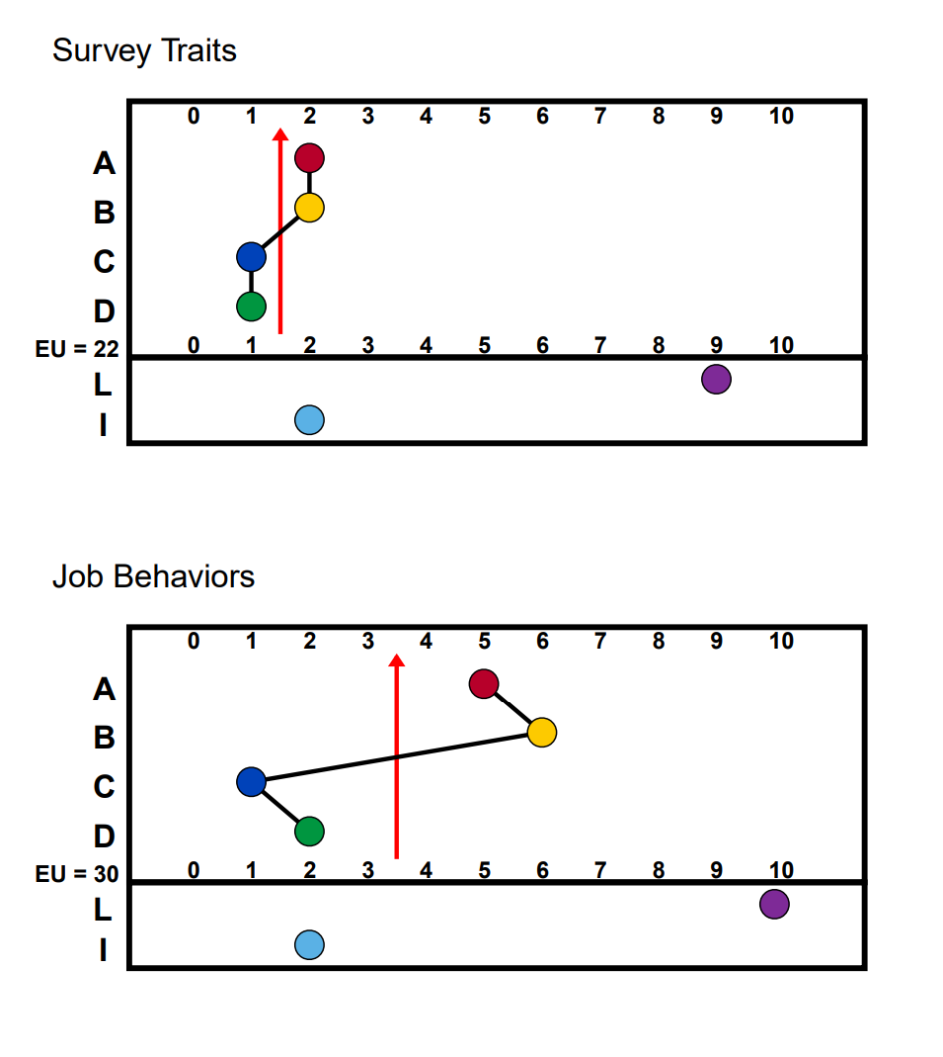
Examples - Aligned
Notes:
5 Minutes – Ingenuity

Slide 31
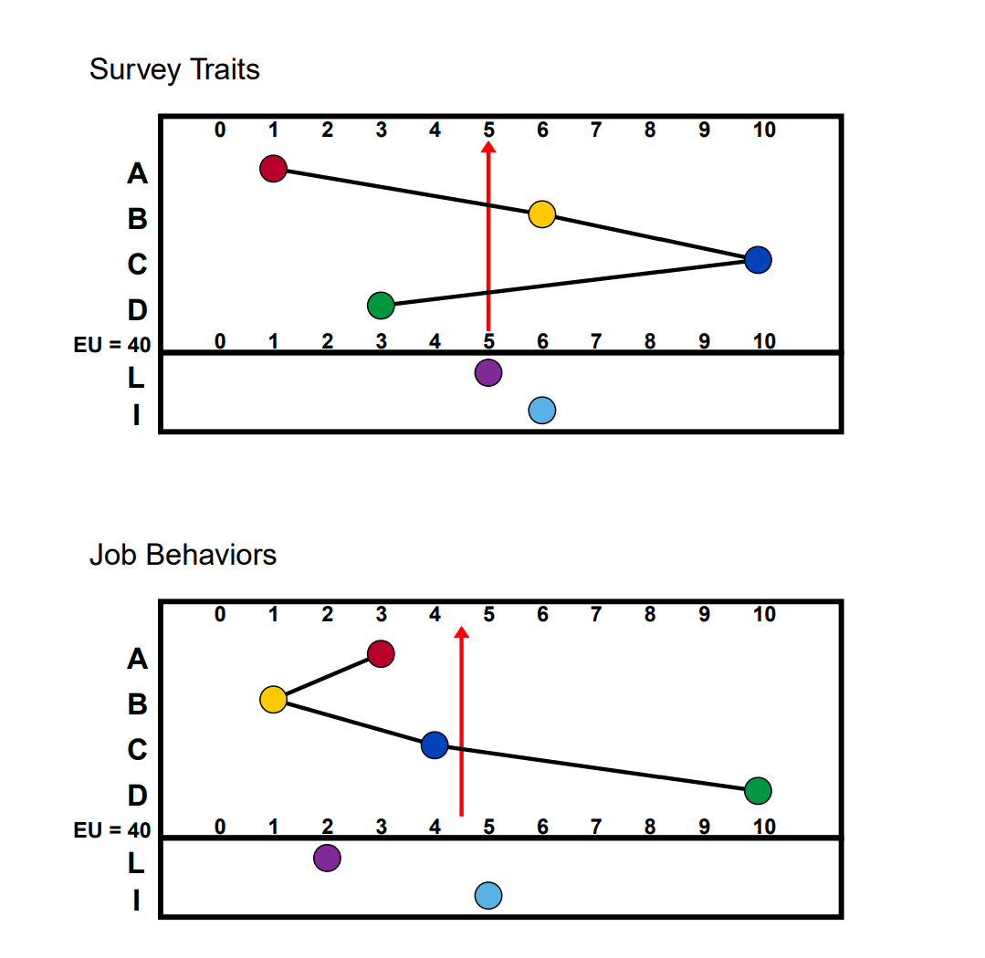
Example - MisAligned
Notes:
5 Minutes – Ingenuity

Slide 33
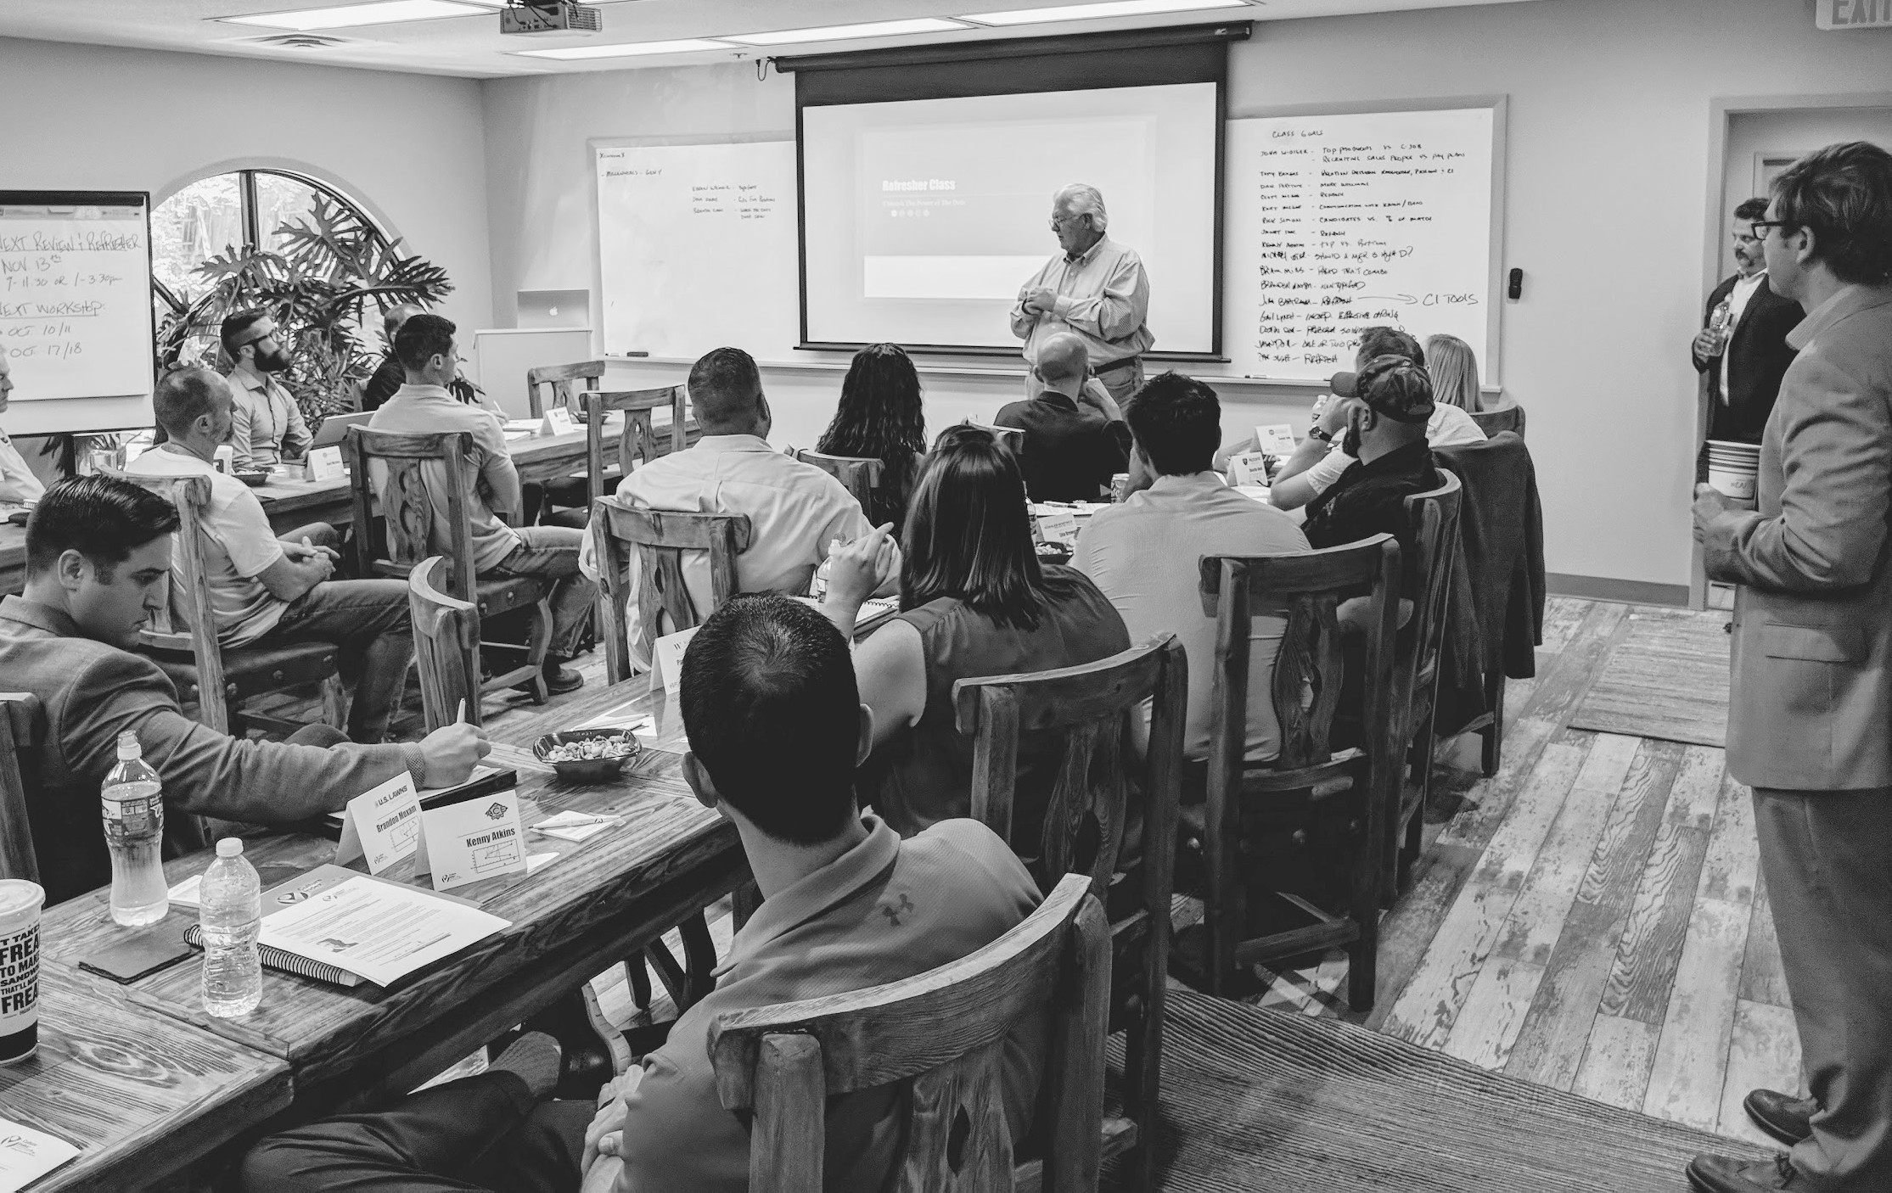
Thank you
Notes:
Be sure to highlight dates at closing as final reminder for the in-person workshop dates and location. Confirm the dates are on everyone’s calendar.

