Slide 1
PICTURE PROCESS MAPS (PPM)
Cash and Coins
April 2025

Slide 2
PURPOSE AND TABLE OF CONTENTS
Cash and Coins
PURPOSE
The Cash and Coins Picture Process Map (PPM) outlines the step-by-step process for handling, sorting, and lotting any currency and coins. This includes but is not limited to, American and foreign currency, gaming tokens, casino chips, and military coins. This PPM provides instructions on how to set up the sorting station, the required materials, and a general process for sorting and lotting. The purpose of this guide is to help processors do their job accurately, ensuring all items are correctly sorted.
TABLE OF CONTENTS
Required Tools and Materials | 2
Workstation | 3
Sorting Category Examples | 4
Sorting Process | 5
Additional Notes | 6

Slide 3
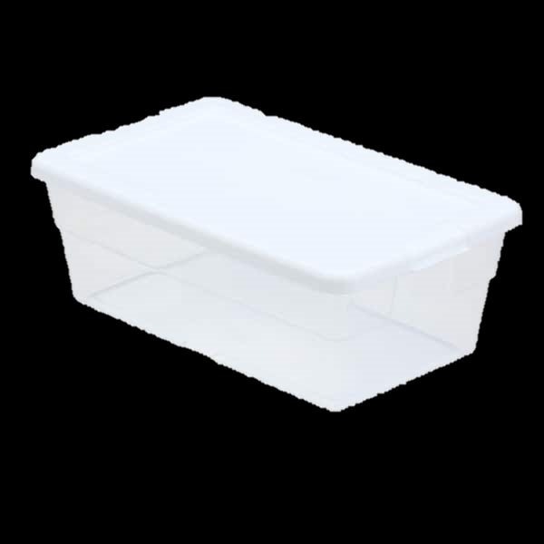
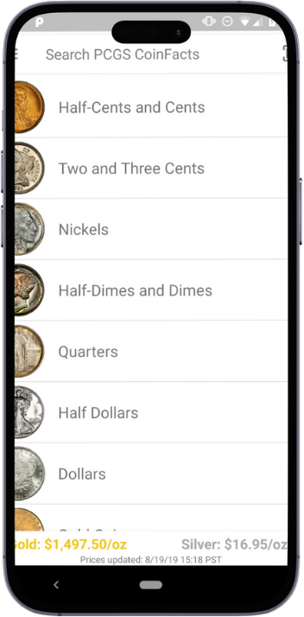
REQUIRED TOOLS AND MATERIALS
Cash and Coins
Plastic bins
Small, medium, and large clear bags
Clear stackable containers
Black marker
Loupe magnifier
Black velvet tray
iPhone with PCGS CoinFacts app
(US coins only)
You will need the following:

Slide 4
WORKSTATION
Cash and Coins
1
2
3
4
5
6
7
8
9
10
11
12
13
15
14
Foreign Currency
American Currency
Commemorative / Recover Coins
Military / Police Coins
Pennies (Pressed, Wheat, Steel, and Indian Head)
Casino Chips / Gaming Tokens
Antique Coins
Research Bin
Lots Bin
Reroutes (Jewelry / Collectables)
Reroutes (Gift Cards)
Shred (Credit Cards, IDs, etc.)
Black Tray
Unprocessed Product
Trash Can

Slide 5
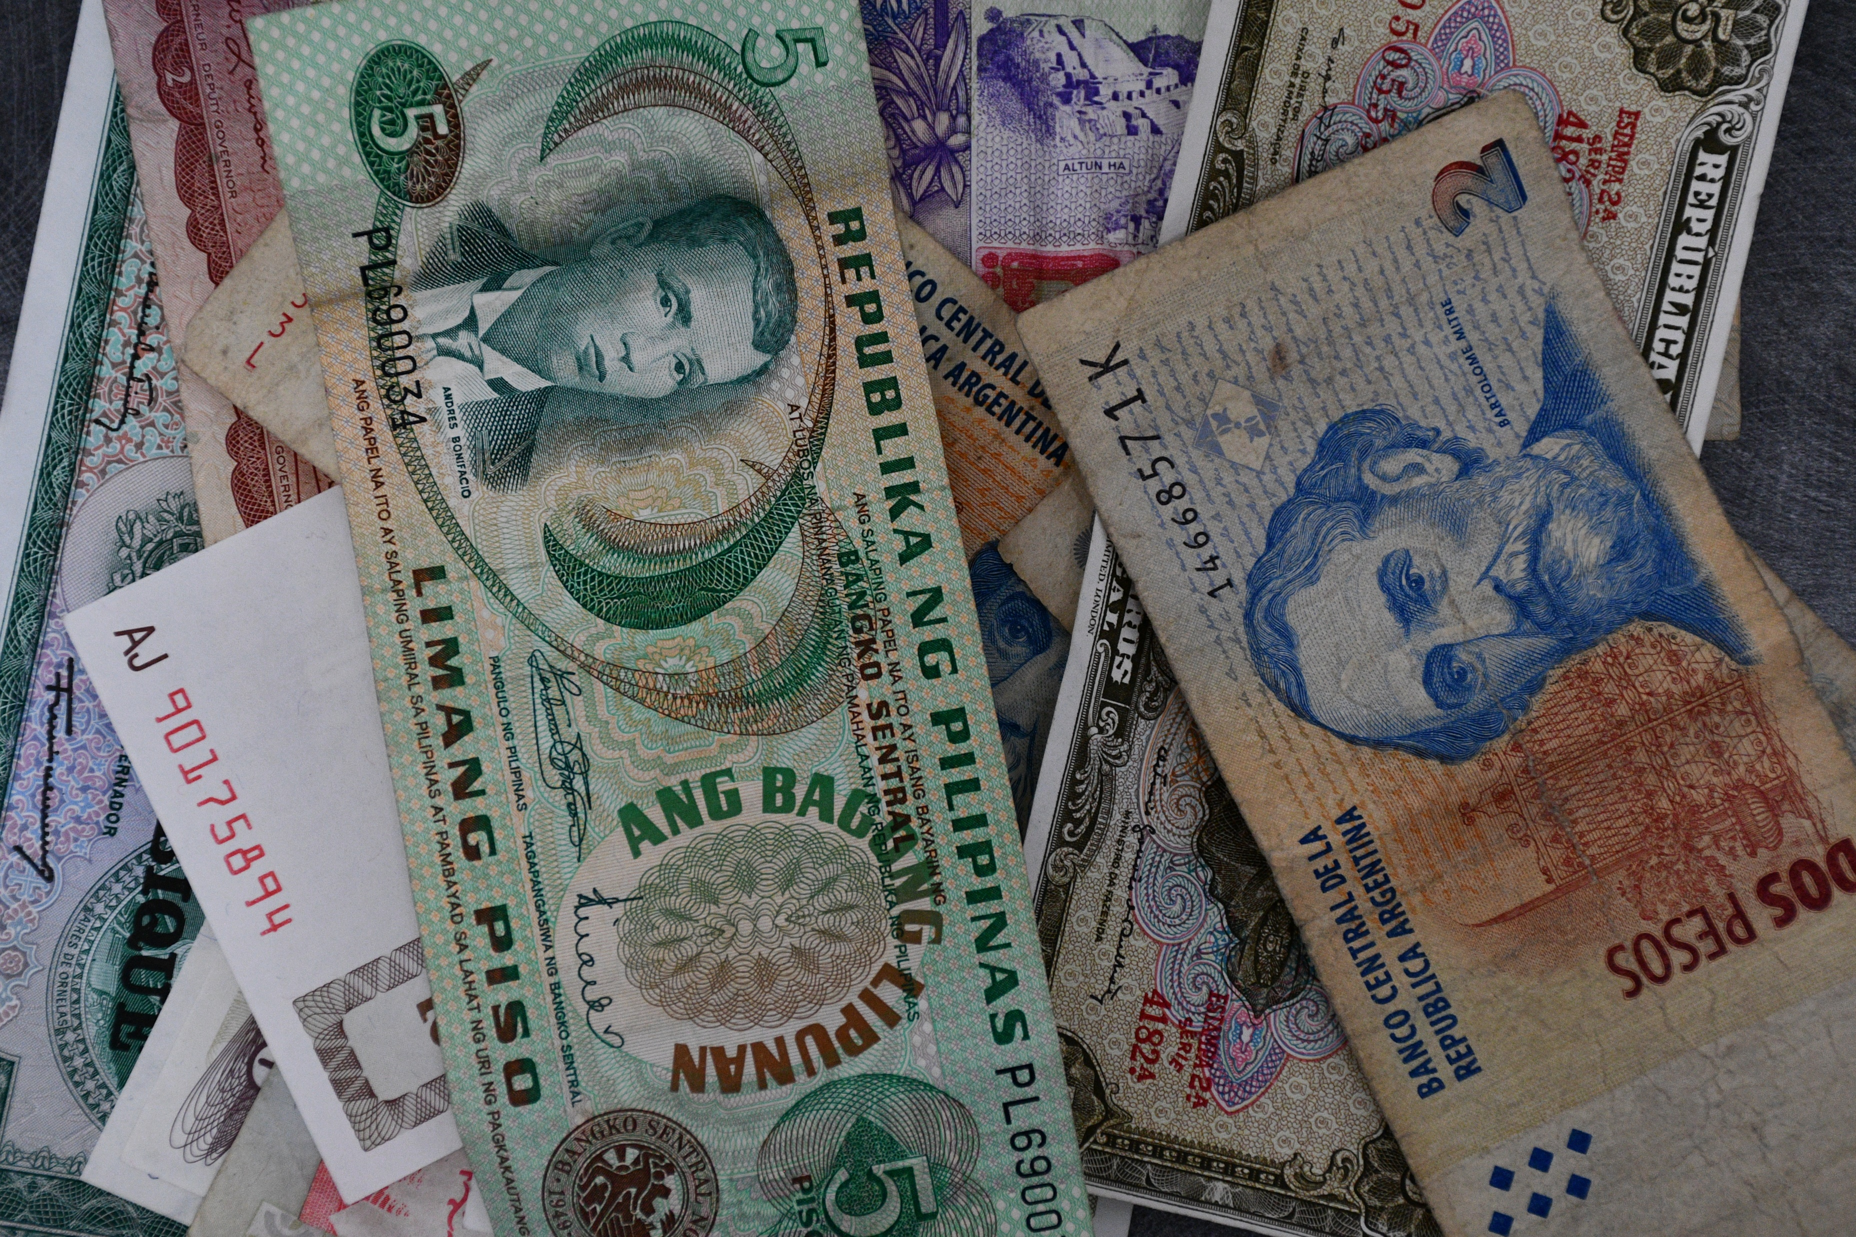
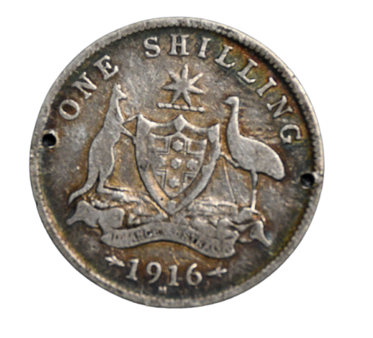
SORTING CATEGORY EXAMPLES
Cash and Coins
Foreign Currency
American Currency
Commemorative / Recovery Coins
Military / Police Coins
Pennies (Pressed, Wheat, Steel, and Indian Head)
Casino Chips / Gaming Tokens
Antique Coins
1
3
5
7
NOTE: PROVIDE EXAMPLE IMAGES FOR EACH

Slide 6
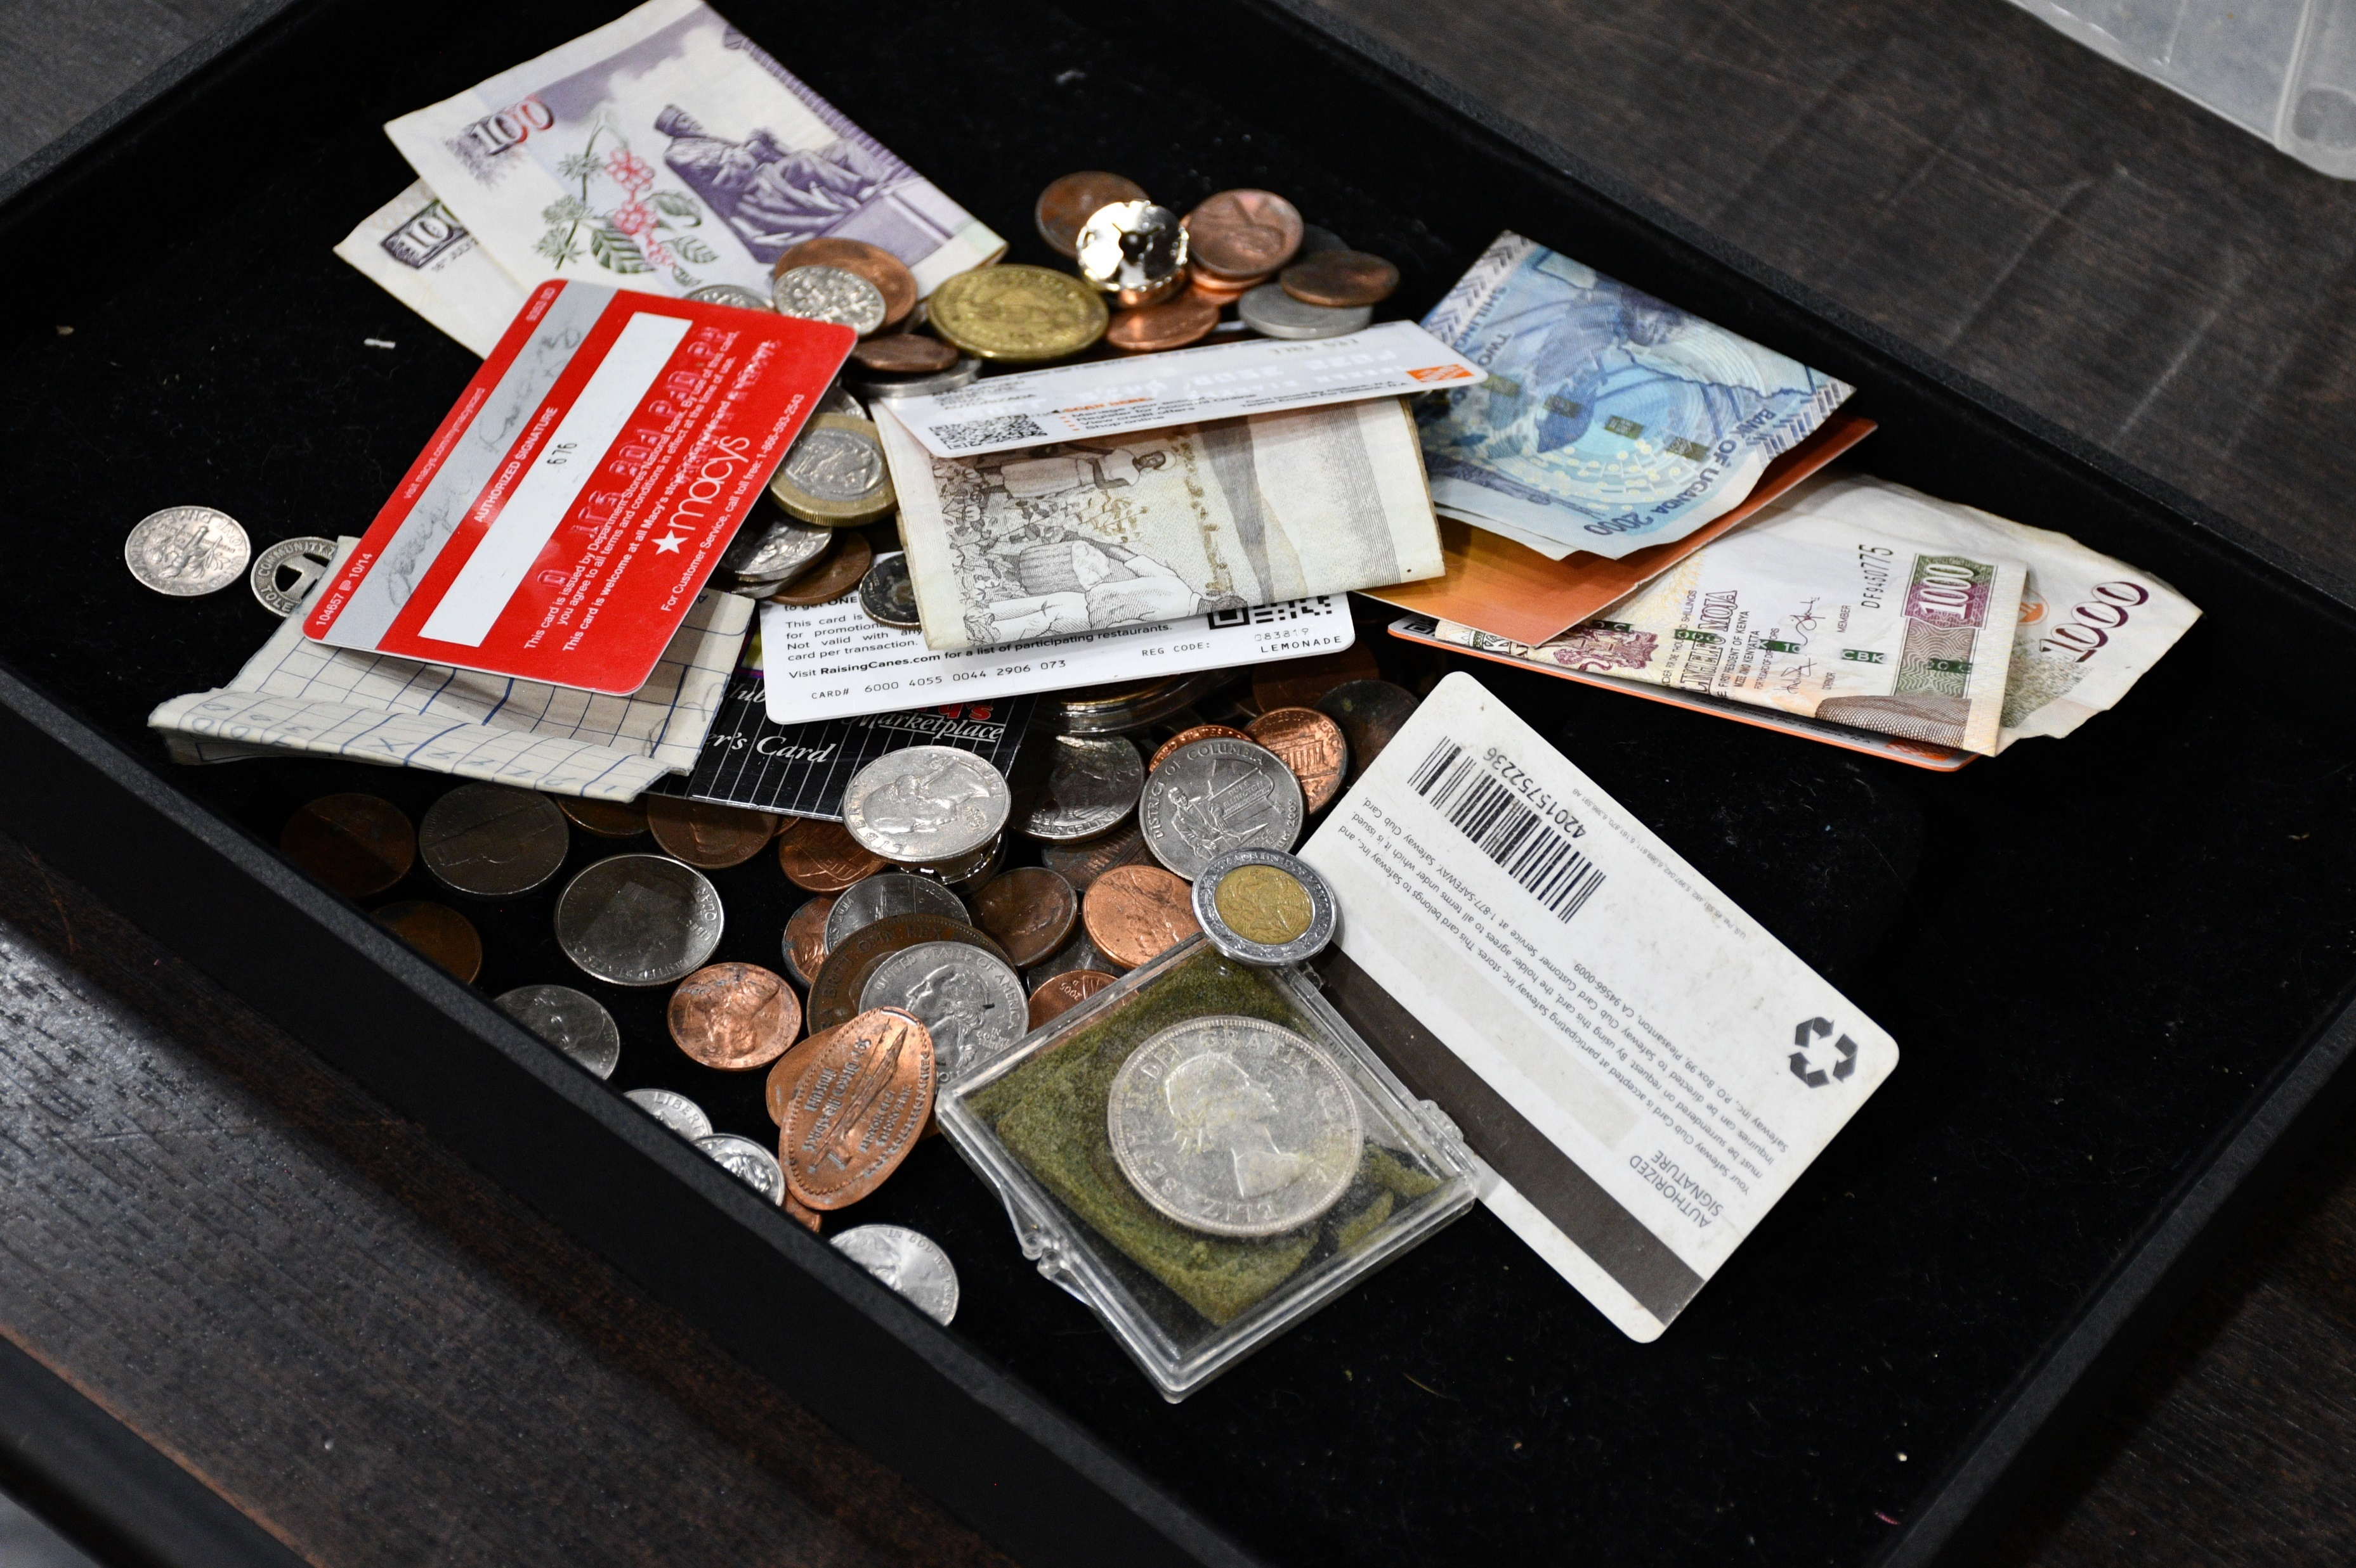
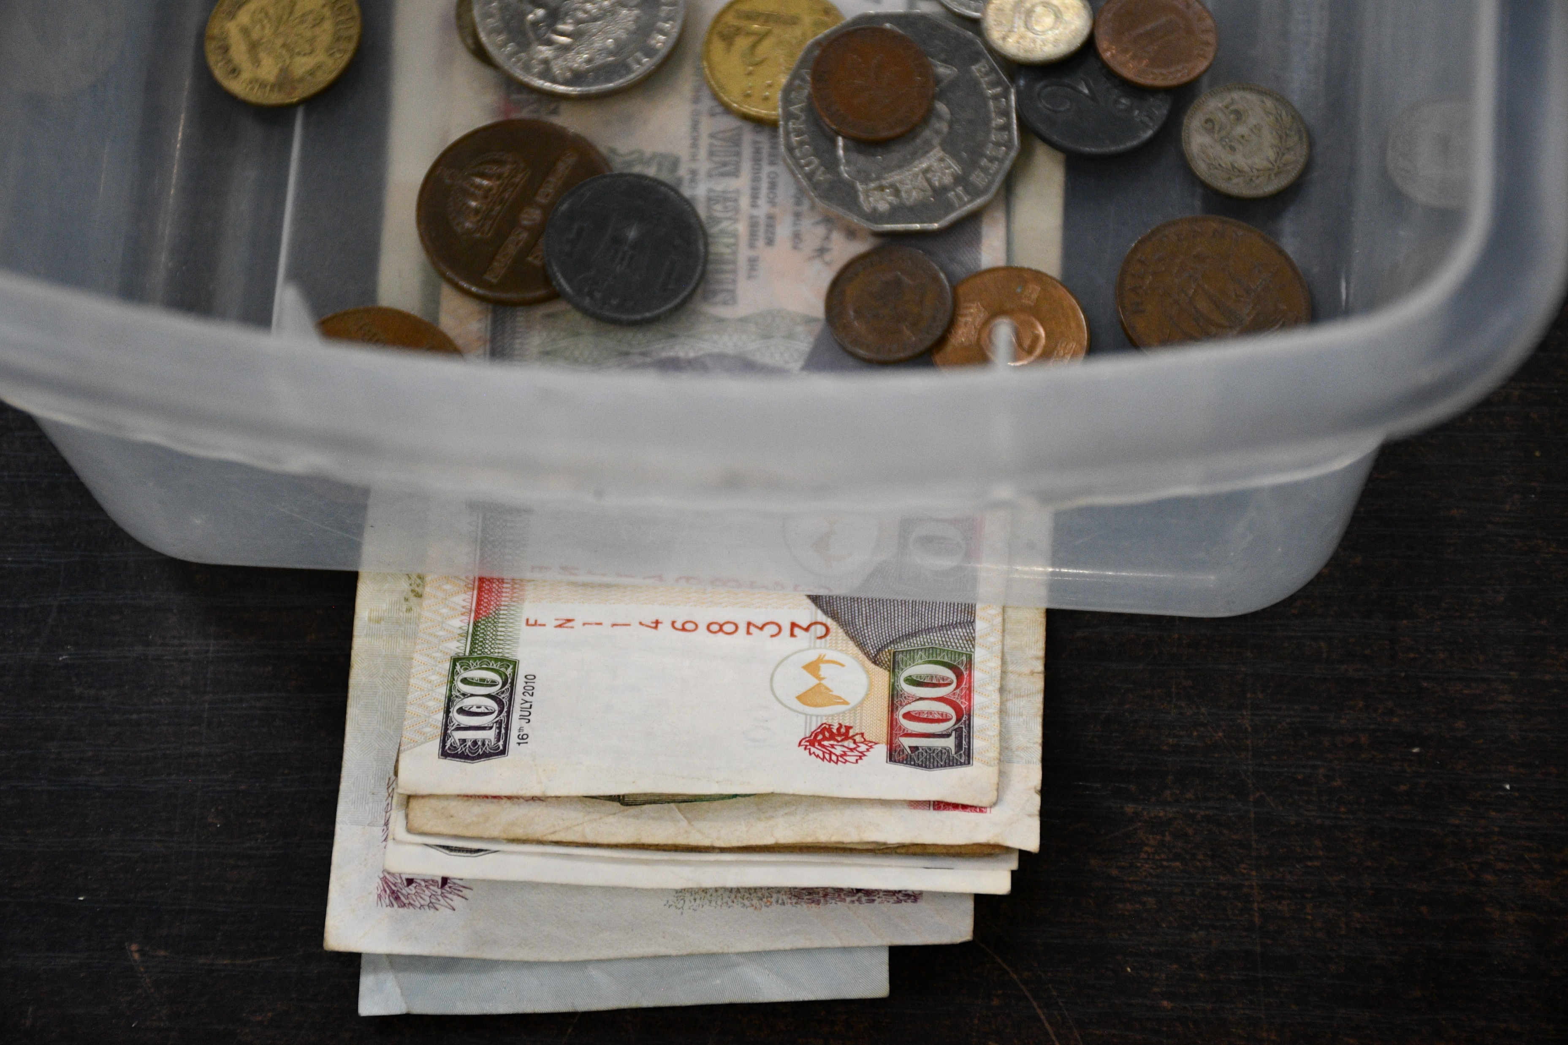
SORTING PROCESS
Cash and Coins
Empty one unit onto the black tray.
Sort all paper money (American and foreign), gift cards, IDs, etc., into the appropriate bins. Remember that any cards that show personal information should be sorted into the shred bin. This includes credit cards, IDs, bus passes, social security cards, etc.
Next, sort any easily identified casino chips or game tokens.
Easily identifiable commemorative and military or police coins should be considered next.
Inspect the remaining coins for anything unique or of high value, and place them in the research bin. You can use Google Lens to assist you in identifying any item, while the Coin Facts app can be used for American currency.
Finally, sort the remaining American and foreign currencies into the appropriate bins.
1
NOTE: Flatten any paper money by placing it underneath the appropriate bin (foreign or American).
2
4
NOTE: The following pages will provide some additional information about some specific items that you may come across.

Slide 7
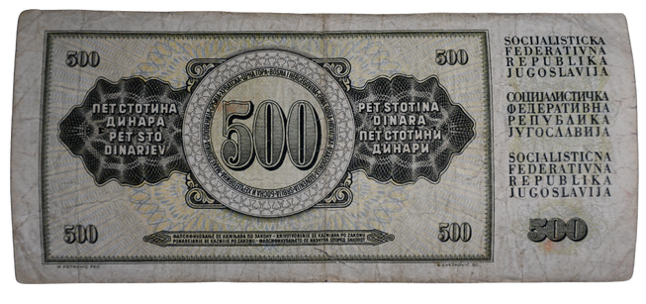
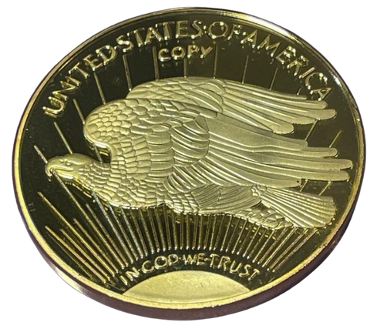
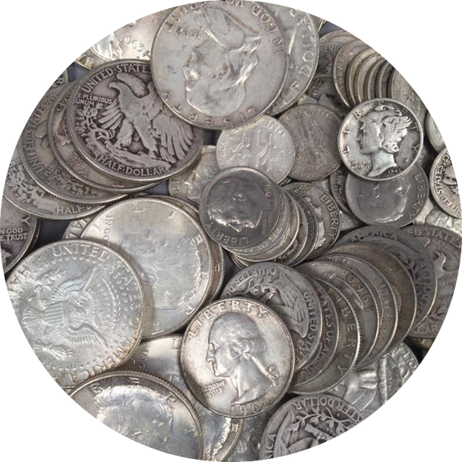
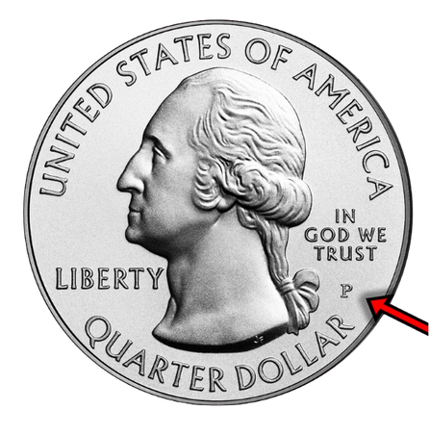
ADDITIONAL NOTES
Cash and Coins
Former Country Currency: Look for currency from countries that no longer exist, as they likely hold some historical value.
Copy or Replica Markings: The word “copy” or “replica” indicates the reproduction of a historical coin.
U.S. Silver Coins: All major United States coins that were minted before 1965 (excluding nickels and pennies) were made of silver.
Mint Marks: These markings indicate where a coin was produced.

Slide 8
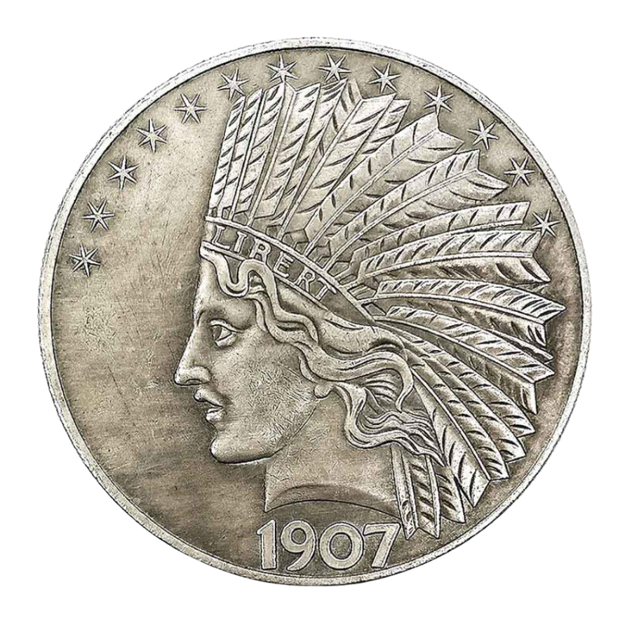
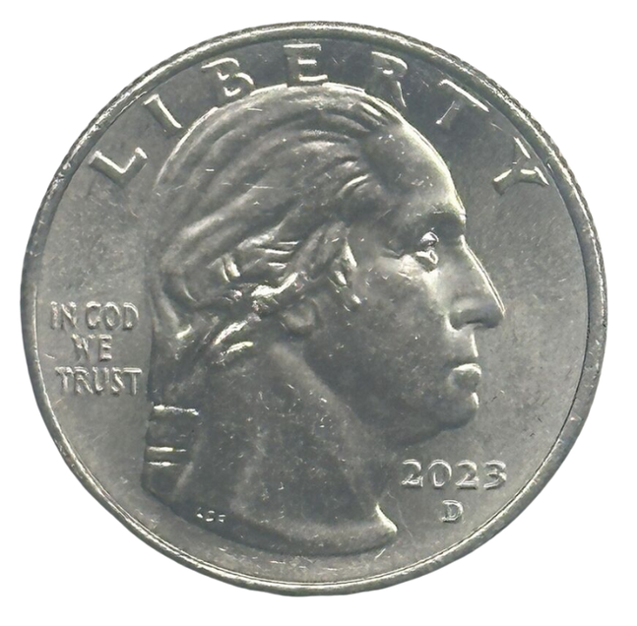
ADDITIONAL NOTES (Cont.)
Cash and Coins
Antique Coins: Coins 100 years or older. Because these coins may have little individual value on their own, they will be sold in grouped lots.
Minting Errors: Currencies are sometimes produced with accidental errors, like this “In Cod We Trust,” quarter.

