Slide 1
GOODWILL
Picture Process Maps (PPM)
E-Commerce Electronics Processor
February 2025

Slide 2
Purpose and Table of Contents
Electronics Processor
PURPOSE
The Picture Process Maps (PPM) document is a detailed guide for E-Commerce Electronics Processors. It explains how to handle, test, and categorize electronic products. It lists the tools needed and steps to follow, from receiving the items to deciding if they can be sold, recycled, or thrown away. The purpose of this guide is to help processors do their job accurately and safely, making sure all electronics are correctly sorted and handled.
TABLE OF CONTENTS
Required Tools and Workstation | 2
Receiving or Manifesting the Product | 4
Renaming Products | 6
Testing the Product’s Power | 8
Declining form the Manifest | 10
Wiping Process: Laptops or Desktops | 11
Wiping Process: Phones or Tablets | 15
Game Consoles or Non-Resettable | 17
Digital Cameras | 18
Audio Equipment | 19
Video Equipment | 21
GOODWILL

Slide 3
Required Tools and Workstation
Electronics Processor
The E-Commerce Electronics Processor's job is to identify the make and model of each product, check if it works, and see if the user data can be erased. If the product works and data can be removed, they start processing and listing it for sale. If the product doesn’t work or the data can’t be removed, the processor decides whether any parts can be sold or if the whole product needs to be disposed of through Dell or other appropriate methods.
Products That Contain User Data
Required Tools and Materials
Workstation
Desktop computers
Laptops
Tablets
Phones
Smart watches
Smart health devices (some)
Game consoles:
  Series X
  PlayStation 3, 4, 5
  PSP
  PS Vita
  Nintendo Switch, Wii, Wii U
  Nintendo DS, 3DS, DSi, DS Lite
Box cutter
Screwdrivers
Rubber bands
Zip ties
Poly bags
Stapler
Tape
Pen
Marker
Scissors
Gloves
Two screens
Computer
Zebra printer
Scanner
Keyboard
Mouse
Three Grey Totes (Reroutes)
Trash can
Green dots
Orange dots
Pink dots
An image of the processing station is shown on the next page.
GOODWILL

Slide 4


Required Tools and Workstation (Continued)
Electronics Processor
Screen
Screen
Tools
Keyboard
Zebra
Broken Tablets
Reroutes
Reroutes
Dell
Reroutes
Laptops
GOODWILL

Slide 5
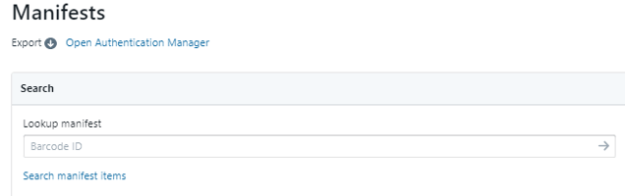
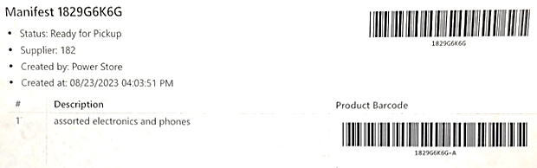
Receiving or Manifesting the Product
Electronics Processor
Sign in to Upright. Click on the “Clipboard” icon on the homepage to update your Manifest.
On the Manifest page, click on the space labeled “Barcode ID” underneath “Lookup Manifest.”
Using your scanner, scan the barcode at the top of the manifest that you received with the product.
GOODWILL

Slide 6
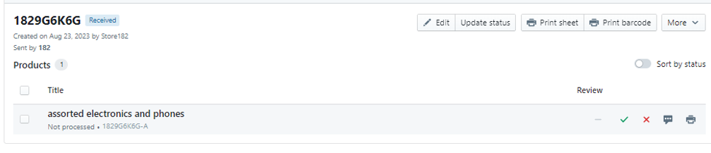
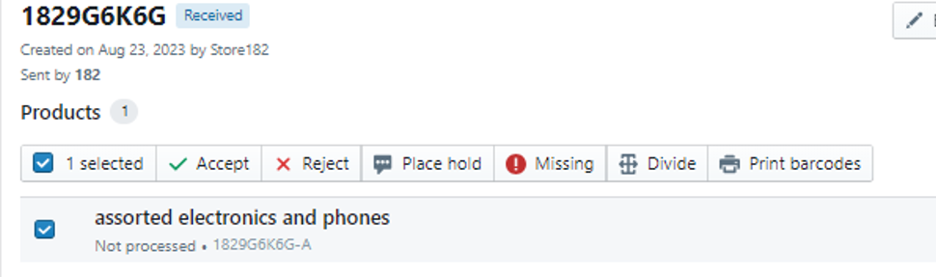
Receiving or Manifesting Product (Continued)
Electronics Processor
Your manifest will appear exactly as the paper copy.
NOTE: Most often, you must “Divide” what is on the manifest. For example, if the product listed is "Assorted Electronics and Phones" and the tote contains a laptop and a cell phone, we would need to divide the product into two items. If the Product name matches the entire contents of the Tote, skip to Step 7.
GOODWILL

Slide 7
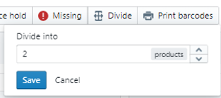
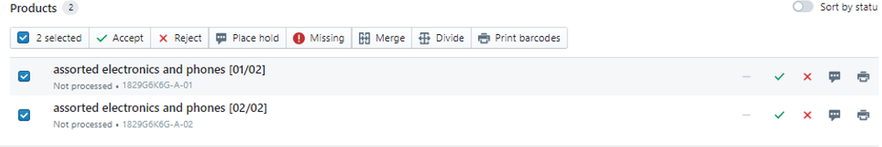
Receiving or Manifesting Product (Continued)
Electronics Processor
Click on “Divide.” The Divide option will pop up. Enter the amount equivalent to the number of items on the manifest and click “Save”.
There are now two products. Click on the checkbox to the left of the product name and either click Accept or the green checkmark to on the right-hand side of the item line to Accept the products. This will allow you to change the names of the products.
GOODWILL

Slide 8
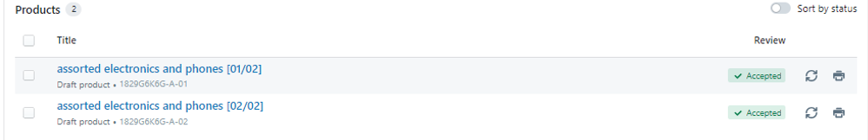
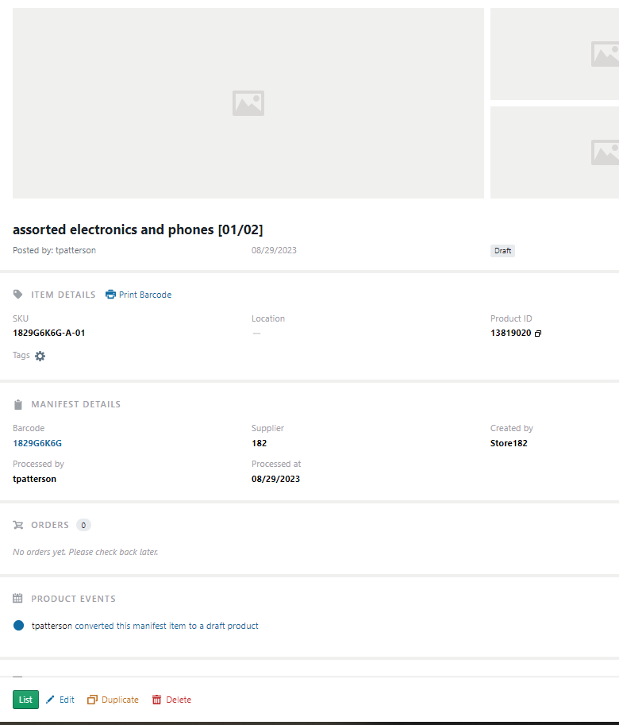
Renaming Products
Electronics Processor
Both products are now “accepted” in the location where the checkmarks were. Click on the product name to start renaming it.
NOTE: If your products were listed correctly, this portion of the process is complete. You can move on to #13.
When you click on the product name (#8), a new page will open. You can now make changes or add information to your listing. At the bottom of the page, click “Edit”.
GOODWILL

Slide 9

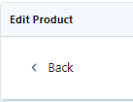
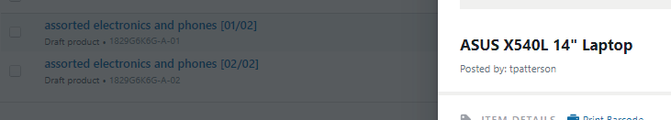
Renaming Products (Continued)
Electronics Processor
The page will now allow you to rename the product. Look for “Title.” Before typing in the basics of the product, ensure that the space is cleared. This step ensures that the old information is removed and that the new details you're about to enter are accurate. For laptops, enter the brand, model number, screen size, and laptop.
When you’re done. Click “Save” at the top right section of the screen.
At the top left section of the screen, click “Back”.
NOTE: The product name will not change on the manifest, but when you click on the product, it will show the updated title of the product (pictured below). You will again start the editing process, as noted in #9, to add other information to the listing. The products that will be added later are noted in the specific processing process for your product.
GOODWILL

Slide 10
Testing the Product’s Power
Electronics Processor
First, check if the product turns on. Consider that the product might need a charge to power on. If the product does power on, follow the appropriate process from the list below:
Apple Products
PC Products
Other Products
Apple laptop wiping procedure
iPhone/iPad procedure
Computer BIOS boot keys
Laptop wiping procedure
Removing BIOS from Fujitsu computers
Processing Smart Watches
For processing specific items, turn to the following page/s:
For laptop/desktop: 11-13
For phone/tablet: 14
Game consoles: 15
Digital cameras: 16
Audio equipment: 17
Video equipment: 18
NOTE: If the product does not power on, determine if it should be parted, sent to Dell, or sent to Clearance.
See the processes on pages 9-10.
GOODWILL

Slide 11
Disposal Procedures
Electronics Processor
For items that do not power on, the following are the disposal procedures:
Items we cannot power on and are assumed to contain user data are (mostly) sent to Dell.
Items that can’t be powered on and are assumed not to have user data are sent to the Clearance Center.
Some computer hard drives and gaming system parts can be sold as “bulk parts.”
Note: No matter how the product is disposed of, the product must be declined from the manifest.
A: Dell
B: Clearance
C: Parts
All Phones
All Tablets
PC Laptops
Gaming Systems
Decline from Manifest
Note: We remove the hard drives for some PC laptops. Add “broken” to the title and note the defect, as it can be sold for parts.
TVs
VCRs
DVDs
Speakers
Decline from Manifest
Intel core: I3, I5, I7 I9/AMD Ryzen 3, 5, 7
  Remove the hard drive and sell as parts
  Parts are kept on hand
Gaming System parts in bulk
GOODWILL

Slide 12
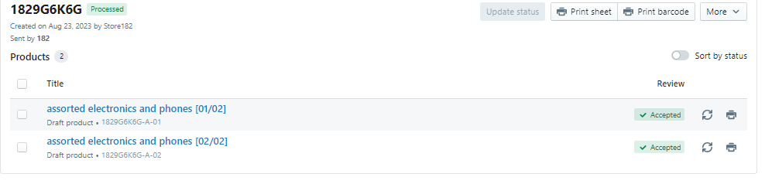
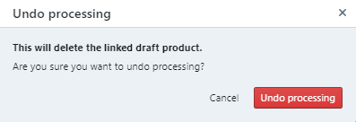
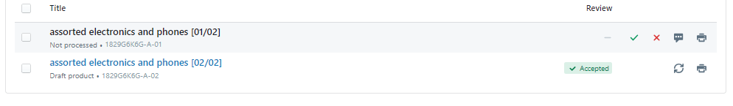
Declining from the Manifest
Electronics Processor
On the Manifest click the “recycle” icon of the product you want to decline.
The undo processing window will pop up. Click “Undo processing”.
NOTE: The product will not show up in black on the Manifest. All other products on the Manifest will show up in blue.
GOODWILL

Slide 13
Wiping Process: Laptop or Desktop
Electronics Processor
Depending on the computer's brand, perform the following series of commands to perform the wiping process. Brands and their processes can be found on this page through page 14 of this PPM. When wiping is complete, click “Report” and then take a picture of the Data Erasure information.
ACER AND DELL
F2 > Bios > Take a picture of the Bios page, including processor and RAM > Find Date/Time > Set Date/Time > Boot Options: Secure Boot-disable (if applicable) > Save/Exit (F10) > F12 USB Hard Drive-let load > (default) Enter > Enter. When wiping, the software appears: Settings > in-process > Change erasure standard to NIST 800-88 purge (enter) > Apply > Erase > Yes.
ASUS
F2 > Bios > Take a picture of the Bios page, including processor and RAM > Find Date/Time > Set Date/Time > Boot Options: Secure Boot-disable (if applicable) > Save/Exit (F10) > F2 > Boot Override > USB Hard Drive-let load> (default) Enter > Enter. When wiping, the software appears: Settings > in-process > Change erasure standard to NIST 800-88 purge (enter) > Apply > Erase > Yes.
GOODWILL

Slide 14
Wiping Process: Laptop or Desktop (Continued)
Electronics Processor
GATEWAY
F2 > Bios > Take a picture of the Bios page, including processor and RAM > Find Date/Time > Set Date/Time > Boot Options: Secure Boot-disable > Save/Exit (F10) > F12 USB Hard Drive-let load > (default) Enter > Enter. When wiping, the software appears: Settings > in-process > Change erasure standard to NIST 800-88 purge (enter) > Apply > Erase > Yes.
HP
F10 > Bios > Take a picture of the Bios page, including processor and RAM > Find Date/Time > Set Date/Time > Boot Options: Secure Boot-disable > Save/Exit (F10) > F9 USB Hard Drive-let load > (default) Enter > Enter. When wiping, the software appears: Settings > in-process > Change erasure standard to NIST 800-88 purge (enter) > Apply > Erase > Yes.
IBM
Blue “ThinkVantage” button > Bios > Take picture of the Bios page including processor and RAM > Find Date/Time > Set Date/Time > Boot Options: Secure Boot-disable > Save/Exit (F10) > F9 USB Hard Drive-let load > (default) Enter > Enter. When wiping, the software appears: Settings > in-process > Change erasure standard to NIST 800-88 purge (enter) > Apply > Erase > Yes.
GOODWILL

Slide 15

Wiping Process: Laptop or Desktop (Continued)
Electronics Processor
LENOVO
F1 or > Bios > Take a picture of the Bios page including processor and RAM > Find Date/Time > Set Date/Time > Boot Options: Secure Boot-disable > Save/Exit (F10) > F12 or USB Hard Drive-let load > (default) Enter > Enter. When wiping, the software appears: Settings > in-process > Change erasure standard to NIST 800-88 purge (enter) > Apply > Erase > Yes.
SONY AND TOSHIBA
F2 > Bios > Take a picture of the Bios page, including RAM and Hard drive > Find Date/Time > Set Date/Time > Boot Options: Secure Boot-disable > Save/Exit (F10) > F12 USB Hard Drive-let load > (default) Enter > Enter. When wiping, the software appears: Settings > in-process > Change erasure standard to NIST 800-88 purge (enter) > Apply > Erase > Yes.
APPLE iMAC OR MACBOOKS
With the computer powered off, Insert a USB drive with Blancco on it. > Power on the computer > Hold down the ALT/Options key > Select EFI Boot from the USB drive > Enter. When wiping, software appears: Settings > in-process > Change erasure standard to NIST 800-88 purge (enter) > Apply > Erase > Yes. > When Wiping is complete: Report > Take a picture of the Data Erasure information.
GOODWILL

Slide 16
Wiping Process: Phones or Tablets
Electronics Processor
ANDROID
Remove the SIM and SD card.
THE PHONE/TABLET SPEC SHEET SHOULD CONTAIN THE FOLLOWING:
Store #
Carrier (SIM card/Phone logos/Power On screen)
Brand
Model Number (Settings: About Phone)
Storage Capacity: (Settings Menu go to Storage)
Factory Y/N (mark yes after reset)
Activation locked Y/N (mostly iPhones)
GOODWILL

Slide 17
Wiping Process: Phones or Tablets (Continued)
Electronics Processor
CONT.
Search settings for “Factory Reset” > Erase All Data. Yes > Erase all data? Yes > Erase all data? Yes > Take a picture of the Bios page, including RAM and Hard drive > Find Date/Time > Set Date/Time > Boot Options: Secure Boot-disable > Save/Exit (F10) > F12 USB Hard Drive-let load > (default) Enter > Enter. When wiping, the software appears: Settings > in-process > Change erasure standard to NIST 800-88 purge (enter) > Apply > Erase > Yes. > When you get the “Welcome Screen,” Turn the Phone off and tape your Spec Sheet to it. Then, place it in the appropriate box.
APPLE IPHONE OR IPAD
With the phone powered off, hold down the home button. > Plug iPhone/iPad into Apple computer while holding the home button. > iTunes or Finder will open on the Apple computer (depending on the OS version). > Select “Update and Restore Device.” > The computer will automatically download the software package for the device and it will install it.
GOODWILL
16

Slide 18
Game Consoles or Non-Resettable
Electronics Processor
NON-FACTORY RESETABLE
Atari 2600/5200/7800/Jaguar/Lynx
ColecoVision
Intellivision
Nintendo Gameboy/Gameboy/Gameboy Color Advance/GameCube/NES/SNES/Gameboy Adv. SP DS Lite/Gameboy Pocket/DS
Sega CD/Dreamcast/Game Gear/Genesis/Master System/Saturn
Sony PlayStation/PlayStation 2 PS2/PlayStation Slim PS2
Microsoft Xbox
Nintendo
FACTORY RESET
Microsoft Xbox One/Xbox Series X/Xbox 360 Slim
Nintendo 2DS/3DS/Switch/Wii/Wii U/3DS XL/Dsi New Nintendo 2DS XL/Dsi XL/3DS XL
Sony PlayStation 3 PS3/4 P S4/5 PS5/PSP/Vita/3 Slim PS3 3 Super Slim PS3
GOODWILL
17

Slide 19
Digital Cameras
Electronics Processor
Do the following if the camera works:
Test by turning the camera on/off.
If the camera works, follow the listing procedures.
If the camera does not work BUT it is worth more than $50,00:
  Remove the SD card.
  Follow the listing procedures.
GOODWILL

Slide 20
Audio Equipment
Electronics Processor
DJ Mixer
Test Power
Connect the speaker to each output channel and verify that audio is played correctly
Guitar Amplifier
Plug the guitar into the amplifier input
Play guitar and verify speaker plays with no distortion
Headphones (Wired)
Plug the headphone cable into the tablet and play audio
Verify audio is played out of each headphone speaker, both left and right
Headphones (Wireless)
Connect headphones to tablet via Bluetooth
Verify audio is played out of each headphone speaker, both left and right
Mixing Console
Play audio through each channel input
Connect the speaker to each output channel and verify that audio is played correctly
Power Amplifier
Play Audio through each channel input
Connect the speaker to each output channel and verify that audio is played correctly
GOODWILL

Slide 21
Audio Equipment (Continued)
Electronics Processor
Reel-to-reel
Press the play button on the device
Verify spindle spins
Speakers (Wired)
Connect the speaker to the amplifier
Play audio through amplifier
Verify speaker plays audio correctly without distortion
Speakers (Wireless)
Connect the speaker to the tablet via Bluetooth
Play audio and verify audio plays without distortion
Stereo Receivers
Play audio through AUX input
Connect the speaker to each output and verify that the audio plays correctly
Tape Deck
Connect the output to a speaker
Insert cassette tape and play
Verify audio plays correctly
Turntable
Connect the turntable to speaker via a receiver
Play record on turntable
Verify that the platter spins
Verify that audio is played correctly
GOODWILL

Slide 22
Video Equipment
Electronics Processor
Blu-ray/DVD Player
Connect output to a television
Verify video is displayed on the screen
Take a photo of the main interface screen
Insert disc
Play disc and verify disc drive works
Media Streamer
Connect the output to a television
Factory reset device
Take a photo of the welcome screen
Reel-to-reel film Projector
Press play on the device and verify spindle spins
Check if the lamp lights up
Television
Connect video player testing device
Verify display shows video without issue
Take a photo of the screen
VHS Player
Connect the output to a television
Take a photo of the main interface screen
Insert VHS tape and check that the tape plays without issue
Video Projector
Go to the menu and locate the lamp hours screen
Take a photo of the lamp hours menu screen
Slide Projector
Check if the lamp lights up
Test if the carousel spins if applicable
GOODWILL

