Slide 1
Retail
Culture &
C O N N E C T
Safety Stop:
Goodwill
Safety Program
Goodwill

Slide 2
Facilitators
Arian Tillman
District Manager
Larry Cruse
Director of Asset Protection
Chris Lysy
Director of Safety
Goodwill
Notes:
2

Slide 3
Objectives
Identify the importance of the Safety Guide, Safety Committee meetings, and accident reporting.
Discuss key elements of the safety guide, committee structure, and accurate and timely accident reporting.
Summarize how following the correct safety procedures affects the associated costs to your store and the organization.
Goodwill
Notes:
3

Slide 4
Icebreaker
Safe?
Unsafe?
Goodwill

Slide 5
Safe
Icebreaker
Safe?
Unsafe?
Goodwill

Slide 6
Icebreaker
Safe?
Unsafe?
Goodwill

Slide 7
Icebreaker
Safe?
Unsafe?
Goodwill

Slide 8
Icebreaker
Safe?
Unsafe?
Goodwill

Slide 9
Icebreaker
Safe?
Unsafe?
Goodwill

Slide 10
Icebreaker
Safe?
Unsafe?
Goodwill

Slide 11
Icebreaker
Safe?
Unsafe?
Goodwill

Slide 12
Icebreaker
Safe?
Unsafe?
Goodwill

Slide 13
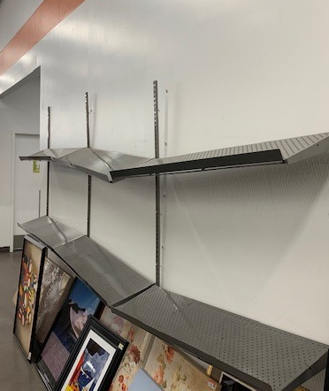
Icebreaker
Safe?
Unsafe?
Goodwill

Slide 14
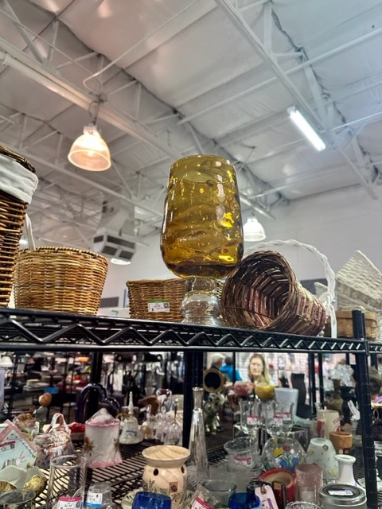
Icebreaker
Safe?
Unsafe?
Goodwill

Slide 15
2024 Safety Guide
What is it?
Where is it located?
Who is it for?
When do you use it?
Goodwill
Notes:
Reference Materials designed to guide you on all safety-related requirements and training and awareness programs.
All team members but focused on site leadership needs.
As a quick reference or for a deeper dive into the fundamentals of the Safety program.
Gazette- Safety links.
17

Slide 16
Safety Guide Location
January
February
March
April
May
June
July
August
September
October
November
December
Goodwill
Notes:
Need a copy of the front page of the safety guide to have populate after the last clicking animation

Slide 17
Safety Guide
New!
FEWER ACCIDENTS
LESS ASSOCIATED
COSTS
Goodwill
Notes:
What's New
Need:
Reintroduction to Goodwill Safety and Priorities.
Lower accidents and associated costs.
Needs:
cover of the safety guide.
Design a spiked sales logo that says “new”
Accident and cost numbers
21

Slide 18
Safety Committee
Why is it needed?
What do they do?
Who should be on it?
What are the benefits?
Goodwill
Notes:
Behavior Based Safety, ADOSH/OSHA, your safety.
Front line Team Members, Leader with access to G-Connect. (Limited Exceptions)
Review safety incidents, Audit, and record meetings.
Lower Insurance Costs, less loss time claims, higher productivity, and YOU.
22

Slide 19
The safety meeting and data entry must be completed by the 7th of each month.
Goodwill

Slide 20
Retail Store
Self-Safety Audit
Audit and data entry must be completed by the end of the third week of the month.
Goodwill

Slide 21
G-Connect Documentation
Late or missing reporting results in denial of claims, Loss of Time claims, etc.
Can we contact the Team Member quickly? Or at all?
Did we use the correct tools to lower costs and avoid unnecessary medical expenses?
Missing or inaccurate information results in delays, resulting in higher claim costs.
Goodwill
Notes:
Documentation
Critical to the case
Accurate information
Contact info
Medical Treatment
Nurse line.
24

Slide 22
GCNA INCIDENT CLAIM ACCURACY
Reduce accident frequency and severity
WHY DOES IT MATTER?
Improve premium costs
Goodwill

Slide 23
Worker’s Comp Claims Info
2022
2023
34%
less incurred costs than 2022!
Total incurred: $1.43M
Total incurred: $931K
YTD lost time / disability claims: $357,063
Average cost per claim: $8.5K
Goodwill

Slide 24
Goodwill Nurse Line
Goodwill

Slide 25
Goodwill Nurse Line
Partner with DAPSM if you need assistance.
Ensure Nurse Line (833-983-3379) is contacted if Team Member has an injury, or if they are transported by ambulance.
If medical treatment is sought, collect paperwork, including work restrictions or work release from Team Member after they return from medical treatment, in order for them to return to work.
Document an incident report within Gconnect.
Goodwill

Slide 26
Activity
Goodwill
Notes:
27

Slide 27
Questions ?
Goodwill

