Slide 1
Retail
Culture &
Essential Leadership Skills:
C O N N E C T
Effective Communication
&
People Development
Goodwill
Notes:
**Goodwill Essential Leadership Skills (potential logo rather than headline)

Slide 2
Facilitators
Rusty Rubert
Retail, Sr. District Manager
Jake Meyer
HR Business Partner
Goodwill

Slide 3
Facilitator
Breanna James,
Retail District Manager
Goodwill
Notes:
Natalie will be main presenter
Justin to co present.

Slide 4
Icebreaker
Goodwill
Notes:
Icebreaker:
One person relays a message to a runner using clear communication. The runner must then go to the table and use a different form of communication to relay the message.
There will be three messages to relay. The first message the runner must convey by drawing a picture, {floorwork log} (representing written communication only), the second message they will relay using only sound effects {calling for product} (no words or body movement), and the third message the runner must use only their body movements to get the table to guess their message. {processor is behind on pieces and needs to hurry up/move faster}

Slide 5
Objectives
Why develop essential leadership skills
Describe the importance of effective communication and people development
Consider how to apply the techniques in real-world scenarios
Goodwill
Notes:
4
DO NOT ADD or CHANGE CONTENT - PLEASE

Slide 6
Why Essential Leadership
Career advancement
Personal growth
Team effectiveness
Organizational impact
Goodwill
Notes:
Career advancement: Can help managers advance in their careers by making them more effective leaders who are better equipped to handle new challenges.
Personal growth: Can be self-aware, improve their decision-making abilities, and develop a sense of purpose in their work.
Team effectiveness: Can create a sense of unity within their teams, foster open communication, and inspire their team members to work together towards a common goal.
Organizational impact: Can have a significant impact on the organization as a whole. Leaders who possess strong leadership skills can drive innovation, manage change, and guide their organizations towards success.

Slide 7
Essential Leadership Skills
Name: Sam Robles
Name: Amy Smith
Role: Store Manager
Role: District Manager IT
Exemplifies: Personal Growth
Exemplifies: Career Advancement
Time with Goodwill: 3 Years
Time with Goodwill: 10 Years
Name: Mireya Orozco-Davila
Name: Ivonne Morales
Name: Rusty Rubert
Role: Sr. Director, Warehouse & Logistics
Role: Store Manager
Role: District Manager
Exemplifies: Organizational Impact
Exemplifies: Team Effectiveness
Exemplifies: Career Advancement
Time with Goodwill: 11 years
Time with Goodwill: 10 years
Time with Goodwill: Two years
Notes:
Sam Robles - Personal Growth Amy Smith - Career Advancement
Mireya (ROC) – Organizational Impact Ivonne Morales - Team Effectiveness

Slide 8
4 Elements of
Effective Communication
1. Know your audience
2. Keep it simple
Goodwill
Notes:
Know your audience
Your audience will naturally be more interested and engaged when you tailor your communication to their interests. Piquing their interest by speaking directly to what matters will naturally engage their desire to underhand and interact with the information you are providing them.
Keep it Simple
Even the most engaged and committed audience will eventually get bored. Keeping your message simple and concise will make it easier to understand and retain. Remember, you already know what you’re going to say, but they may be hearing it for the first time.
7

Slide 9
4 Elements of
Effective Communication
Consider the best method to
deliver your message
Get them involved
Goodwill
Notes:
Best Method to Deliver Message
Get Them Involved
Effective communicators clearly inform others and actively listen to them at the same time. They can accept input, both verbal and non-verbal, while also expressing their thoughts and opinions in an inclusive way.
Regardless of the communication style, effective communication involves a connection with others. This means the most powerful skill you can leverage is being in sync with your audience.
It involves understanding and speaking to its needs, and then responding to real-time feedback.
8

Slide 10
Activity
Goodwill
Notes:
Activity Notes
10min Activity / 5 min Reflect & Discuss
Purpose:
To provide participants with an opportunity to utilize the 4 elements of effective communication.
Set-up / Execution:
Each table will have an envelope containing one of three scenarios – RMP, DA, and RSA
Each table has character cards representing the individual employees (frontline and management)
One person reads the scenario to the group. As a group they should discuss the best way to approach the scenario using the 4 elements of effective communication.
Group should break out into partners and give participants an opportunity to role play the scenario from each viewpoint.
Reconvene the group/room. Ask for volunteer(s) to demonstrate each scenario. Work the room to identify usage of the 4 elements and/or where there is opportunity to improve/change.
9

Slide 11
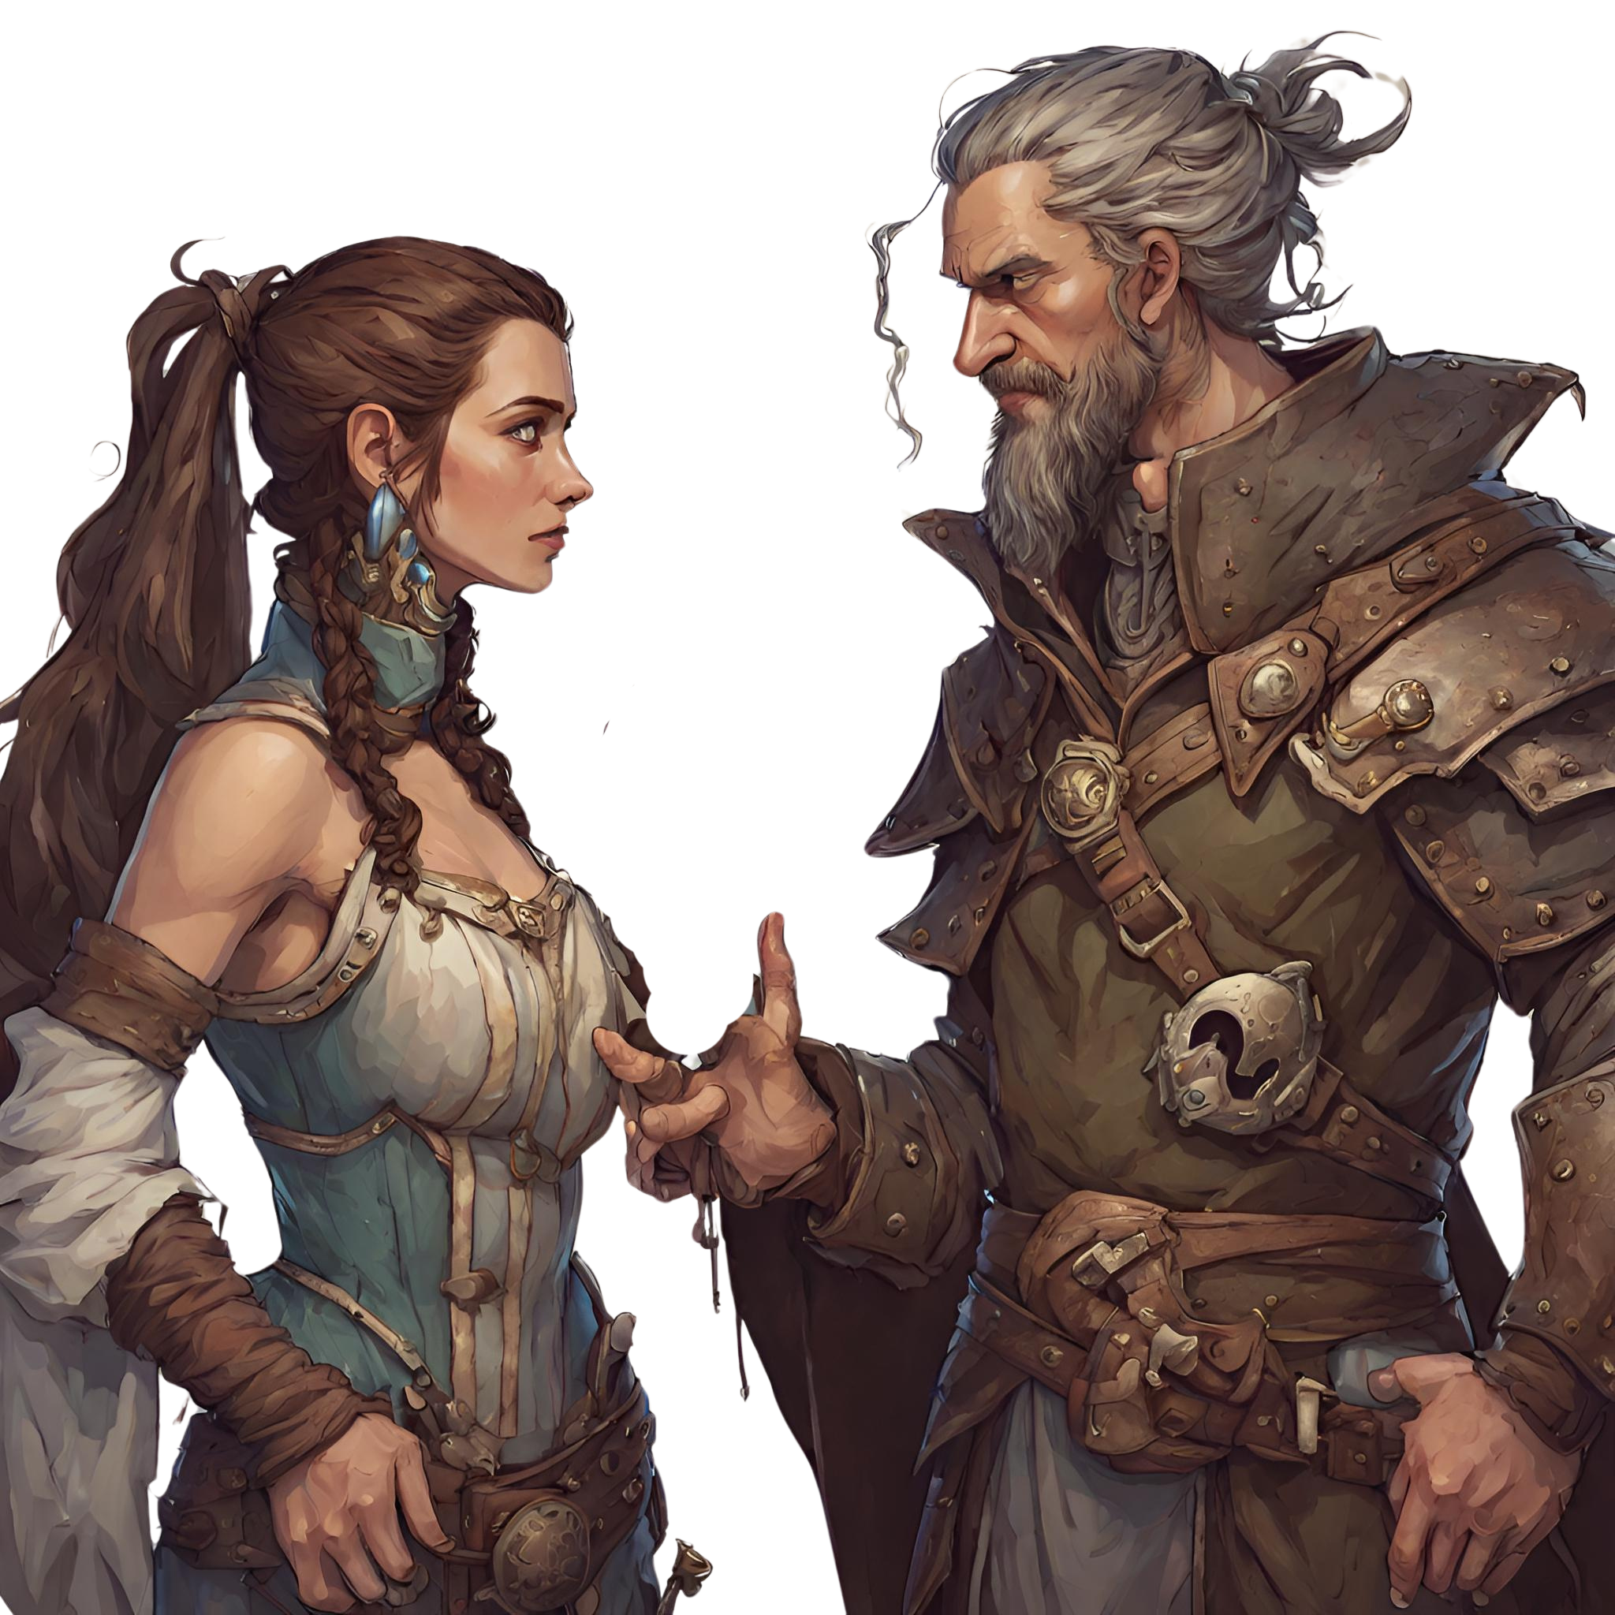
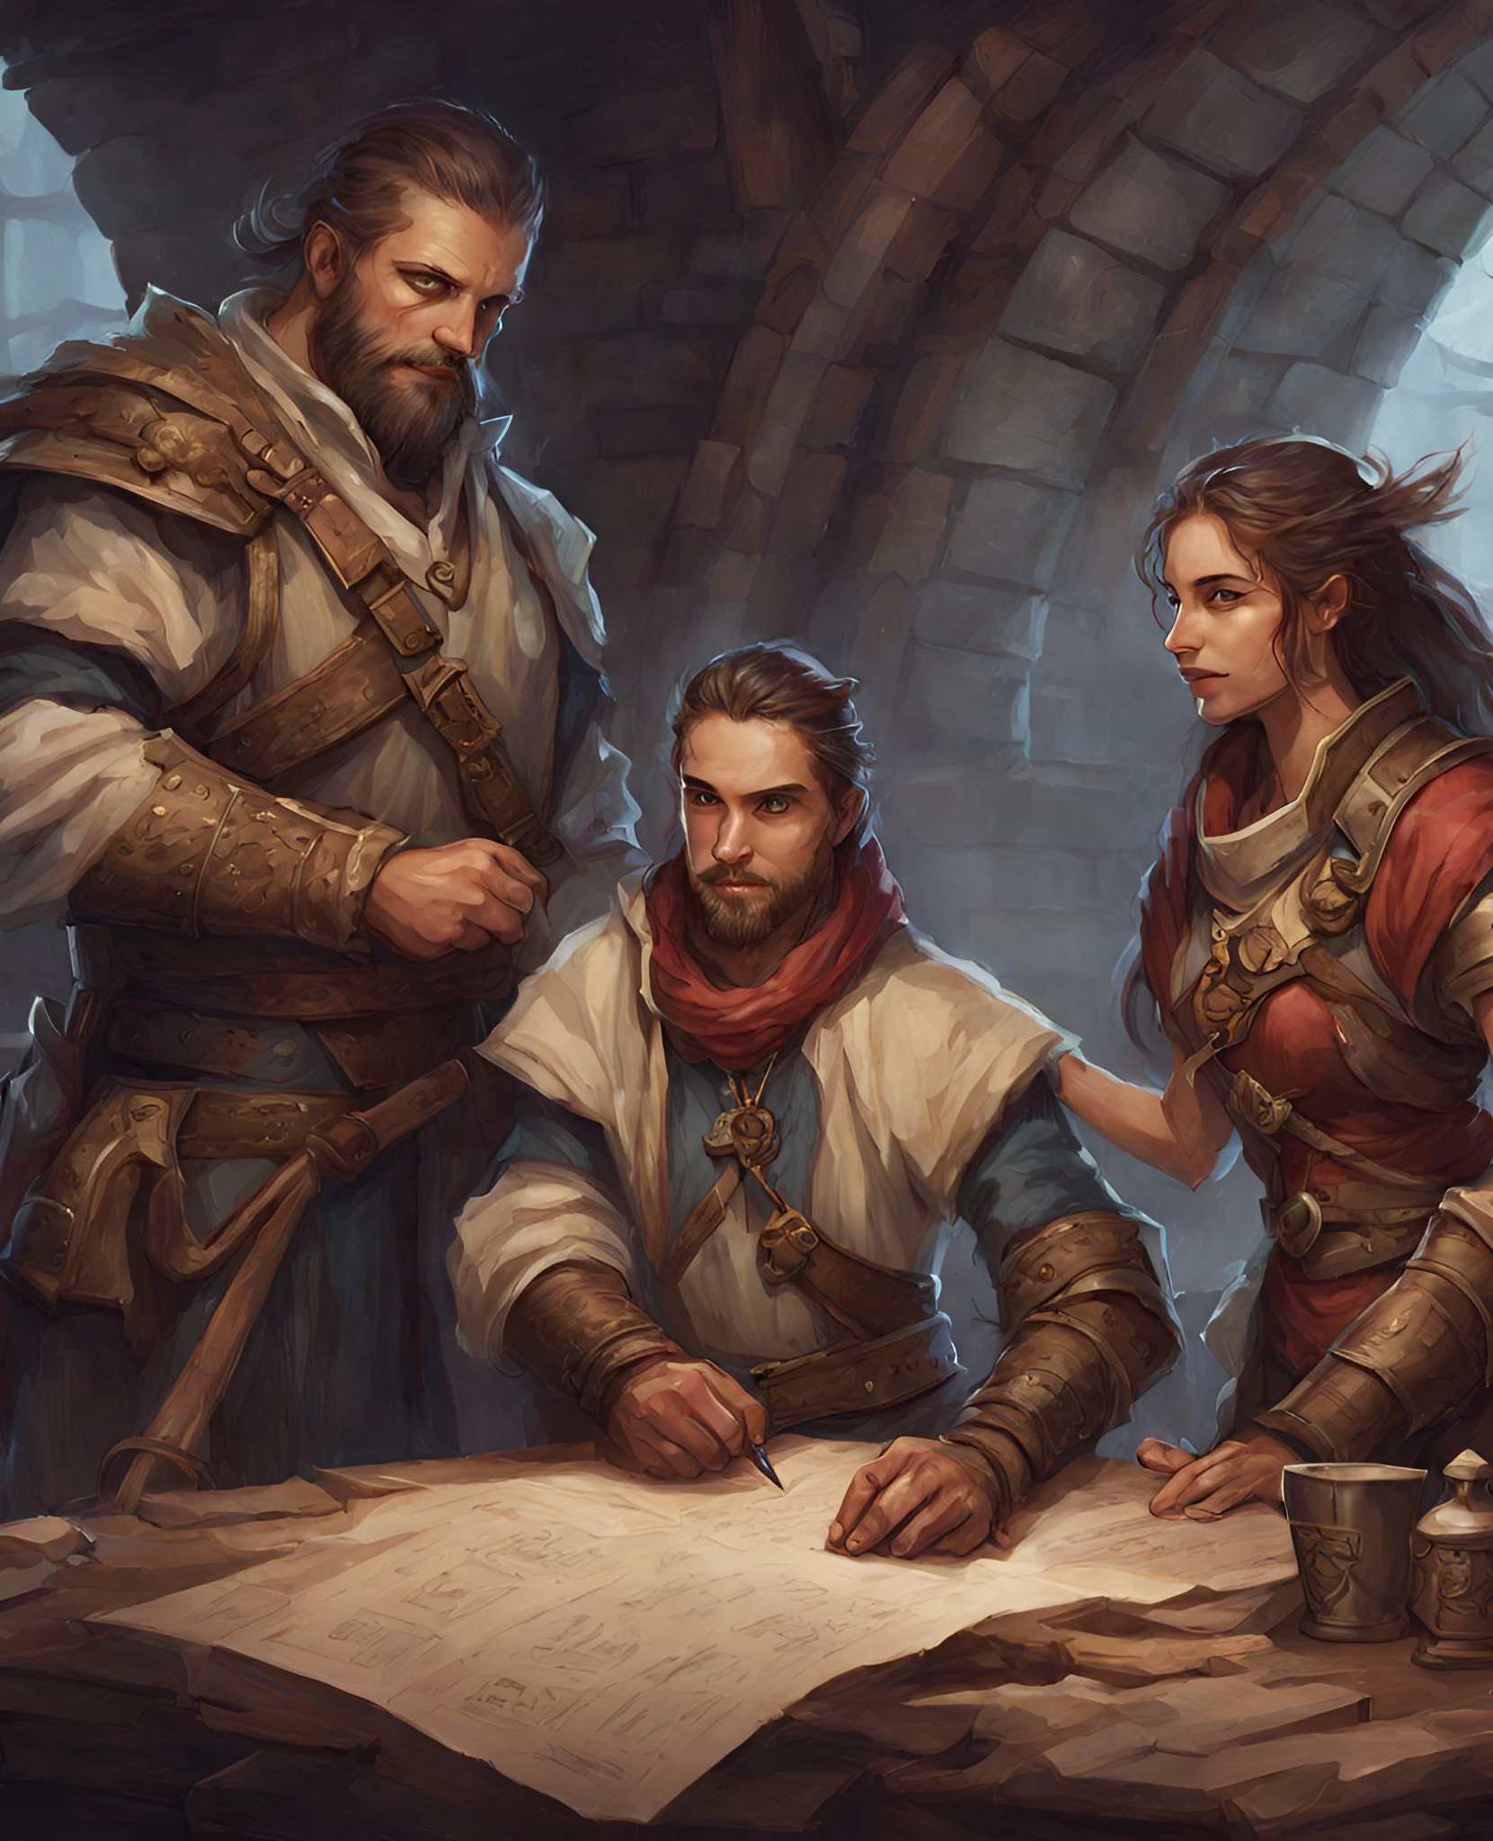
5 Elements of
People Development
Understanding your team
Building a supportive environment
Goodwill
Notes:
Understand your team:
Unique Needs: Recognize that frontline workers in the thrift industry have distinct needs.
Entry-Level Skills: Acknowledge entry-level skills.
Diverse Roles: Understand the various roles—RMP, RSA, DA, CSMs and ASM.
Build a supportive environment
Clear Expectations: Set clear performance expectations for each role.
Positive Culture: Foster a positive work environment where everyone feels valued.
Feedback Loop: Establish regular feedback mechanisms to address concerns and celebrate achievements.
10

Slide 12
5 Elements of
People Development
3. Skill development
4. Coaching and recognition
5. Promote career pathways
Goodwill
Notes:
Skill Development
On-the-Job Training: Provide hands-on training for specific tasks.
Cross-Training: Encourage learning across different roles (e.g., cashiers understanding merchandise processing).
Soft Skills: Develop communication, teamwork, and customer service skills.
Coaching/recognition
Coaching: Regularly coach frontline workers on performance and growth.
Recognition Programs: Implement programs to celebrate achievements.
Empowerment: Encourage autonomy and decision-making.
Career pathways
Visibility: Share potential career paths within the organization.
Skill Enhancement: Offer opportunities for skill development (e.g., cashier to key holder).
Promote from Within: Prioritize internal promotions to motivate and retain talent.
11

Slide 13
Activity
Goodwill
Notes:
Need detailed activity notes (Tim and Corey lead activities)
Activity Notes:
10min Activity / 5 min Reflect & Discuss
See Alex’s Character Collaboration Notes
12

Slide 14
Review
Why develop essential leadership skills?
Key elements of effective communication.
Support personal and professional development at Goodwill.
Goodwill
Notes:
Why Develop Essential Leadership Skills: Group response
Know Audience
Keep it Simple
Best Delivery Method
Get Them Involved
Key elements of effective communication: Group response
Understand Your Team
Build Supportive Environment
Skill Development
Coach / Recognize
Promote Career Pathways
Support personal and professional development @ Goodwill: Group response
Understand, Support, Skill Develop, Coach/Recognize, Promote Career Path

Slide 15
Questions ?
Goodwill
Notes:
16

Slide 16
This slide shows the required PowerPoint branding for RCC slide decks.
Headline
Arial Bold 60 pt
Goodwill
Logo Pacifico 24 pt
Red boxes provide directions for what to include on each slide. Once you include the content, be sure to delete the red boxes.
Also, please review the next slide for facilitation tips and tricks!
RGB = 0 173 187
RGB = 29 55 108
RGB = 181 173 165

Slide 17
Facilitation:
Let your audience know whether you prefer questions either in the moment or at the end of the session.
Designate one person to facilitate and another to circulate the mic for questions. Or: Keep your mic, take questions from the audience, and recite the questions into your mic before answering them so the entire audience can hear.
Assign sections to facilitators so everyone has a piece to own and lead.
Arrive early and do a ‘dry un’ to check connections/cords/speakers/slideshow before workshop.
Supply planning:
Candy/manipulatives for tables?
Bluetooth speaker for music between sessions/upon entry
Props to support your workshop
Supplies for workshop activities
Wifi/digital/AV needs
Handouts: how many?
Gift cards/WorkTango points for drawings/competitions/participation?
People: will you need additional hands (training administrators) to complete this workshop?
Copies of the Powerpoint deck with speakers’ notes for reference

Slide 18
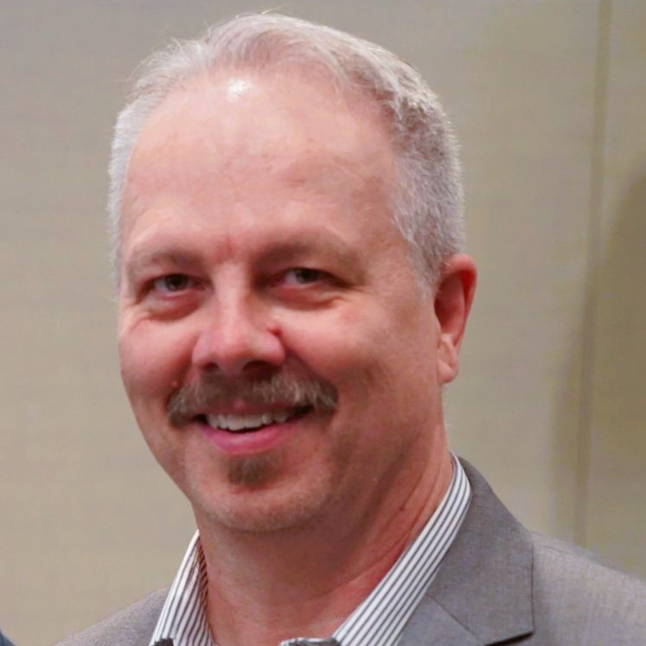
Facilitator(s)
Jake Meyer,
Human Resources Business Partner
Rusty Rubert,
Sr. District Manager
Goodwill
Notes:
Need Jake photo

Slide 19
Objectives
Describe the importance of effective communication and people development.
Discuss and demonstrate the key elements of effective communication
Discuss and demonstrate the key elements of people development
Goodwill

Slide 20
Icebreaker
Goodwill
Notes:
Icebreaker:
One person relays a message to a runner using clear communication. The runner must then go to the table and use a different form of communication to relay the message.
There will be three messages to relay. The first message the runner must convey by drawing a picture (representing written communication only), the second message they will relay using only sound effects (no words or body movement), and the third message the runner must use only their body movements to get the table to guess their message.
Corey to provide Charade Scenarios (Goodwill Oriented)

Slide 21
Why Essential Leadership
Career advancement
Personal growth
Team effectiveness
Organizational impact
Goodwill
Notes:
Career advancement: Can help managers advance in their careers by making them more effective leaders who are better equipped to handle new challenges.
Personal growth: Can more self-aware, improve their decision-making abilities, and develop a sense of purpose in their work.
Team effectiveness: Can create a sense of unity within their teams, foster open communication, and inspire their team members to work together towards a common goal.
Organizational impact: Can have a significant impact on the organization as a whole. Leaders who possess strong leadership skills can drive innovation, manage change, and guide their organizations towards success.

Slide 22
Essential Leadership Skills
Holding for Sam, Amy, Mireya, and Ivone
4 profiles / 1 slide
Each profile can fill a quarter of the screen and fade in one at a time
Name: Sam Robles
Name: Amy Smith
Role: Store Manager
Role: Area Manager
Exemplifies: Personal Growth
Exemplifies: Career Advancement
Time with Goodwill: XX Years
Time with Goodwill: XX Years
Name: Mireya Orozco-Davila
Name: Ivonne Morales
Name: Rusty Rubert
Role: Sr. Director, Warehouse & Logistics
Role: Store Manager
Role: District Manager
Exemplifies: Organizational Impact
Exemplifies: Team Effectiveness
Exemplifies: Career Advancement
Time with Goodwill: XX years
Time with Goodwill: XX years
Time with Goodwill: Two years
Notes:
4 people to discuss: Picture and Quote
Sam Robles - PG
Amy - CA
Mireya (ROC) – OI
Ivone Morales - TE
Career advancement
Personal growth
Team effectiveness
Organizational impact

Slide 23
4 Elements of
Effective Communication
1. Know your audience
2. Keep it simple
Goodwill
Notes:
Know your audience
Your audience will naturally be more interested and engaged when you tailor your communication to their interests. Piquing their interest by speaking directly to what matters will naturally engage their desire to underhand and interact with the information you are providing them.
Keep it Simple
Even the most engaged and committed audience will eventually get bored. Keeping your message simple and concise will make it easier to understand and retain. Remember, you already know what you’re going to say, but they may be hearing it for the first time.
The Graphics need to be GW team members as examples.

Slide 24
4 Elements of
Effective Communication
3. Consider the best method to deliver your message
4. Get them involved
Goodwill
Notes:
Best Method to Deliver Message
xxxx
Get Them Involved
xxx
Effective communicators clearly inform others and actively listen to them at the same time. They can accept input, both verbal and non-verbal, while also expressing their thoughts and opinions in an inclusive way.
Regardless of the communication style, effective communication involves a connection with others. This means the most powerful skill you can leverage is being in sync with your audience.
It involves understanding and speaking to its needs, and then responding to real-time feedback.

Slide 25
Activity
Goodwill
Notes:
Need detailed activity notes… (Tim provided scenarios: Tim / Corey lead activities)
Activity Notes
10min Activity / 5 min Reflect & Discuss
Purpose:
To provide participants with an opportunity to utilize the 4 elements of effective communication.
Set-up / Execution:
Each table will have an envelope containing one of three scenarios – RMP, DA, and RSA
Each table has character cards representing the individual employees (frontline and management)
One person reads the scenario to the group. As a group they should discuss the best way to approach the scenario using the 4 elements of effective communication.
Group should break out into partners and give participants an opportunity to role play the scenario from each viewpoint.
Reconvene the group/room. Ask for volunteer(s) to demonstrate each scenario. Work the room to identify usage of the 4 elements and/or where there is opportunity to improve/change.

Slide 26
Reminder…
1. Be approachable
2. Be patient
3. Be self-aware
4. Check for understanding
5. Switch out the messenger.
Goodwill
Notes:
Be approachable. If your team feels intimidated or worried that you may not respond well, they’re less likely to come to you with information
Be patient. Not everyone communicates the same way. Take time to be sure you’ve understood the audience and communicate clearly.
Be self-aware. It’s okay if your nervous, having a bad day, or are still developing your communication skills. It takes time and practice to become a skilled communicator.
Check for understanding. Don’t be afraid to invite feedback or ask questions to ensure that everyone's on the same page.
Switch out the messenger. Allow other leaders or team members to develop their communication skills by empowering them to lead discussions and meetings.

Slide 27
Activity
Goodwill
Notes:
Need detailed activity notes (Tim and Corey lead activities)
Activity Notes:
10min Activity / 5 min Reflect & Discuss
See Alex’s Character Collaboration Notes

Slide 28
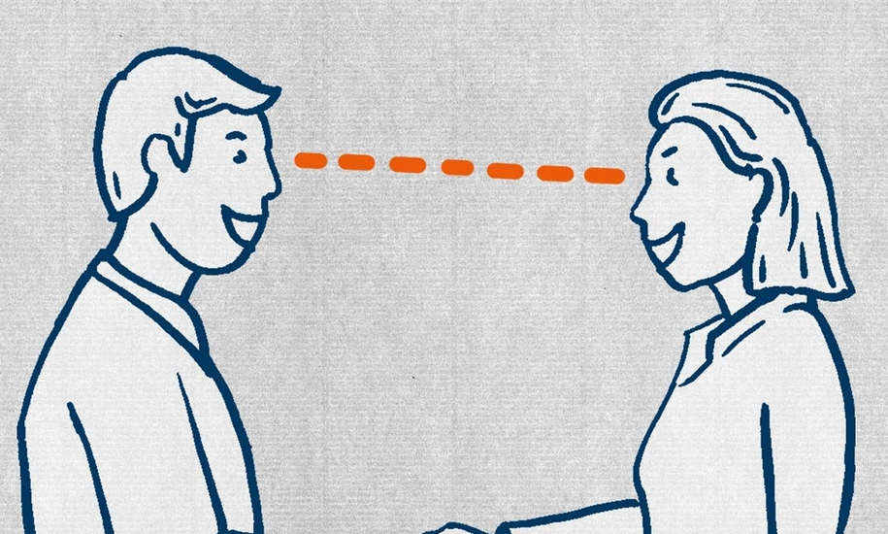
Face-to-face Communication
Communicating face-to-face adds multiple layers of information to an exchange, whether between two people or two hundred people. Often, there’s a synergy created with in-person communication that’s difficult to replicate elsewhere.
Make eye contact
If your wondering whether or not your message is getting across, few metrics provide as much feedback as eye contact. You can easily tell if the person you’re speaking to is understanding you, is distracted, worried, or confused – much of which is lost in digital communication.
Ask for feedback
Not sure if they got it? ASK! A powerful technique is to ask people to repeat back their version of what you just said. Often, this can improve retention, immediate understanding, and minimize misunderstandings later on. You can also ask them to reach out to you with helpful ways that you can improve.
Goodwill
Notes:
Graphics need to be GW team members as examples.

Slide 29
Face-to-face Communication
Read non-verbal cues
There are various types of non-verbal cues. Yawns, fidgeting and looking around the room are usually clear signs that your audience is thinking about something other than what you’re trying to convey. If you notice this, don’t take it personally. Try asking them to share what’s on their mind, recap previous points they may have missed, or adjourn for a later time.
Minimize distractions
If you’re chatting with someone (or a group) face-to-face, keep distractions at bay by leaving unnecessary electronic devices out of the space. Keep attendance limited to just those who need to be there, and avoid scheduling at a time when people are likely to focus on something else (like just before the end of the day or right before lunch).
Goodwill
Notes:
Graphics need to be GW team members as examples.

Slide 30
Communication Types
Goodwill
Notes:
Verbal Communication – Thoughts are shared through speech. Examples include presentations, one-on-one meetings and calls.
Written Communication – Thoughts and ideas are shared via the written word. This can be email, hand-written notes, or signage,
Non-verbal Communication – Information is shared without the use of written or spoken words. Examples include facial expressions, tone of voice, body language and gestures.
Active Listening – Active listening is about receiving information. When someone is listening actively, they might ask questions to understand the information better, but refrain from focusing on their response so much that they fail to hear the speaker.

Slide 31
Why is this happening?
Goodwill
Notes:
Verbal Communication – Thoughts are shared through speech. Examples include presentations, one-on-one meetings and calls.
Written Communication – Thoughts and ideas are shared via the written word. This can be email, hand-written notes, or signage,
Non-verbal Communication – Information is shared without the use of written or spoken words. Examples include facial expressions, tone of voice, body language and gestures.
Active Listening – Active listening is about receiving information. When someone is listening actively, they might ask questions to understand the information better, but refrain from focusing on their response so much that they fail to hear the speaker.

Slide 32
“
This slide can be used to insert an inspirational quote, although, it is not a requirement
Goodwill

Slide 33
Review
Assess the significance of effective communication and the development of team members.
Discuss the four elements involved in achieving effective communication and fostering professional growth.
Demonstrate the acquired knowledge by applying effective communication strategies and techniques to facilitate professional development in real-life situations.
Goodwill

Slide 34
Reminder…
1. Recognize your unique team
2. Help them feel valued
3. Level them up
4. Coach and celebrate wins
5. Encourage career development
Goodwill
Notes:
1. Recognize your unique team: Your team is made of individuals. Find their unique strengths
2. Help them feel valued: Setting clear expectations provides structure and support. Demonstrate our core values daily
3. Level Up: Keep your team engaged by cross-training and always promoting development/improvement of skills
4. Coach / Celebrate Wins: Drive operational excellence. Communicate quickly and often – whether you are providing developmental feedback or giving a high five!
5. Encourage career development: Encouraging continuous learning can help transform from the common to the exceptional. Help your team find their path to success and put their experience to the test.

Slide 35
Effective Communication?
The most effective communicators clearly inform others and actively listen to them at the same time. They can accept input, both verbal and non-verbal, while also expressing their thoughts and opinions in an inclusive way.
Regardless of the communication style, effective communication involves a connection with others. This means the most powerful skill you can leverage is being in sync with your audience.
It involves understanding and speaking to its needs, and then responding to real-time feedback.
Goodwill

Slide 36
How to improve communication skills
Goodwill

Slide 37
People Development
Goodwill
Notes:
Understanding who are our people? Do you know what to look for in an RSA? DA? RMP?
How to develop yourself? ← Notes? Talking point? Doesn’t need to be a whole slide.
How to build a supportive environment
Development strategies <- Everyone has different needs….adaptability
Career pathways <- what does this mean? Are you in a dead end job?
Coaching/recognition < How to coach. Most important thing you can do as a leader is grow talent. TRAIN THE TRAINER.
Providing high level overview for certain topics, providing concrete specific things they can take away immediately.
There is always going to be turn. Adaptability.

Slide 38
People Development
Goodwill
Notes:
Understanding your team
Promote career pathways – promote from within to retain talent
Build supportive environment
Develop skills – Soft skills, cross training
Coaching/Recognition – coach on performance and recognition
Understanding who are our people? Do you know what to look for in an RSA? DA? RMP?
How to develop yourself? ← Notes? Talking point? Doesn’t need to be a whole slide.
How to build a supportive environment
Development strategies <- Everyone has different needs….adaptability
Career pathways <- what does this mean? Are you in a dead end job?
Coaching/recognition < How to coach. Most important thing you can do as a leader is grow talent. TRAIN THE TRAINER.
Providing high level overview for certain topics, providing concrete specific things they can take away immediately.
There is always going to be turn. Adaptability.

Slide 39
Top Heading Area
You’ll have one hour to present; no more than 10-15 slides in your PowerPoint deck.
Drive behavior change by explaining the positive/negative consequences of applying the knowledge highlighted by your workshop: ‘If you conduct more effective interviews, you’ll need to see fewer candidates and spend less time interviewing.” Tell them what’s in it for them to apply what they learn.
The idea here is not to include everything that will be said. Highlight your speaking points by providing on-screen bullet points of key takeaways
Duplicate this slide to continue adding content, or you can use one of the other slide layouts
Goodwill

